Slide 1
Good Practices for Python
Code Documentation
+ Code Style Standardization

Slide 2
Python does not enforce any one particular coding style, or require any documentation, testing or type checking
However – there are very good reasons to use standardized styles, and formal levels of code documentation, type checking, and unit testing.
This may take a little longer to initially code, but will ultimately
save you time
code will be more reliable
code will be much more useful to others

Slide 3
Code Style Standardization
Why use a standardized coding style?
Provides consistency
Makes code more readable
Improves collaboration
Improves code quality and reliability

Slide 4
Code Standardization using PEP8
Main style recommendations:
Naming conventions for variables, functions, classes, constants
variables, functions, modules: snake_case
classes: CamelCase
packages: lowercase single word: package
constants: UPPERCASE
Line length (79 or 72 chars for comments, docstrings)
Line Spacing
Comment and docstrings (PEP-257)
…

Slide 5
Code Standardization using PEP8
PEP-8 style (documentation removed)
Mixed styles
from climate import Atmosphere
DEFAULT_ANSWER=42
def fix_climate_change(fudge_factor=3):
atmospheric_adjustment=4.3
this_model=Atmosphere(fudge_factor)
try:
answer=this_model.solve_climate()
except:
answer= DEFAULT_ANSWER
return answer
from climate import atmosphere
defaultAnswer=42
def fixClimateChange(fudgeFactor=3):
atmosphericAdjustment=4.3
thisModel=atmosphere(fudgeFactor)
try:
Answer= thisModel.solveClimate()
except:
Answer= defaultAnswer
return Answer
Improves consistency, readability, maintainability
Easier to identify components such as classes, constants

Slide 6
Converting old code to PEP-8
Manually change (refactor) the code
Use AI tools to do it for you
Always retest your code afterwards

Slide 7
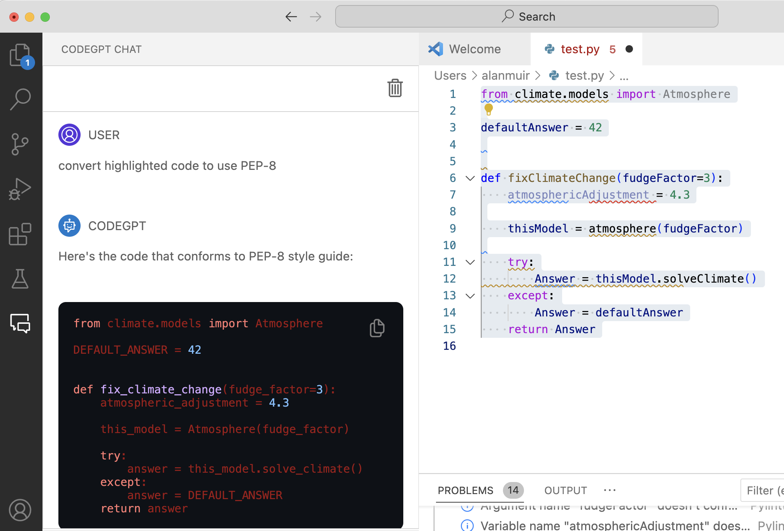
Using AI tools to convert code to PEP-8
Example: VSCode editor extension: CODEGPT (ChatGPT, GPT4)

Slide 8
Code Style Standardization
PEP-8 Coding Style
When not to use?
Making minor adaptions to existing code with an alternative coding style
Otherwise, Never

Slide 9
Tools to check coding style compliance
Linting tools:
pylint
flake8
Can be integrated into Code Editors such as VS Code
Reports PEP-8 non-compliance
Reports on identifiable coding errors
Gives your code a score out of 10

Slide 10
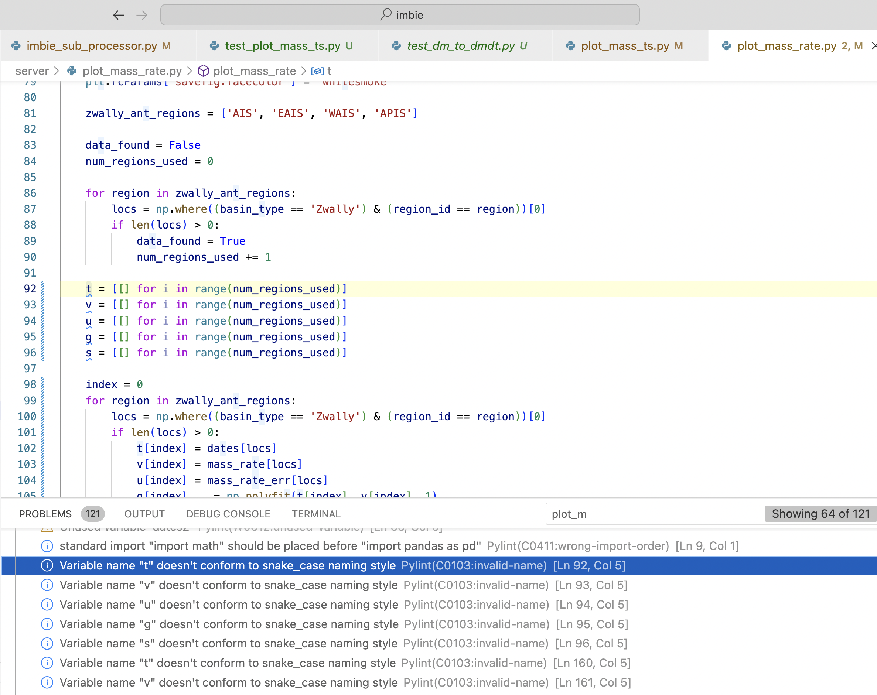
Integrate Linters in
to code editors
ie VSCode

Slide 11
Code Documentation?
Who is the Audience ?
Yourself (in a few months time)
Other researchers using/adapting your code
Python objects (__doc__ attribute)
Auto-documentation tools (Sphinx)
Workflow tools (ie type checkers, etc (mypy))
AI tools (ChatGpt, etc)

Slide 12
Code Documentation : Main Guidelines
Use docstrings
“””summary
Multi-line
documentation
“””

Slide 13
Code Documentation : Main Guidelines
my_module.py
“”” Module docstring summary line
my_function(): short function description
“””
Module docstring
def my_function(my_var):
“”” function docstring summary line
Args:
my_var (type): description
Returns:
type: description
“””
code # only useful comments

Slide 14
Code Documentation : Main Guidelines
“”” Module docstring summary line
my_function(): short function description
”””
def my_function(my_var):
“”” function docstring summary line
Args:
my_var (type): description
Returns:
type: description
“””
code # only useful comments
Function docstring
Inside function not before

Slide 15
Code Documentation : Main Guidelines
“”” Module docstring summary line
my_function(): short function description
“””
# function description
def my_function(my_var):
“”” function docstring summary line
Args:
my_var (type): description
Returns:
type: description
“””
code # only useful comments
Function docstring

Slide 16
Code Documentation : Main Guidelines
“”” Module docstring summary line
my_function(): short function description
“””
def my_function(my_var):
“”” function docstring summary line
Args:
my_var (type): description
Returns:
type: description
“””
code # only useful comments
Function docstring
my_function.__doc__ attribute

Slide 17
Code Documentation : Main Guidelines
“”” Module docstring summary line
my_function(): short function description
“””
def my_function(my_var):
“”” function docstring summary line
Args:
my_var (type): description
Returns:
type: description
“””
code # only useful comments
comments

Slide 18
Code Documentation : Main Guidelines
“”” Module docstring summary line
my_function(): short function description
“””
Always Include:
Module docstring
Function docstring
Argument types & description
Return value type &
description
Class docstring
def my_function(my_var):
“”” function docstring summary line
Args:
my_var (type): description
Returns:
type: description
“””
code # only useful comments

Slide 19
Different Function Docstring Formats
Format standards:
Google format
NumPy/SciPy
reStructuredText
Epytext
“”” function docstring summary line
Args:
my_var (type): description
Returns:
type: description
“””

Slide 20
Function Docstring Formats
Format standards:
Google format
NumPy/SciPy
reStructuredText
Epytext
“”” function docstring summary line
Parameters
----------------
Args:
my_var : type
description of my_var
Returns
------------
type:
description
“””

Slide 21
FindSq.py
import numpy as np
Missing module docstring
Line too long (101/100)
Missing function or method docstring
Module name "FindSq" doesn't conform to snake_case naming style (invalid-name)
Argument name "a" doesn't conform to snake_ case naming
Variable name "x" doesn't conform to snake_ case naming style
No typing of function args or return type
Too many spaces
Unnecessary comment
Function description outside function
Function name not descriptive enough
# Function to find the square root of a number whi
def FindSq(a) :
x= np.sqrt(a) # find sqrt of a
return x
# pylint FindSq.py …
Your code has been rated at 0.00/10

Slide 22
find_square_root.py
“”” Contains function find_square_root() “””
# imports
import numpy as np
def find_square_root(number : float ) -> float :
“””Function to find the square root
Calculates and returns the square root of the argument variable number
Args:
number (float) : number to find sqrt of
Returns:
float: square root of number
“””
result= np.sqrt(number)
return result
# pylint find_square_root.py
Your code has been rated at 10.00/10

Slide 23
Documentation through Type Hints
Python is dynamically typed
find_square_root.py
Type hints are a formal solution to specify types of variables, function arguments and return types
Adding type hints has no runtime effect
Helps to document code
Can be checked by type hint checkers such as MyPy
Can catch unexpected errors
Using type hints is strongly recommended for all code
(apart from short throw
away code)
“”” Contains function find_square_root(): “””
# imports
import numpy as np
def find_square_root(number : float ) -> float :
“””Function to find the square root
Calculates and returns the square root of the argument variable number
Args:
number (float) : number to find sqrt of
Returns:
float: square root of number
“””
result= np.sqrt(number)
return result

Slide 24
Documentation through Unit Testing
Providing unit tests:
Shows users examples of how to call your function
Demonstrates to users that your function (still) works

Slide 25
Documentation through Unit Testing
def my_square(float x):
return x*x
/my_square.py
…
/tests/test_my_square.py
def test_my_squares():
r_val=my_square(3)
assert r_val == 9
% pytest
tests/test_my_square.py . [100%]
======================= 1 passed, in 0.36s ========================

Slide 26
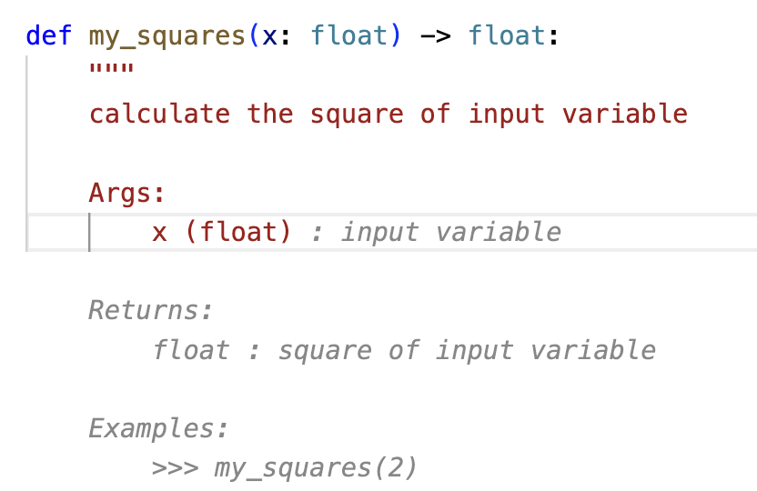
AI Tools/Extensions to help with documentation
VSCode Extensions:
autoDocstring
AI in-code suggestions:
Github CodePilot
AWS Code Whisperer (free)
AI external
CodeGPT
ChatGPT
GPT4
etc

Slide 27
Summary
Always use PEP-8 code style
Use linters to automatically check and debug your code style
Integrate linters (pylint, flake8) in to your code editor
Always provide docstrings in your code
At top of each module
Within (not outside) each function
Use Google style function docstrings for arguments and return types
Use type hinting for function arguments and return types
Write unit tests for each function using pytest
Use AI extensions/suggestions to help

Slide 28
"""utility functions for slope correction
get_heading() :
Function to get heading angles from [x1,y1,x2,y2,..] (requires at least 2 records)
"""
# ----------------------------------------------------------------------
# Imports
# ----------------------------------------------------------------------
from typing import List
import numpy as np
def get_heading(x_locs: List[float],y_locs: List[float],
) -> np.ndarray:
"""
Function to get S3 track headings (requires at least 2 records)
Args:
x_locs (List[float]): list of nadir x locations
y_locs (List[float]): list of nadir y locations
Returns:
headings (np.ndarray) : list of heading angles in degrees (0..360)
""”
…
return heading
import numpy as np
# finds the track heading
def getHeading(x,y):
….
return heading

Slide 30
135°
1,1
2
315°
45°
225°
1
3
0,0
2,0
315°
1,-1

