Slide 1
CPOM Software Update
November 2022
www.cpom.ucl.ac.uk/cpomsoft
CPOM Software Manual
This presentation
…

Slide 2
cpom.altimetry.level2.cs2.retrackers
CryoSat-2 Retrackers
New modules developed for Cryo-TEMPO Baseline-B
Module | Function
cs2_sin_max_coherence_retracker.py* | Maximum Coherence SARin Retracker
cs2_tcog_retracker.py* | TCOG retracker (any mode)
cs2_tfmra_retracker.py | TFMRA retracker (any mode)
*Used in CryoTEMPO Baseline-B processor
Previously these were in a development branch, now in ‘main’ branch after tests completed

Slide 3
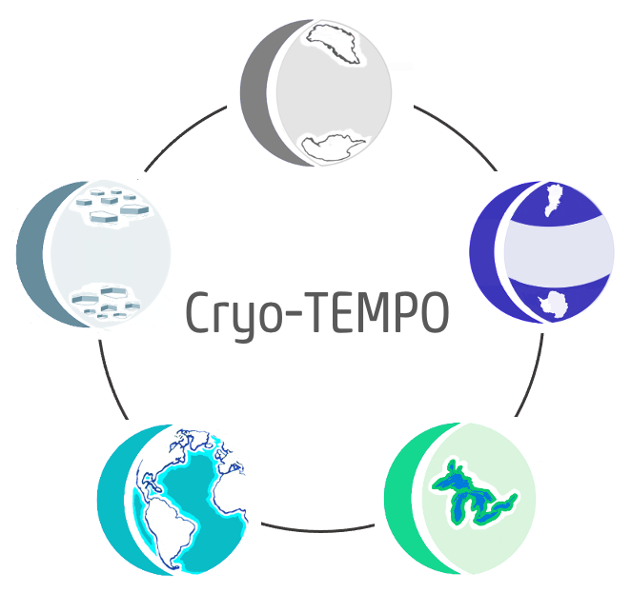
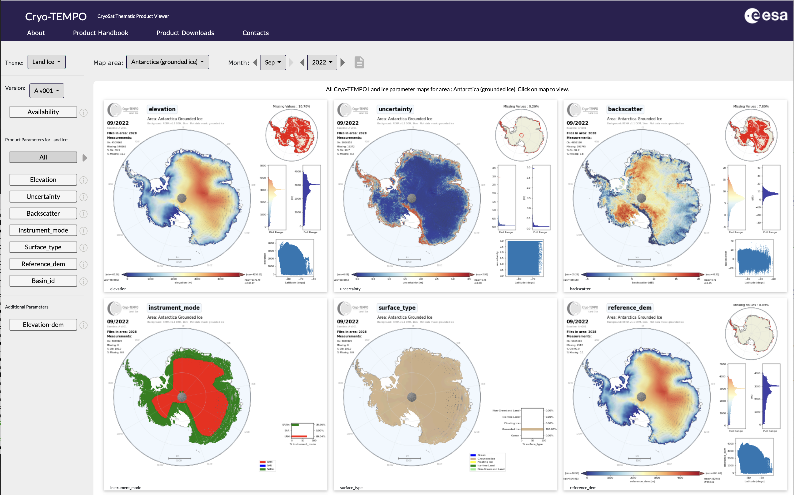
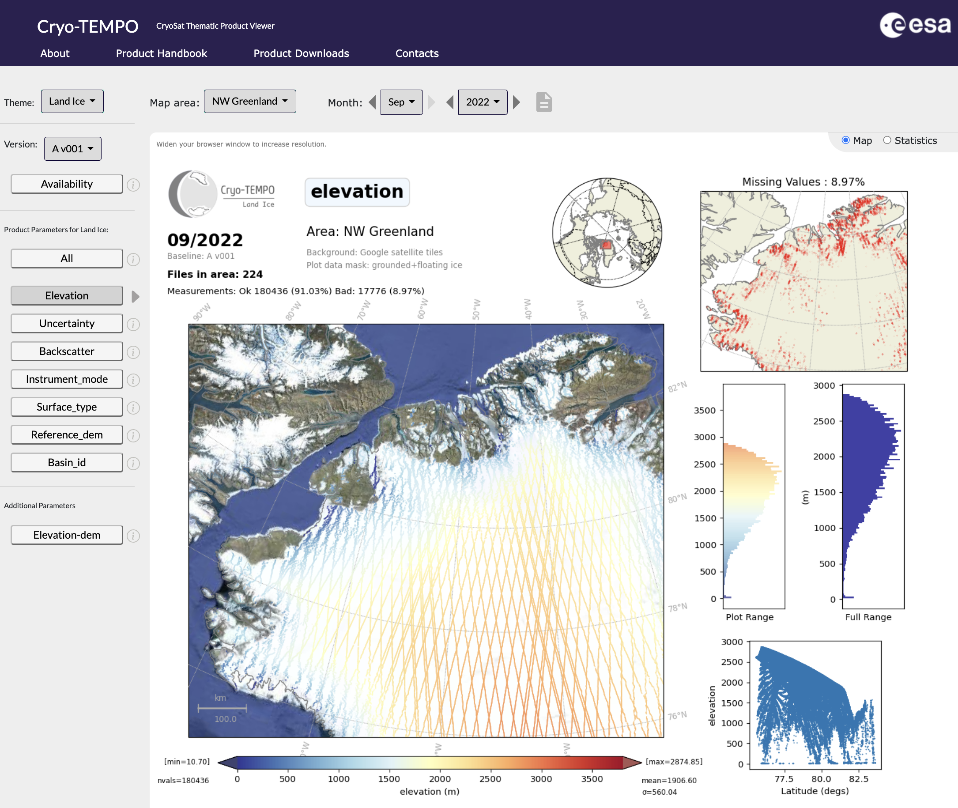
Cryo-TEMPO (CryoSat-2 Thematic L2) Data
Full mission Baseline-B products installed at Lancaster, Leeds, UCL:
[Official public release: Jan[Mar?] 2023]
$CPDATA_DIR/SATS/RA/CRY/Cryo-TEMPO/B/(001)/LAND_ICE/
SEA_ICE/
POLAR_OCEANS/
COASTAL_OCEANS/ INLAND_WATERS/
Monthly parameter viewer, statistics at QCV portals:
www.cpom.ucl.ac.uk/cryotempo (Baseline-A)
www.cpom.ucl.ac.uk/cryotempo_evolutions (Baseline-B)

Slide 4
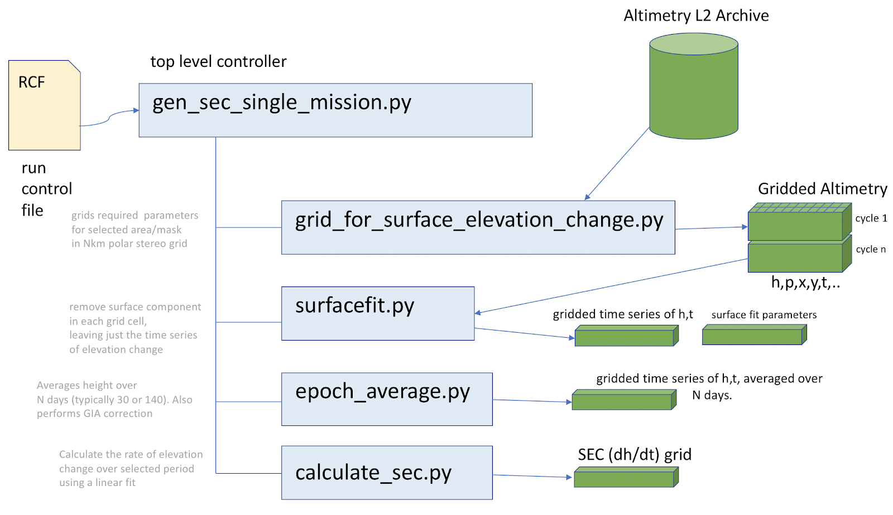
cpom.altimetry.tools.
Direct support for Cryo-TEMPO Baseline-B in Surface Elevation Chain
cpom.altimetry.tools.gen_sec_single_mission.py
cpom.altimetry.tools.grid_for_surface_elevation_change.py
Now use either ESA CS2 L2i, or
CryoTEMPO Baseline-B

Slide 5
cpom.altimetry.tools.
New ‘dataset’ keyword in the run control file
allows use of new supported data sets other than standard ESA/NASA products.
#
# Run Control File for CryoTEMPO Baseline-B SEC Processing
#
#--------------------------------------------------------------------------------------------------
[mission]
#--------------------------------------------------------------------------------------------------
# mission name in lower or upper case. One of e1,e2,ev,s3a, s3b, cs2, is2 (cpom.missions.Mission.name)
mission = cs2
# Set alternative mission dataset : cs2_cryotempo_b (use CS2 CryoTEMPO Baseline-B)
dataset = cs2_cryotempo_b
…
Example:
altimetry/projects/cryotempo/sec_chain_test/single_mission_rcfs/cs2.rcf

Slide 6
cpom.altimetry.tools.
grid_for_surface_elevation_change.py [-h] [--scenario SCENARIO] [--mission MISSION]
[--dataset DATASET] [--cycle1 CYCLE1] [--cycle2 CYCLE2]
[--alternative_l2_dir ALTERNATIVE_L2_DIR]
[--maxfiles MAXFILES] [--area AREA]
[--gridarea GRIDAREA] [--binsize BINSIZE] [--mode MODE]
[--outdir OUTDIR]
[--elevation_parameter ELEVATION_PARAMETER]
[--elevation_parameter_lrm ELEVATION_PARAMETER_LRM]
[--elevation_parameter_sin ELEVATION_PARAMETER_SIN]
[--power_parameter POWER_PARAMETER]
[--power_parameter_lrm POWER_PARAMETER_LRM]
[--power_parameter_sin POWER_PARAMETER_SIN] [--tidecorr]
[--allow_commissioning_cycles]
--dataset cs2_cryotempo_b

Slide 7
cpom.altimetry.missions.Mission
thismission = Mission(mission,dataset=“cs2_cryotempo_b”)
Common functions will return CryoTEMPO values, instead of ESA L2i
instrument_modes = thismission.get_instrument_mode(nc)
lats, lons = thismission.get_20hz_lat_lon(nc, …)
…

Slide 8
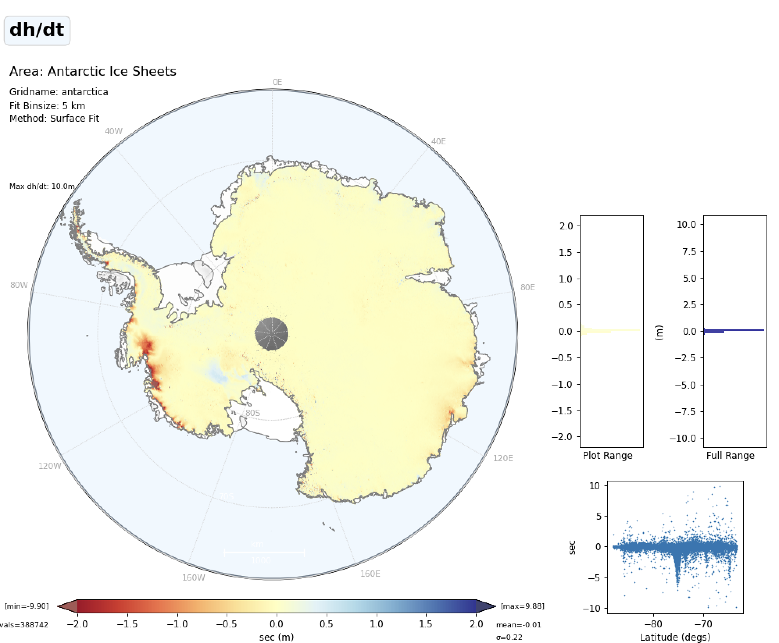
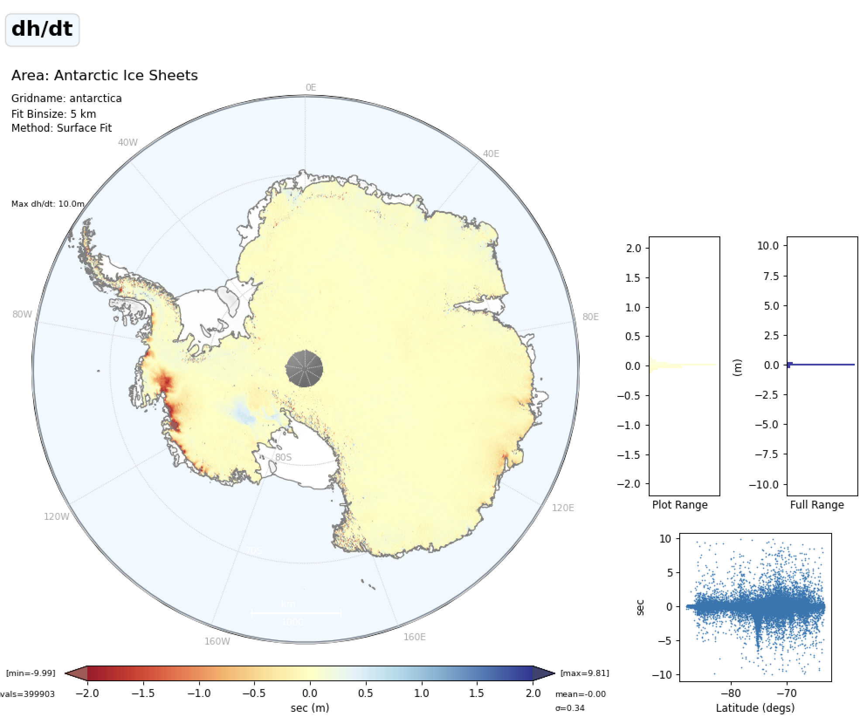
Surface Elevation Change (2010-2022)
Surface Elevation Change (2010-2021)
CryoTEMPO-Baseline-B
ESA Baseline-D L2i
Notes:
./plot_single_mission_dhdt.py -f /cpnet/altimetry/landice/sec_processing/ais_cryotempo_b/single_mission_scenarios/cs2/surfacefit_latest/dhdt.npz -a ais
./plot_single_mission_dhdt.py -f /cpnet/altimetry/landice/sec_processing/ais_cci_plus/single_mission_scenarios/cs2/surfacefit_latest/dhdt.npz -a ais

Slide 9
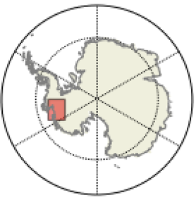
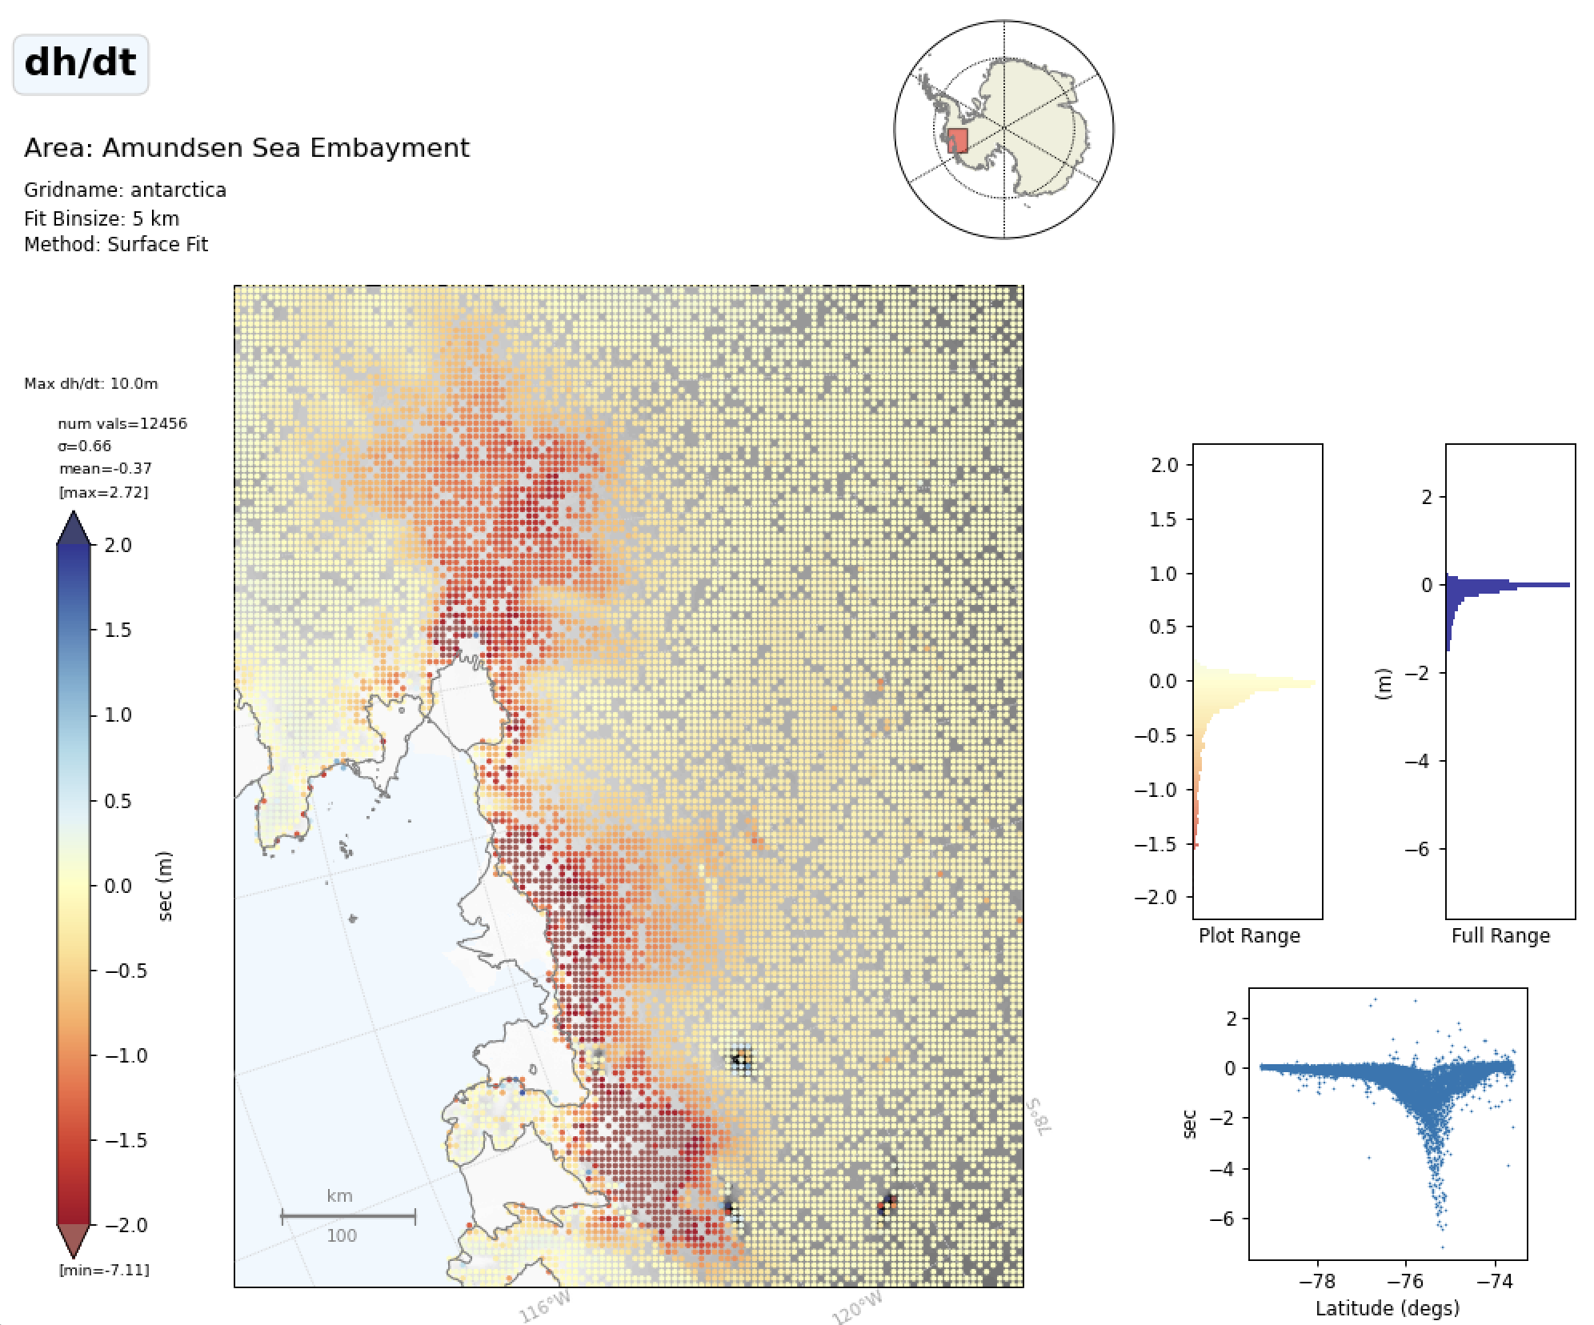
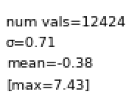
Surface Elevation Change (2010-2022)
Surface Elevation Change (2010-2021)
CryoTEMPO Baseline-B
AIS CCI SEC (using ESA L2i)
12456 valid bins
12424 valid bins
Notes:
./plot_single_mission_dhdt.py -f /cpnet/altimetry/landice/sec_processing/ais_cci_plus/single_mission_scenarios/cs2/surfacefit_latest/dhdt.npz -a ase_masked

Slide 10
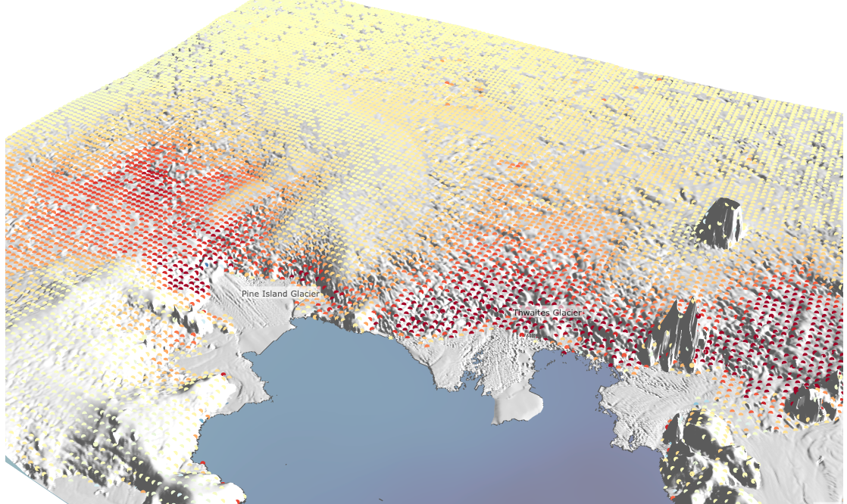
Surface Elevation Change (2010-2022): CryoTEMPO Baseline-B

Slide 11
cpom.areas.area_plot.Polar_plot
Polarplot(‘greenland’).plot_points(..,hillshade=True)
New Features
Hill Shading
Background layers
Support for Cartopy 0.21
Applies a shading over your plot variable to show underlying terrain
(topographic context)

Slide 12
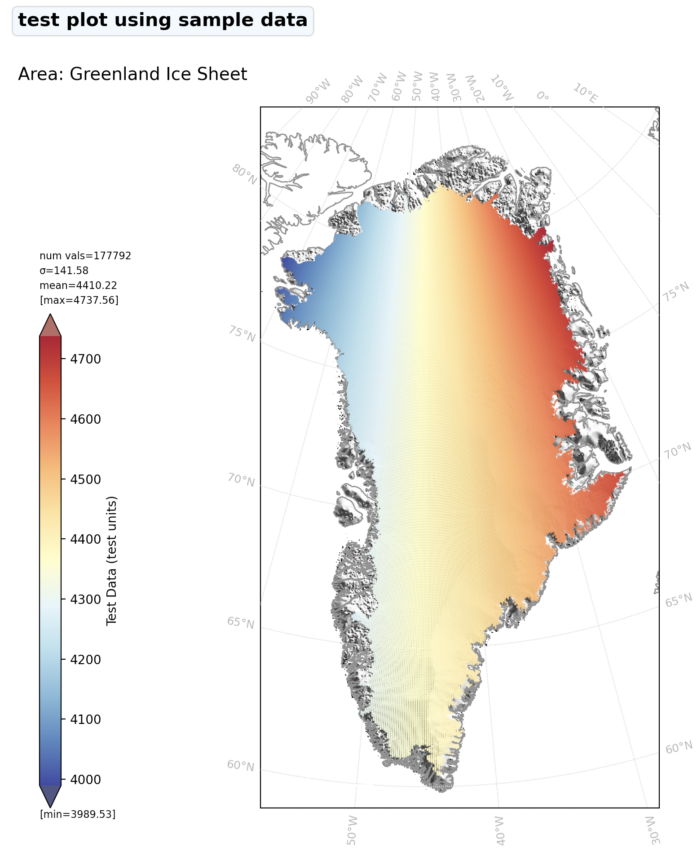
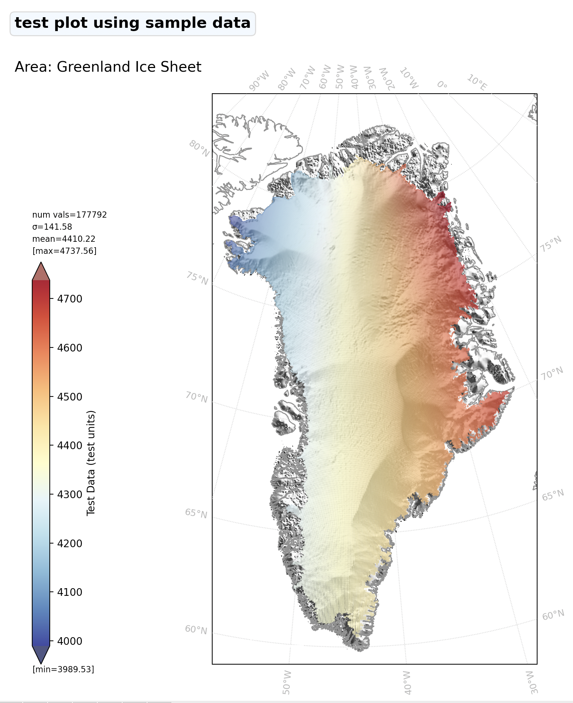
Hill shade applied
Hill Shade Applied

Slide 13
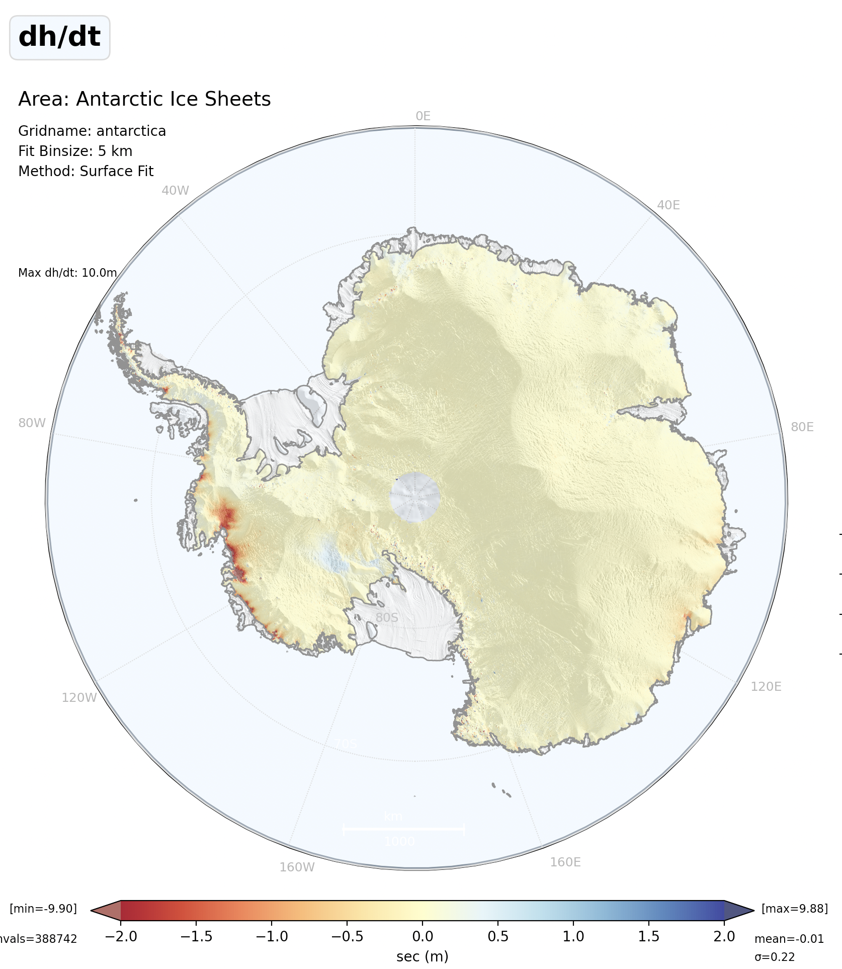
Hill shade applied
Notes:
{'alpha': 0.02, 'azimuth': 235.0, 'pitch': 45.0, 'dem': 'awi_ant_1km’}

Slide 14
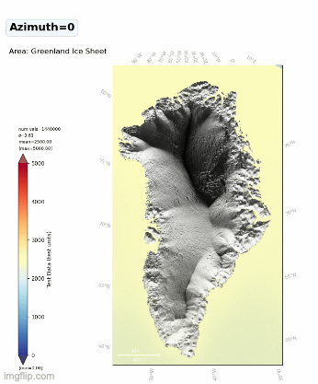
cpom.areas.area_plot
Optional hill shade arguments
hs_dict = {
"alpha": 0.3, # 0..1, vary transparency of hill shade
"azimuth": 140.0, # degrees (0..360)
"pitch": 45.0, # degrees (0..90)
"dem": "awi_grn_1km", # source DEM of hill shade
}
Polarplot(‘ais’).plot_points(…,hillshade=True,hillshade_params=hs_dict)
New Features
Hill Shading
Background layers
Support for Cartopy 0.21

Slide 15
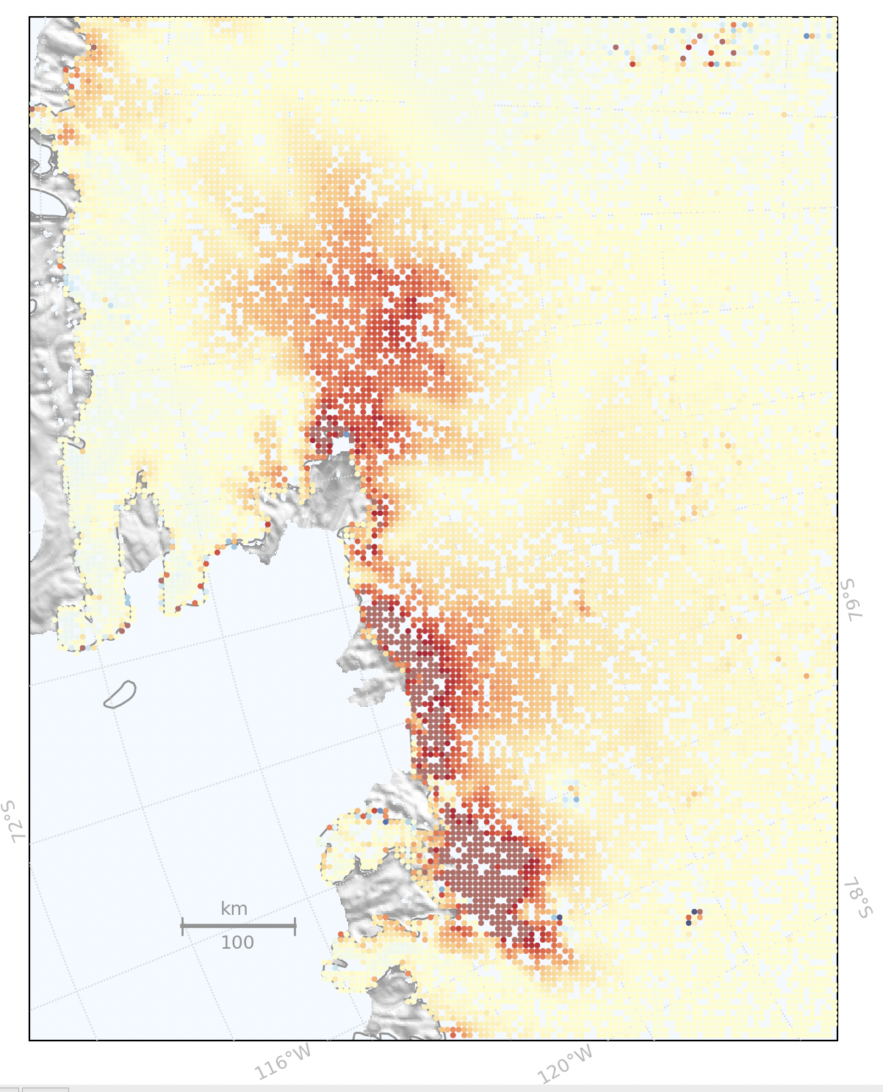
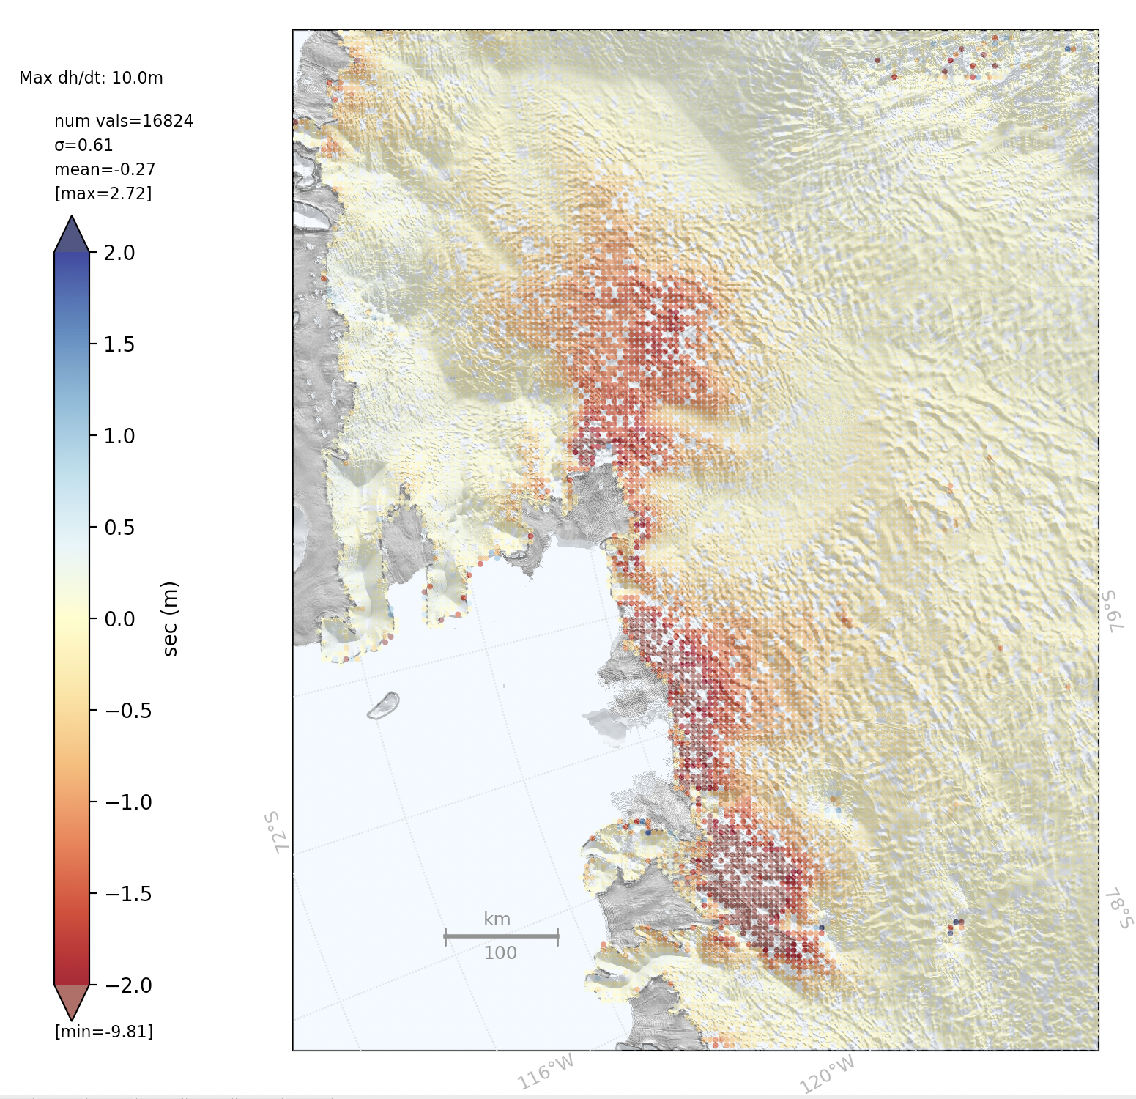
Polarplot(‘ase’).plot_points(…)
Polarplot(‘ase’).plot_points(…,hillshade=True,hillshade_param={‘dem’:’rema_ant_200m’})

Slide 16
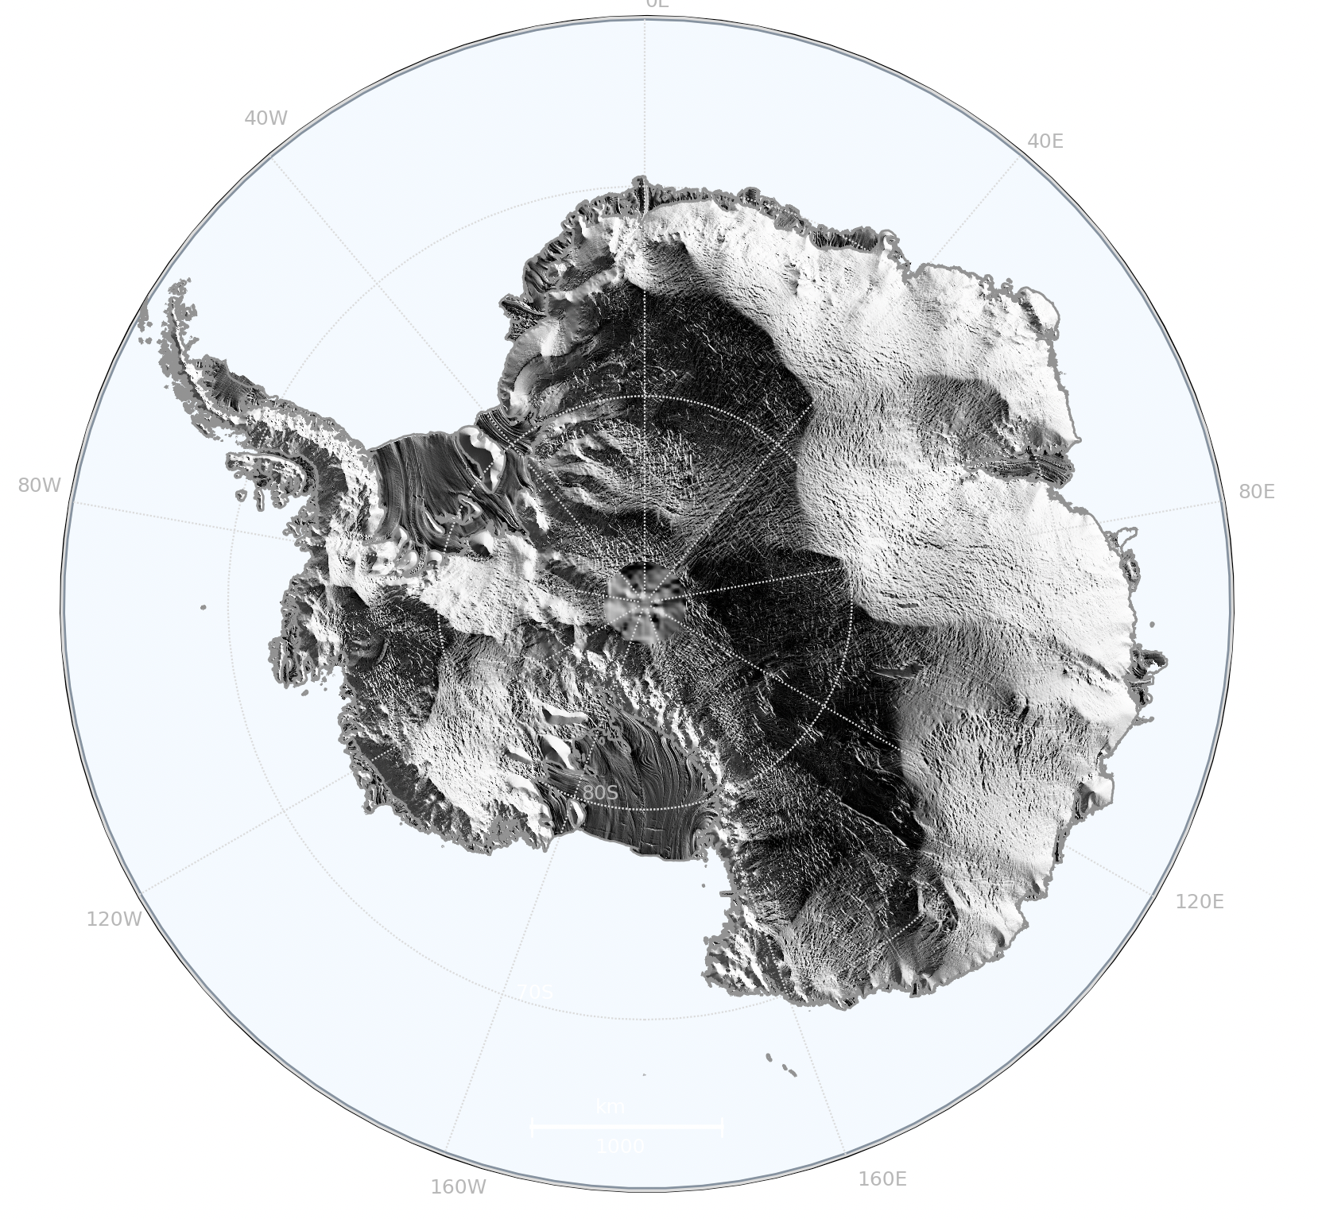
cpom.areas.area_plot
Polarplot(‘ais’).plot_points(background='hillshade')
New Plot Features
Hill shading
Hill shade backgrounds
Background layers
Support for Cartopy 0.21

Slide 17
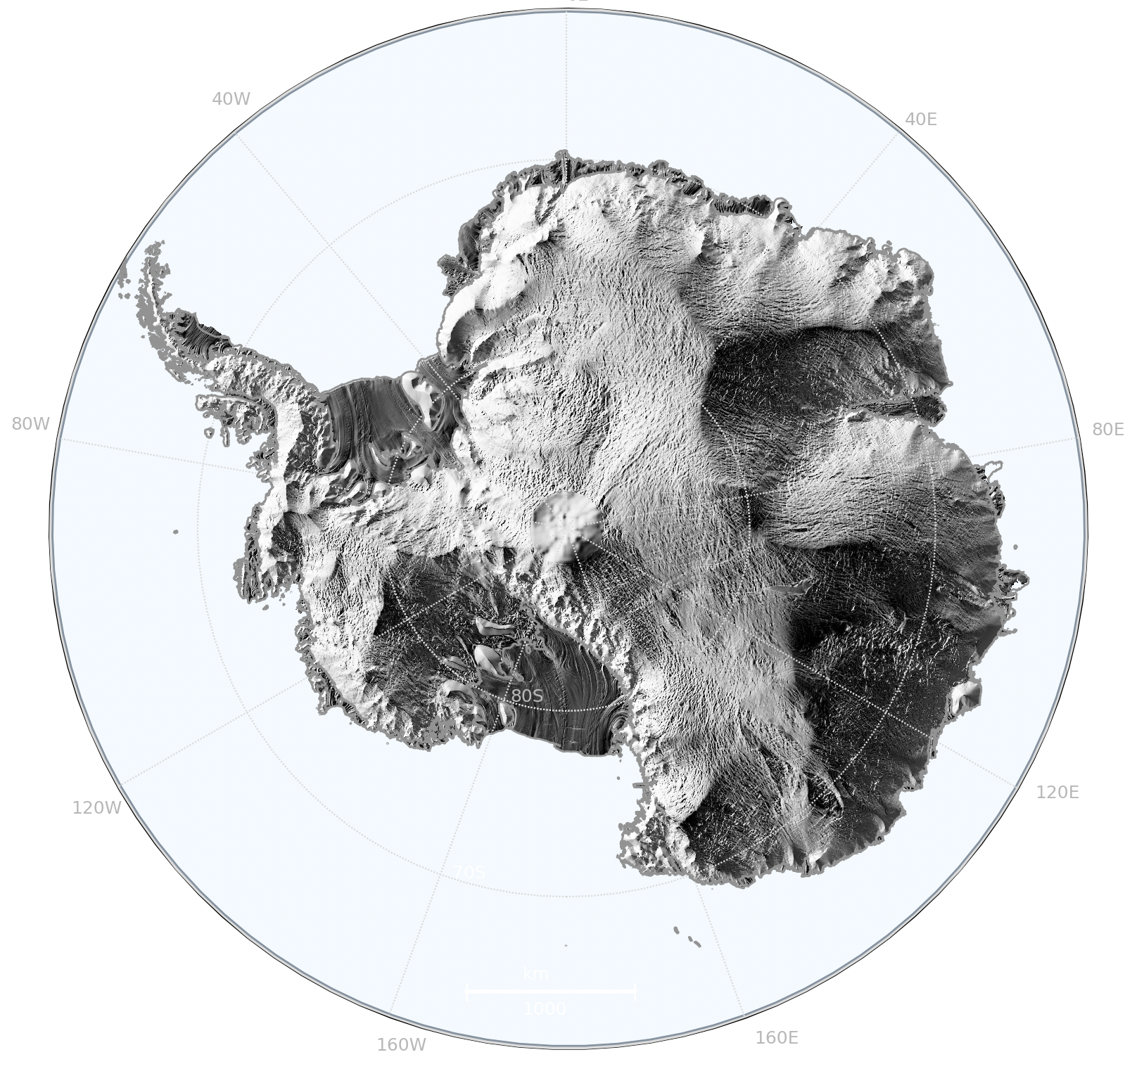
cpom.areas.area_plot
Polarplot(‘ais’).plot_points(background='hillshade’, hillshade_params= {'azimuth': 120})
New Plot Features
Hill shading
Hill shade backgrounds
Background layers
Support for Cartopy 0.21

Slide 18
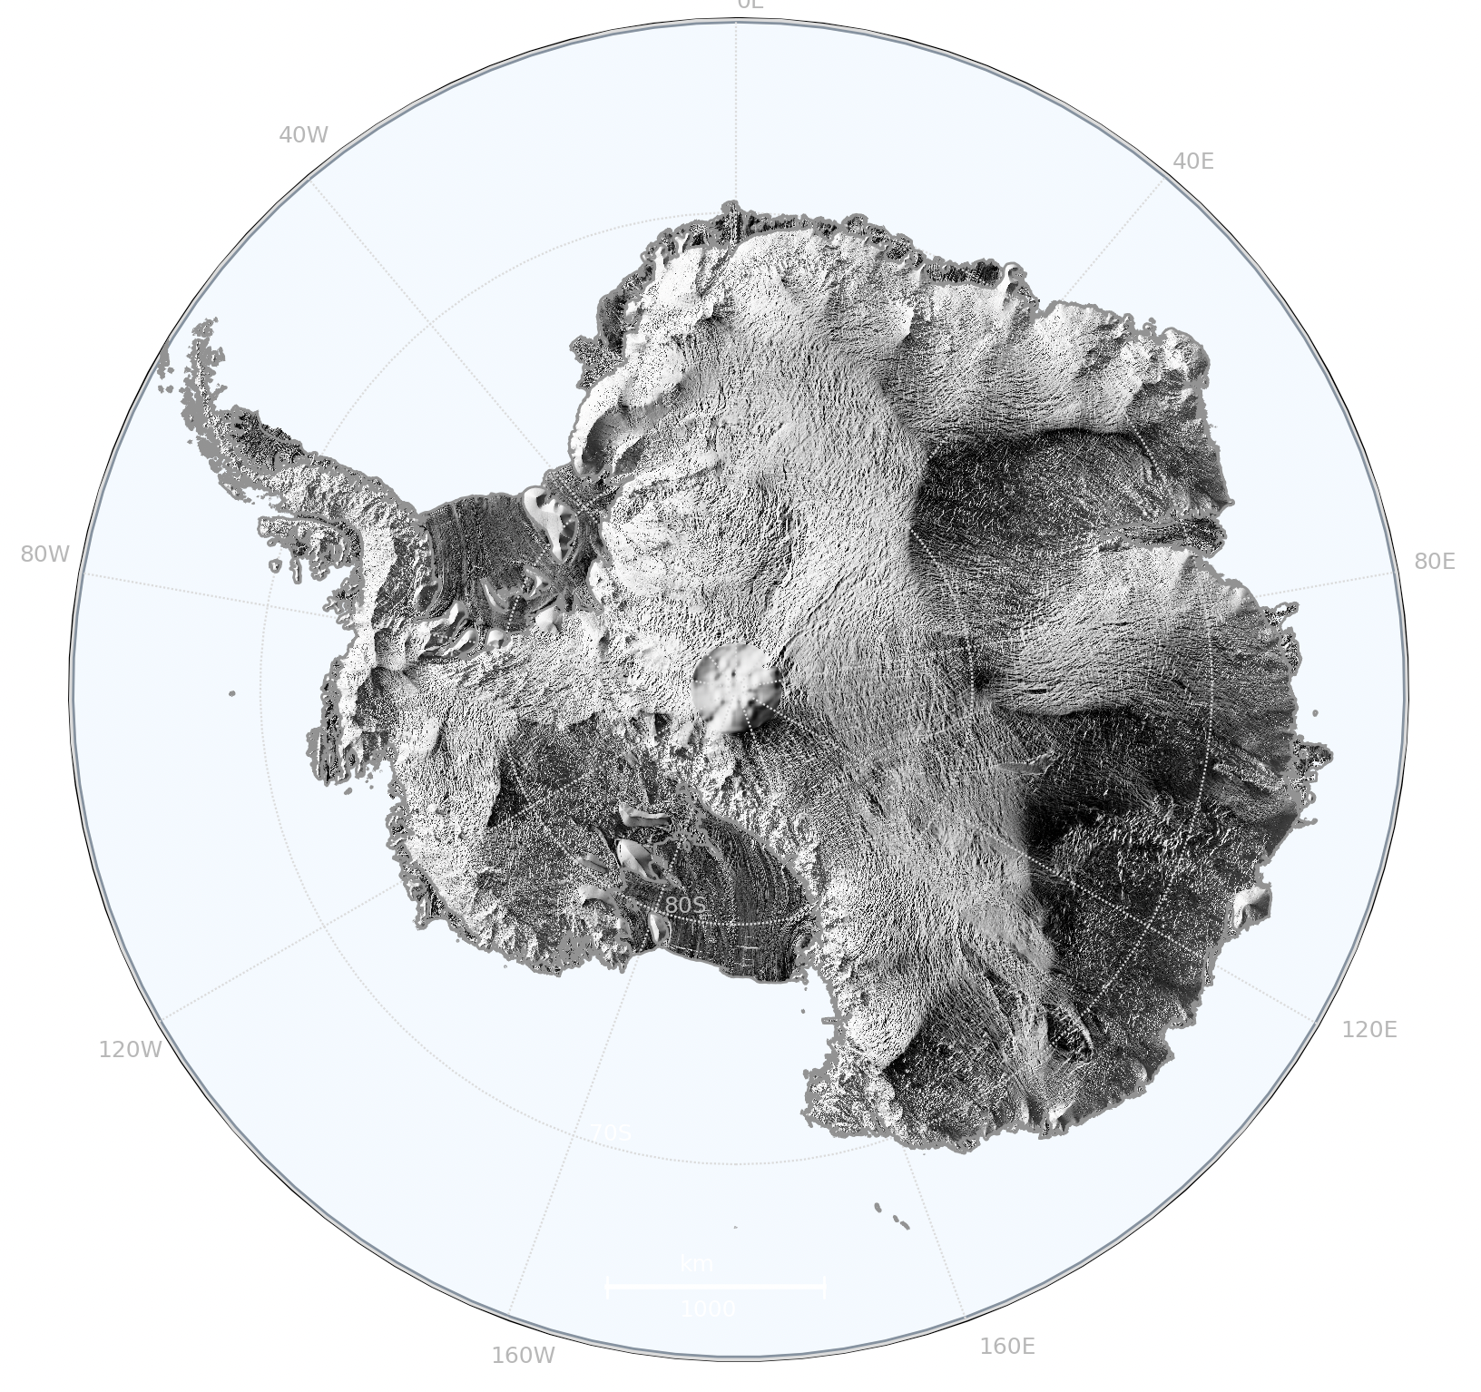
cpom.areas.area_plot
Polarplot(‘ais’).plot_points(background='hillshade’, §hillshade_params= {'azimuth': 120, 'dem': 'rema_ant_1km'})
New Plot Features
Hill shading
Hill shade backgrounds
Background layers
Support for Cartopy 0.21

Slide 19
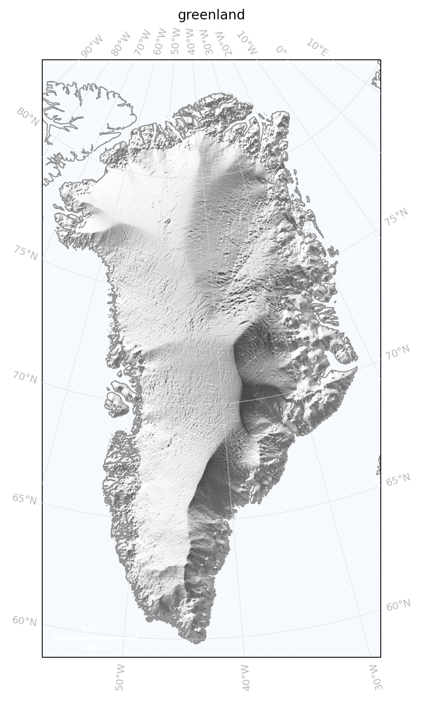
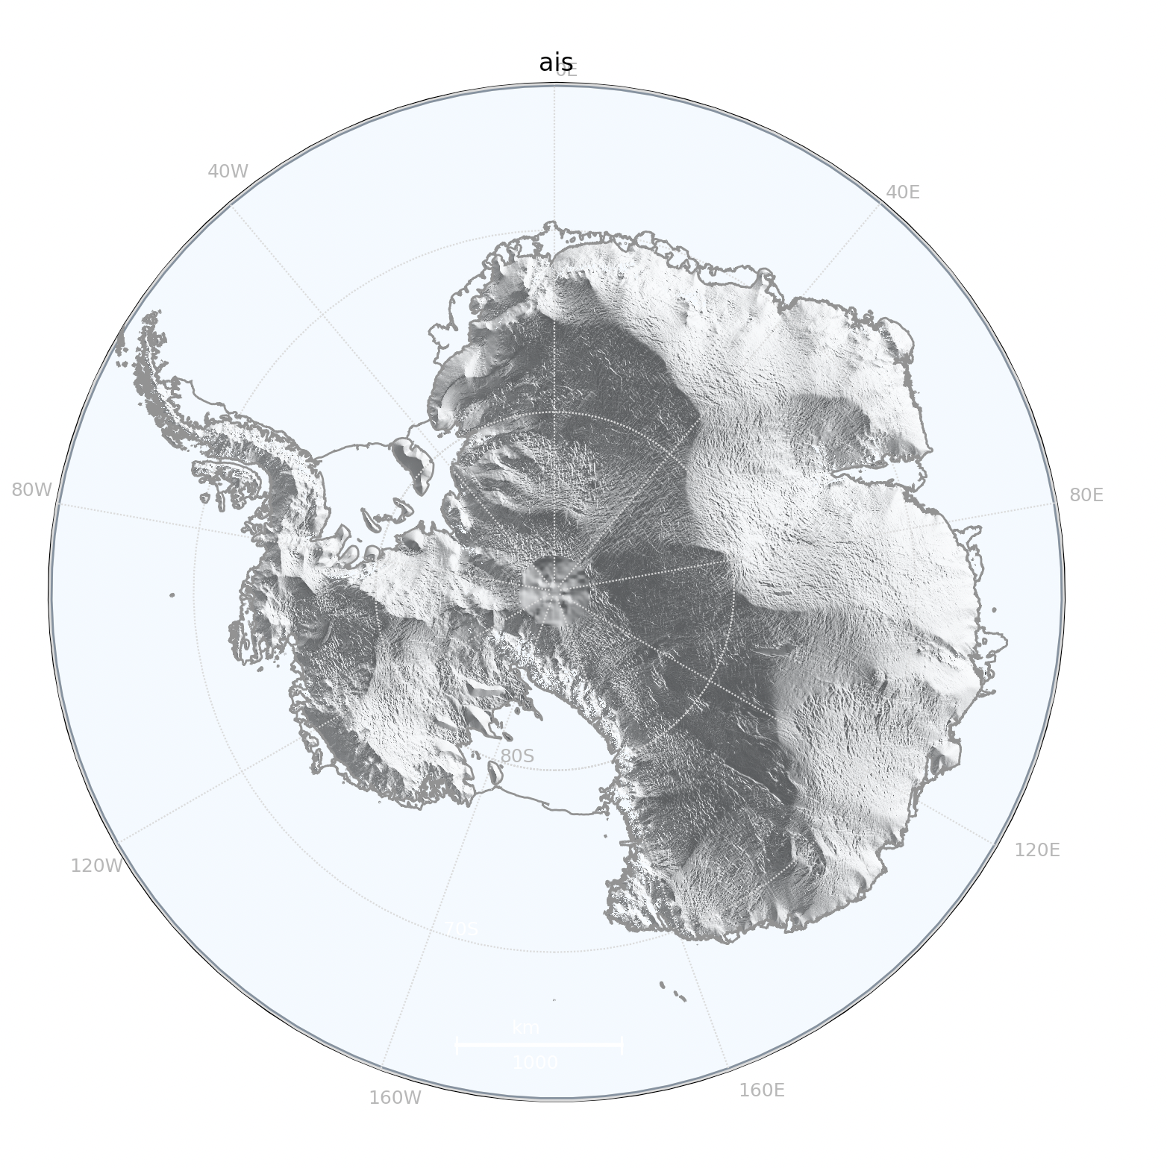
Polarplot('ais').plot_points(lats=[],lons=[],vals=[],background='hillshade',
background_alpha=0.7)

Slide 20
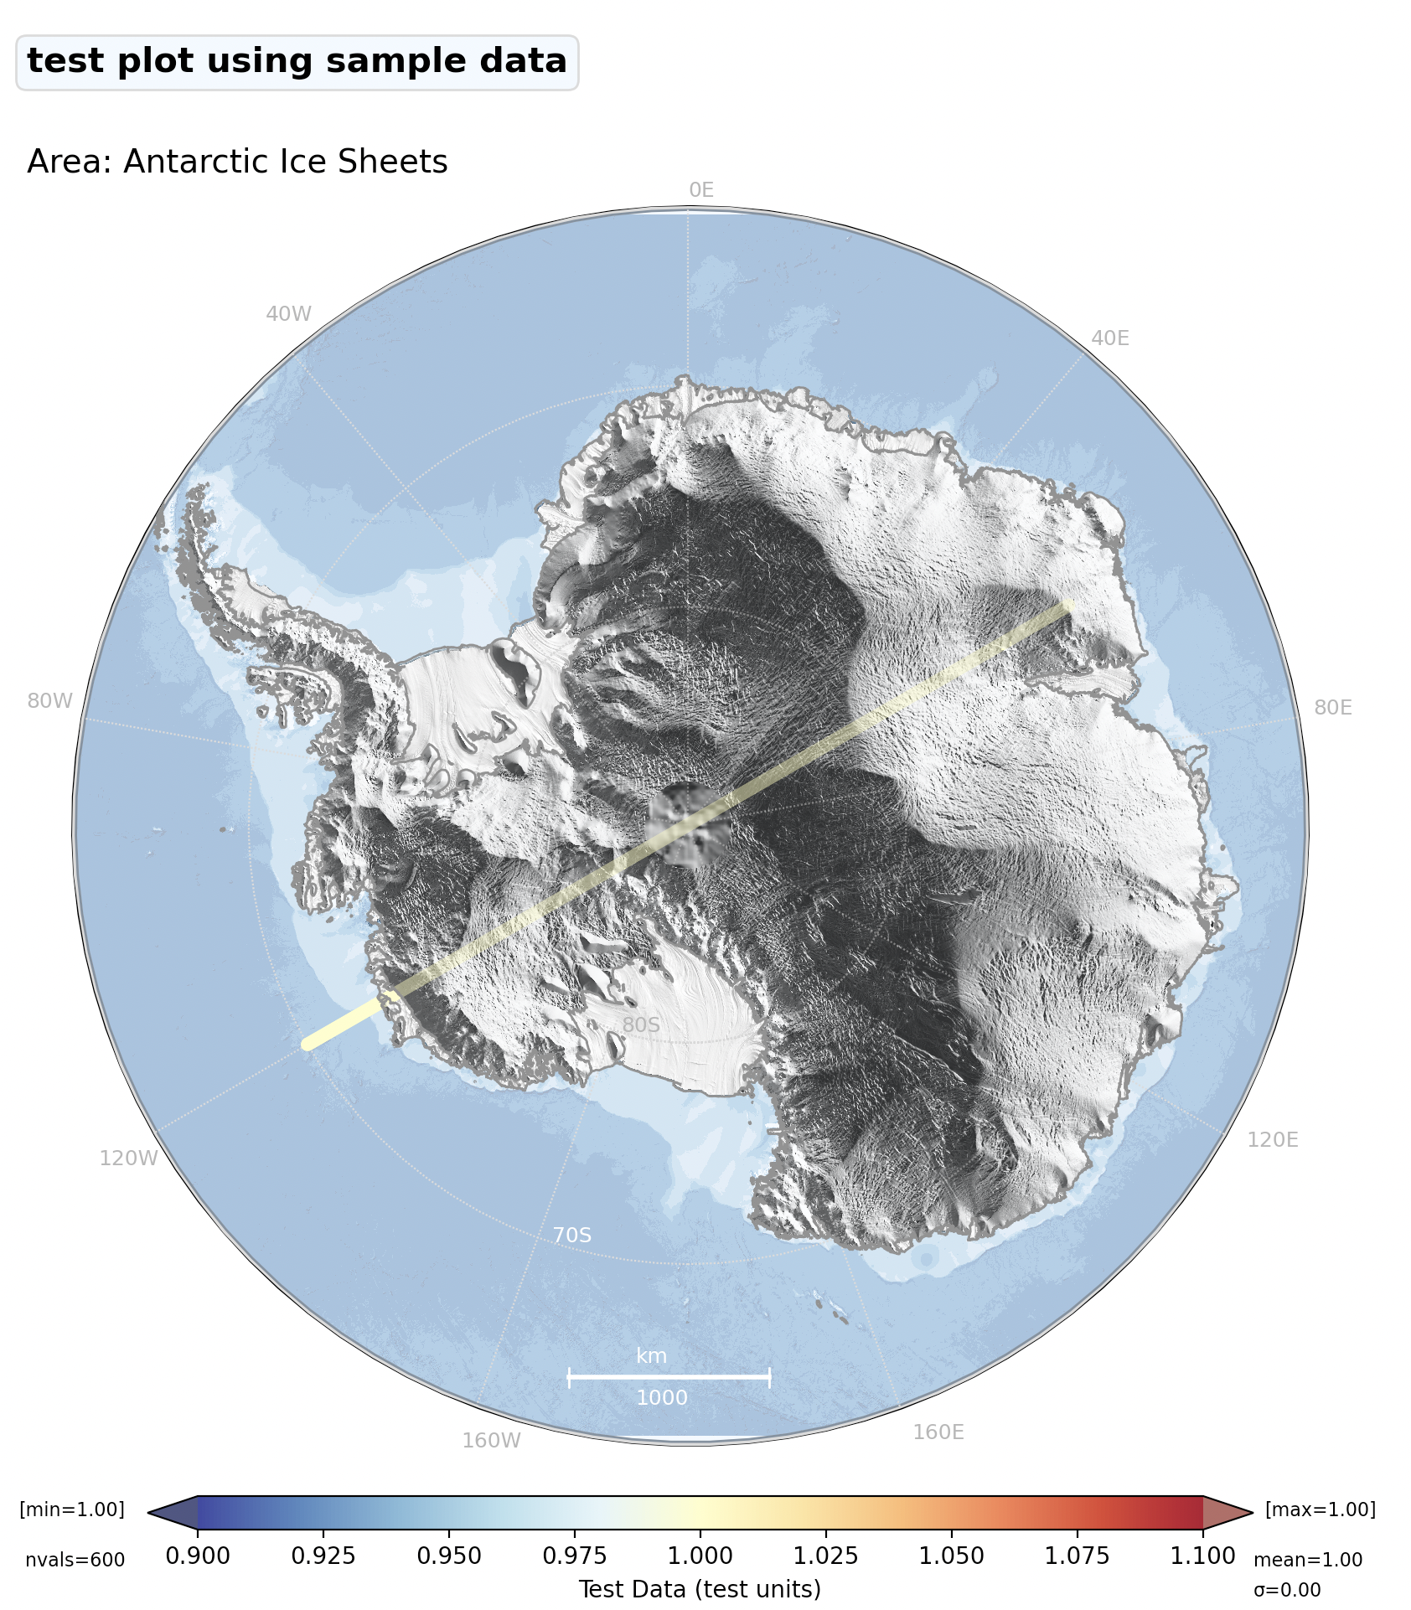
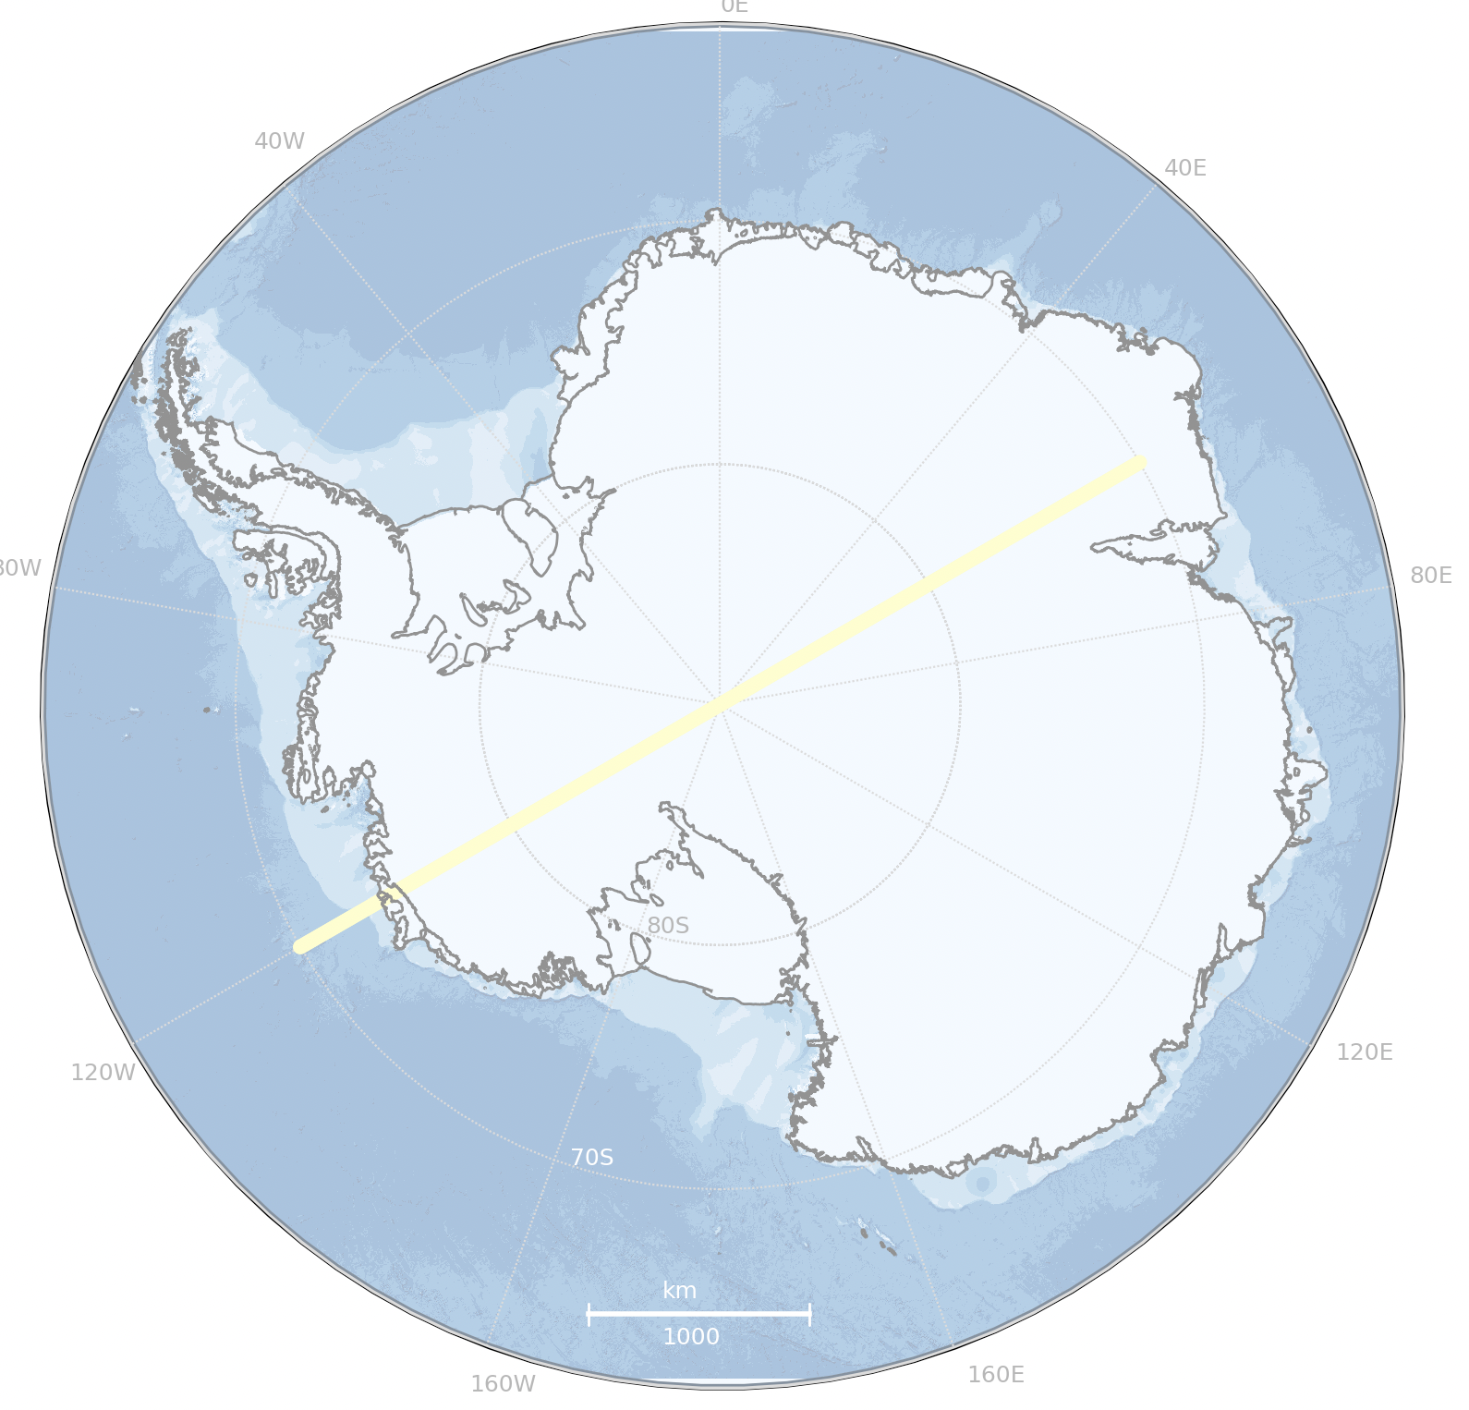
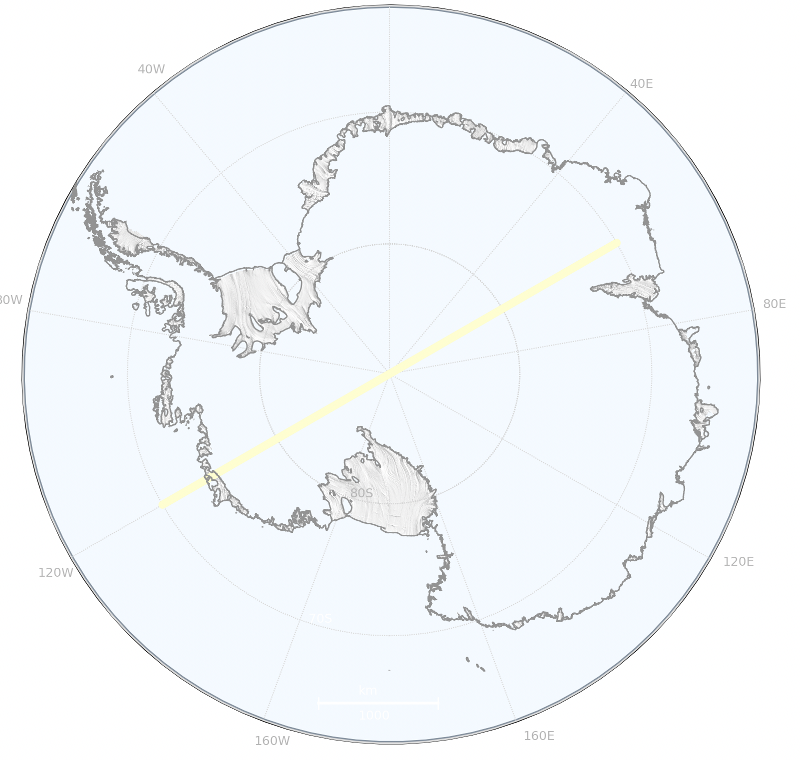
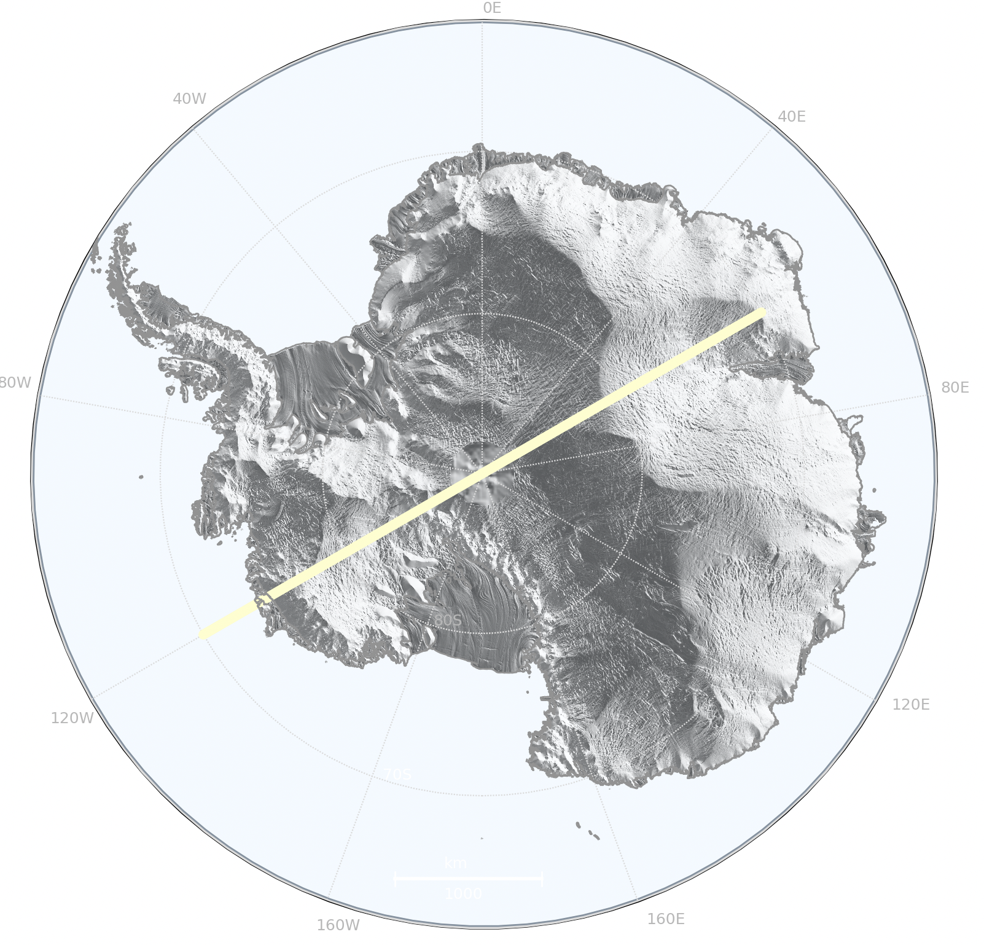
Layered backgrounds
Polarplot(‘ais’).plot_points(…,
background=[
'ibcso_bathymetry’,
'hillshade’,
'ant_iceshelves'],
background_alpha=[0.4,0.7,1.0],
hillshade_params={'alpha': 0.5, 'dem': 'awi_ant_1km_grounded'},
hillshade=True,
…)
'ibcso_bathymetry'
'ant_iceshelves’
'hillshade'

Slide 21
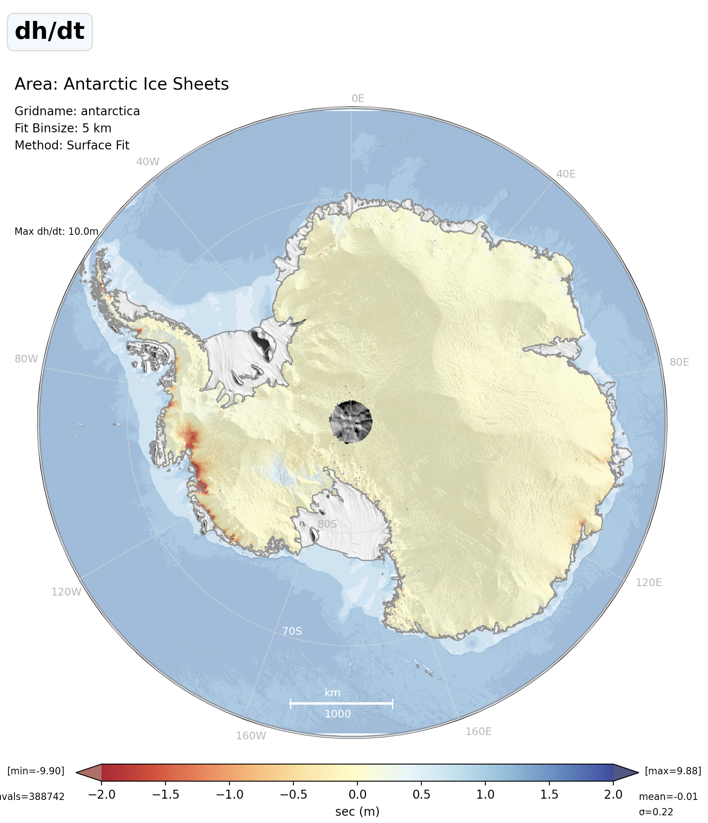
Hill Shade: AWI_DEM_2013 Bathymetry: IBCSO_v2_bed
Hill shade applied
Notes:
{'alpha': 0.02, 'azimuth': 235.0, 'pitch': 45.0, 'dem': 'awi_ant_1km’}

Slide 22
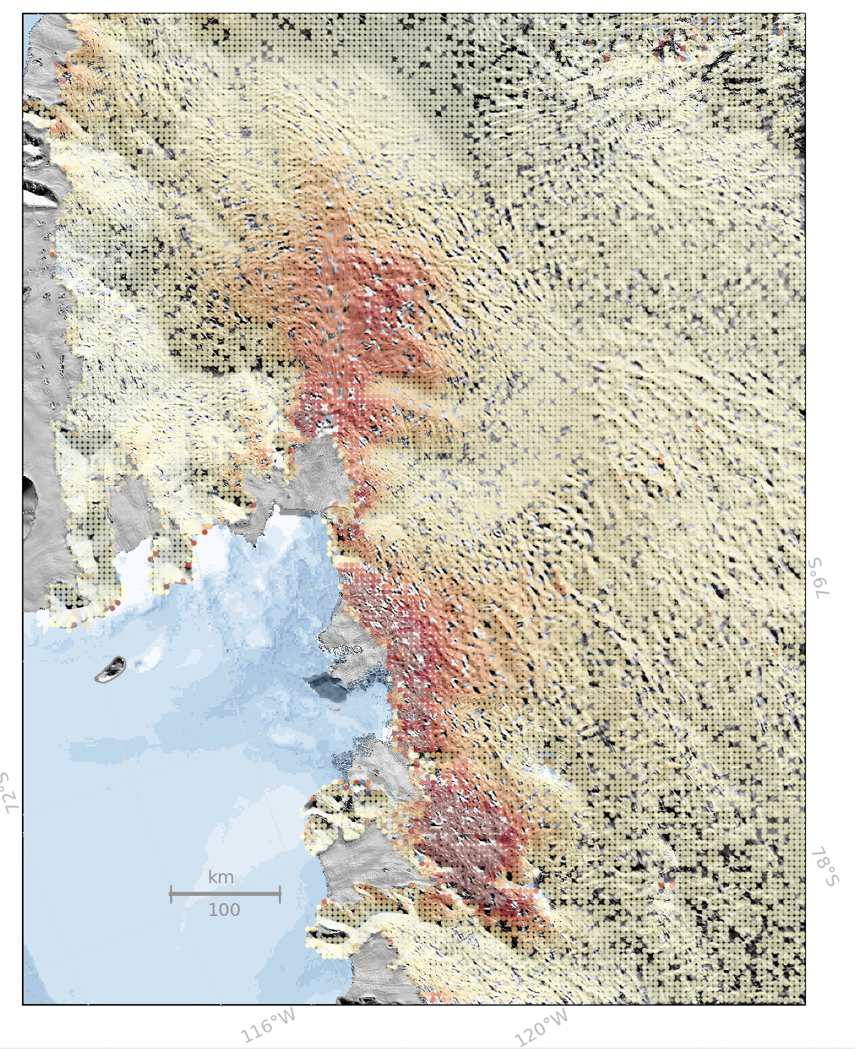
REMA 200m DEM for Hill Shade

Slide 23
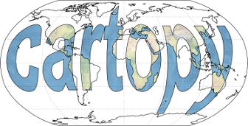
CPOM Conda Environment Changes
Check if you are using the latest version:
$ conda list | grep cartopy
cartopy 0.21.0
Cartopy 0.21
If not update your packages:
$ conda env update -f $CPOM_SOFTWARE_DIR/cpom.yml
import pyproj
pyproj.set_use_global_context True
# This is required to speed up Cartopy (>0.20) projection transforms.
# If not set the geolocation may run extremely slowly
or set environment variable
PYPROJ_GLOBAL_CONTEXT=ON

Slide 24
Software Development Tools and Workflow
PEP8 Auto-formatting
Static type-checking/type annotation
Linting
Unit Testing

Slide 25
Software Development Tools and Workflow
Idea
Coding
Does it work?
No
Application
New feature
../another_module/func.py
Probably
myfunc(…)
../module/myfunc.py
Does it work?

Slide 26
Idea
Design
Software Development Tools and Workflow
Test Design
Unit Tests
Module
Coding
Coding
Can all be done inside a code editor such as VSCode
Auto-formatting
to PEP8
Auto-formatting
to PEP8
static type-checking
(eg. mypy)
eg. black
eg. black
fail
fail
Lint eg. pylint, flake8
Lint eg. pylint, flake8
fail
../module/test/test_myfunc.py
Run unit tests eg: pytest
Integration Tests
../module/myfunc.py
pass

Slide 27
Software Development Tools and Workflow
Auto-formatters
black, isort, autopep8, yapf
Automatically formats your code to comply with PEP8 style guide
Doesn’t change the functionality of the code.
Usage
pip install black. [if not already installed]
black yourfile.py [autoformats the file]
or
Configure your editor to automatically run black when you save your file.

Slide 28
Software Development Tools and Workflow
Static type checking
Tools: mypy, pyright,pytypes,pyre
Since python 3.5, type hints are available
Usage
my_number = "rocket"
my_number : int = "rocket” # using type hints
Advantages
Detecting type errors
Preventing bugs
Documenting your code
mypy tool will flag an error
error: Incompatible types in assignment (expression has type "str", variable has type "int") python won’t trigger an error
Also assign type of function return values:
def announcement(language: str, version: float) -> str:

Slide 29
Software Development Tools and Workflow
Linting
Tools: pylint, flake8
Automatically formats your code to comply with PEP8 style guide
Doesn’t change the functionality of the code.
Usage
pip install pylint [if not already installed]
pylint my_script.py [checks the file]
or
Configure your editor to automatically run pylint when you save your file.
Advantages
Identify bugs
Identify PEP8 stylistic errors
my_script.py:13:0: C0304: Final newline missing (missing-final-newline)
my_script.py:1:0: C0114: Missing module docstring (missing-module-docstring)
my_script.py:3:0: W0611: Unused pandas imported as pd (unused-import) …

Slide 30
Software Development Tools and Workflow
Unit Testing
Tools: pytest, unittest
module.py
test/test_module.py
def module():
“”” Return a integer of value 10”””
return 9
def test_module():
n = module()
assert n == 10, “Should be 10”
pytest
test_module.py : F
================================= FAILURES ================================= FAILED : test_module.py:: assert 9 == 10

