Slide 1
S3 Thematic IPF PM#4
Sea Ice Validation
A.Muir (MSSL)
28-Sep-2021

Slide 2
Validation of:
Sea Ice Thematic IPF TDS (version 2)
Availability : from CLS on 7th Sep 2021
T-IPF Sea Ice TDS : cycle 15/16 : 04-Mar-2017 -> 30-Mar-2017
Also provided:
IPF 6.18 reference TDS: for same period.

Slide 3
Changes in S3__SR_2_CON_AX Thresholds used in T-IPF for Sea Ice
Sea Ice Discrimination
 | IPF | T-IPF
ALT_MAN_WAV_02: peakiness_high_ths_ice | 11 | 16
Peakiness_low_ths_lead | 21 | 24
Sea Ice Retracker Bias
 | IPF | T-IPF
ALT_RET_ICE_06: diffuse_bias_c: | 0.1623 | 0.1789
Based on tuning studies from IPF data (will need repeating with T-IPF once enough data is available)

Slide 4
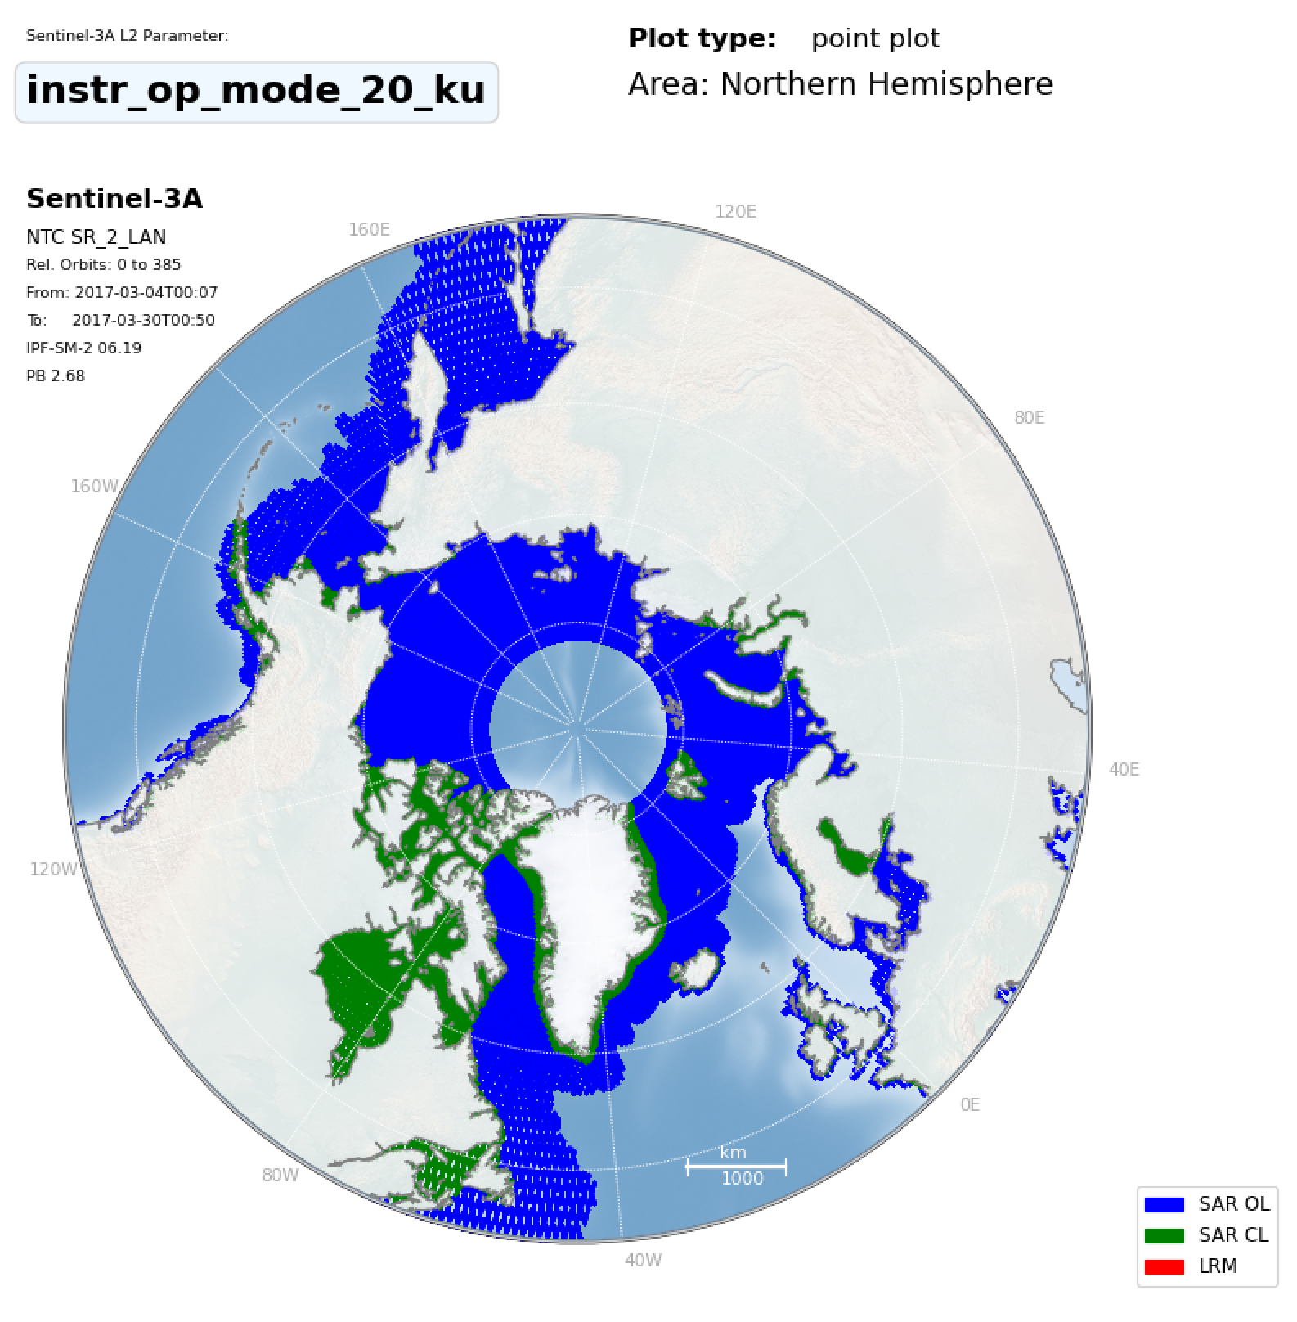
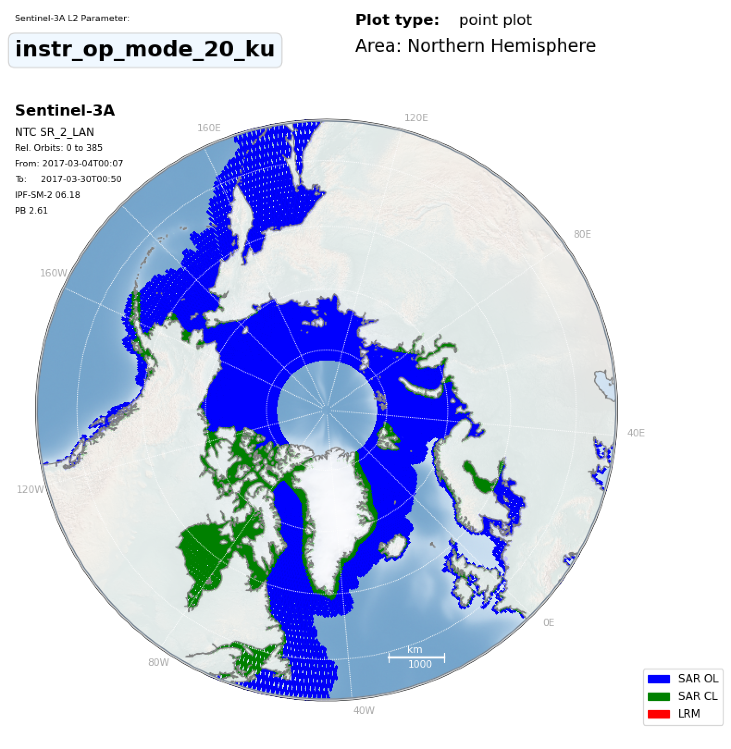
THEMATIC_SEAICE
Area Coverage/Mode
IPF_6.18

Slide 5
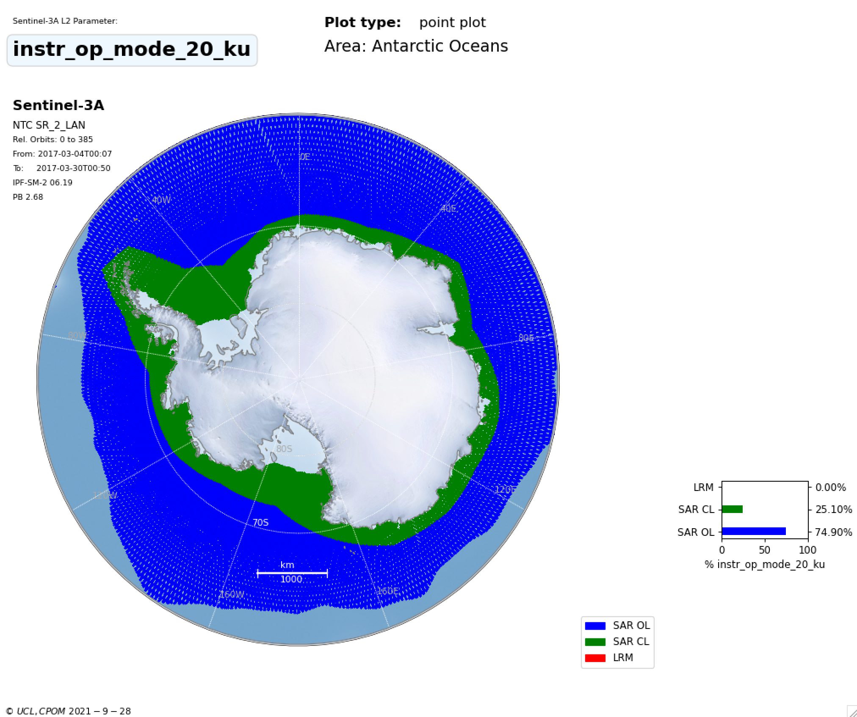
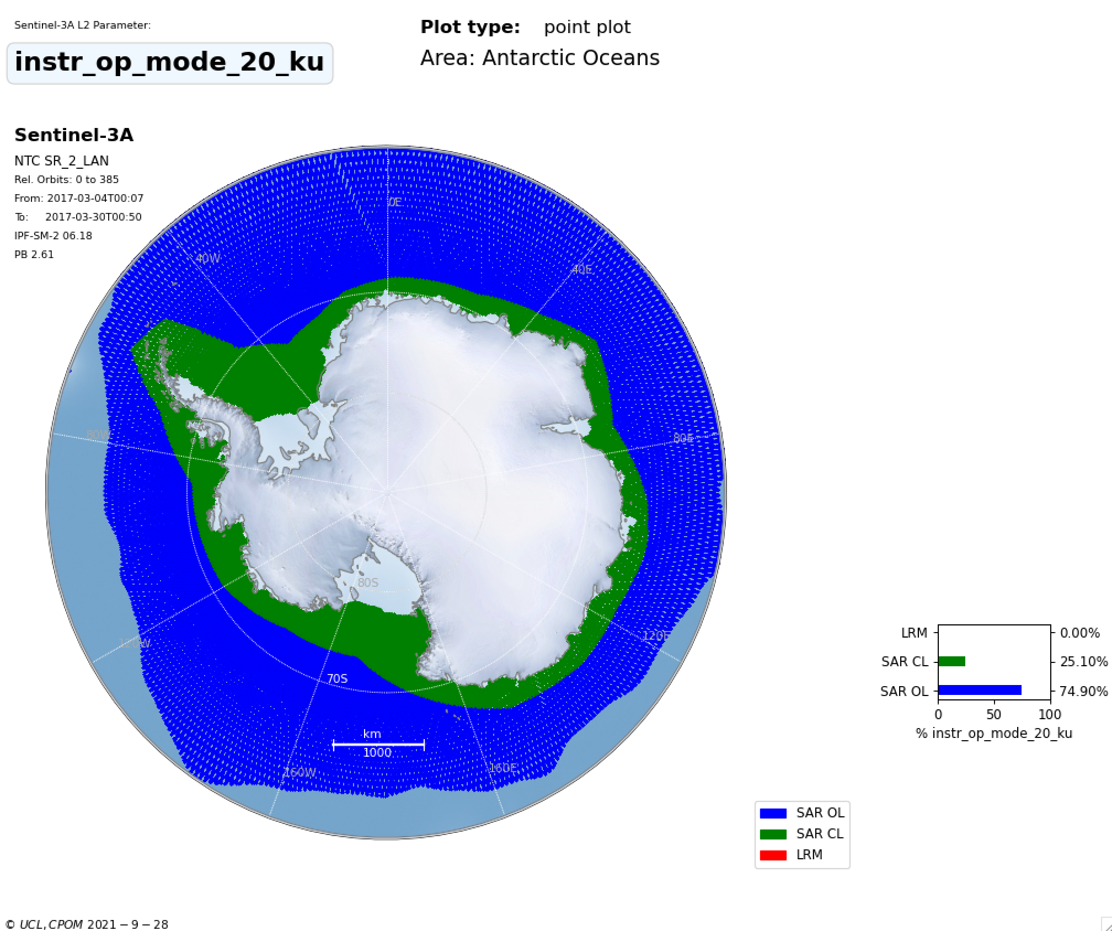
THEMATIC_SEAICE
Area Coverage/Mode
IPF_6.18

Slide 6
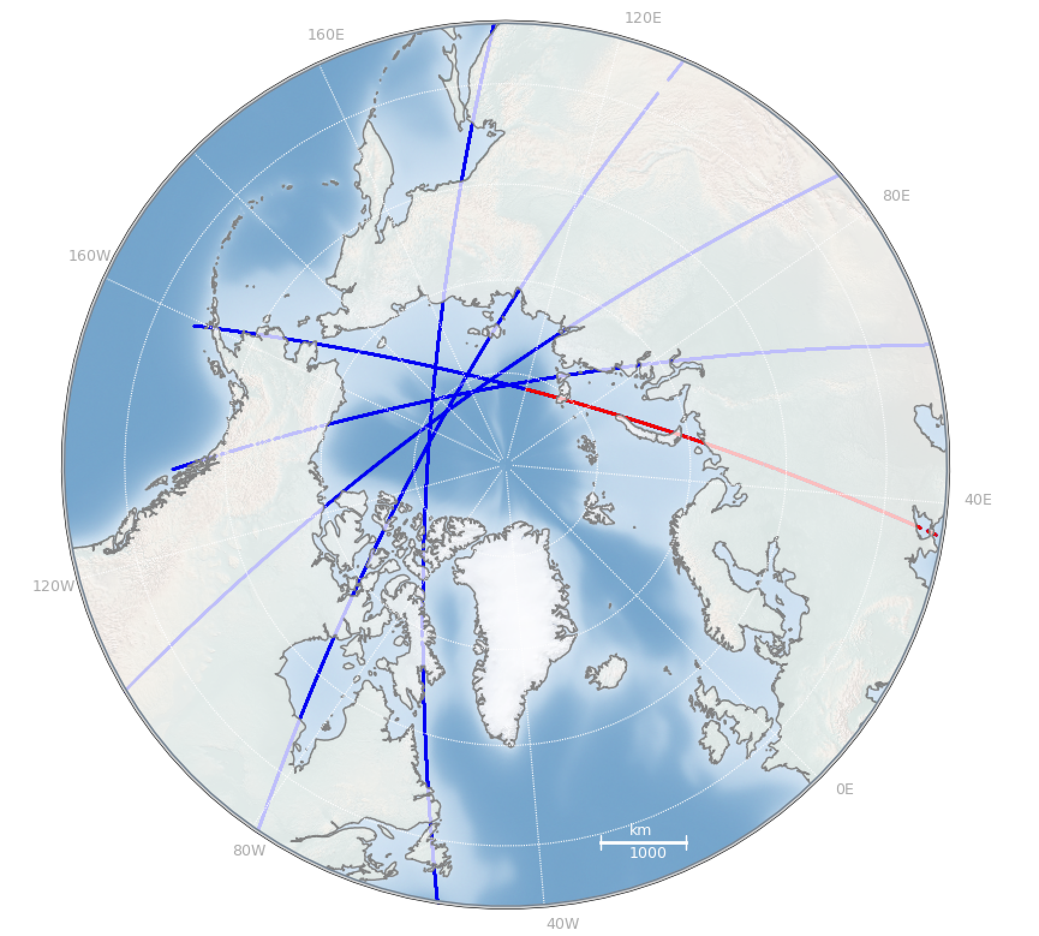
T-IPF not processed
Equator to Equator?
1 L2 product

Slide 7
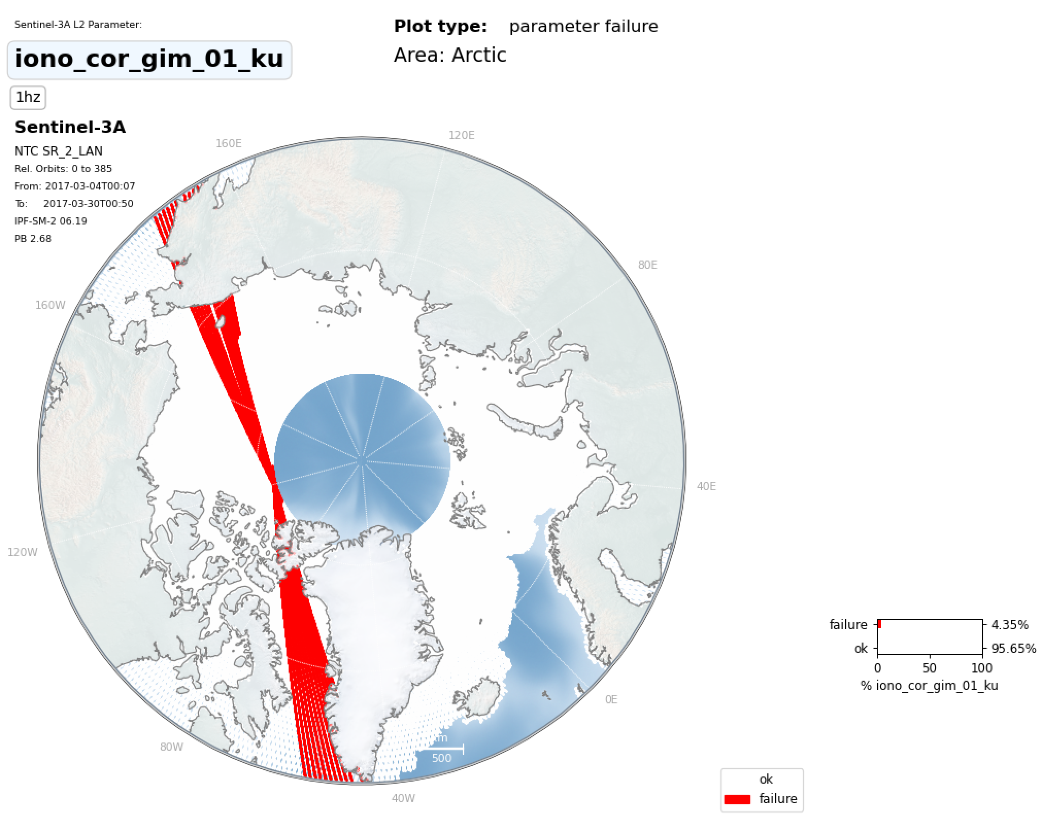
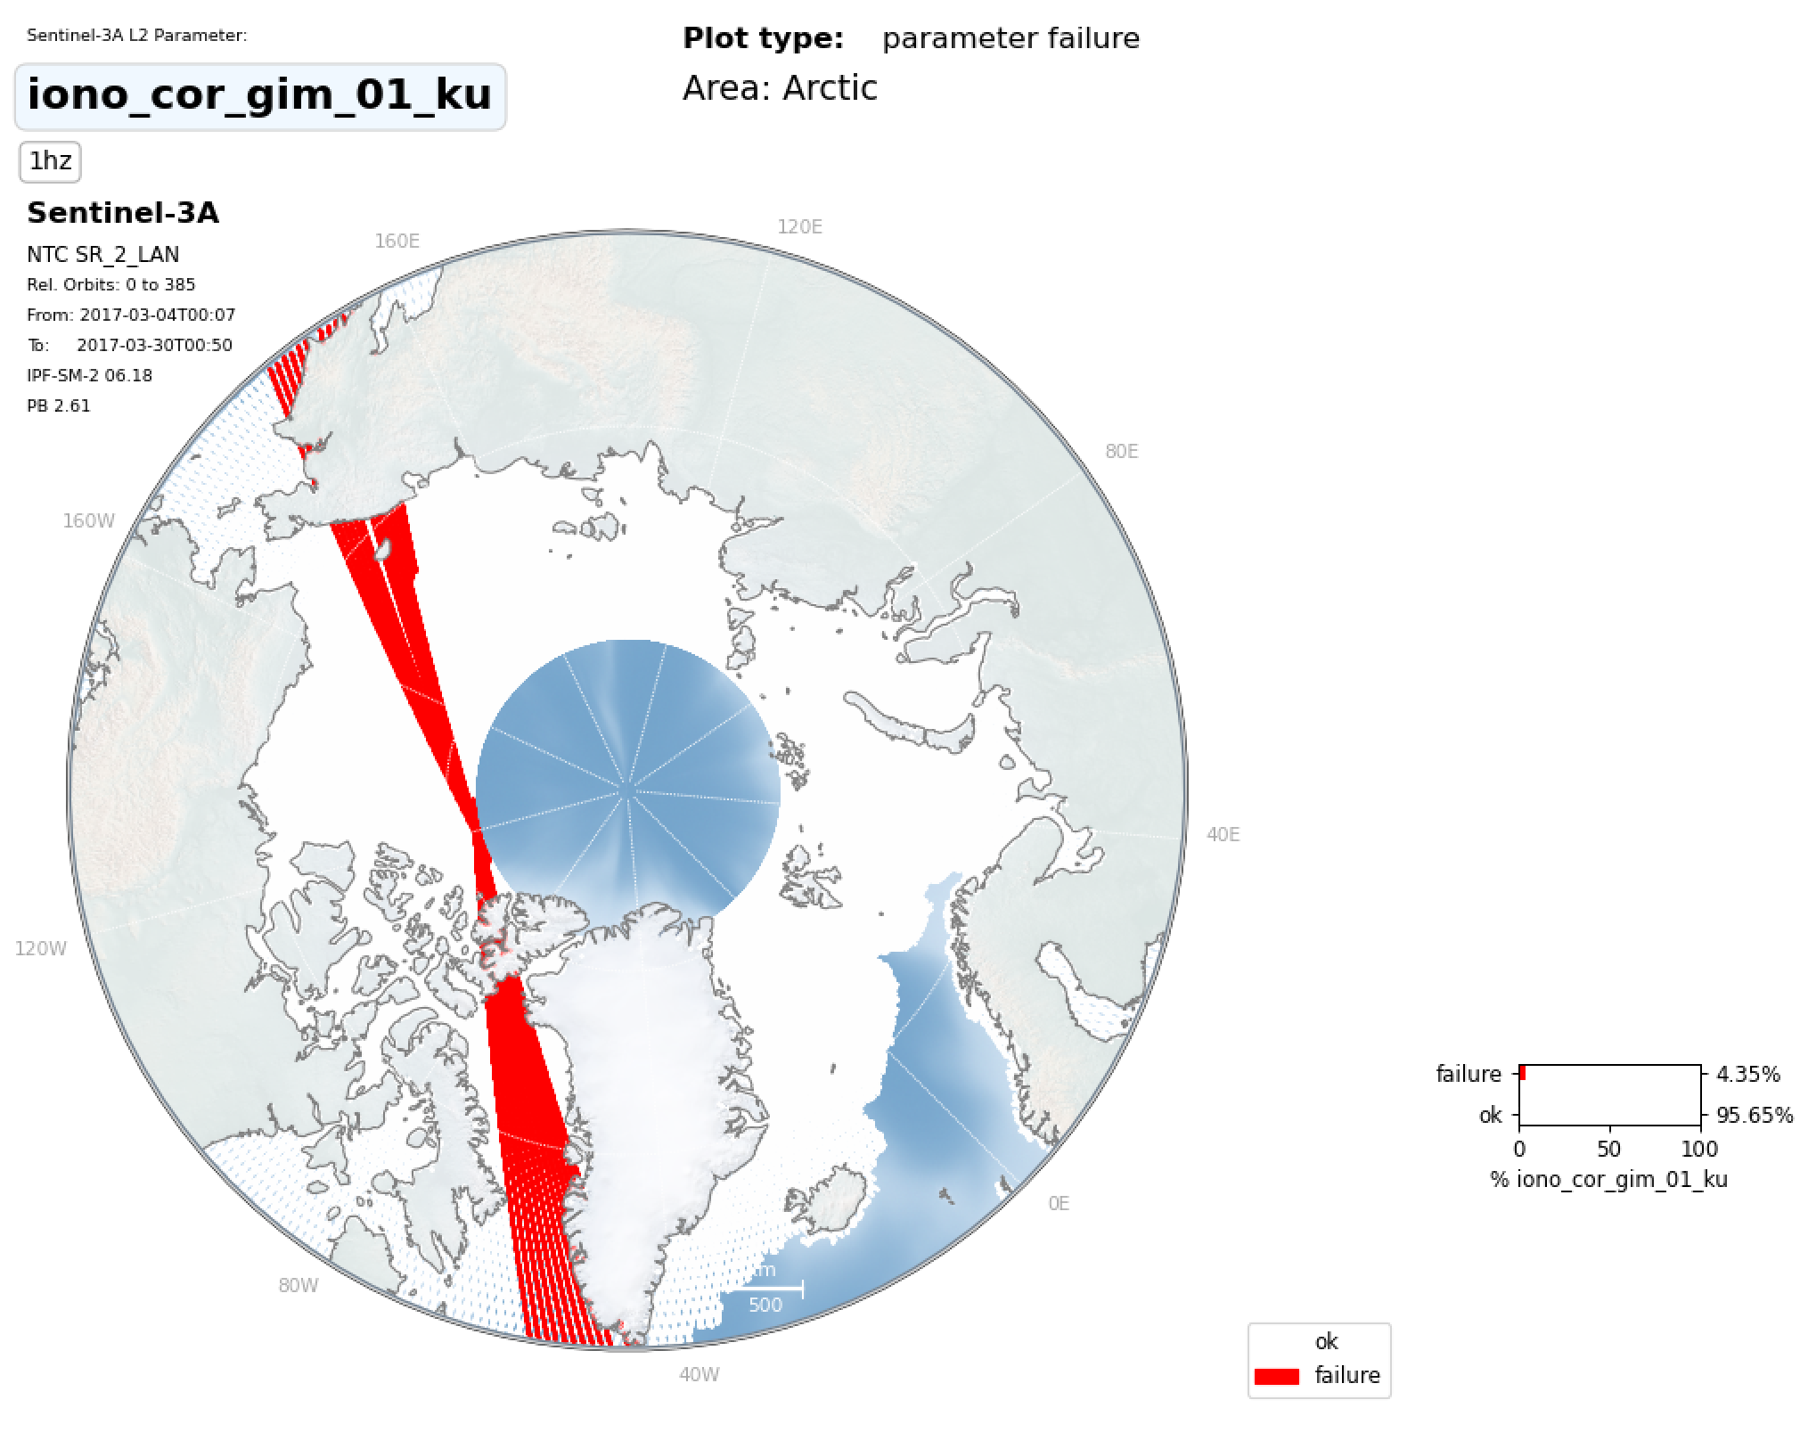
THEMATIC_SEAICE
Missing corrections in both
IPF_6.18
Correction missing
Correction missing

Slide 8
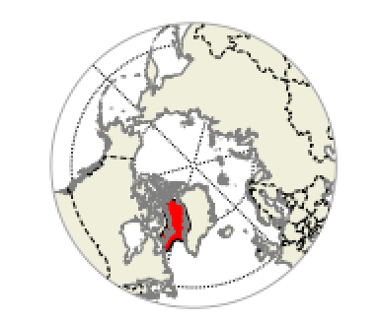
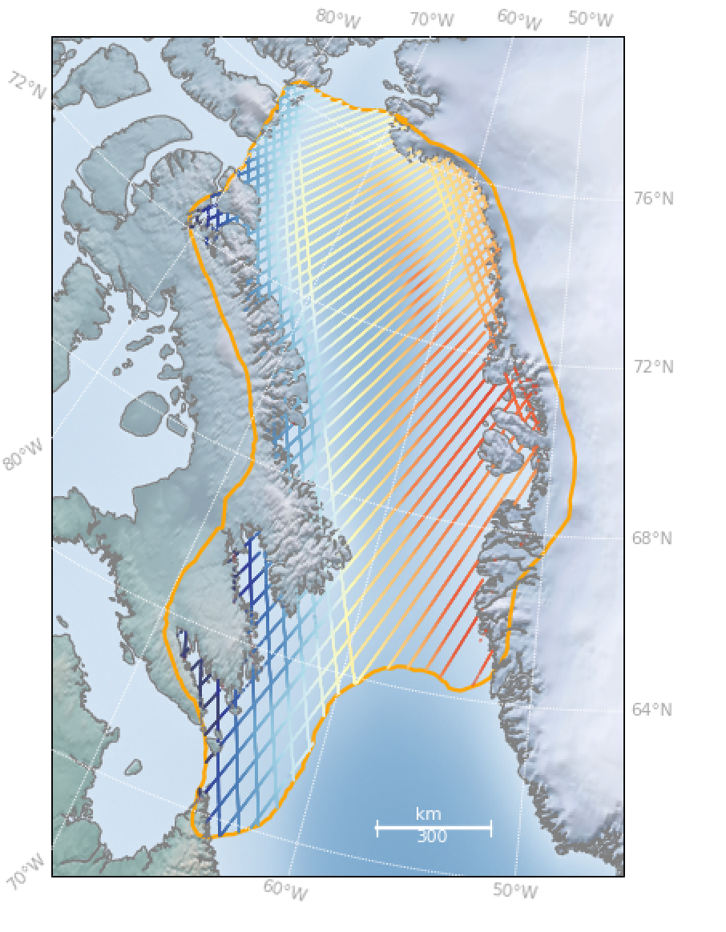
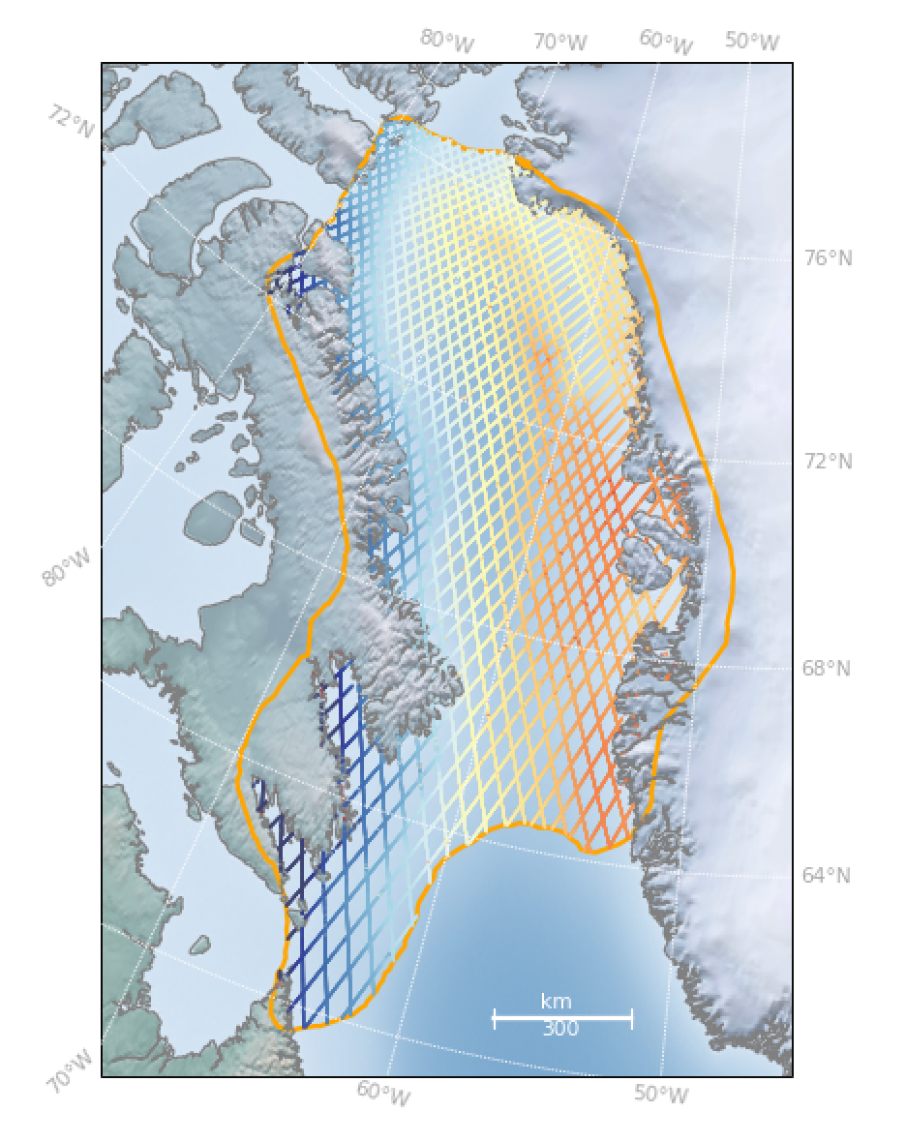
T-IPF
IPF
Expected behaviour in T-IPF and IPF 6.19
not good for comparison statistics between T-IPF and reference data set (6.18)

Slide 9
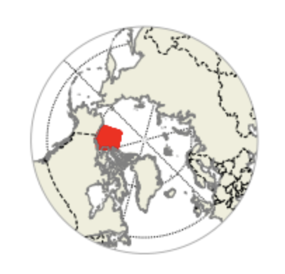
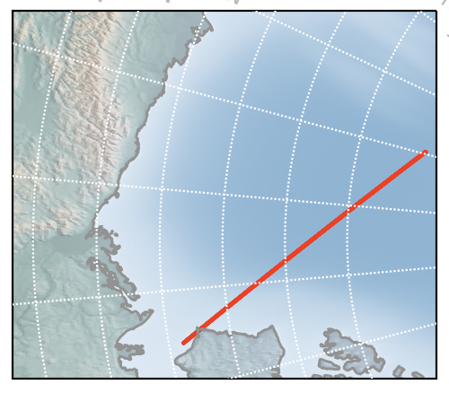
Arctic: Beaufort Sea
Zero padding: 2x sampling
THEMATIC_SEAICE
IPF_6.18

Slide 10
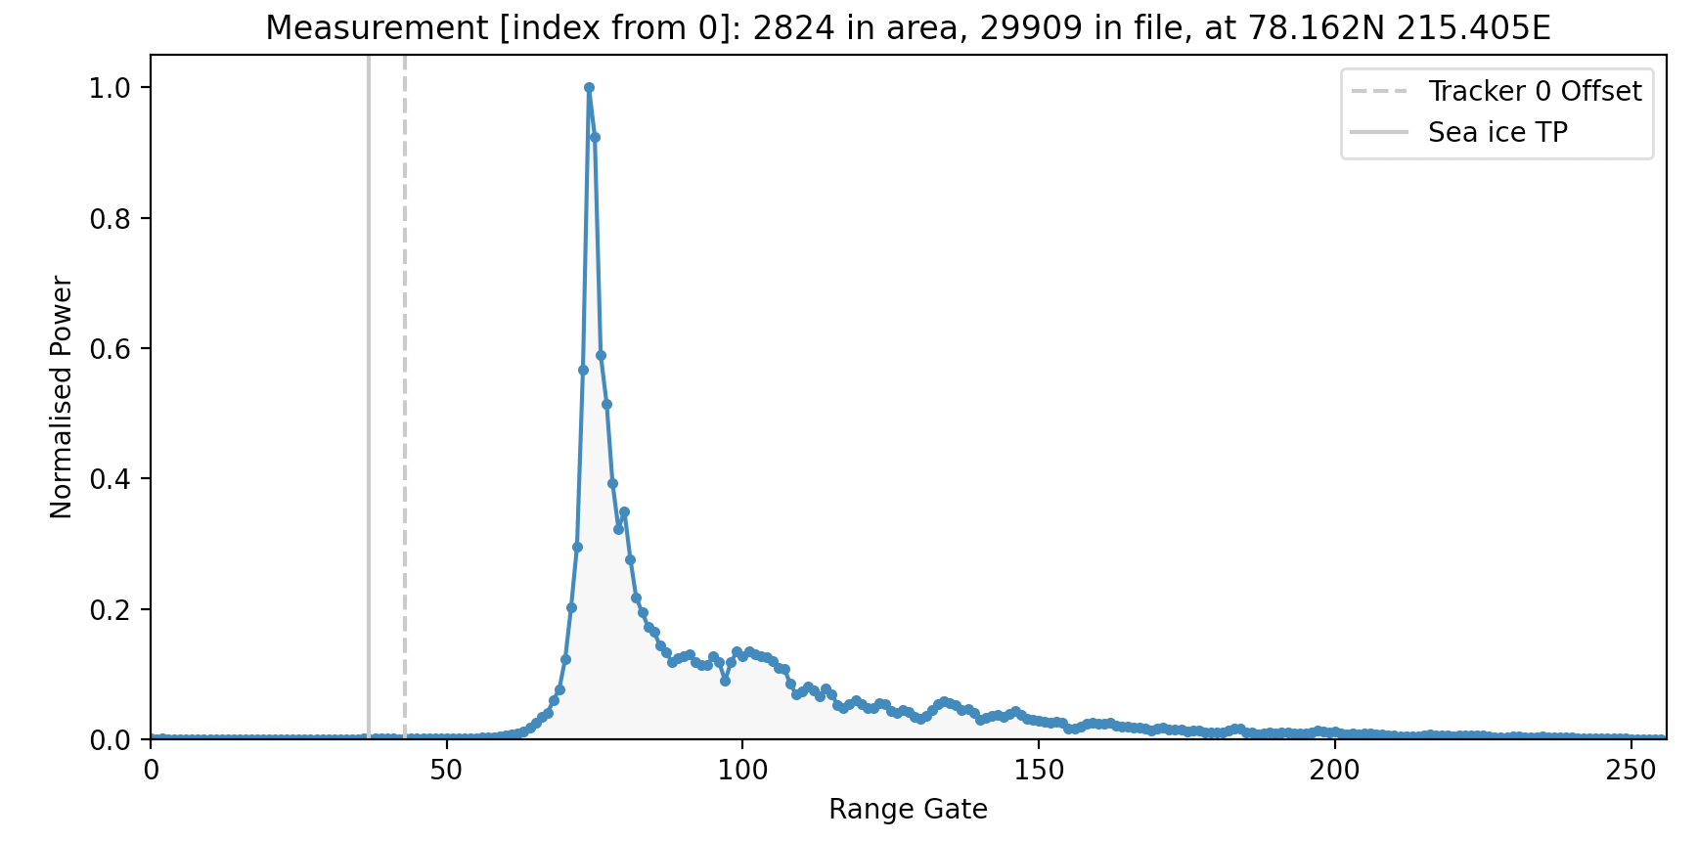
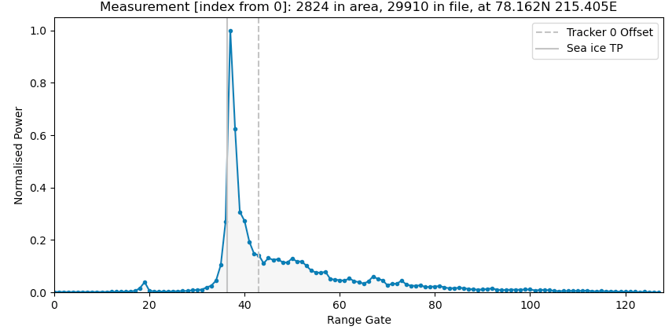
Twice sampling of the leading edge
THEMATIC_SEAICE
Arctic: Beaufort Sea
Off-nadir peaks removed
IPF_6.18

Slide 11
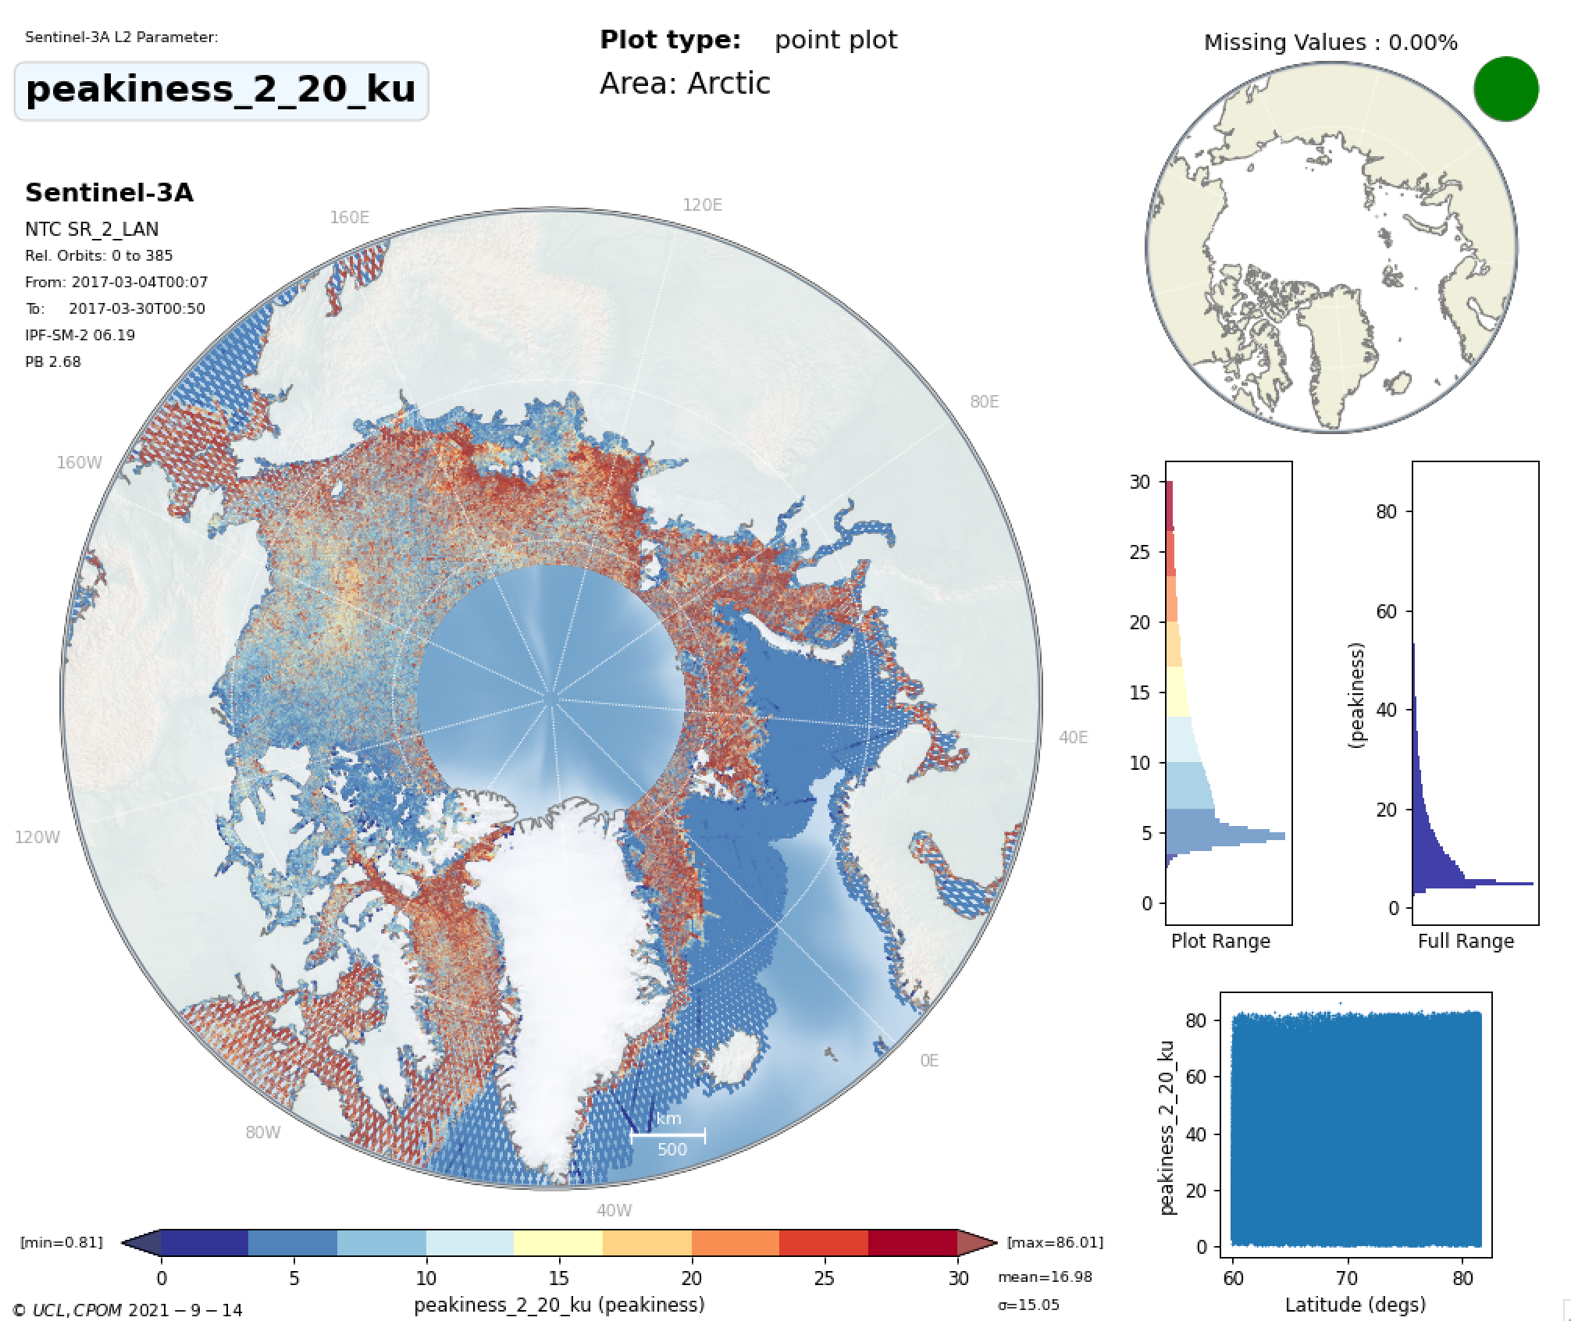
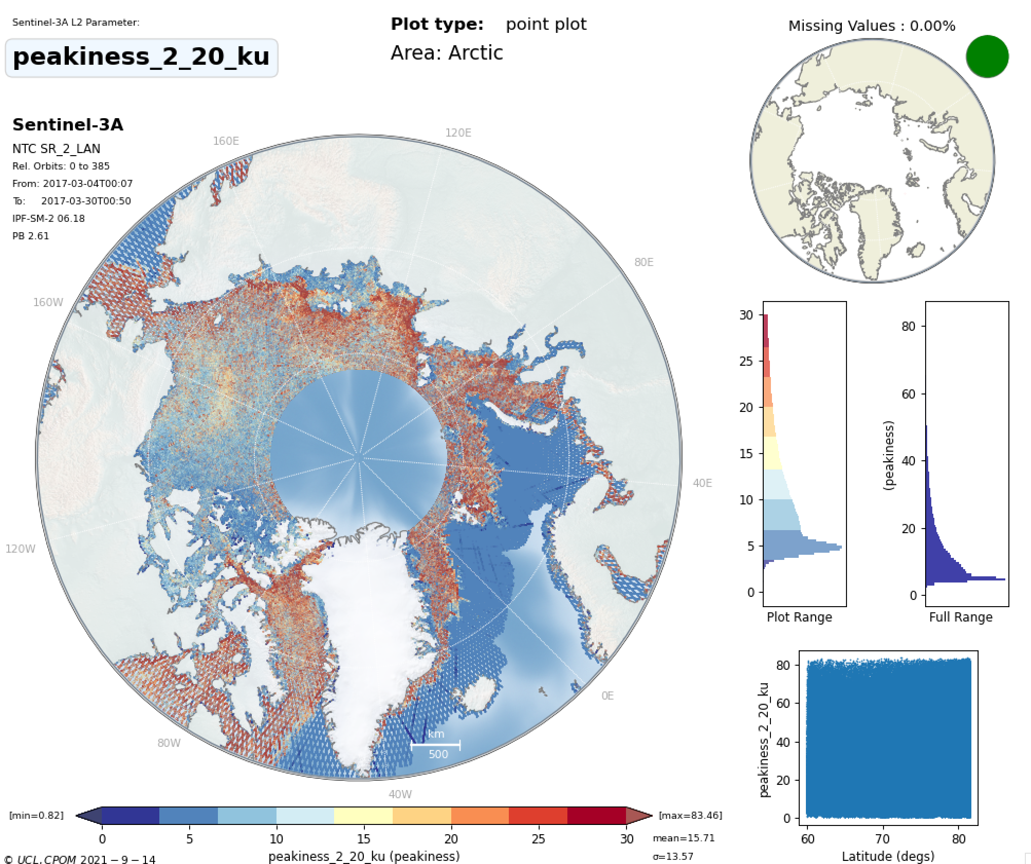
THEMATIC_SEAICE
IPF_6.18
Mean peakiness=16.98
Mean peakiness=15.71
Slightly higher peakiness expected with ZP/Hamming

Slide 12
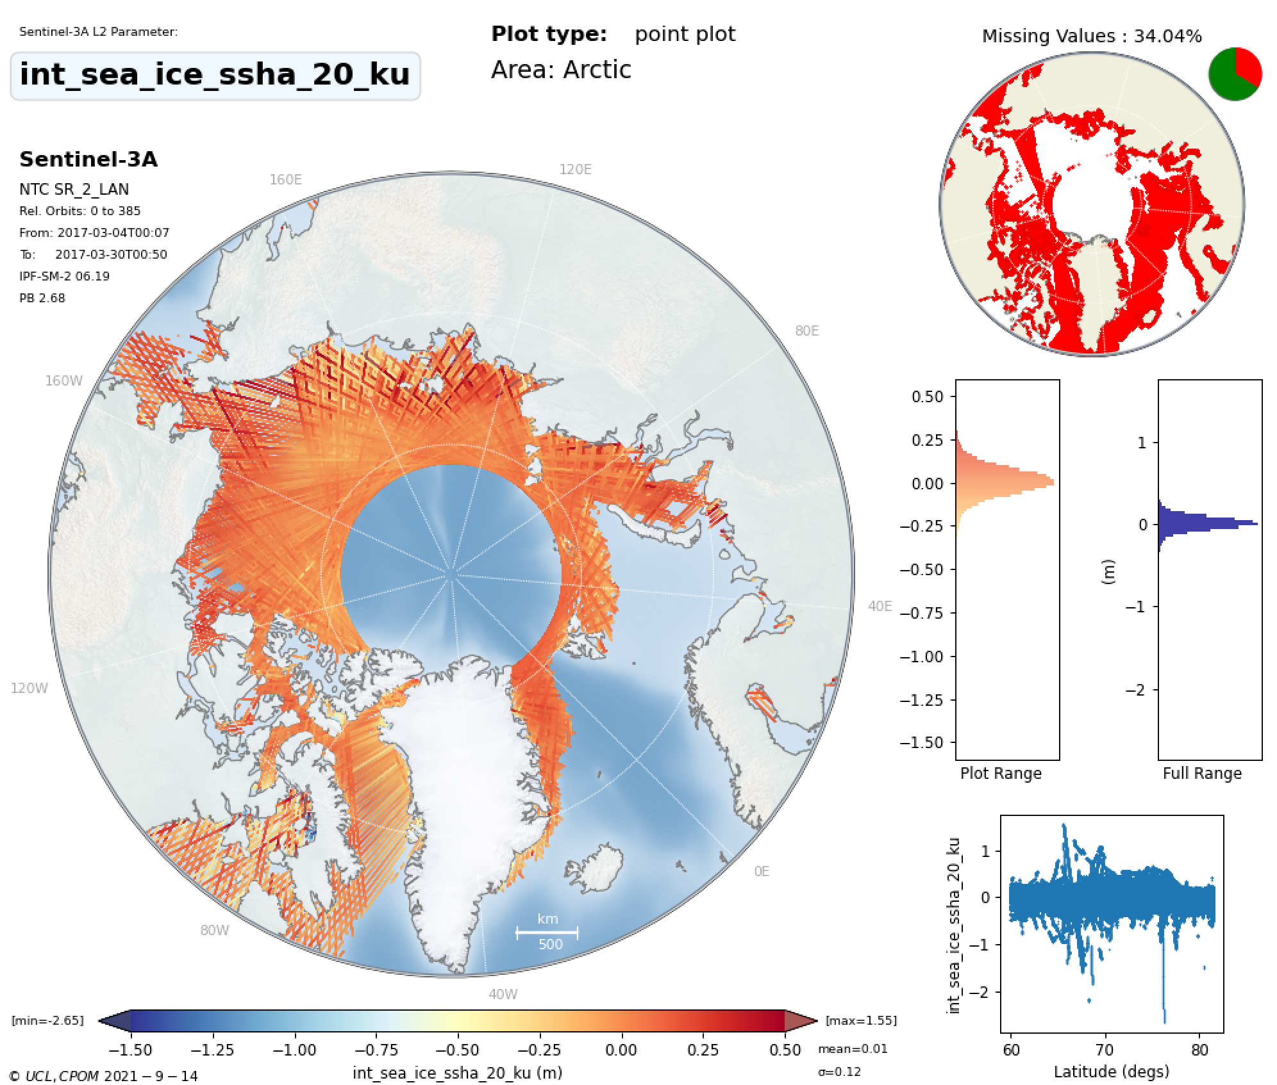
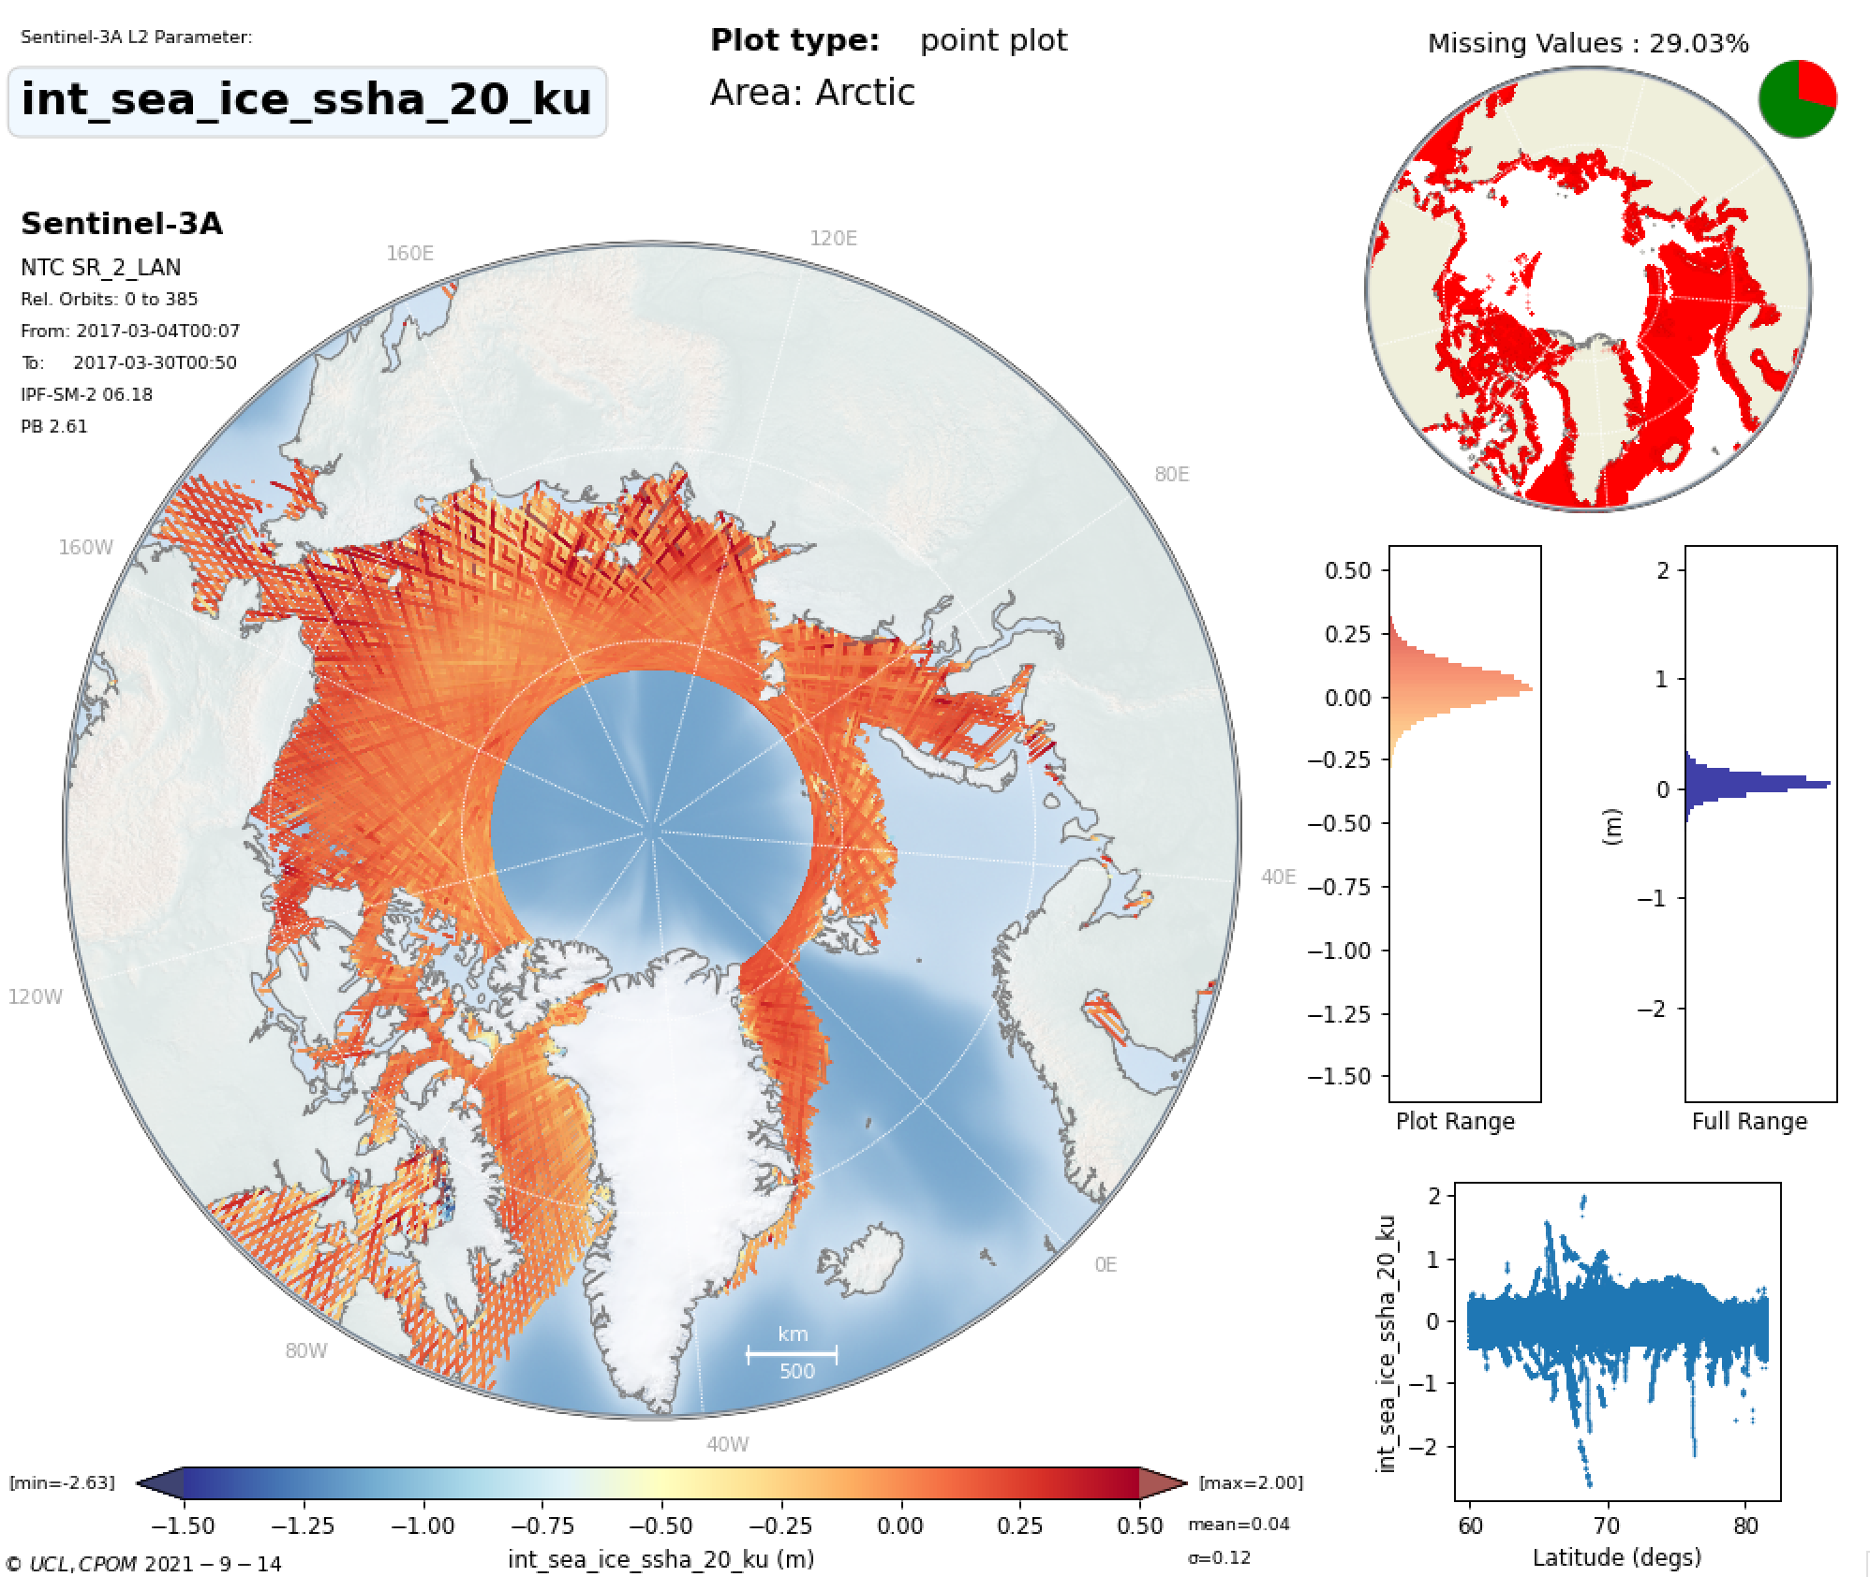
Interpolated SSHA between Leads
THEMATIC_SEAICE
IPF_6.18
MEAN =0.01m
MEAN =0.04m

Slide 13
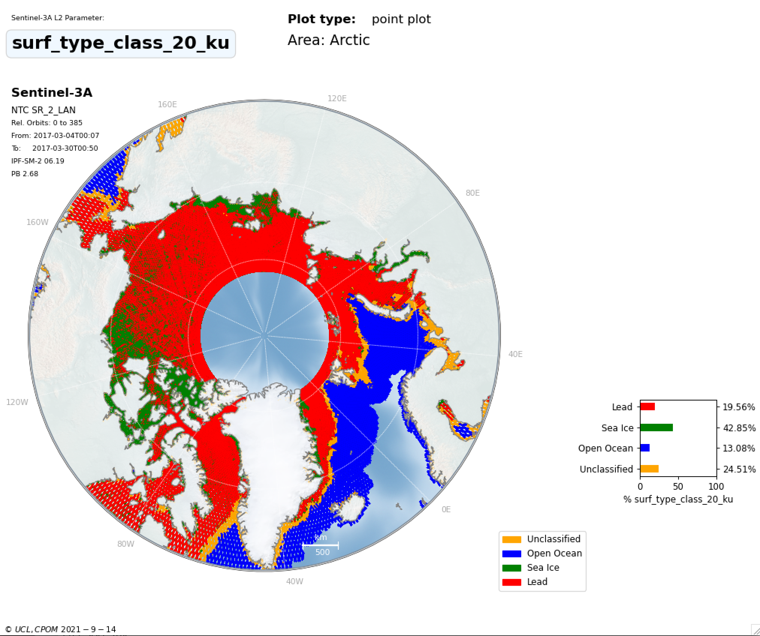
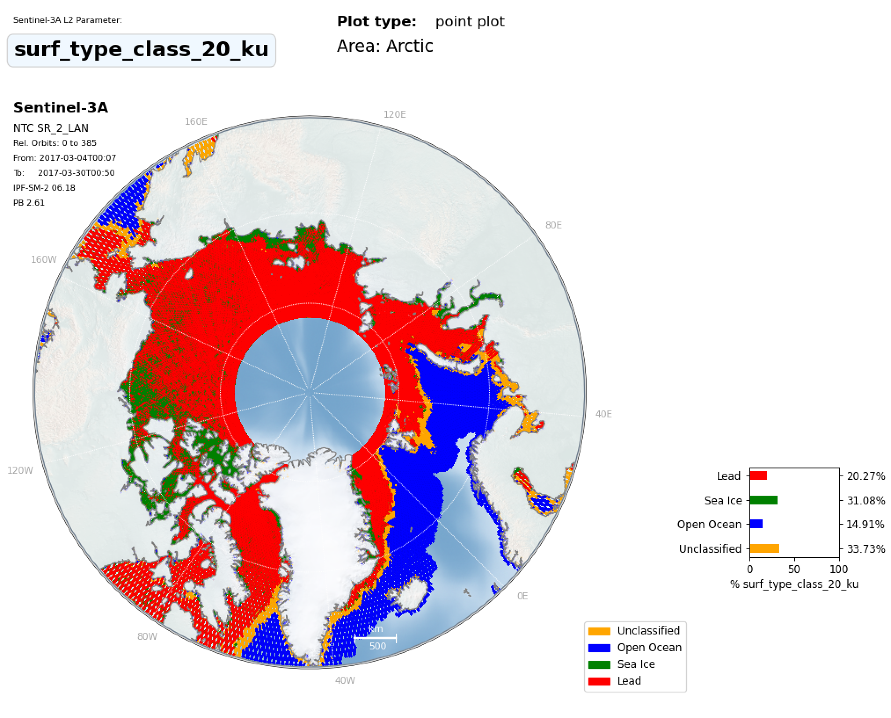
THEMATIC_SEAICE
Sea Ice Discrimination
IPF_6.18
11% more sea ice floes classified
9% less unclassified waveforms
Due to Hamming & new discrimination tuning

Slide 14
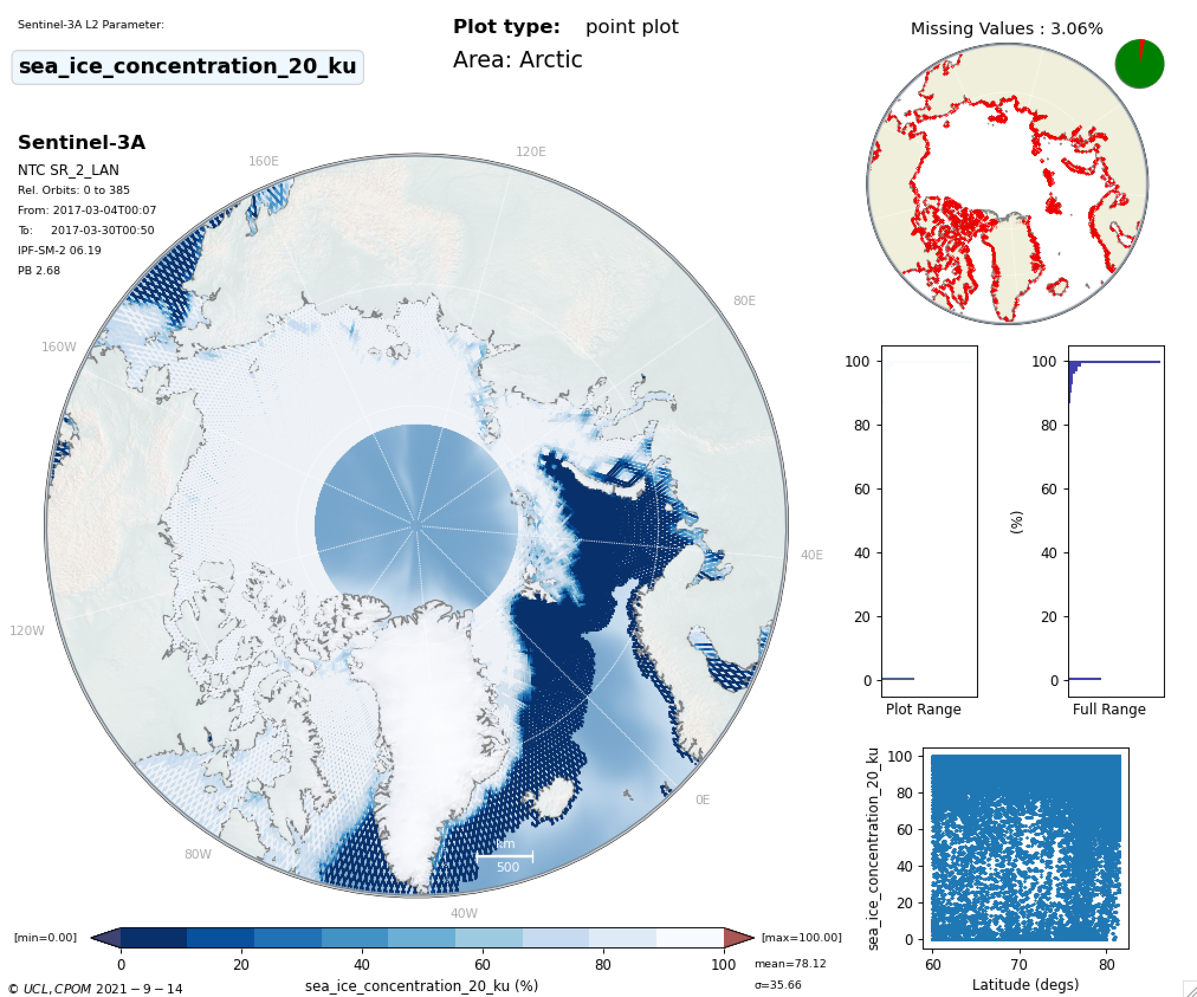
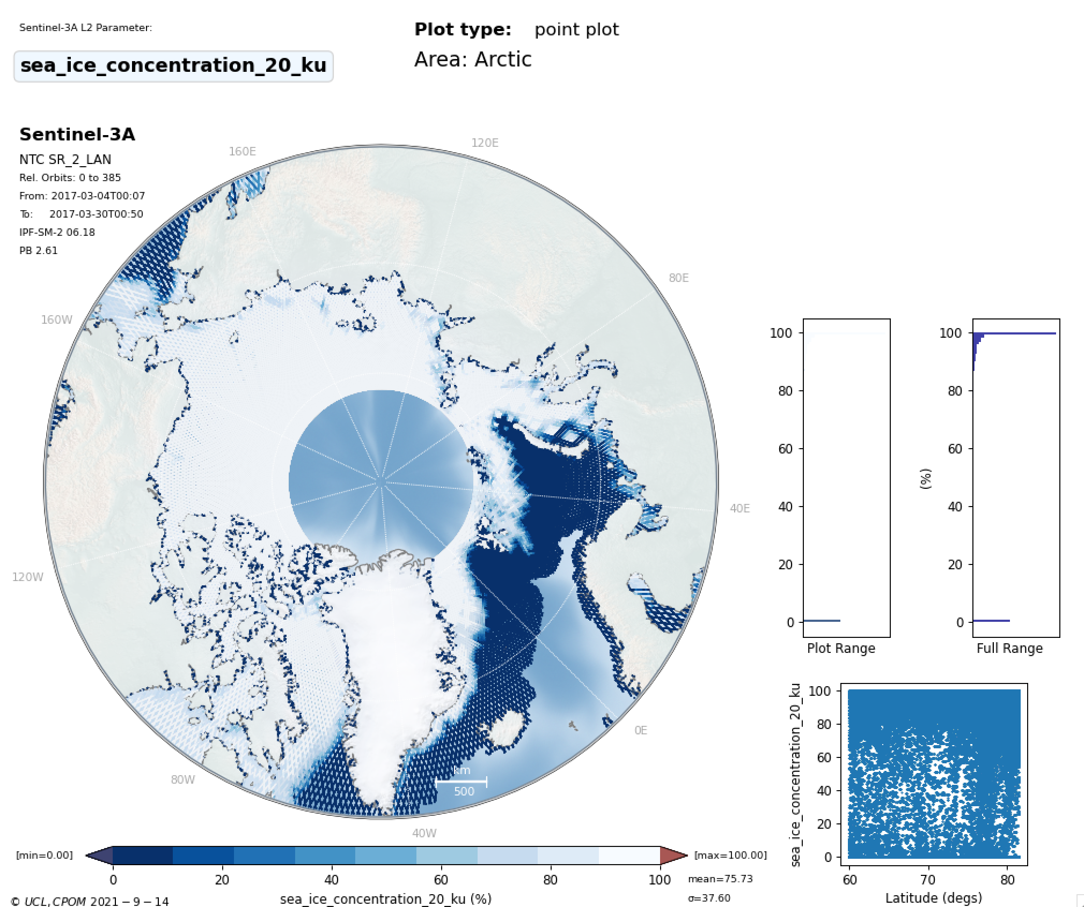
Sea Ice Concentration
THEMATIC_SEAICE
IPF_6.18

Slide 15
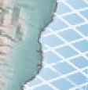
THEMATIC_SEAICE
IPF_6.18
Sea Ice
Concentration
Expected behaviour in Thematic product
Zero values around coastline
Notes:
./plot_combined_freeboard.py -f2 ~/fb2/cs2/2017/3/*.npz -f1 ~/fb2/s3a_ipf/s3a/2017/3/*.npz -o ~/fb2 –diff
./plot_combined_freeboard.py -f2 ~/fb2/cs2/2017/3/*.npz -f1 ~/fb2/s3a_thematic/s3a/2017/3/*.npz -o ~/fb2 --diff

Slide 16
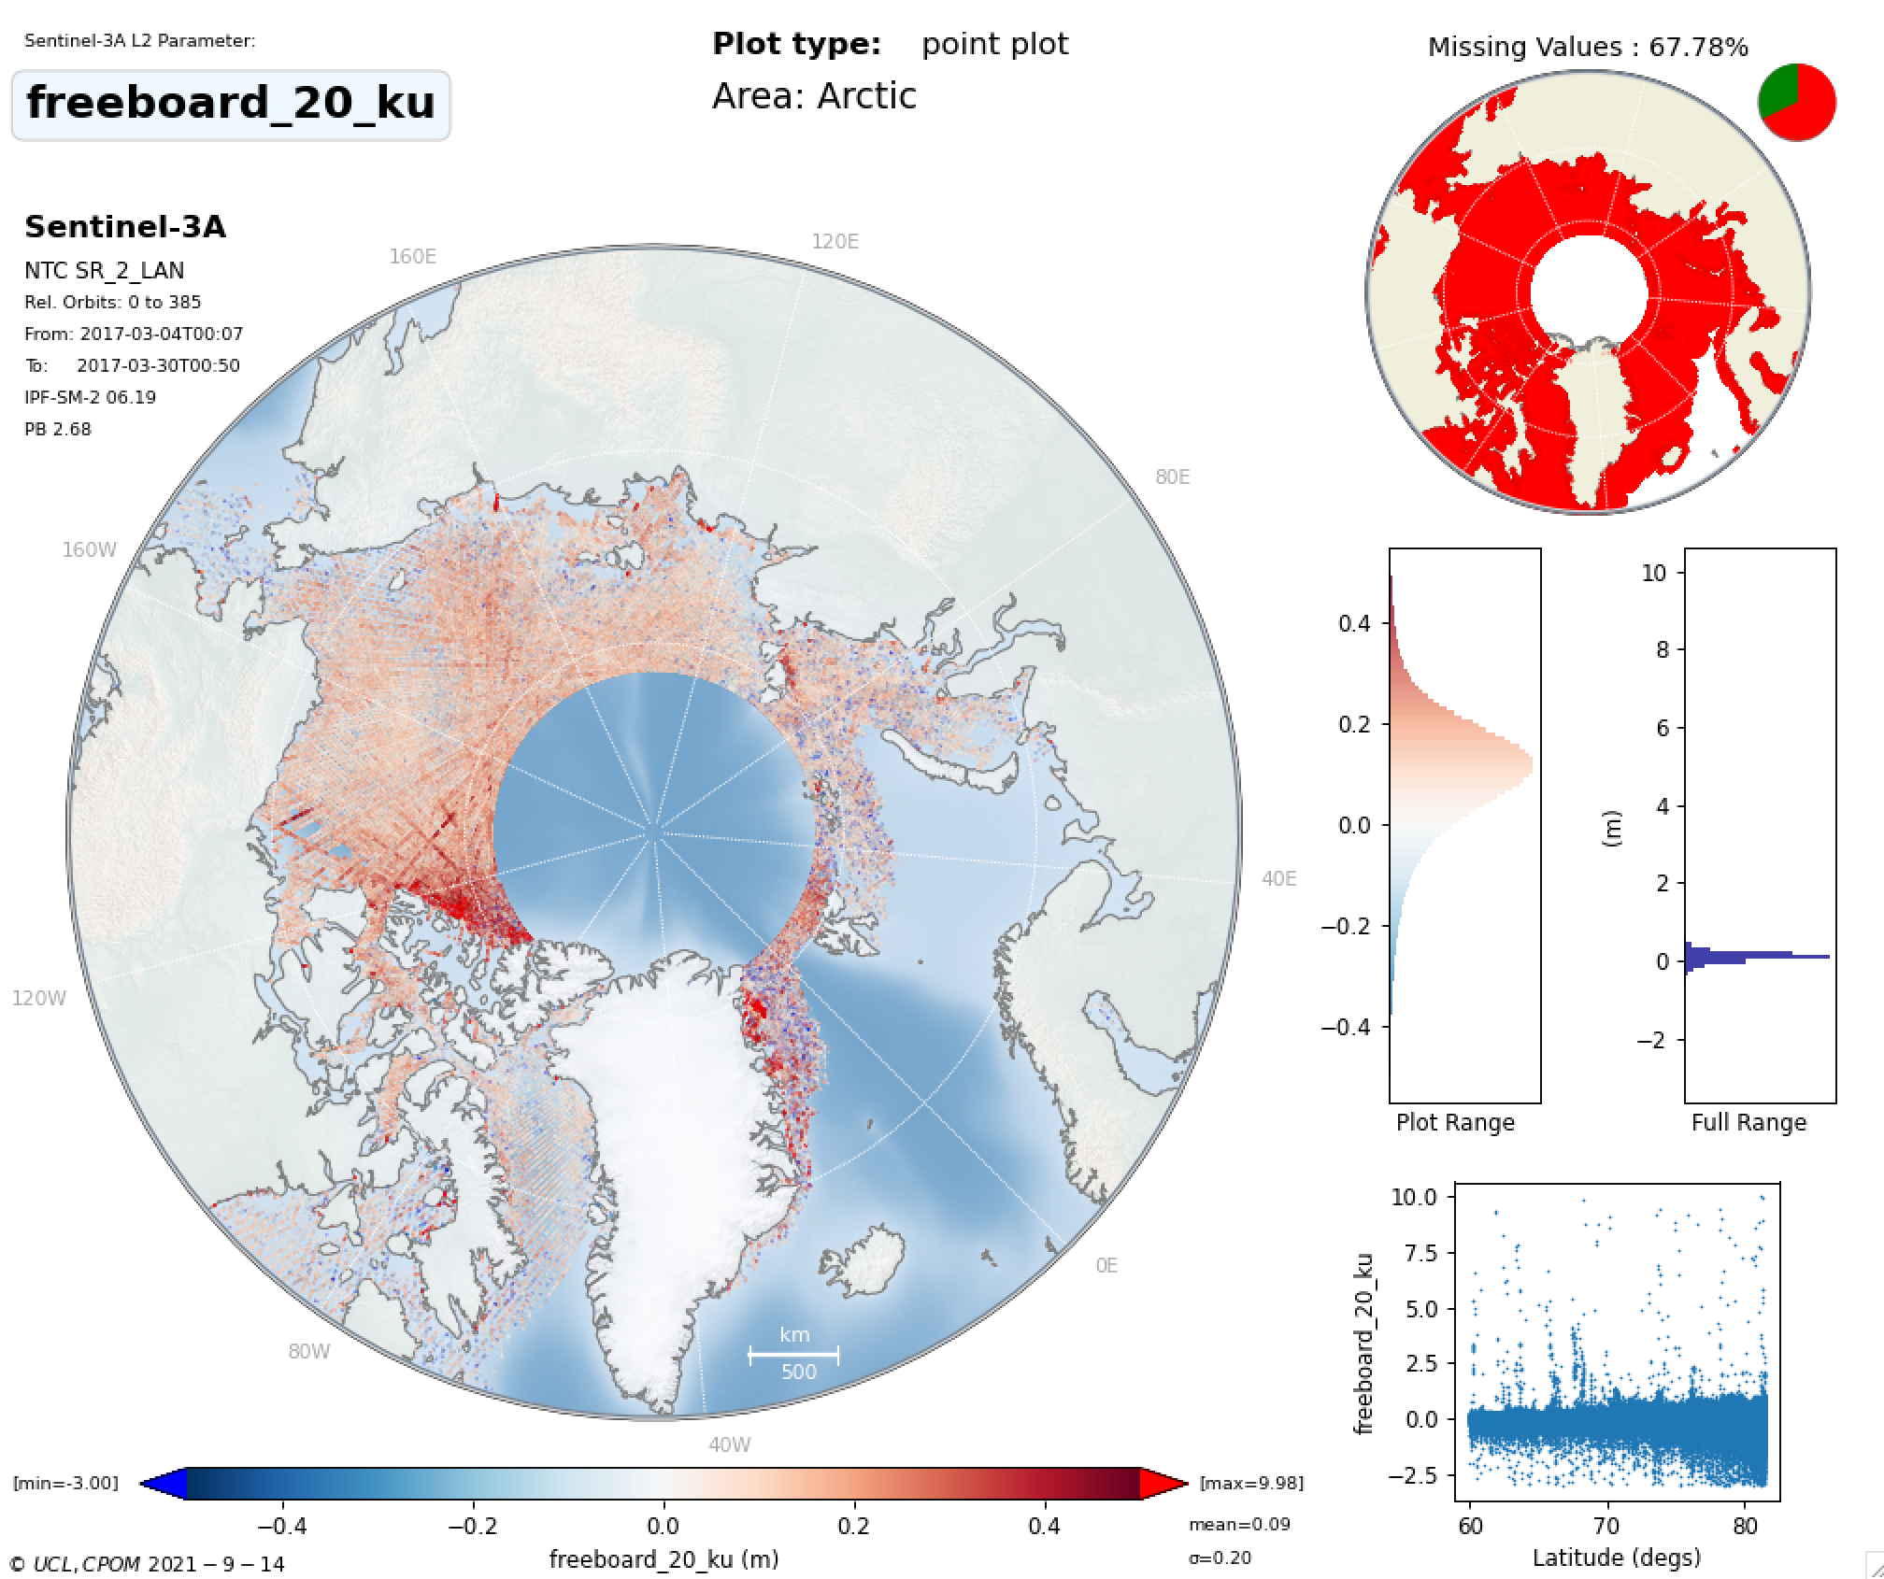
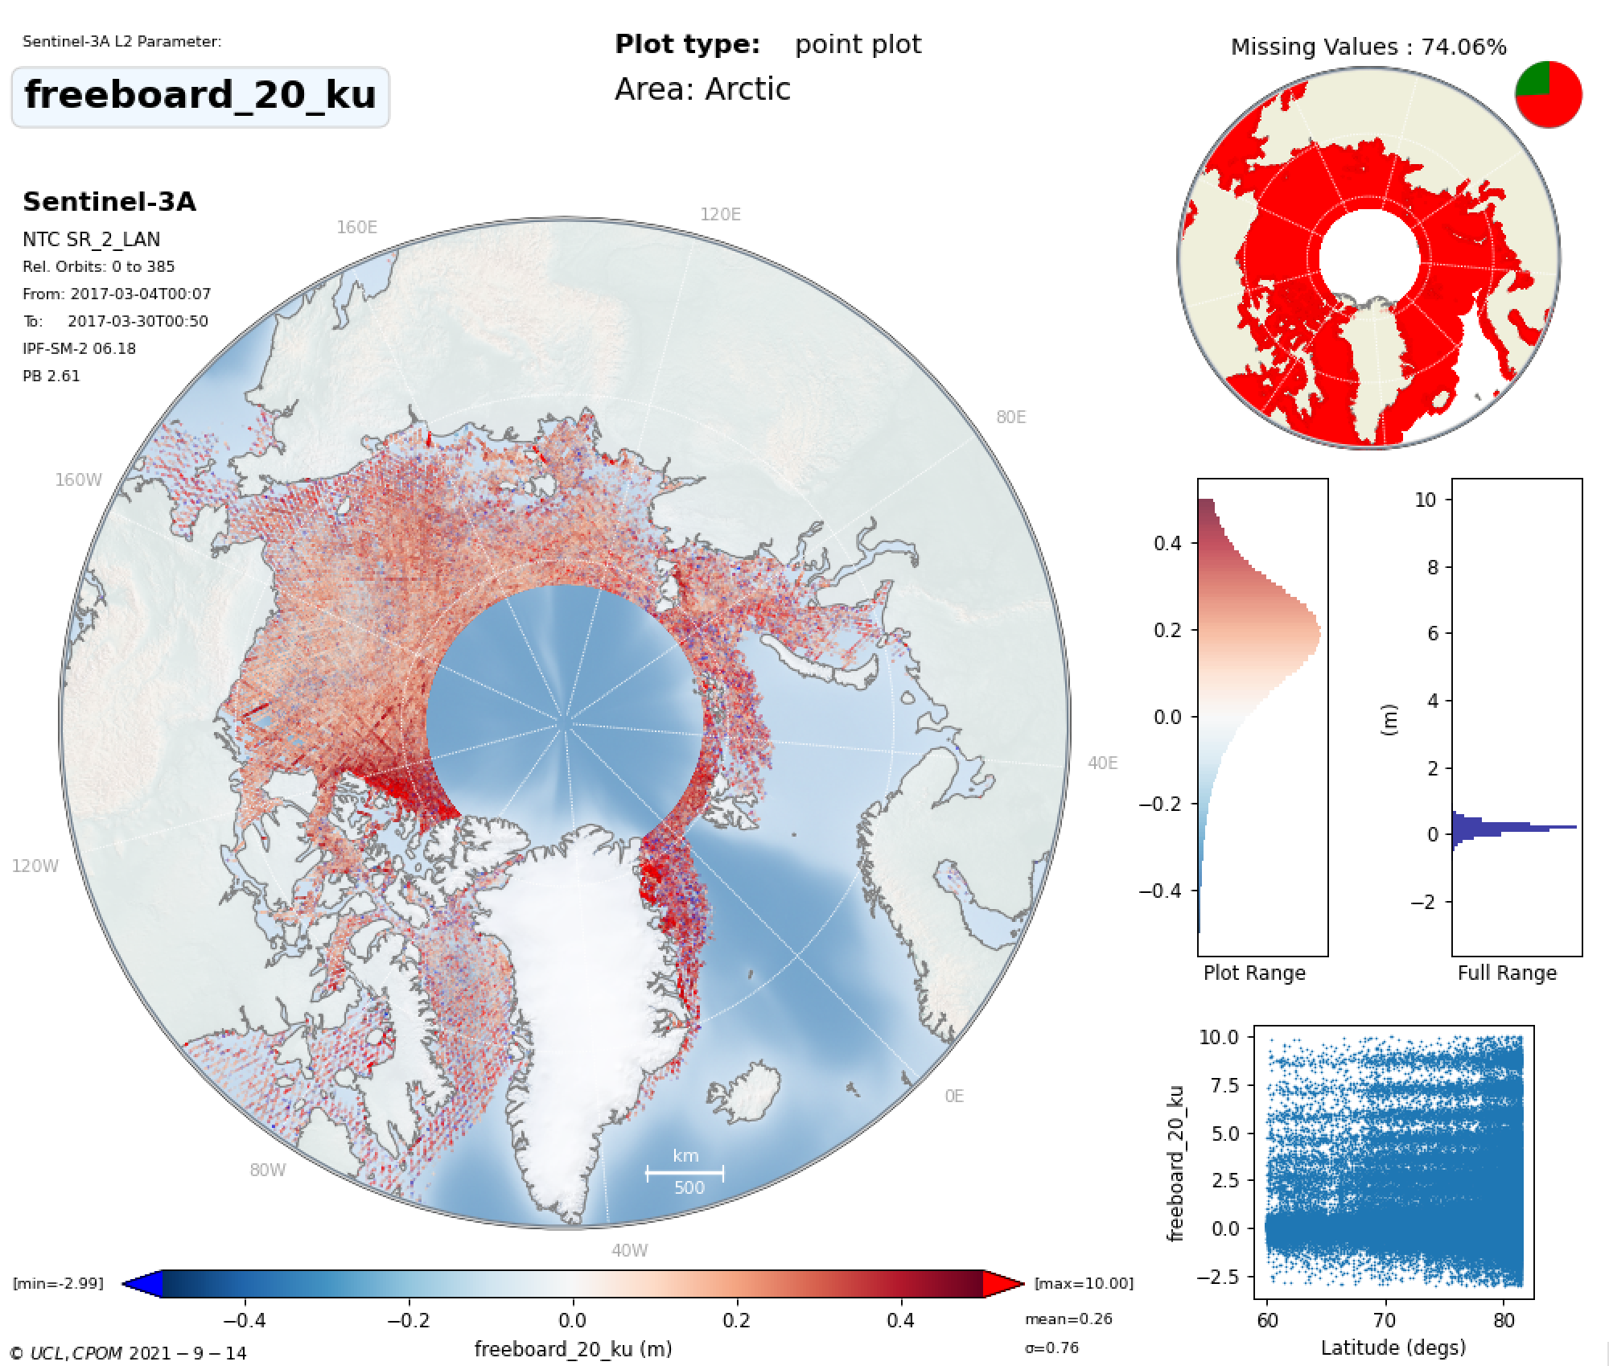
THEMATIC_SEAICE
Freeboard
IPF_6.18
Number of freeboard measurements: 1286206
250715 more measurements (24% more)
Number of freeboard measurements: 1035491

Slide 17
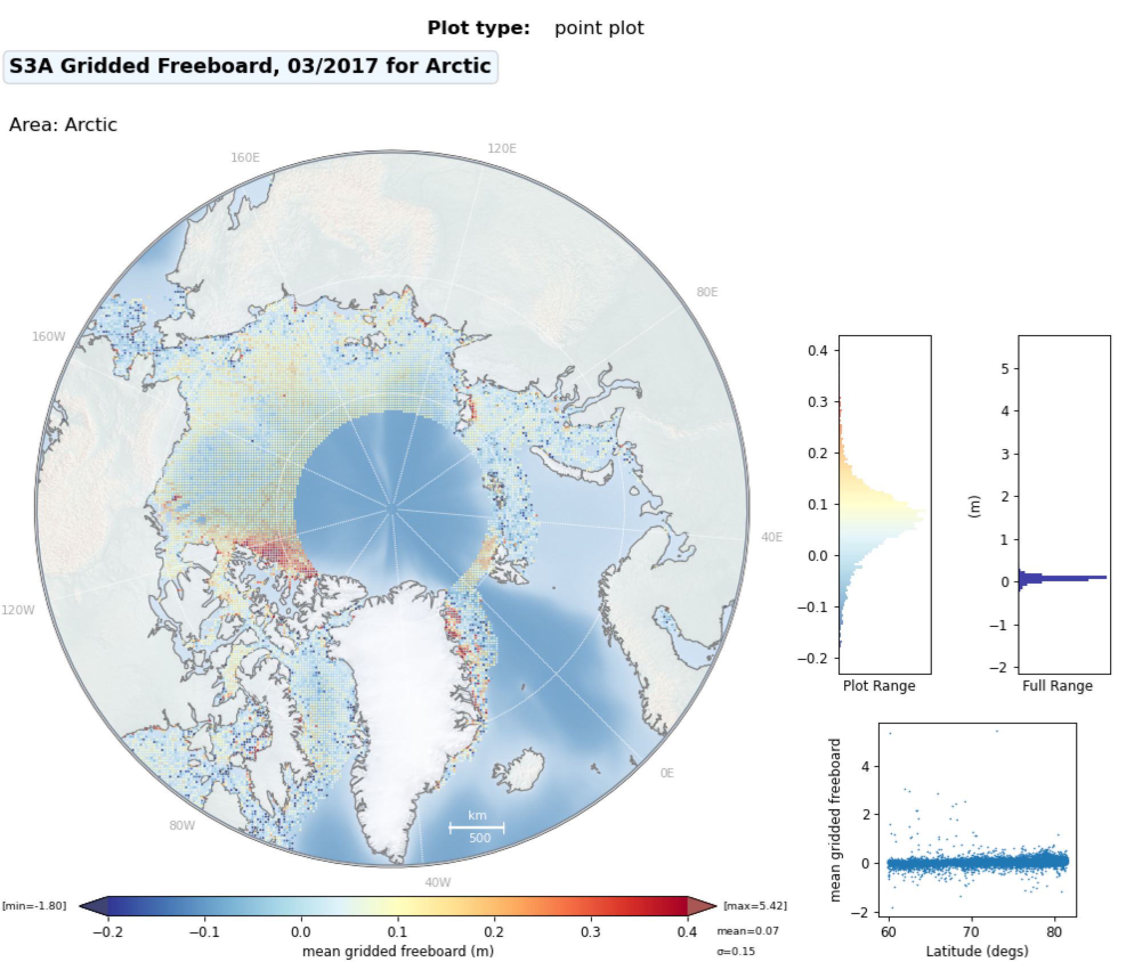
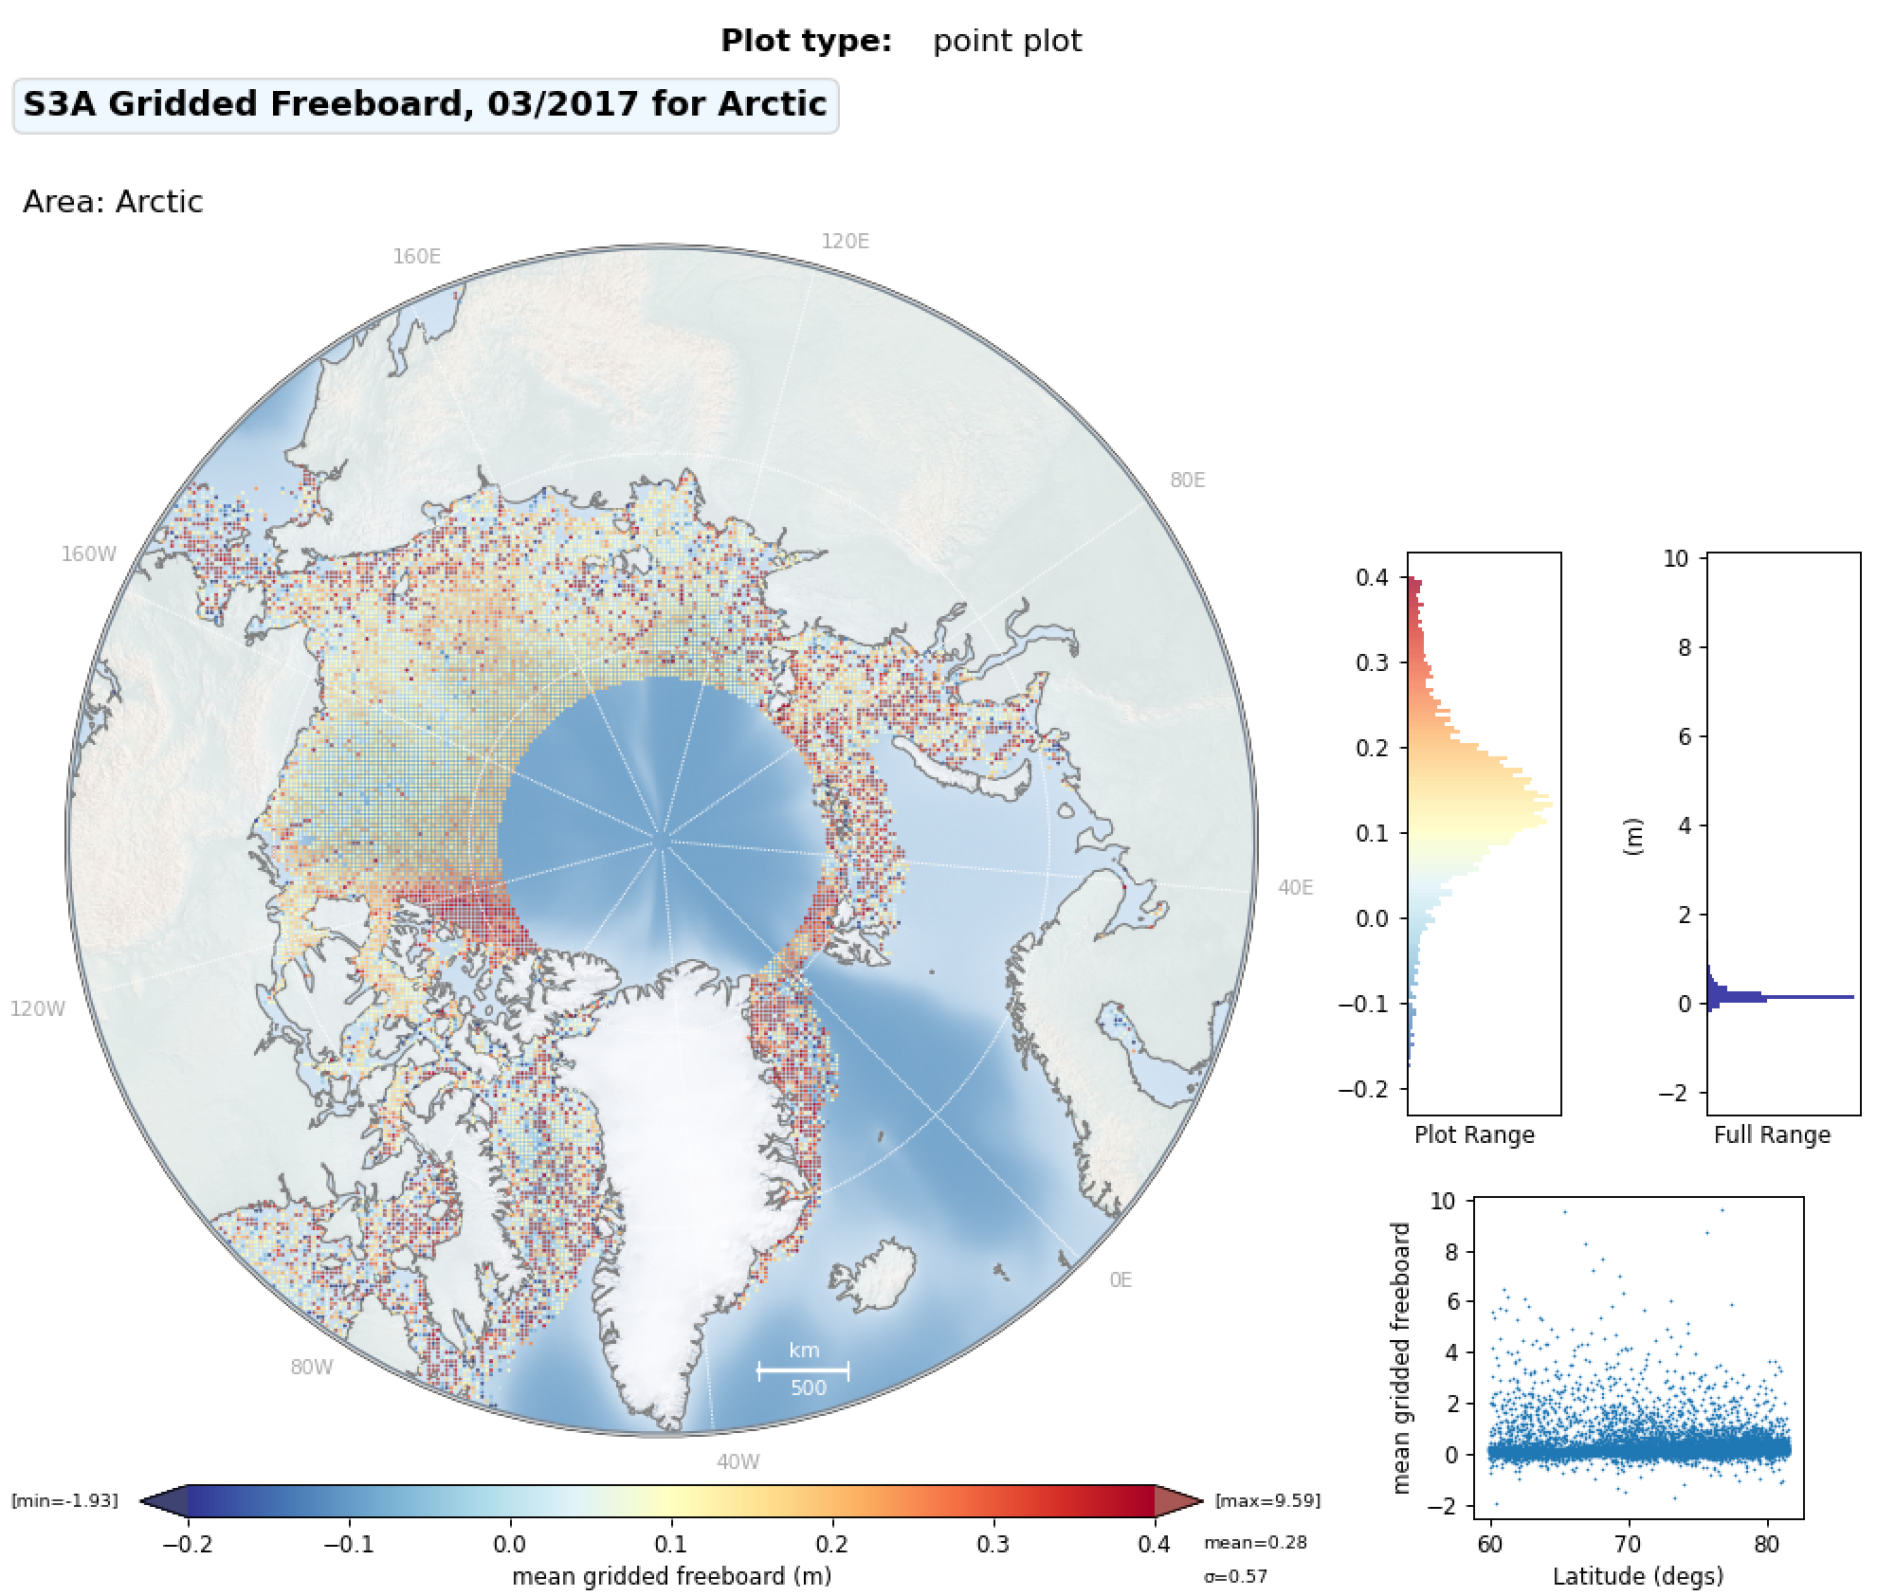
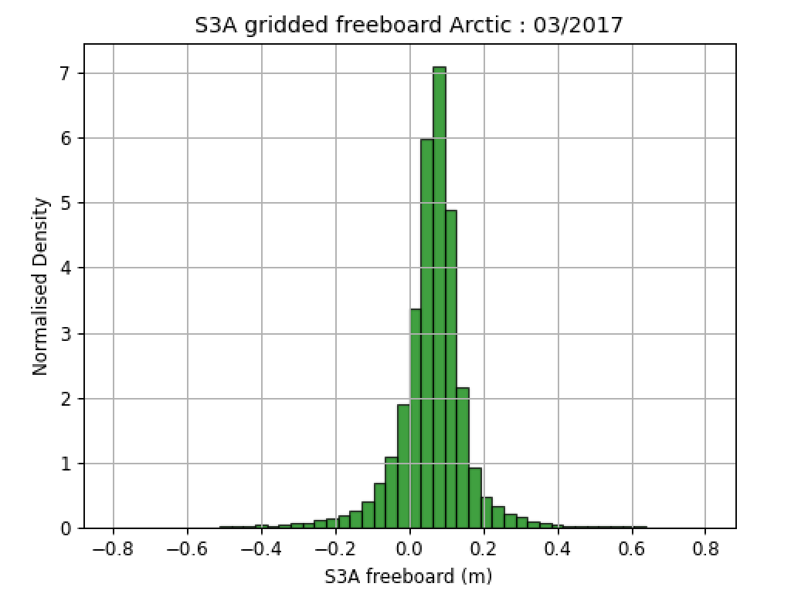
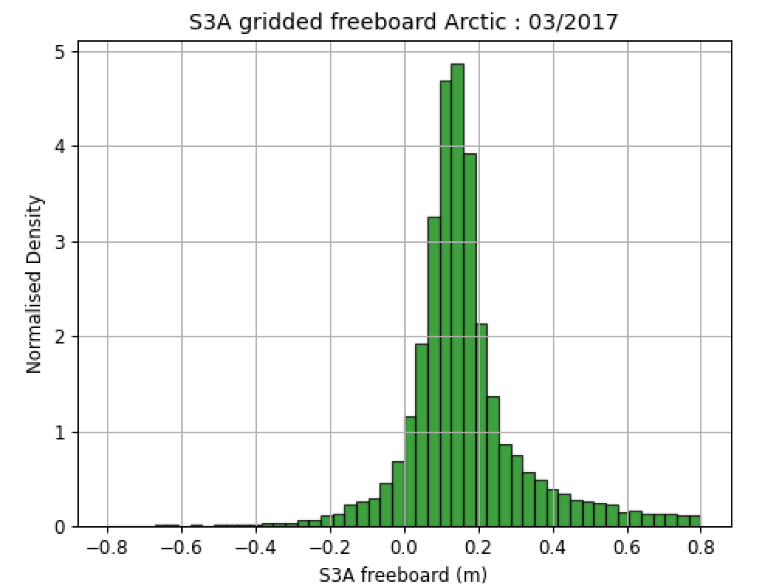
25km Gridded Arctic Freeboard (March 2017):
THEMATIC_SEAICE
CS2 Baseline-D
IPF_6.18

Slide 18
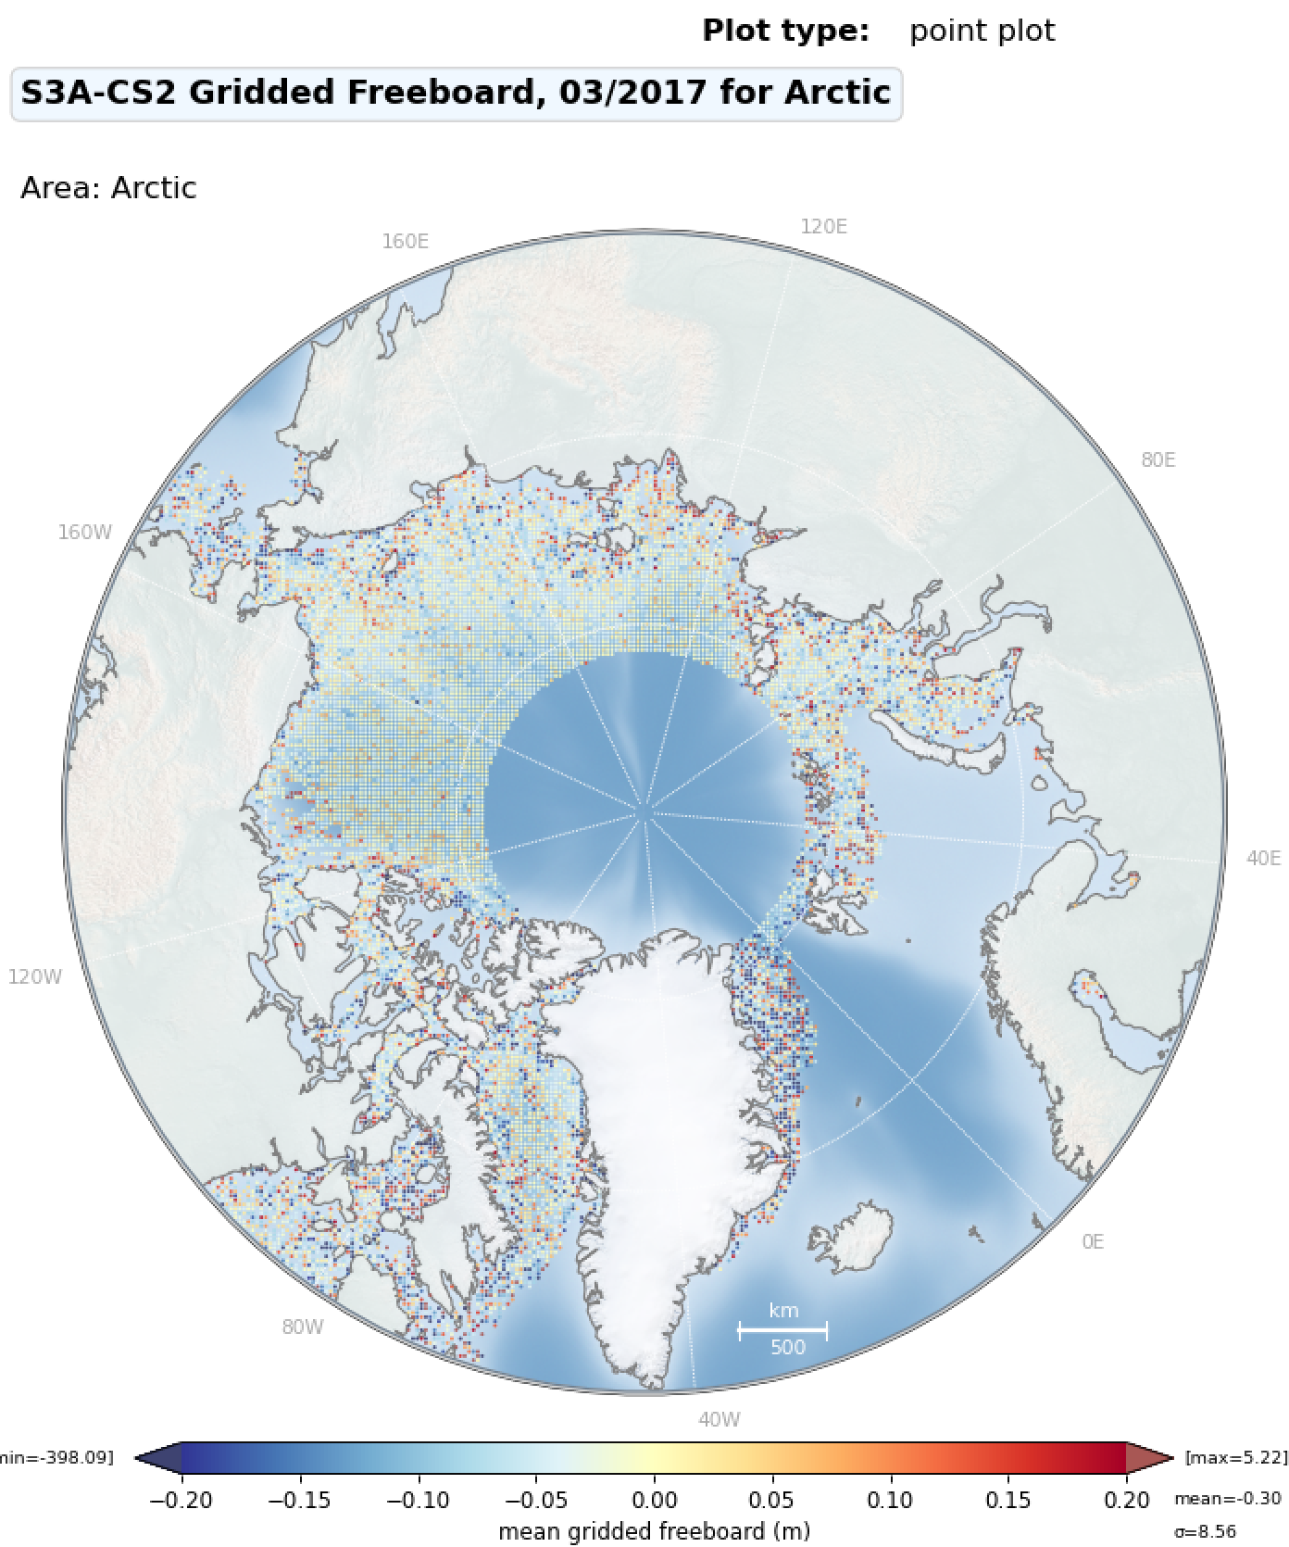
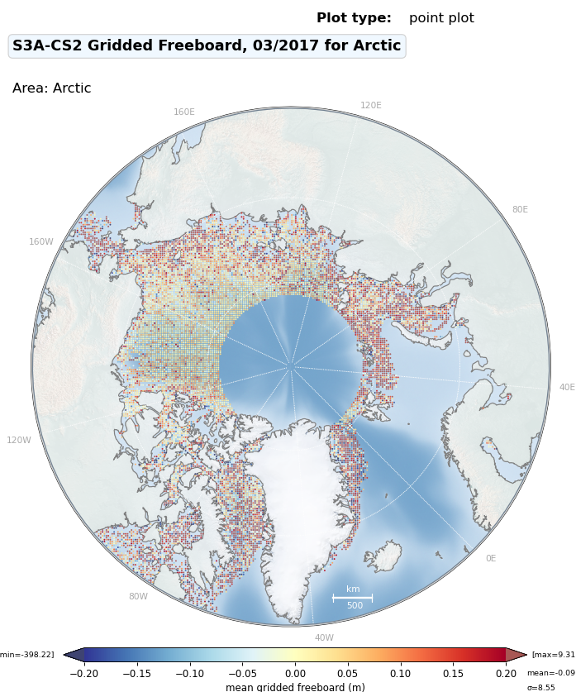
Gridded Freeboard Differences to CS2
T-IPF
IPF 6.18

Slide 19
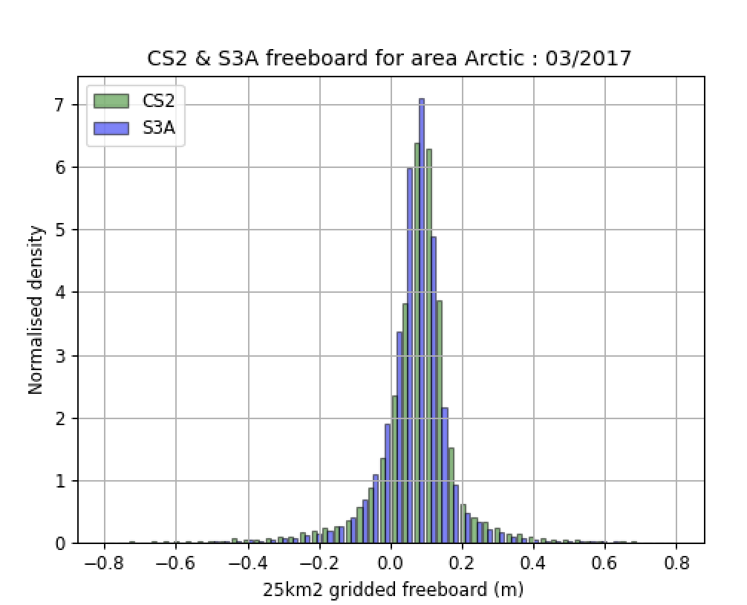
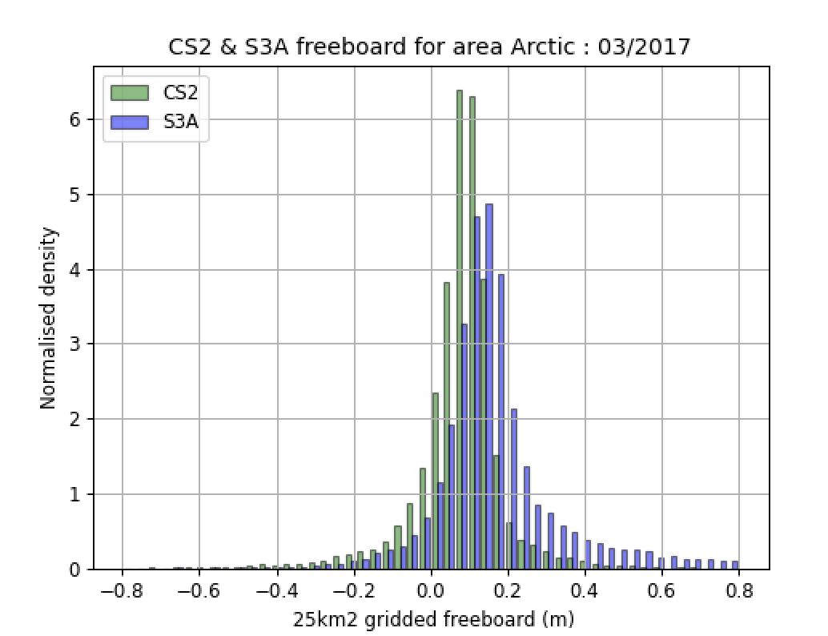
Histogram of Gridded Arctic Freeboard (March 2017):
CS2 , S3 Thematic TDS
CS2 , IPF_6.18
Notes:
./plot_combined_freeboard.py -f1 ~/fb2/cs2/2017/3/*.npz -f2 ~/fb2/s3a_ipf/s3a/2017/3/*.npz -o ~/fb2
./plot_combined_freeboard.py -f1 ~/fb2/cs2/2017/3/*.npz -f2 ~/fb2/s3a_thematic/s3a/2017/3/*.npz -o ~/fb2

Slide 20
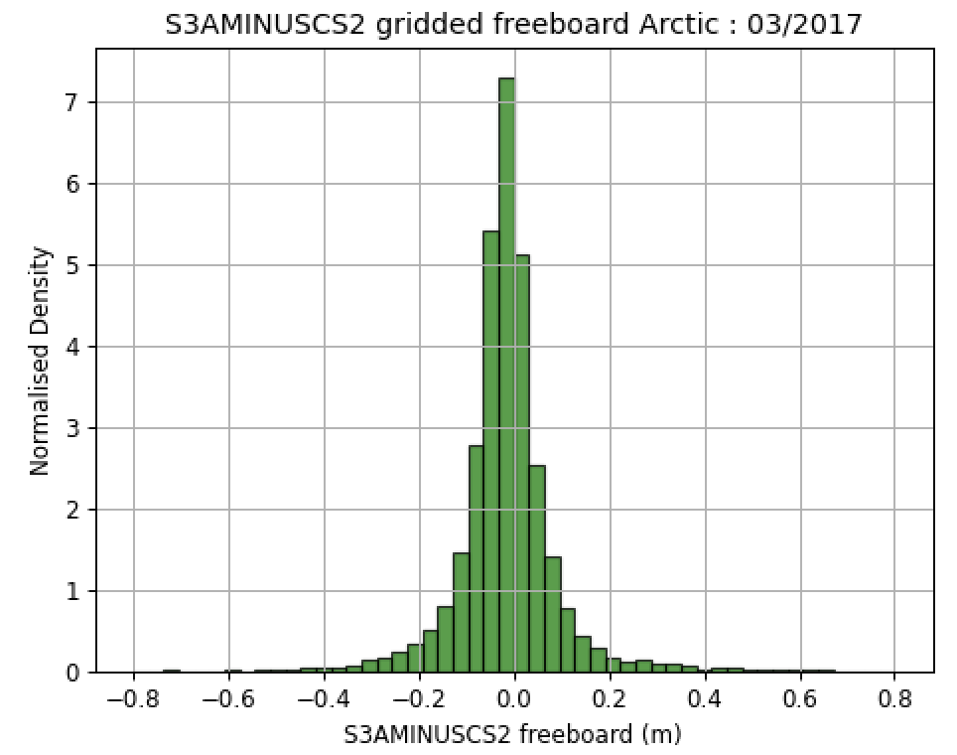
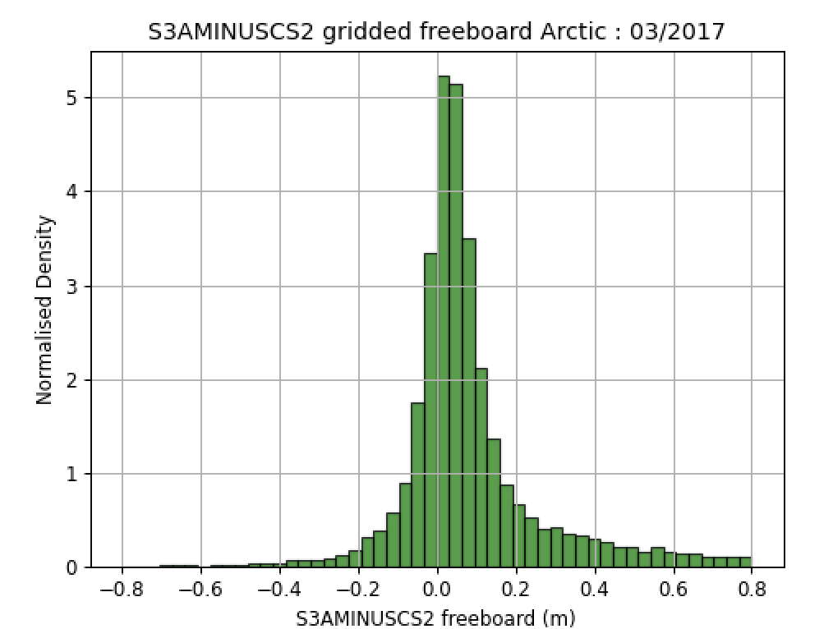
Gridded Arctic Freeboard
Differences to CryoSat-2: Mar 2017, Arctic (below 81.35N)
-1.8cm mean diff
6.9cm stdev
(S3A Thematic TDS – CS2)
-
(S3A IPF_6.18 – CS2)
+6.2cm mean diff
12.8cm stdev
-
Notes:
./plot_combined_freeboard.py -f2 ~/fb2/cs2/2017/3/*.npz -f1 ~/fb2/s3a_ipf/s3a/2017/3/*.npz -o ~/fb2 –diff
./plot_combined_freeboard.py -f2 ~/fb2/cs2/2017/3/*.npz -f1 ~/fb2/s3a_thematic/s3a/2017/3/*.npz -o ~/fb2 --diff

Slide 21
T-IPF Sea Ice Study Conclusions
Expected performance found with T-IPF 1-month TDS over sea ice
T-IPF maybe not processed equator to equator.
Hamming/Zero Padding appears to be applied.
Comparison done against same data from IPF 6.18 : would be better to use IPF 6.19
Missing Iono corrections are handled differently in T-IPF and IPF-6.18
Improved classification of echoes (9% less unclassified)
Sea ice concentration calculated correctly around coastline
24% more freeboard measurements in T-IPF
Good correspondence with CryoSat freeboard histogram for T-IPF (<2cm bias)
Further tuning of retracker bias, and discrimination parameters with whole Arctic winter and summer season of T-IPF data required to reduce bias to CryoSat-2 further.

