Slide 1
S3A/B STM L2 LAND products Product Performance Status
Pierre Féménias - ESA ESRIN
With contributions from the S3 Mission Performance Centre (S3 MPC)
S3 Mission Constellation Review #2 14 June 2021
VC

Slide 2
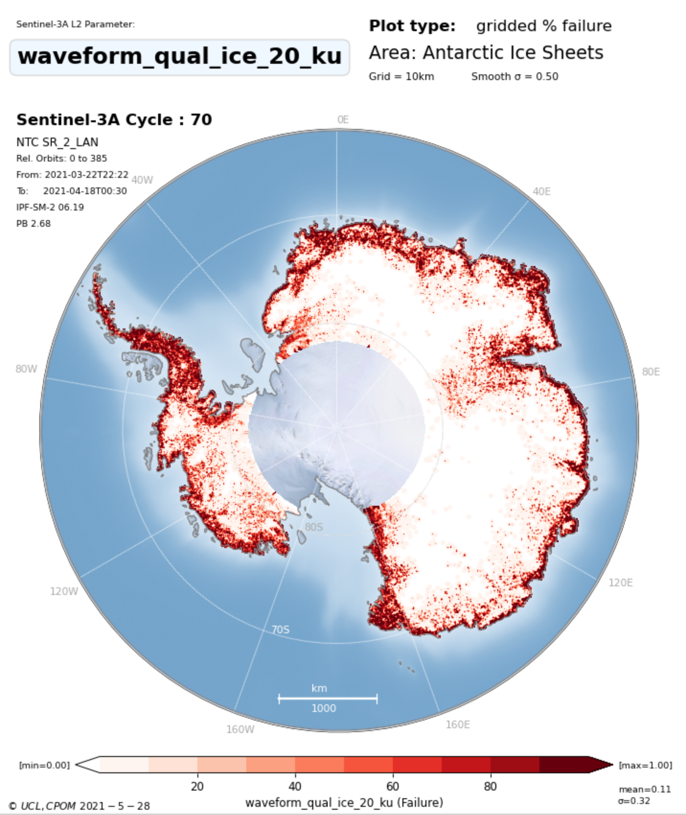
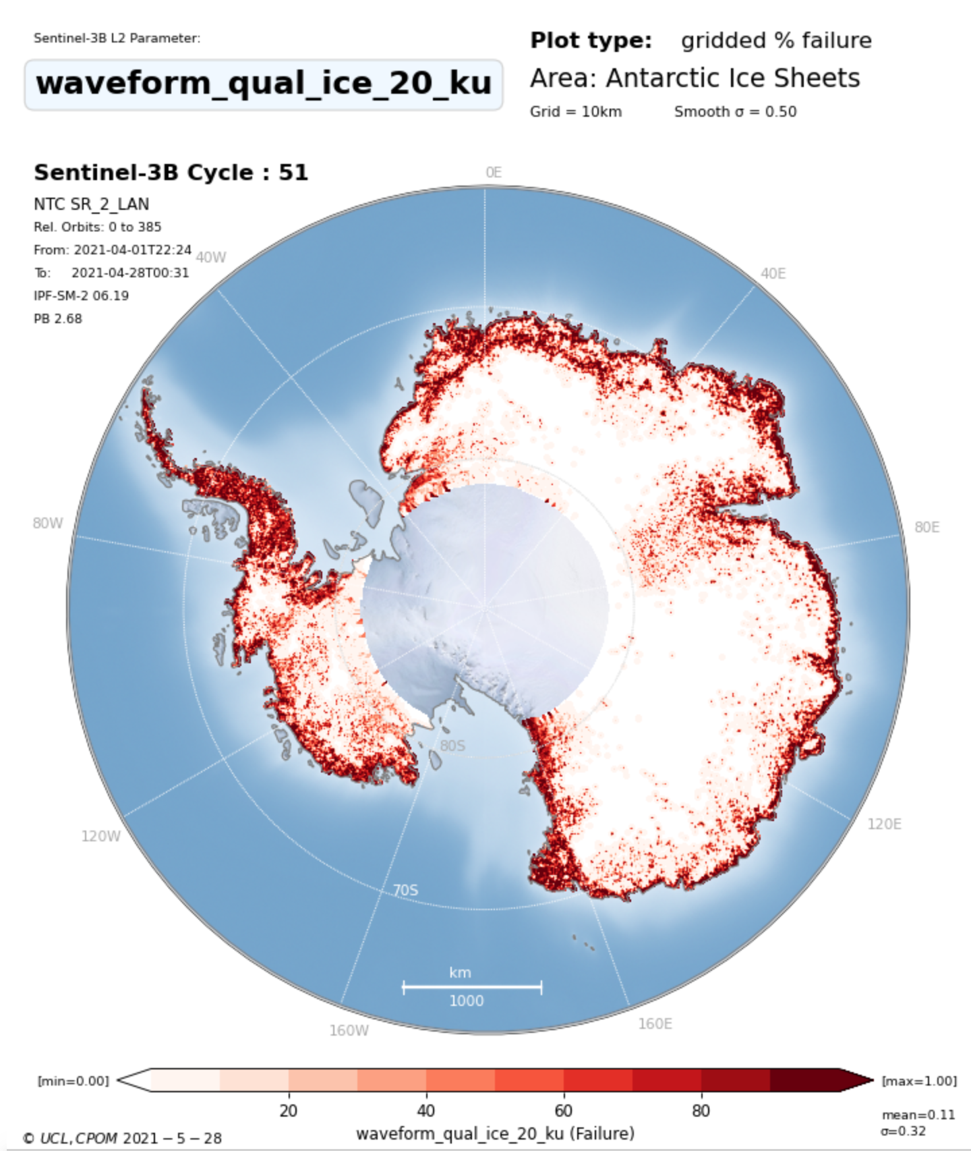
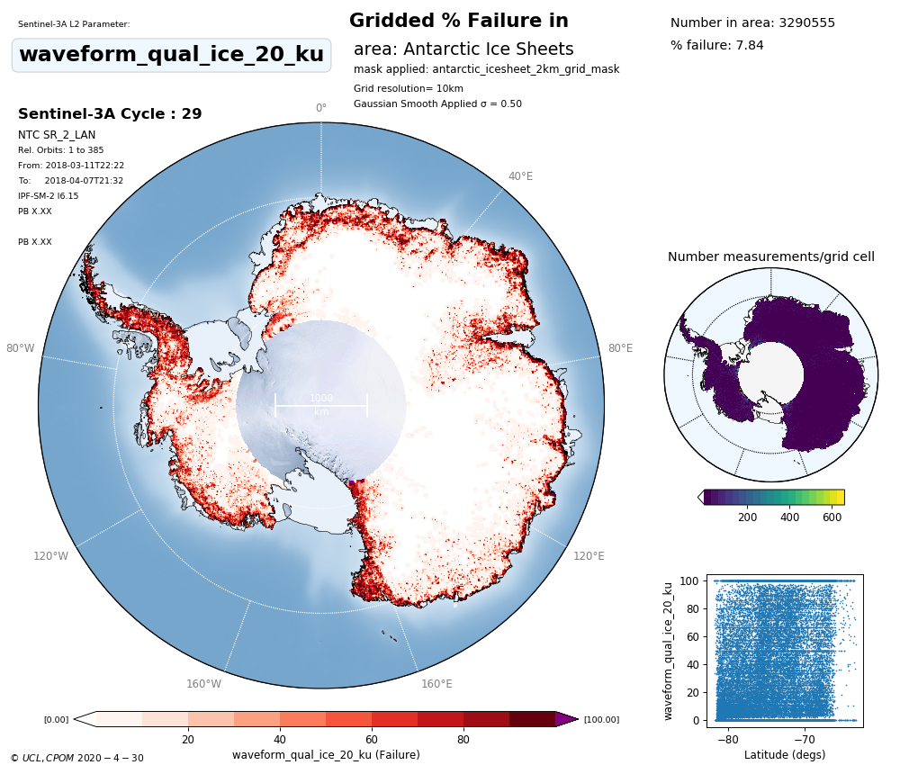
S3-A&B STM Land Ice Product Performance
Ice Sheet Measurement Quality
Prototype Processing equivalent to Thematic Products in 2021
100%
Measurement Failure
S3A
S3B
S3A
11.39% Failure
11.4% Failure
0%
7.8% Failure
Good measurement quality over ice sheet interior
Stable failure rate over mission (~11%) observed for both S3A/B satellites with expected high failure over the margins (areas of high slope).
Land Ice Thematic Prototype shows 3.6% improvement in measurement quality over the Antarctic ice sheet, and 11% improvement over the margins.
2

Slide 3
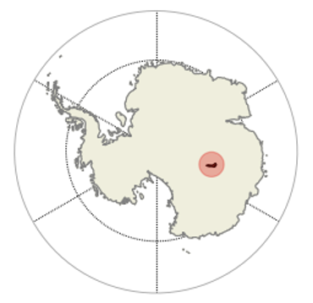
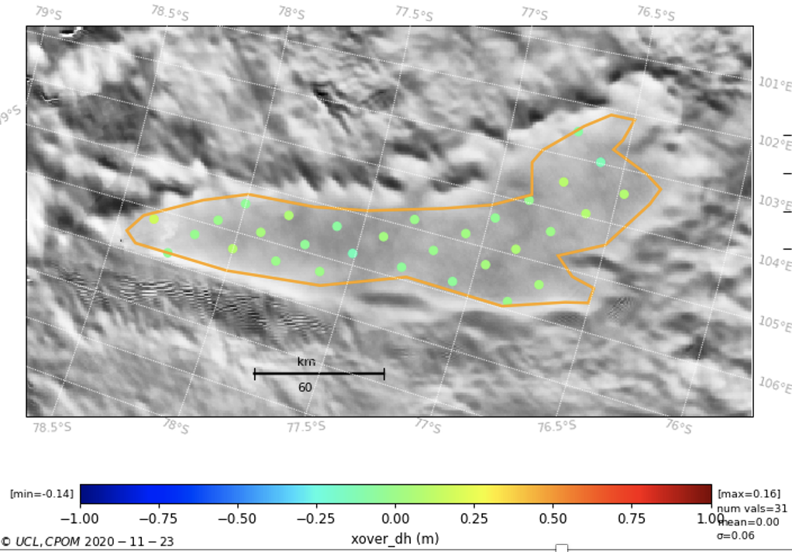
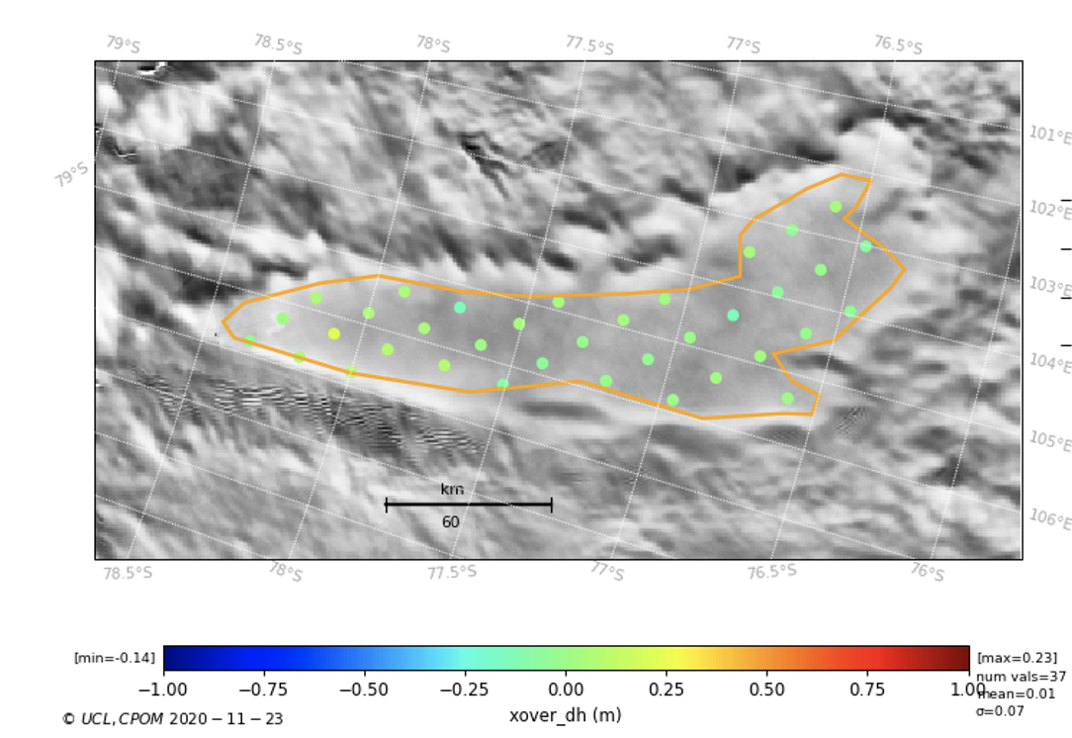
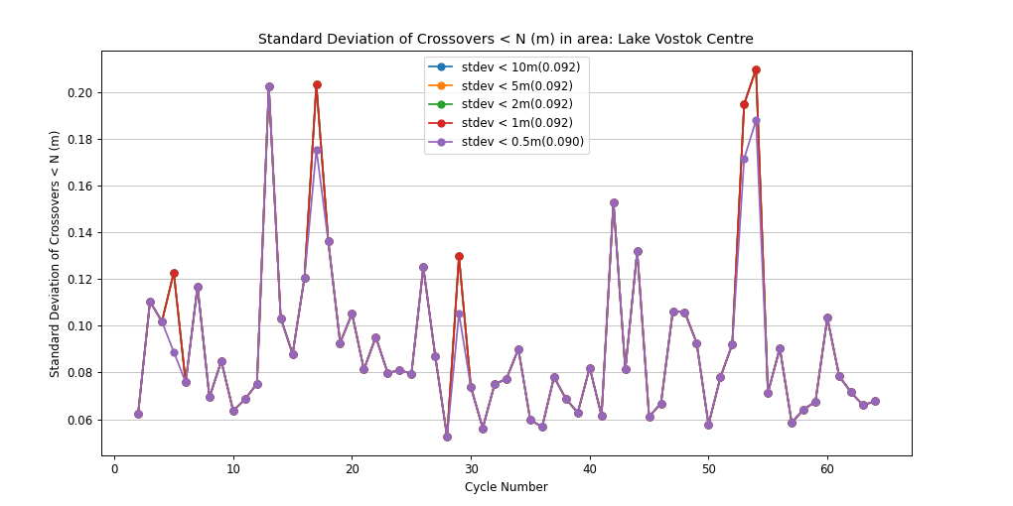
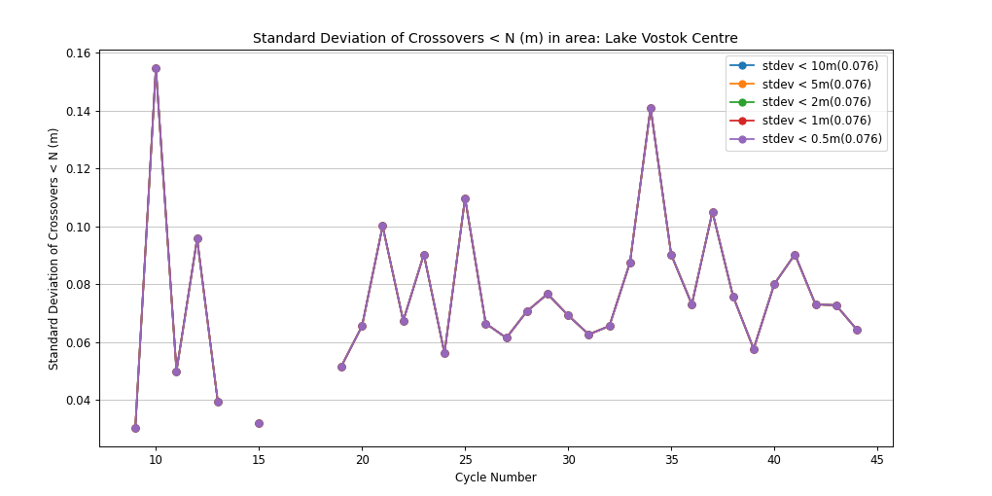
S3-A&B STM Land Ice Product Performance
Ice Sheet Precision over Low Slopes (Lake Vostok test site)
PB2.68
Precision over whole S3A Mission
10cm
S3A cycle 69
S3B cycle 51
Precision over whole S3B Mission
Mean diff: 0.01 σ=0.07m
Mean diff: 0.00 σ=0.06m
10cm
Crossover Elevation Differences over Lake Vostok
Over areas of low slope, mean S3A/B precision (measured using repeat elevation differences at orbit crossovers) is excellent at ~8cm (with expected seasonal variability)
Equivalent mean precision for CryoSat (LRM) is ~10cm
0.0m mean S3 difference indicates no polarization bias between ascending and descending tracks
3

Slide 4
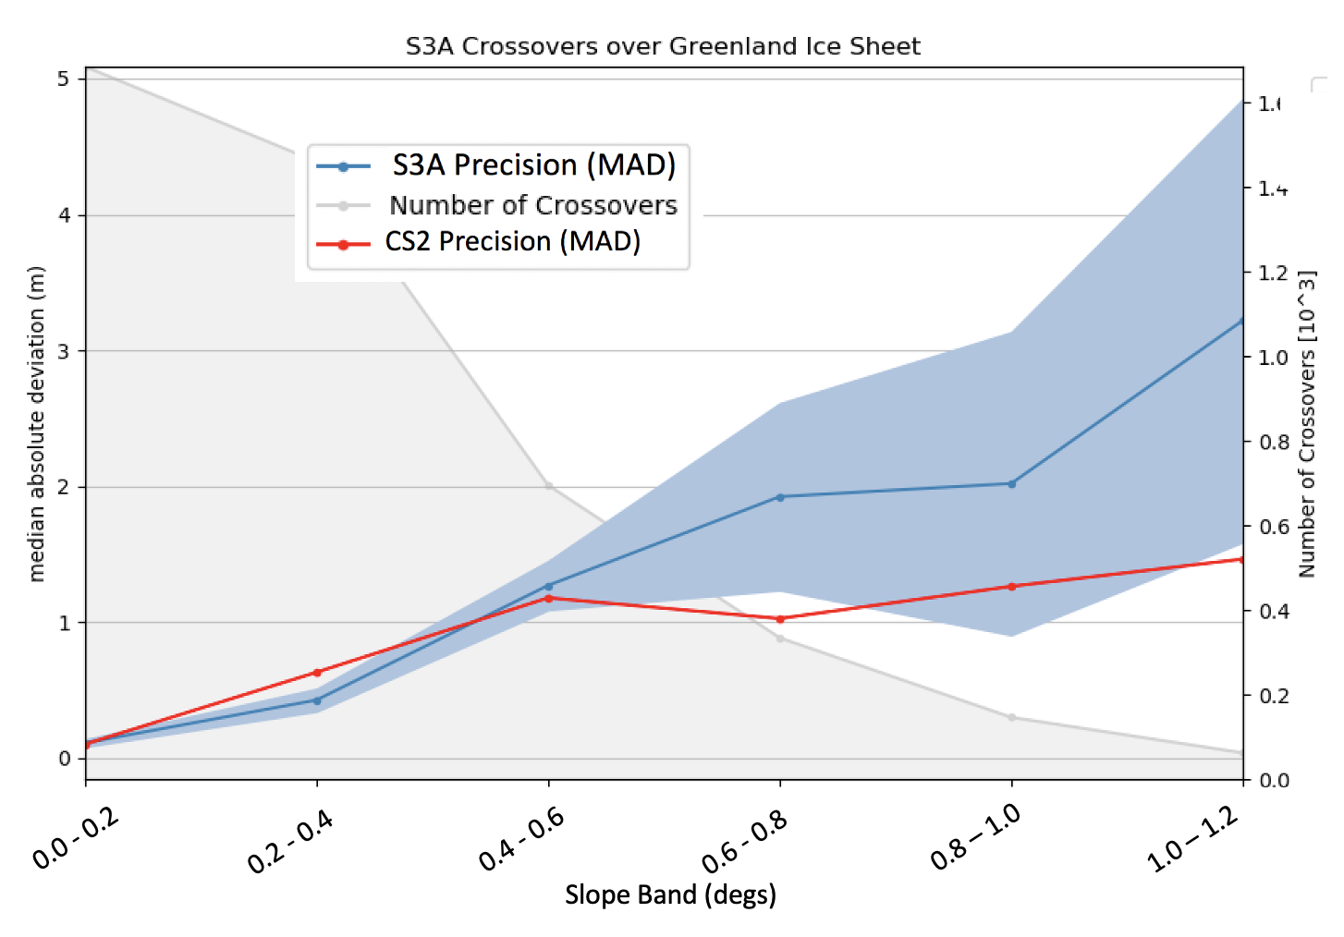
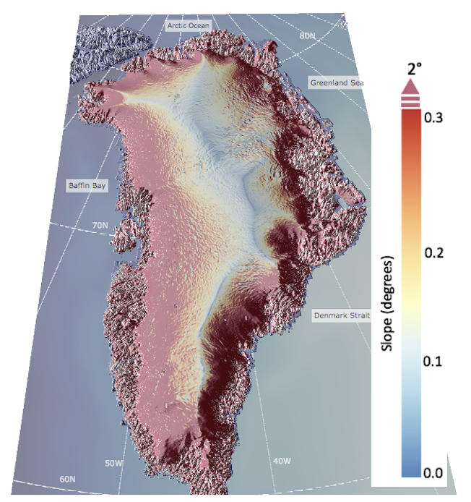
S3-A&B STM Land Ice Product Performance
Elevation Precision over the whole ice sheet measured per band of surface slope
Surface Slope of Greenland
S3A Precision per Slope Band
S3A/B precision of elevation decreases with surface slope as expected.
At lower slopes (< 0.4∘), S3A has equal or better precision than CryoSat.
At high slopes CryoSat’s SARin mode has better performance as expected. Future S3 slope model improvements can reduce this difference.
4

Slide 5
S3-A&B STM Land Ice Product Performance
S3^{AB} Slope Correction
Nadir track
PB2.61,2.68
% of Crossovers < 1m (improved with new slope model in PB2.61)
60%
A further slope model update is planned for 2021
50%
PB2.61,PB2.68
5

Slide 6
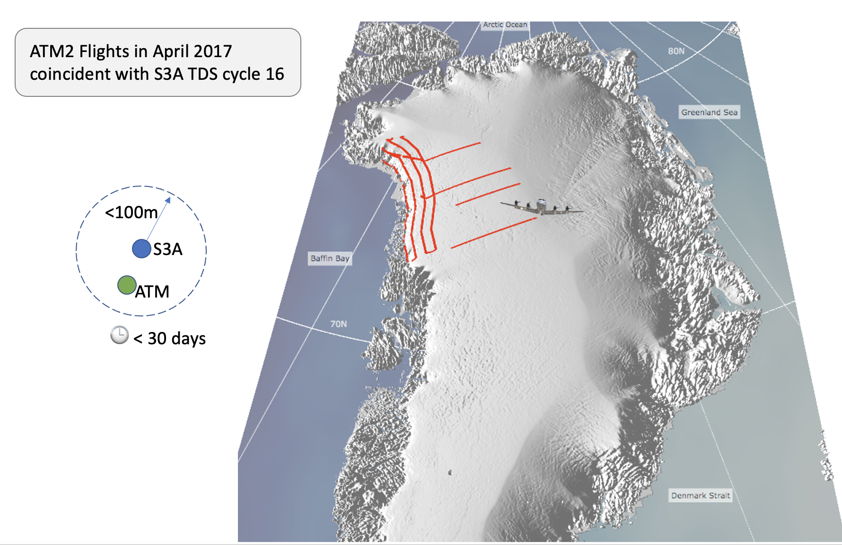
S3-A&B STM Land Ice Product Performance
S3A/B Ice Sheet Measurement Accuracy measured by Airbourne Laser*
*Operation IceBridge
Slope Band | S3A - Airbourne Median Absolute Diff (m)
0.0 to 0.1° | 0.08
0.0 to 0.2° | 0.10
0.2 to 0.4° | 0.87
0.4 to 0.6° | 3.69
Accuracy at low slopes is excellent.
Accuracy reduces with slope as expected.
6

Slide 7
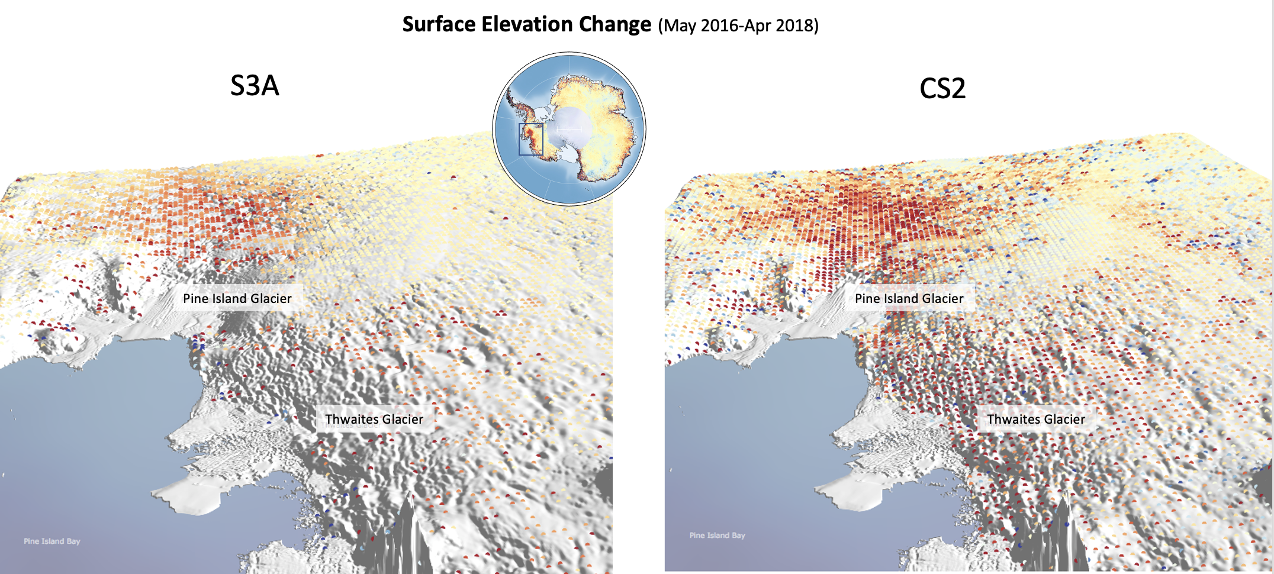
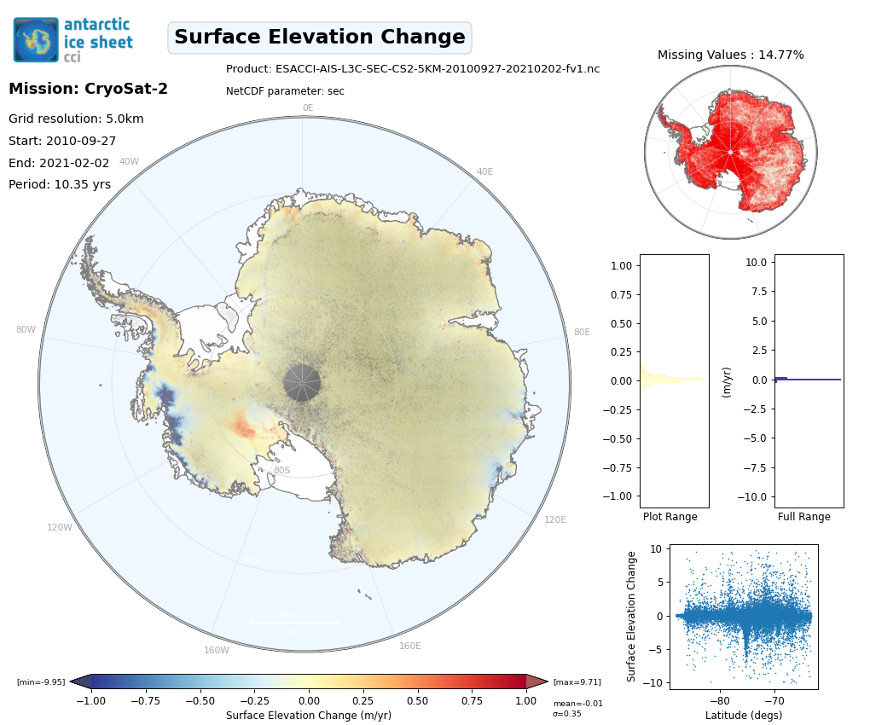
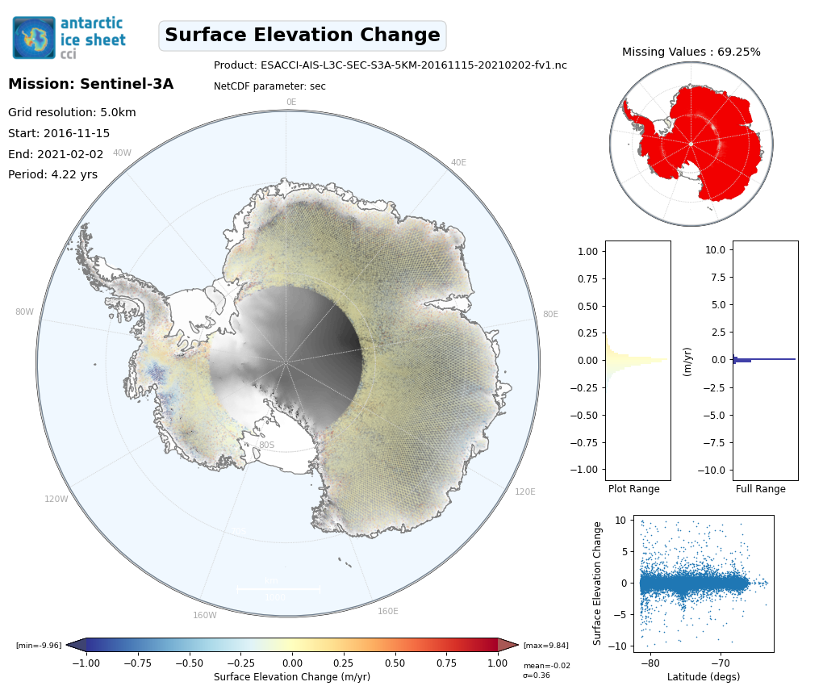
S3-A&B STM Land Ice Product Performance
CS2
S3A
Surface elevation change of critical Antarctic and Greenland Glaciers is now being successfully measured by S3A and S3B.
After cross-calibration it is merged with CryoSat data in new ESA CCI ice sheet products to improve coverage and reduce uncertainty.
7

Slide 8
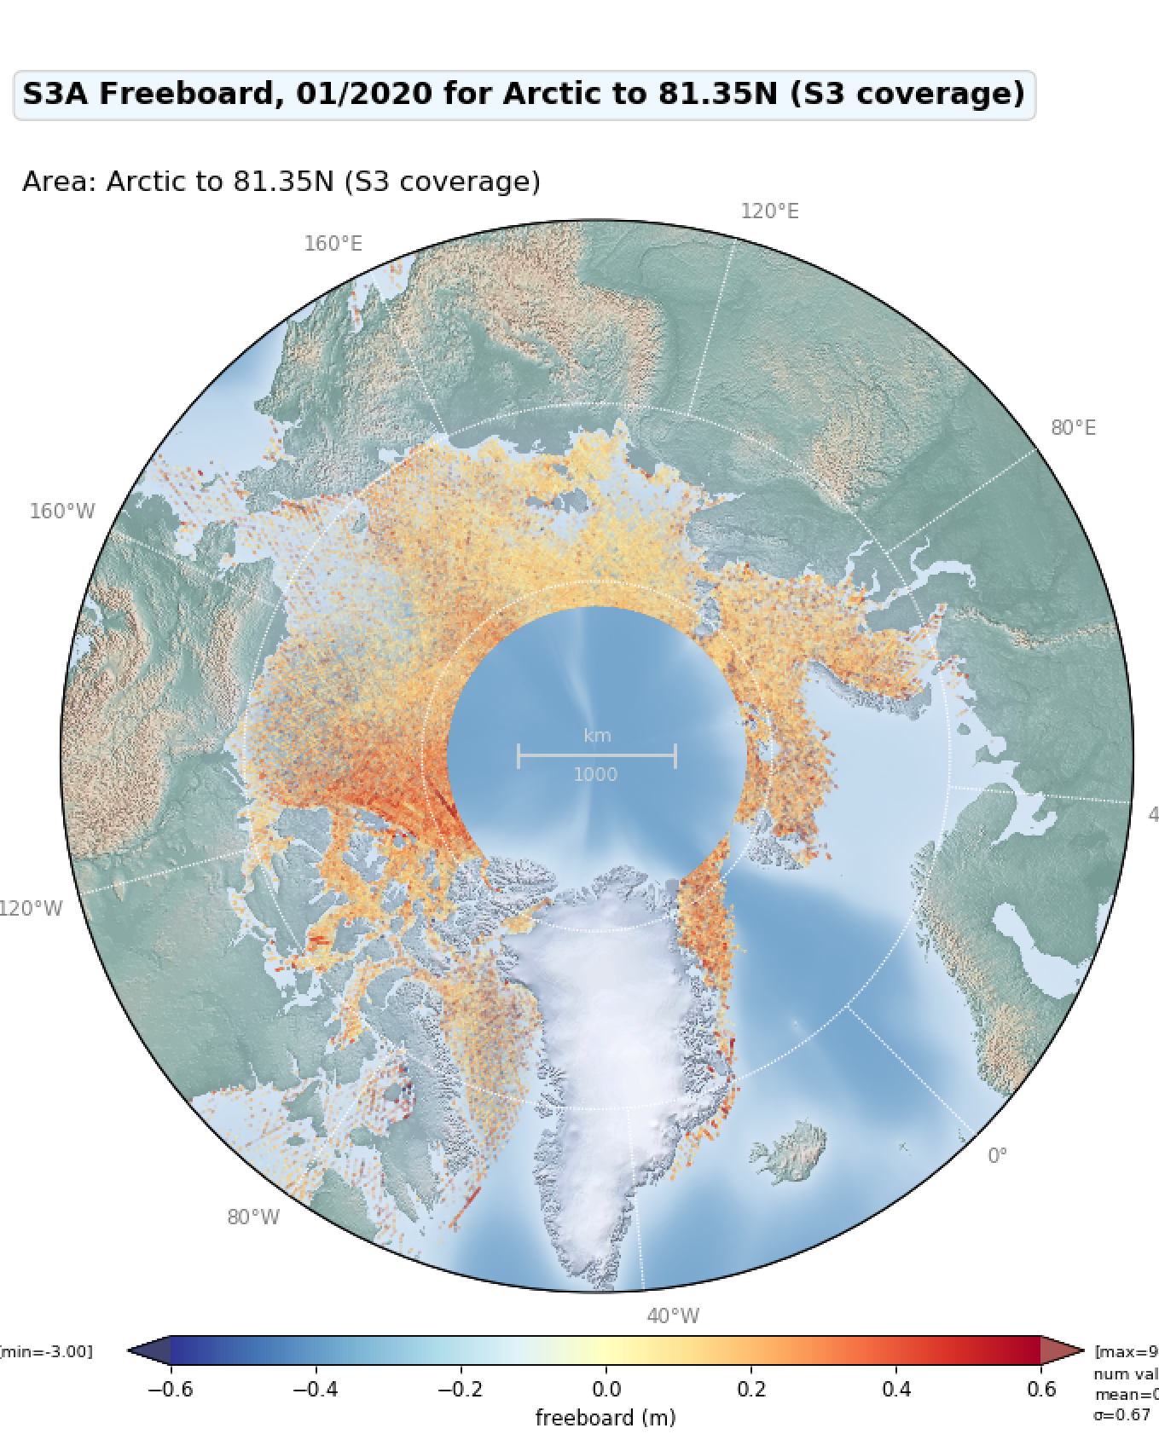
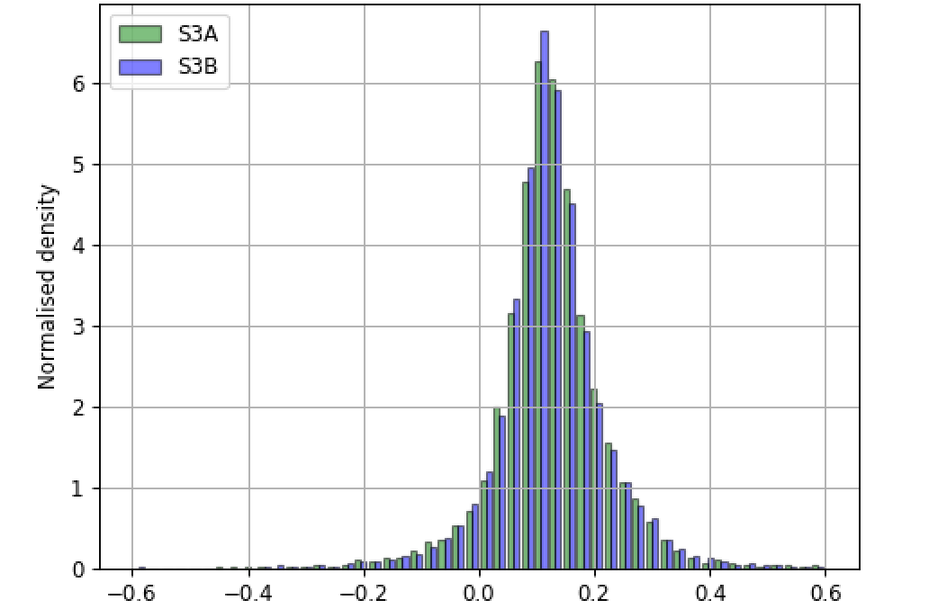
S3-A&B STM Sea Ice Product Performance
Freeboard
Jan 2020
S3A and S3B Arctic Freeboard
S3A
S3B
Near identical freeboard from S3A & S3B S3A& B have different ground tracks so minor differences expected.
Jan 2020
8

Slide 9
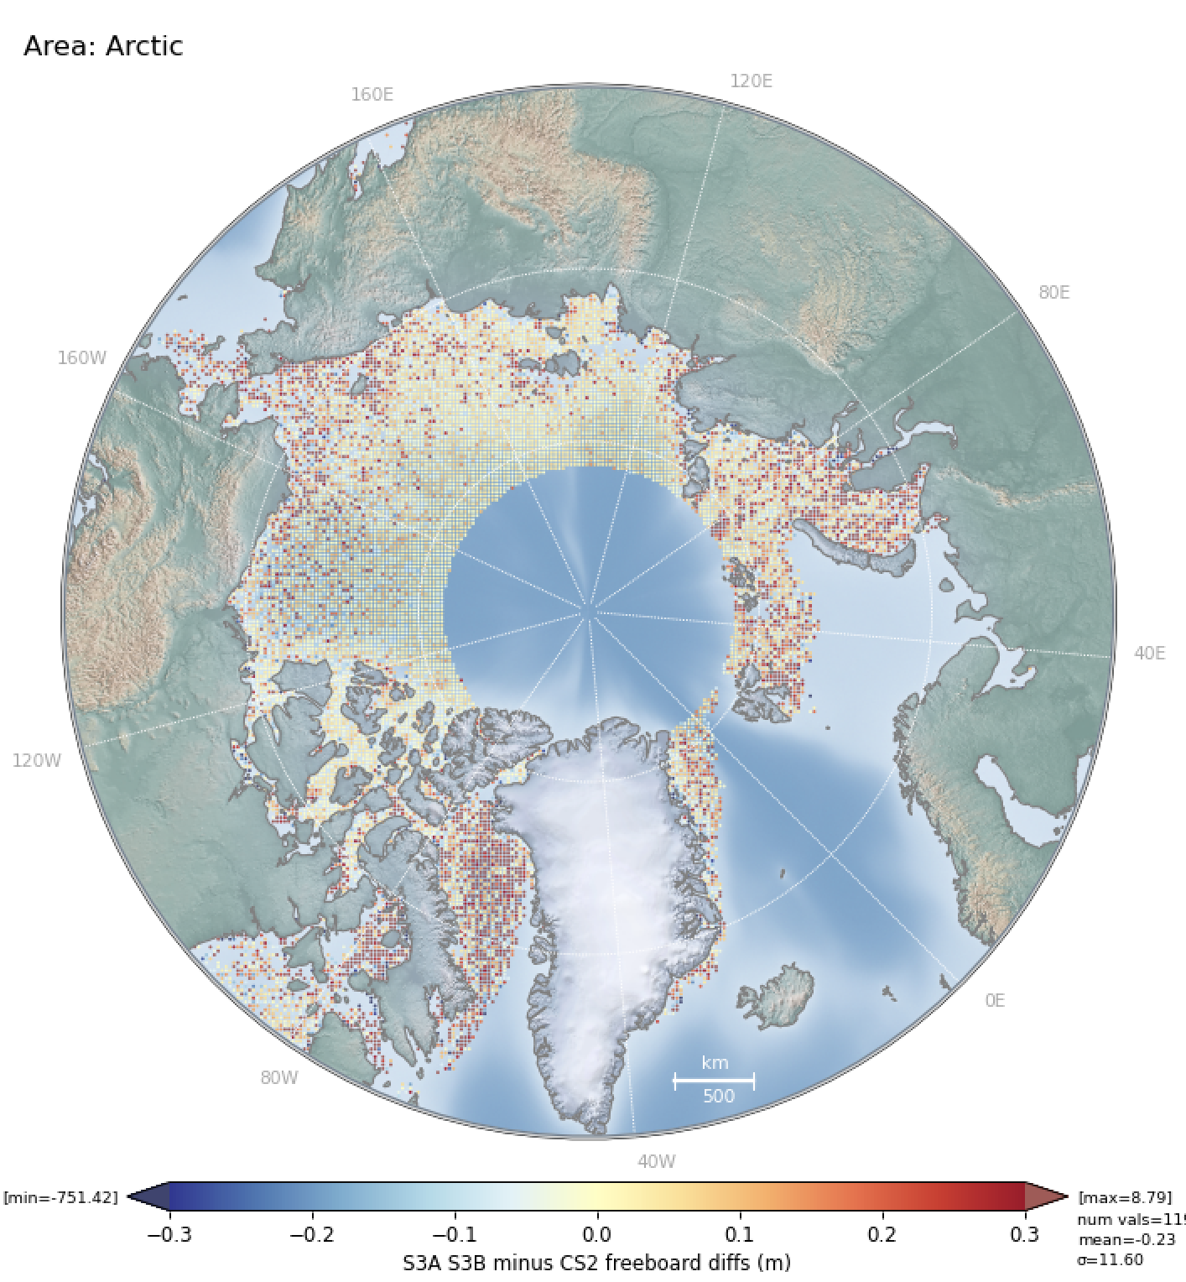
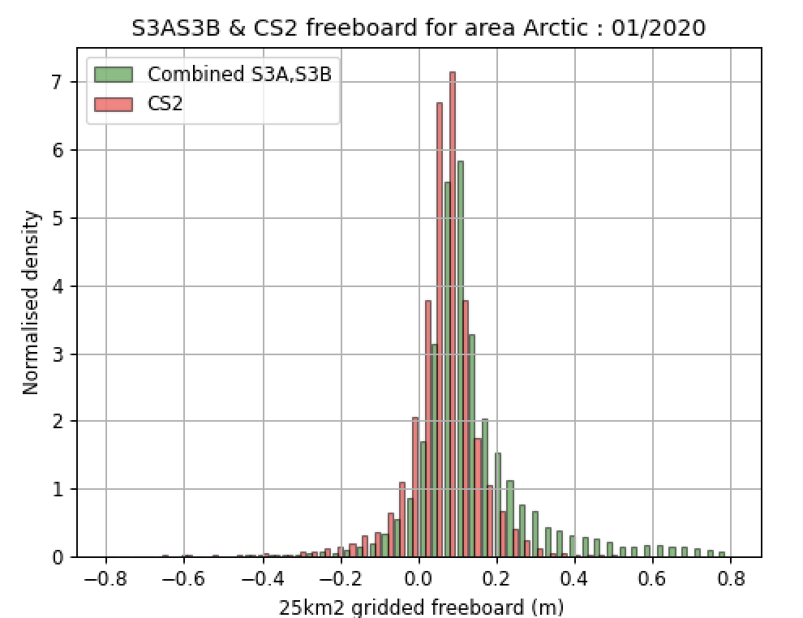
S3-A&B STM Sea Ice Product Performance
S3^{AB-}CryoSat-2 Gridded Mean Freeboard
S3^{AB} from PB2.68 have a higher distribution of mean freeboard compared to CS2, with larger differences near the coastline
Mean difference is 4cm
9

Slide 10
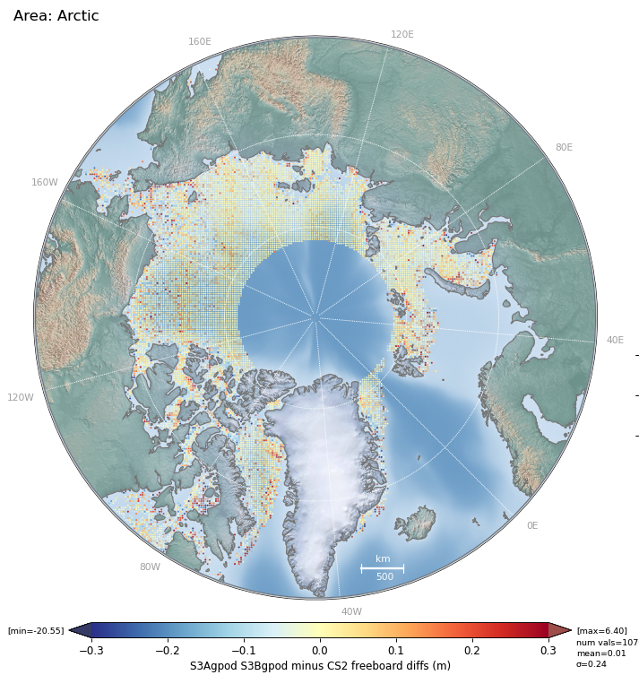
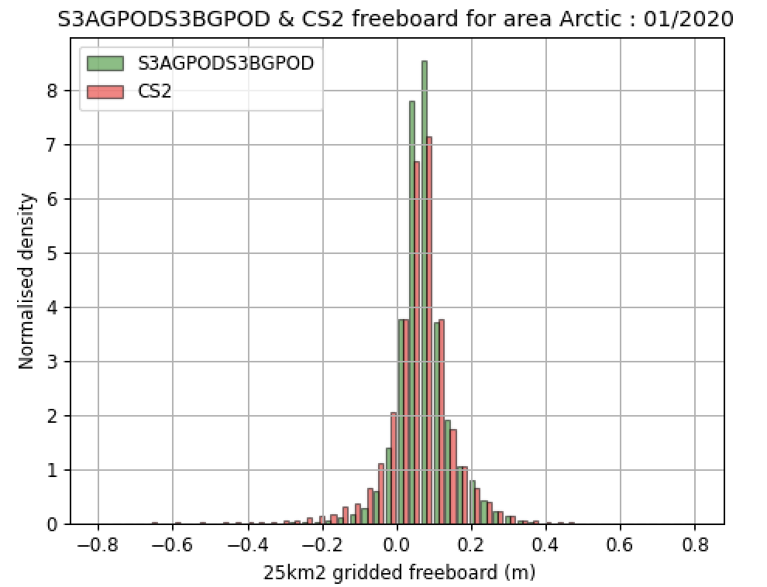
S3-A&B STM Sea Ice Product Performance
S3^{AB Thematic Equivalent-}CryoSat-2 Gridded Mean Freeboard
S3^{AB} freeboard processed by GPOD with a configuration similar to the thematic S3 sea ice product has a near identical performance to CryoSat.
Mean difference is < 1cm.
10

Slide 11
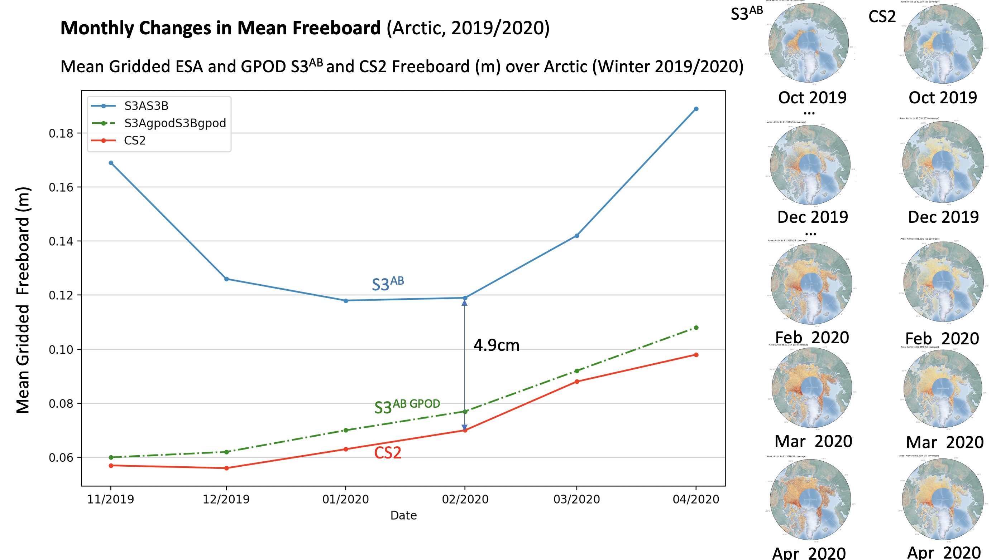
S3-A&B STM Sea Ice Product Performance
S3^{AB} processed with thematic configuration tracks CS2 freeboard over Arctic winter season, whereas
current IPF freeboard has significant divergence

