Slide 1
S3 MPC S3 Performance over Sea Ice
Alan Muir^{1,2}, David Brockley¹ , Steve Baker¹, Isobel Lawrence³
¹Mullard Space Science Laboratory (MSSL), University College London (UCL), UK. ² Centre for Polar Observation and Modeling (CPOM), UCL, UK.
³ University of Leeds (CPOM),UK
S3 Mission Performance Centre, ESL for Ice Surfaces
ESL STM Council Meeting #8 – Nov 2021

Slide 2
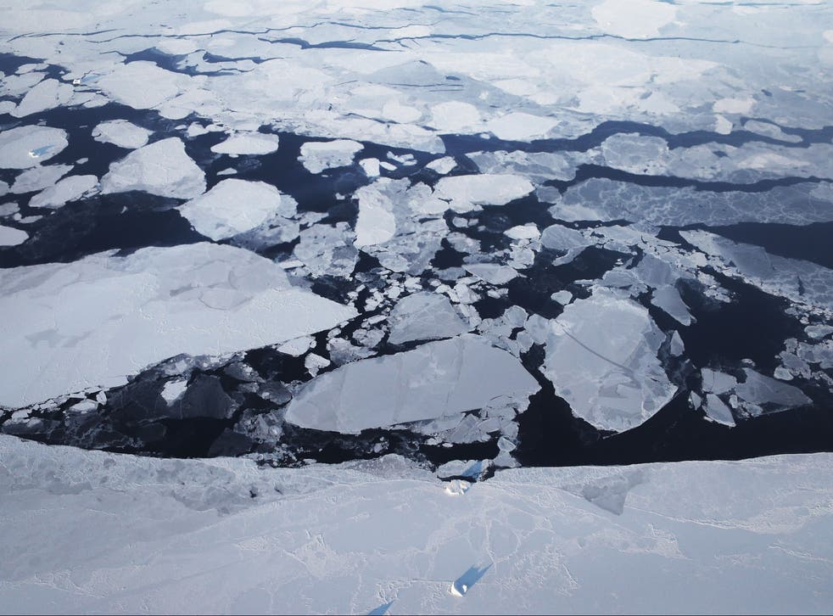
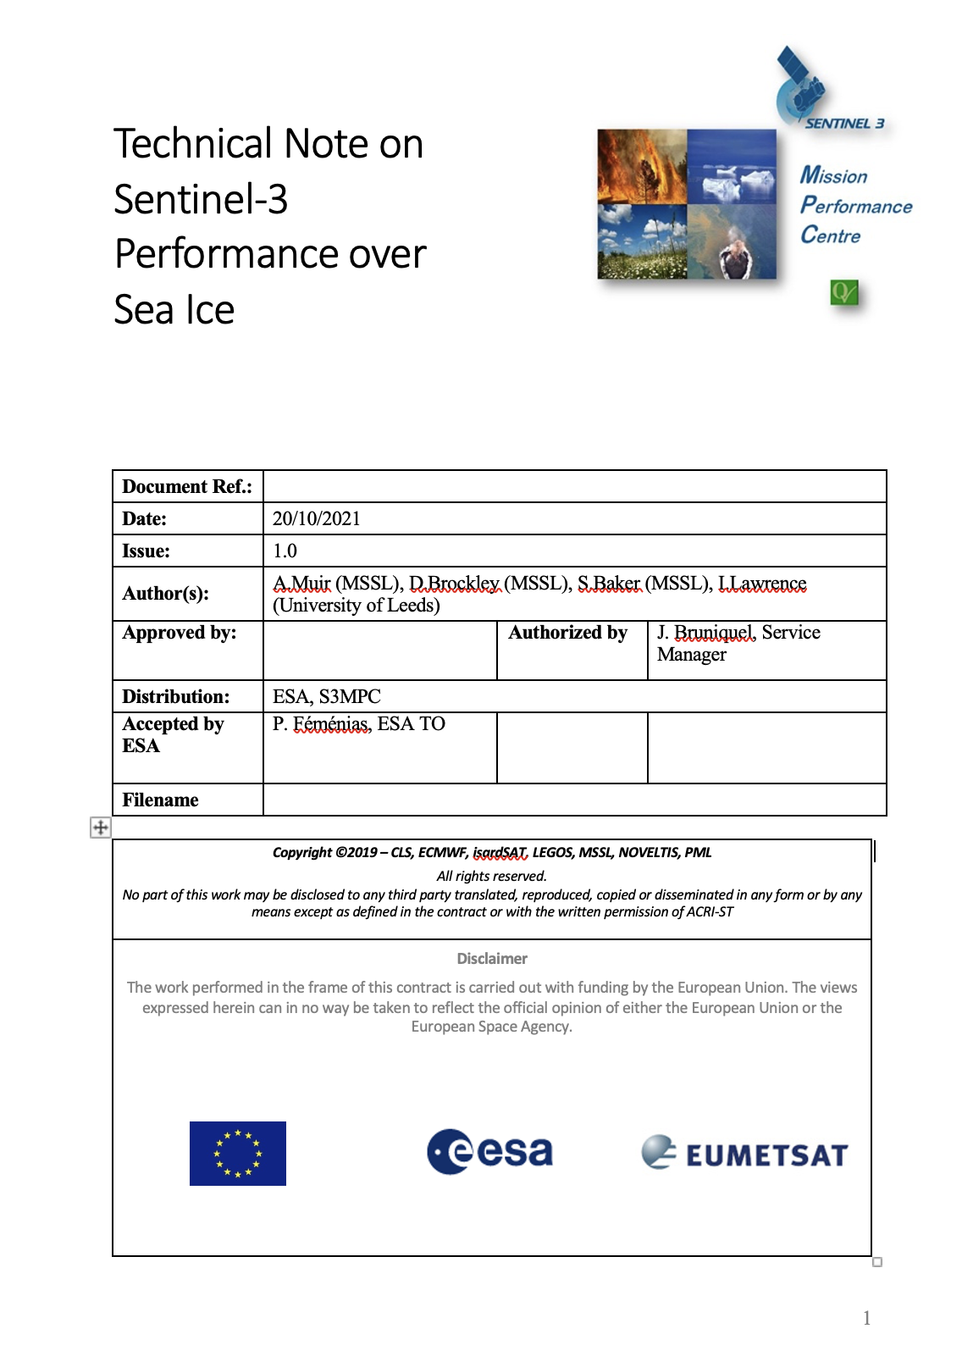
S3 Sea Ice Performance
Technical Note on Sea Ice Performance delivered on 22-Oct-21
Details performance of latest operational products (PB2.68)
Does not include future performance of Thematic products
Baseline to measure against future products

Slide 3
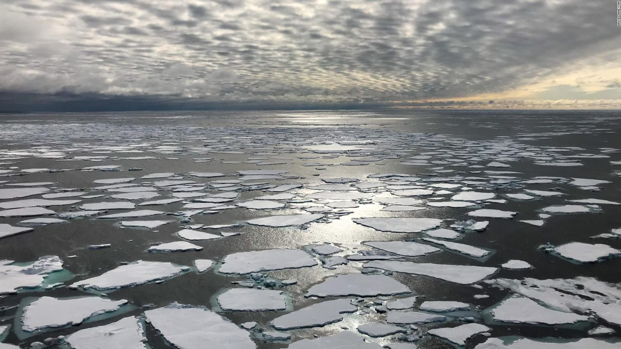
S3 Freeboard Measurement Coverage
Using available L2 data from <= PB 2.68

Slide 4
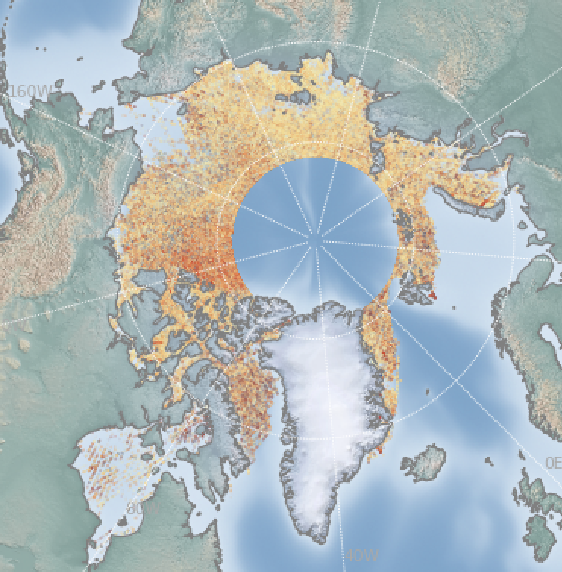
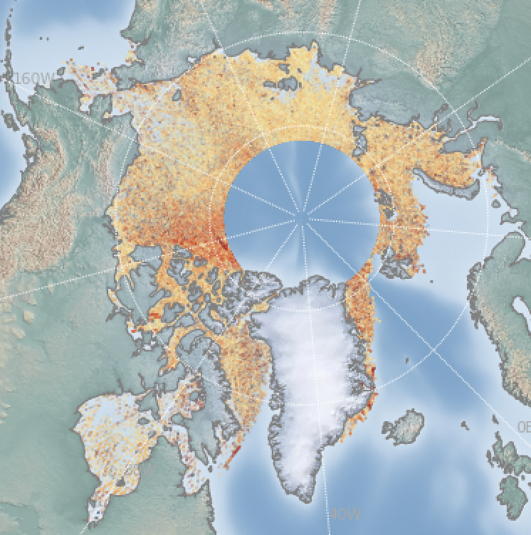
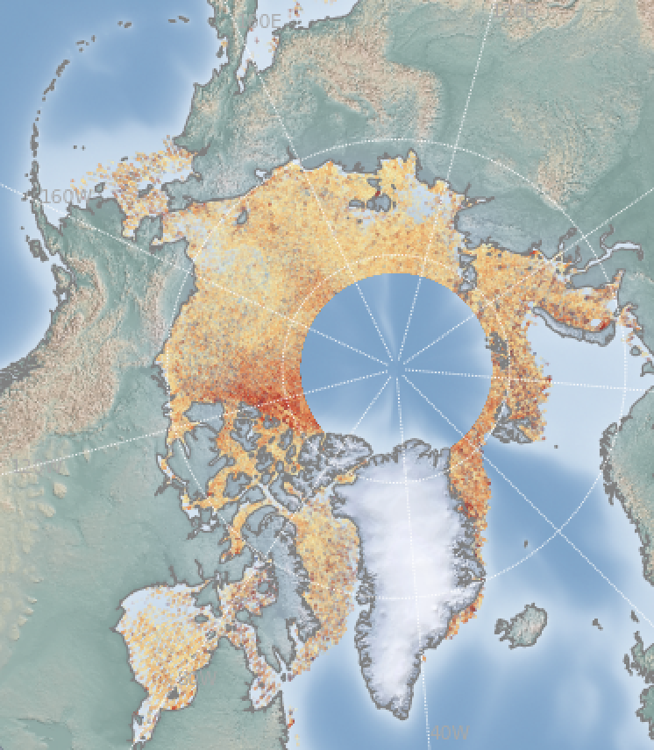
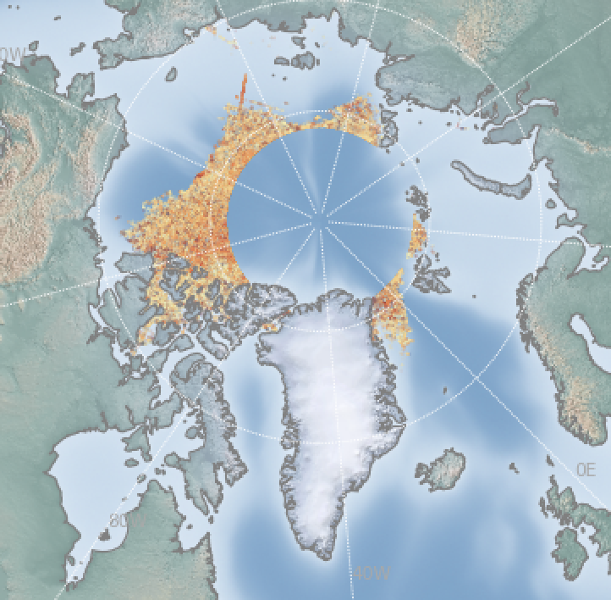
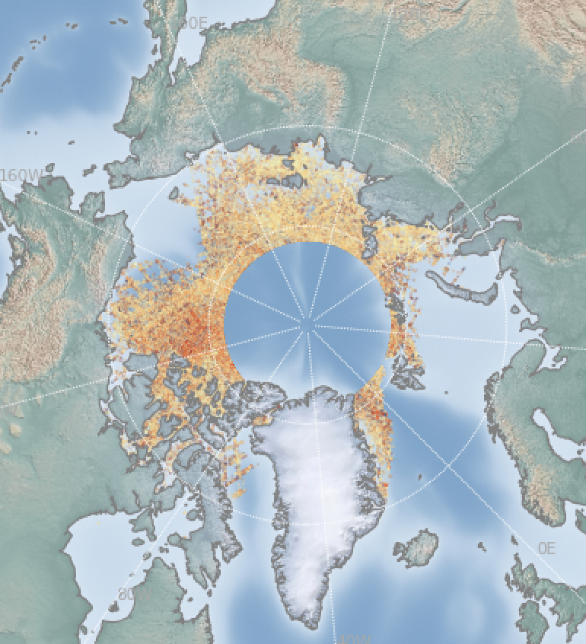
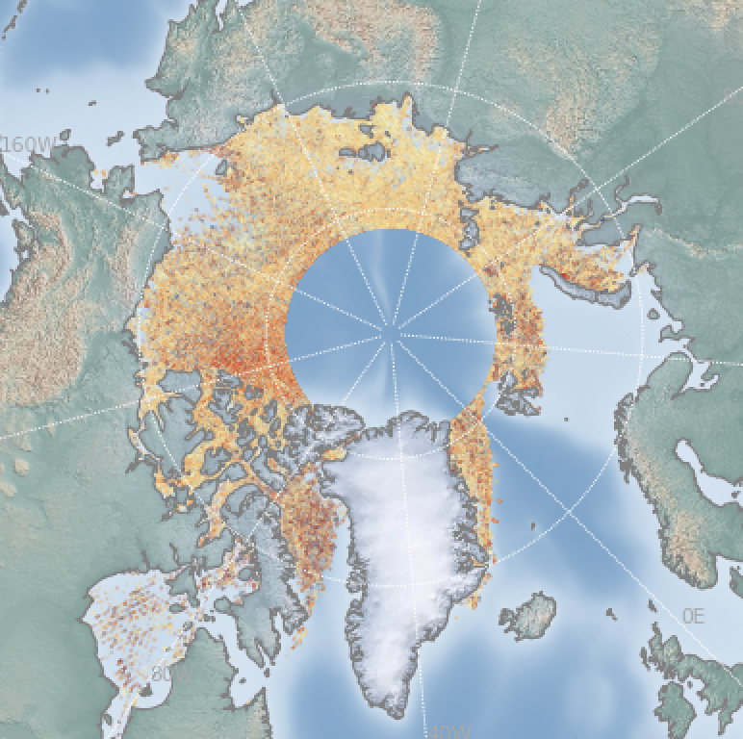
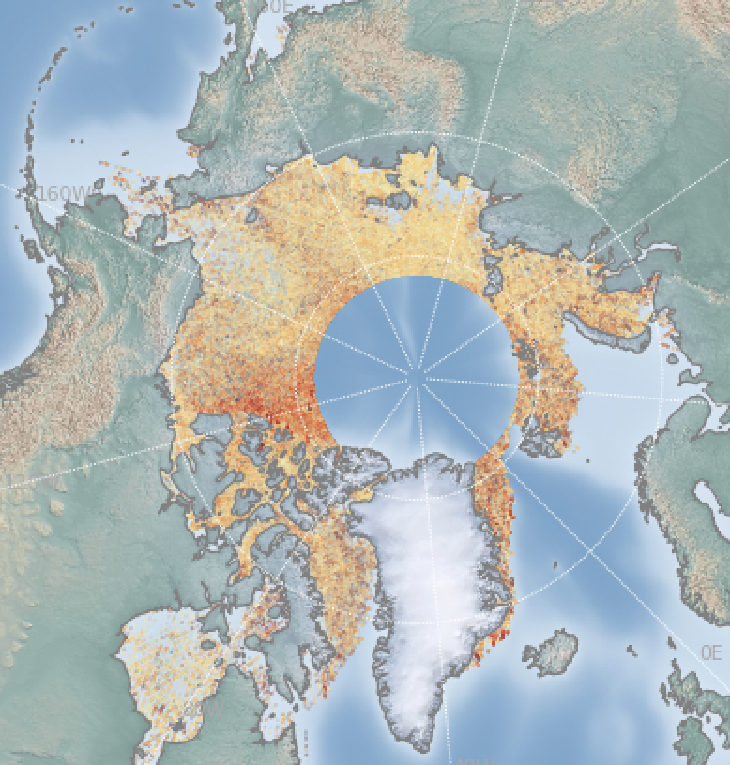
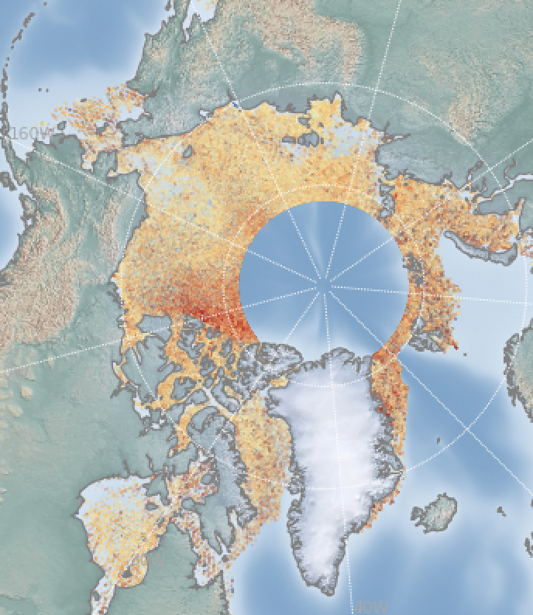
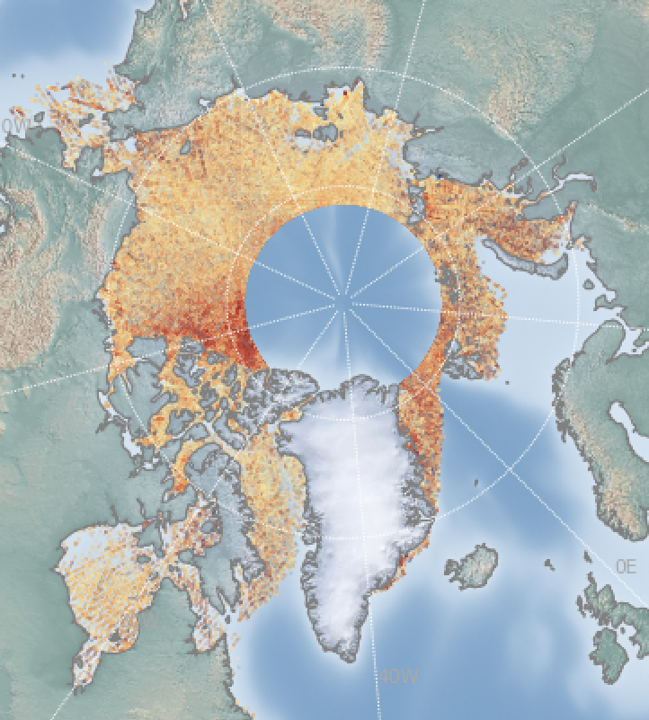
S3 Freeboard Coverage: Arctic Seasonal Variability
S3A
S3B
NSIDC Sea Ice 15% Extent
Passive Microwave
Oct 2019
Nov 2019
Dec 2019
Jan 2020
Feb 2020
Mar 2020

Slide 5
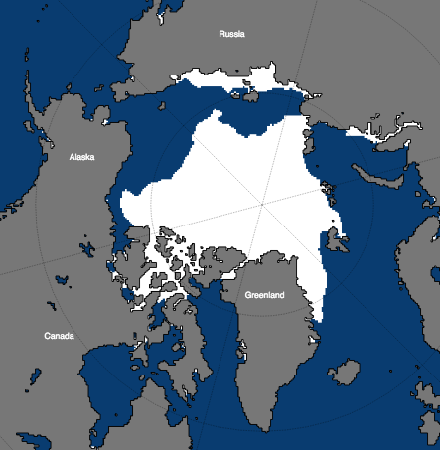
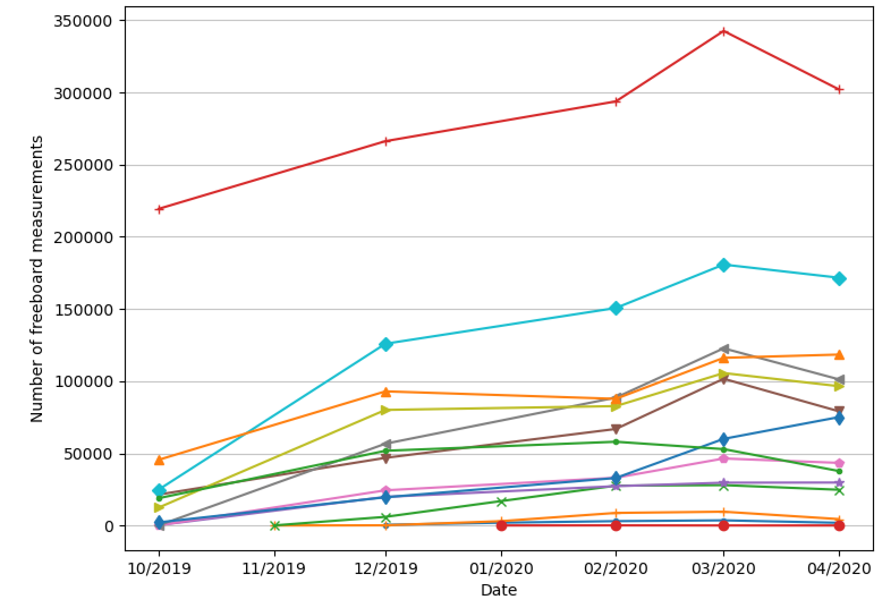
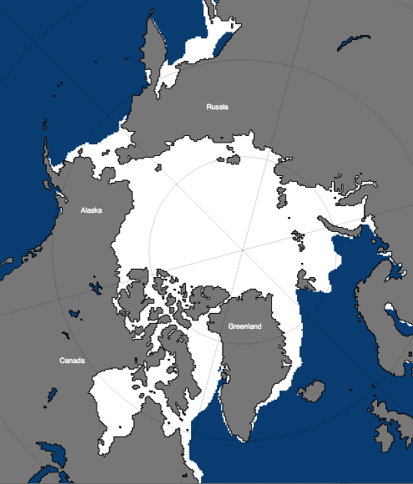
Regional Freeboard Statistics
Winter 2019/2020
NSIDC Sea Ice Extent
S3A
Monthly Number of S3A Freeboard Measurements per Arctic Basin
Central Arctic
Oct 2019
East Siberian Sea
Apr 2020
Kara Sea
Beaufort Sea
E. Greenland Sea
Chukchi Sea
Laptev Sea
Canadian Islands
Hudson Bay
Bering Sea
St John’s, Gulf of St Lawrence
Notes:
plot_fb_stats_multibasin.py -v nvals -m s3a -g -r nsidc

Slide 6
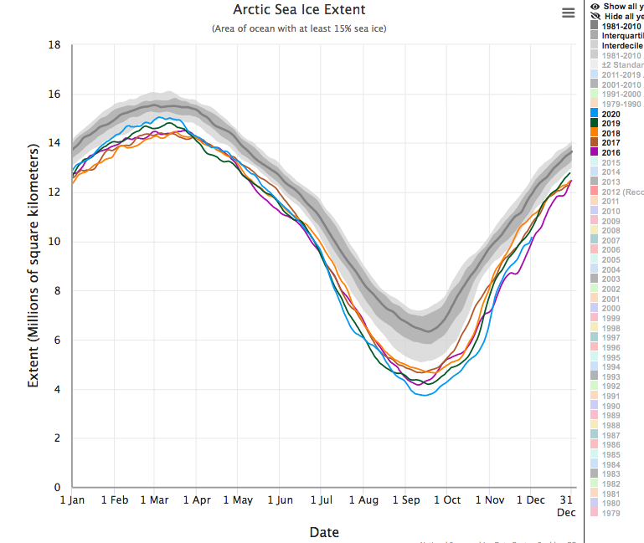
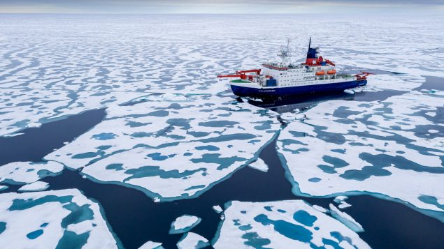
Annual Arctic Sea Ice Extent (NSIDC) : 2016-2020
Melt Ponds in the Sea Ice
peak extent in mid-March
Aug 2020, Polarstern, photo: AWI

Slide 7
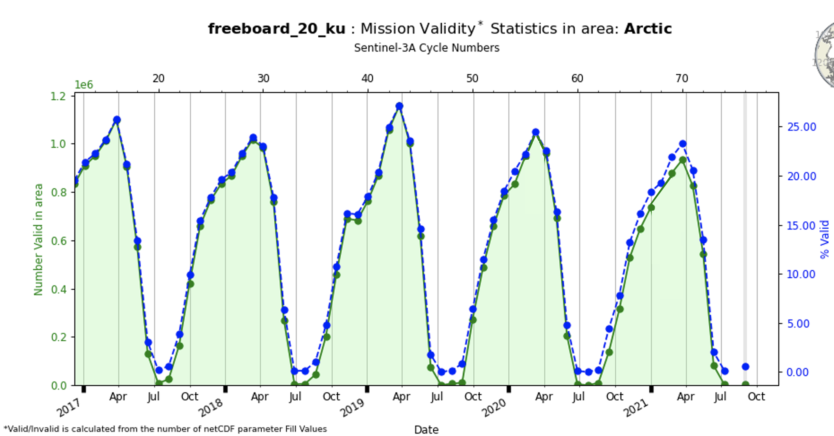
Seasonal Arctic Freeboard Availability
S3A
Peak coverage Mid-March

Slide 8
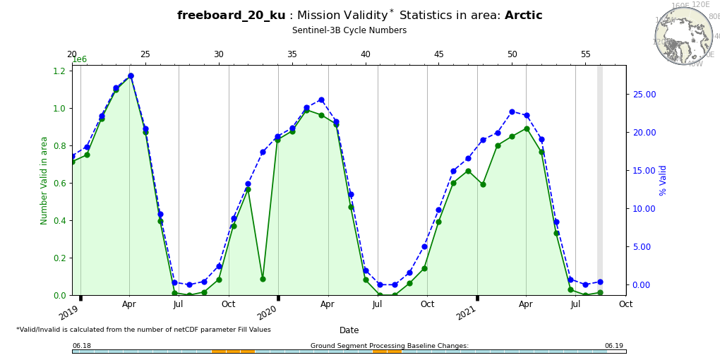
Seasonal Arctic Freeboard Availability
S3B
Peak coverage Mid-March

Slide 9
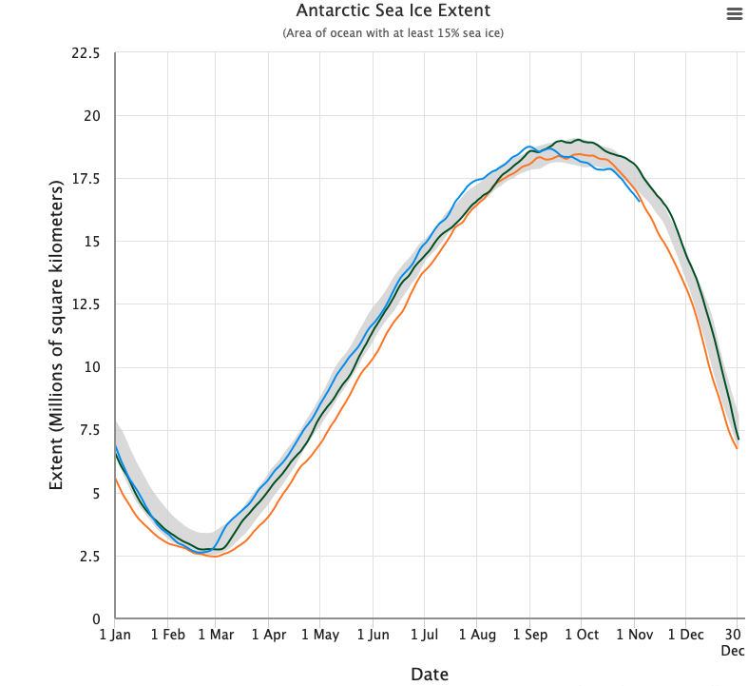
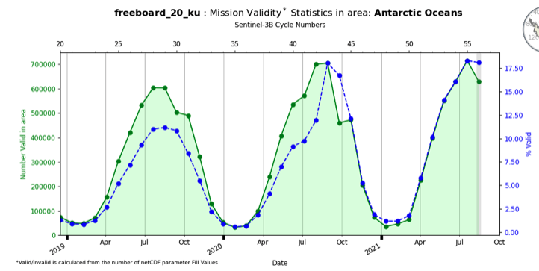
Seasonal Antarctic Freeboard Availability
NSIDC
2019
2020
2021
S3B
Maximum extent: October
Maximum coverage: August
S3 maximum freeboard coverage lags maximum sea ice extent by ~2months

Slide 10
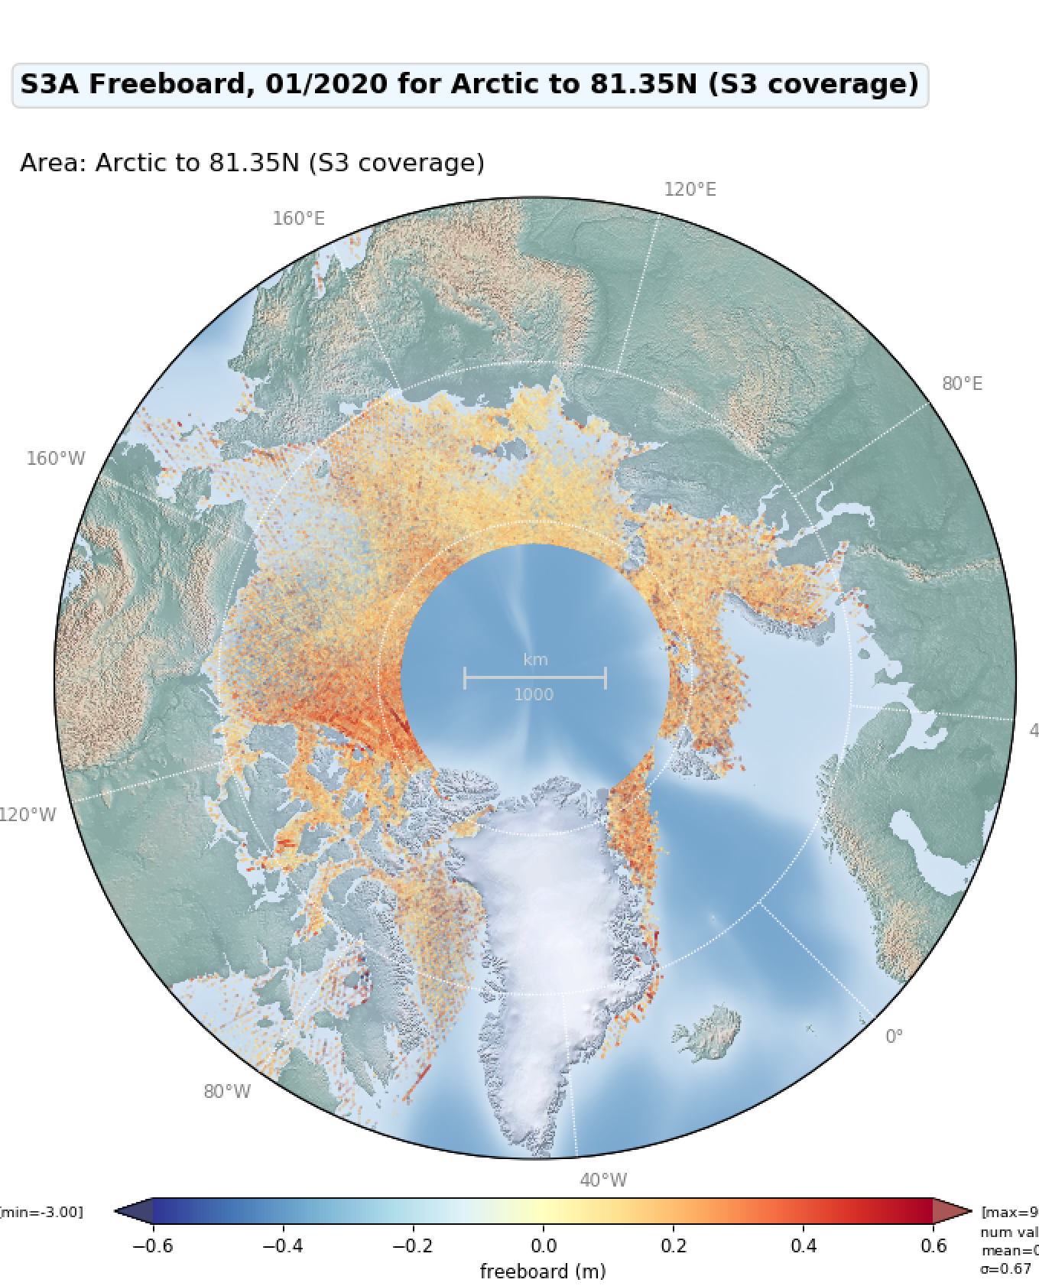
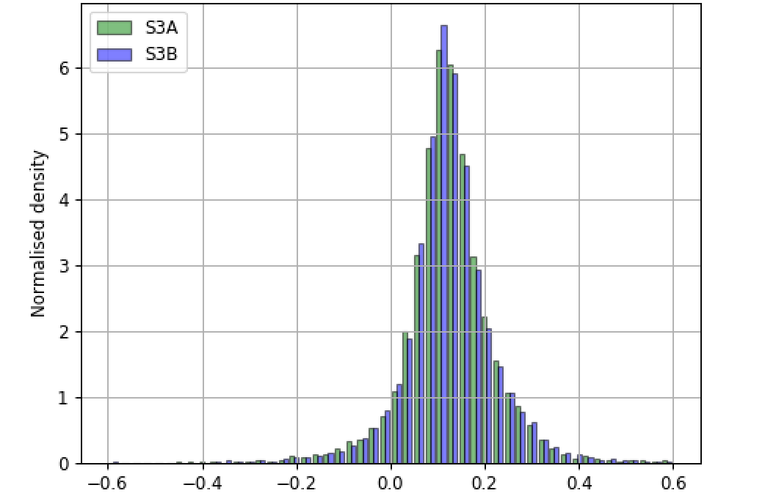
S3A and S3B Freeboard Comparison
Jan 2020
S3A
S3B
Freeboard (m)

Slide 11
Measurement Precision over Sea Ice
Using available L2 data from <= PB 2.68
?
Sea ice floe
Lead
?

Slide 12
Precision measured over very thin ice in Hudson Bay (as per Tilling et al) and compared with CS2
Mission | SLA SD over Leads | SLA SD over Floes
S3A | 12.5 | 11.4
CryoSat-2 | 4.1 | 9.8
S3A lead SHA precision ~3x worse than CS2

Slide 13
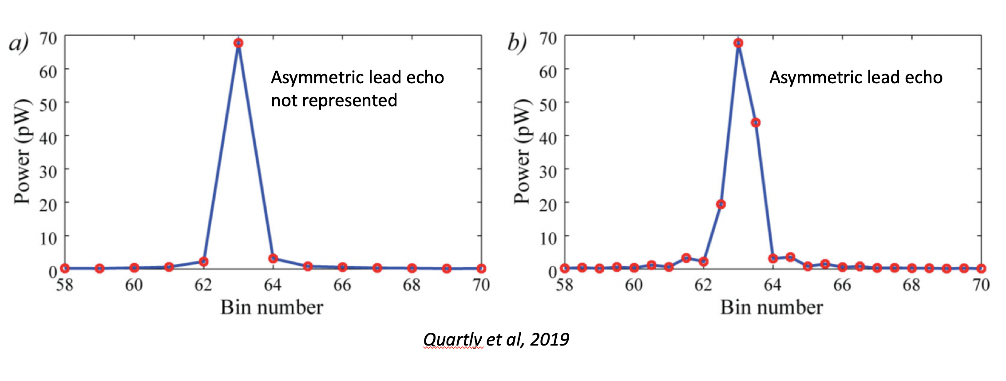
Poor Lead SHA Precision due to under-sampling of Specular Echoes

Slide 14
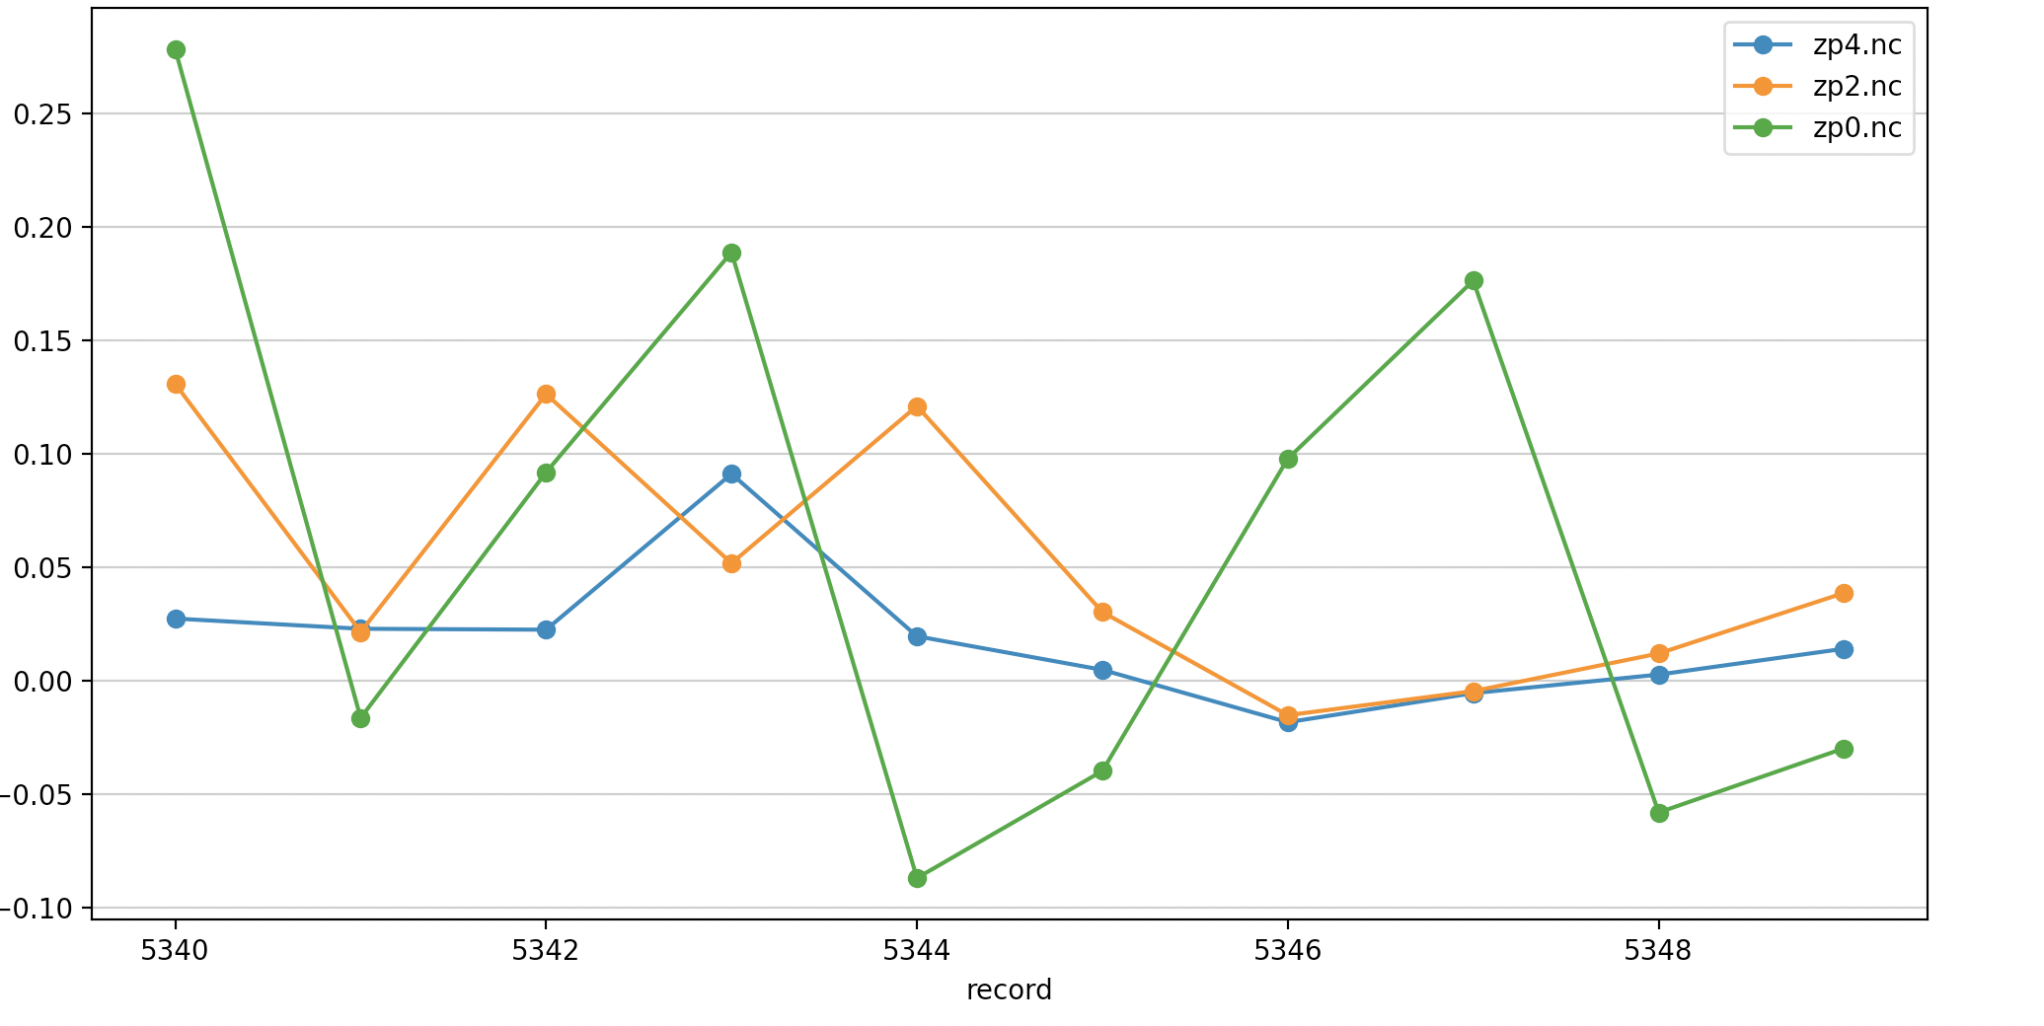
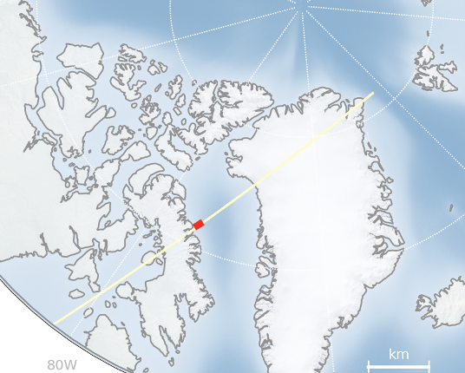
Lead SSHA Jitter and Precision improves with Zero Padding sampling rates
S3A_SR_2_LAN____20170304T162333_20170304T171402
Area of test track where we have consecutive Lead measurements
No ZP
Lead SSHA (m)
ZP=2
ZP=4
 | No ZP | ZP2 | ZP4
SD (m) | 0.12 | 0.05 | 0.03
MAD (m) | 0.09 | 0.03 | 0.01
Mean (m) | 0.06 | 0.05 | 0.02
Notes:
[macbook] cd /cpdata/SATS/RA/S3A/TDS/ZERO_PADDING_4_TDS/S3A_SR_2_LAN____20170304T162333_20170304T171402_20211026T172954_3029_015_083______LN3_O_NT_004.SEN3
/Users/alanmuir/software/cpom_software/cpom/altimetry/tools/plot_params_along_track.py -f zp4.nc -v sea_ice_ssha_20_ku_leads -m s3a -r 5340,5350 -f2 zp2.nc -f3 zp0.nc

Slide 15
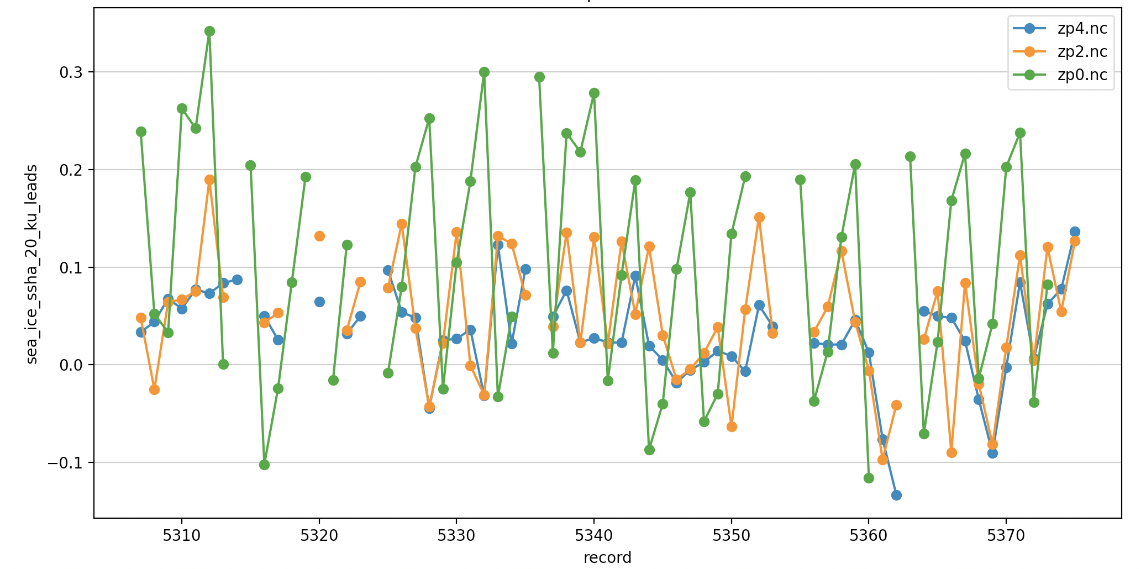
The effect of Zero-Padding (sampling rate) on Lead SSHA Jitter and Precision
S3A_SR_2_LAN____20170304T162333_20170304T171402
Area of test track where we have consecutive Lead measurements
No ZP
ZP=2
Lead SSHA (m)
ZP=4
 | No ZP | ZP2 | ZP4
SD (m) | 0.12 | 0.06 | 0.04
MAD (m) | 0.11 | 0.04 | 0.02
Mean (m) | 0.10 | 0.05 | 0.03
Notes:
[macbook] cd /cpdata/SATS/RA/S3A/TDS/ZERO_PADDING_4_TDS/S3A_SR_2_LAN____20170304T162333_20170304T171402_20211026T172954_3029_015_083______LN3_O_NT_004.SEN3
/Users/alanmuir/software/cpom_software/cpom/altimetry/tools/plot_params_along_track.py -f zp4.nc -v sea_ice_ssha_20_ku_leads -m s3a -r 5340,5350 -f2 zp2.nc -f3 zp0.nc

Slide 16
Measurement Accuracy over Sea Ice
Using available L2 data from <= PB 2.68
?
Sea ice floe
Lead
?

Slide 17
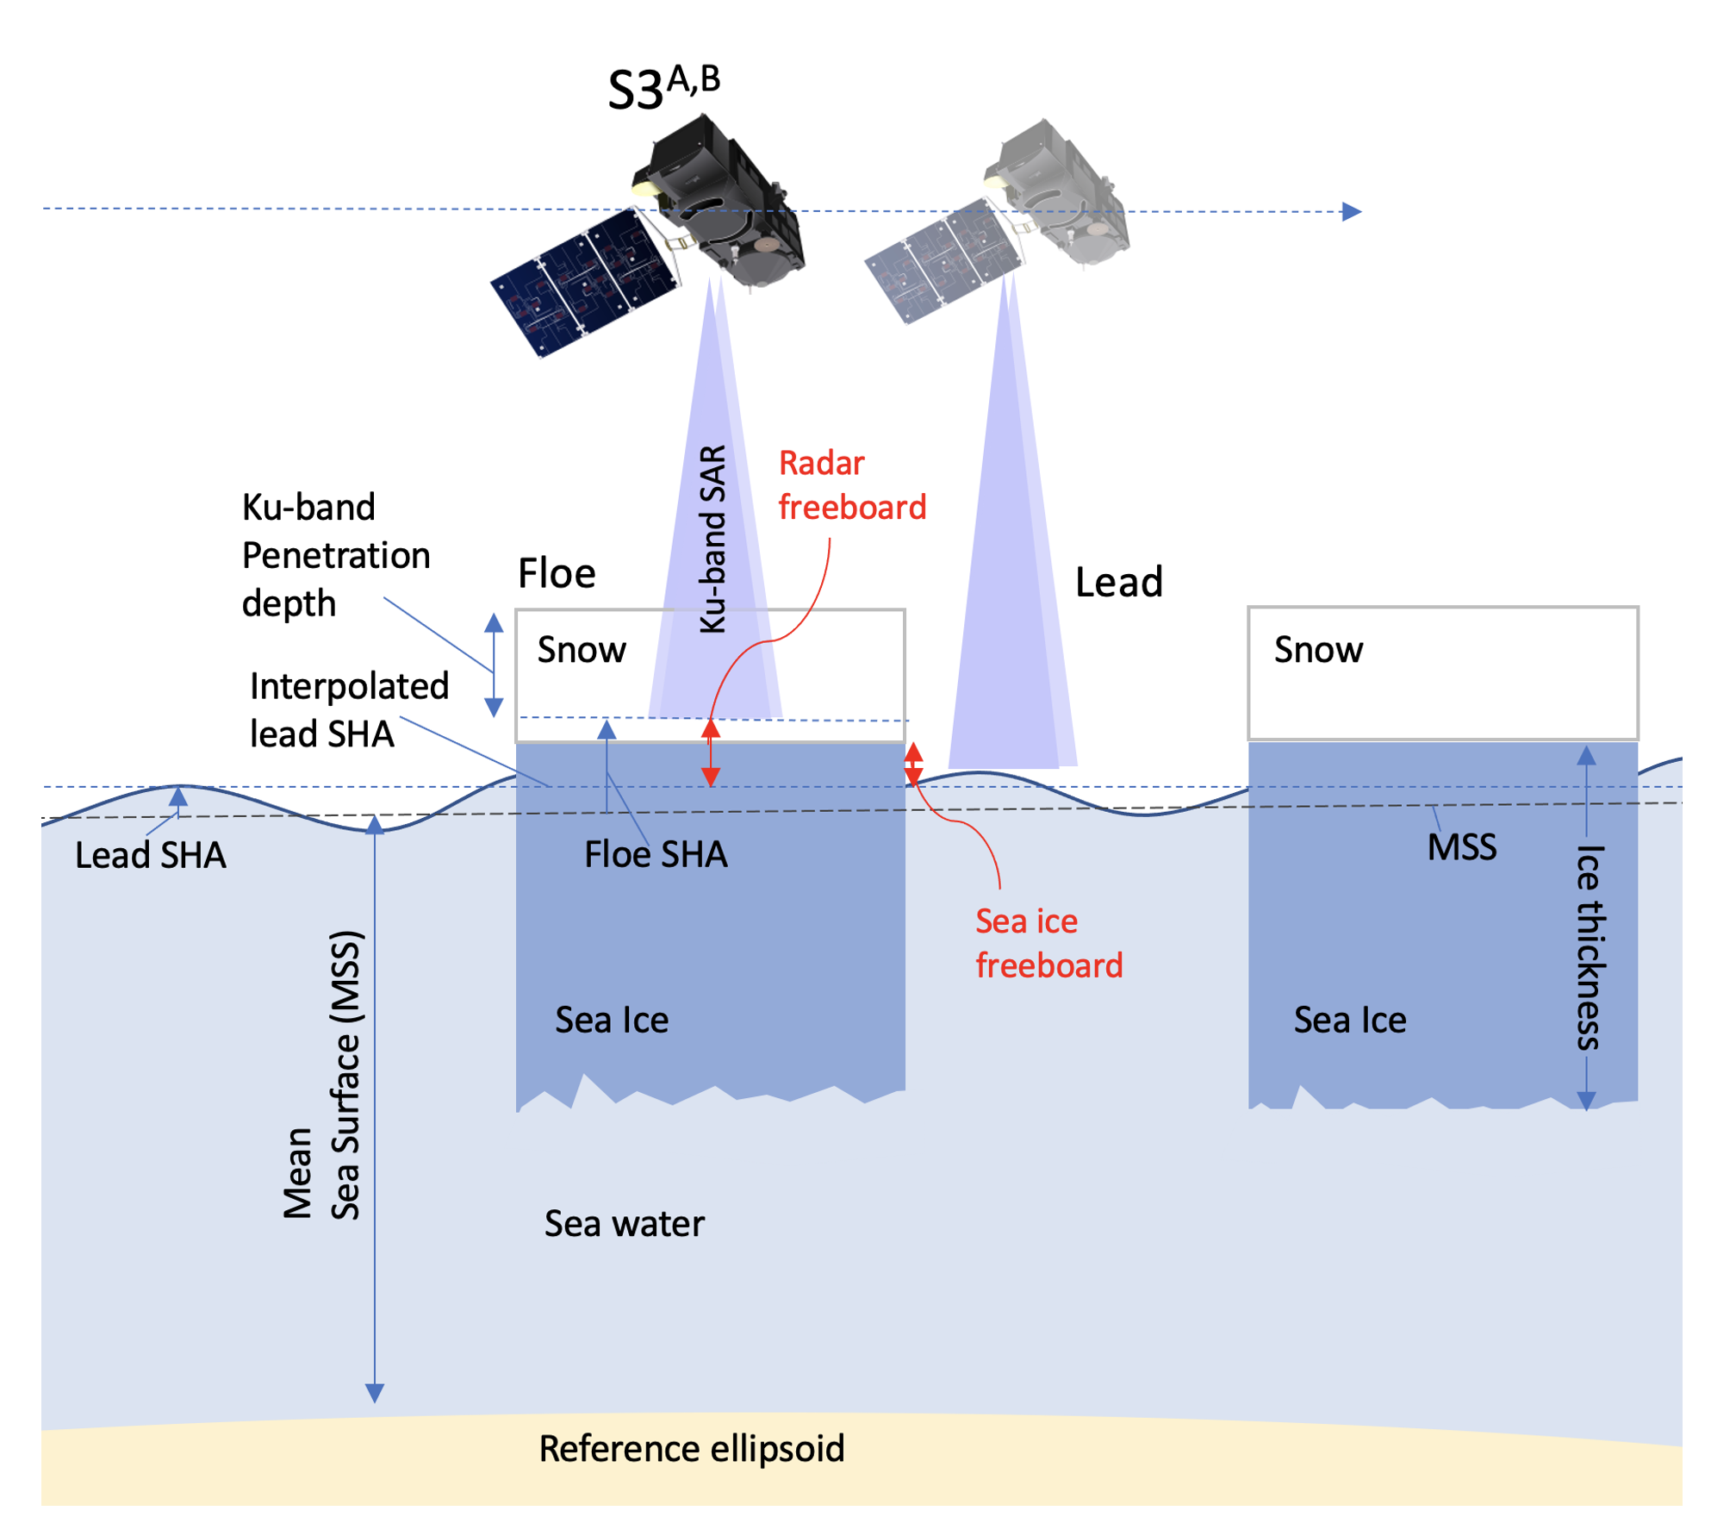

Slide 18
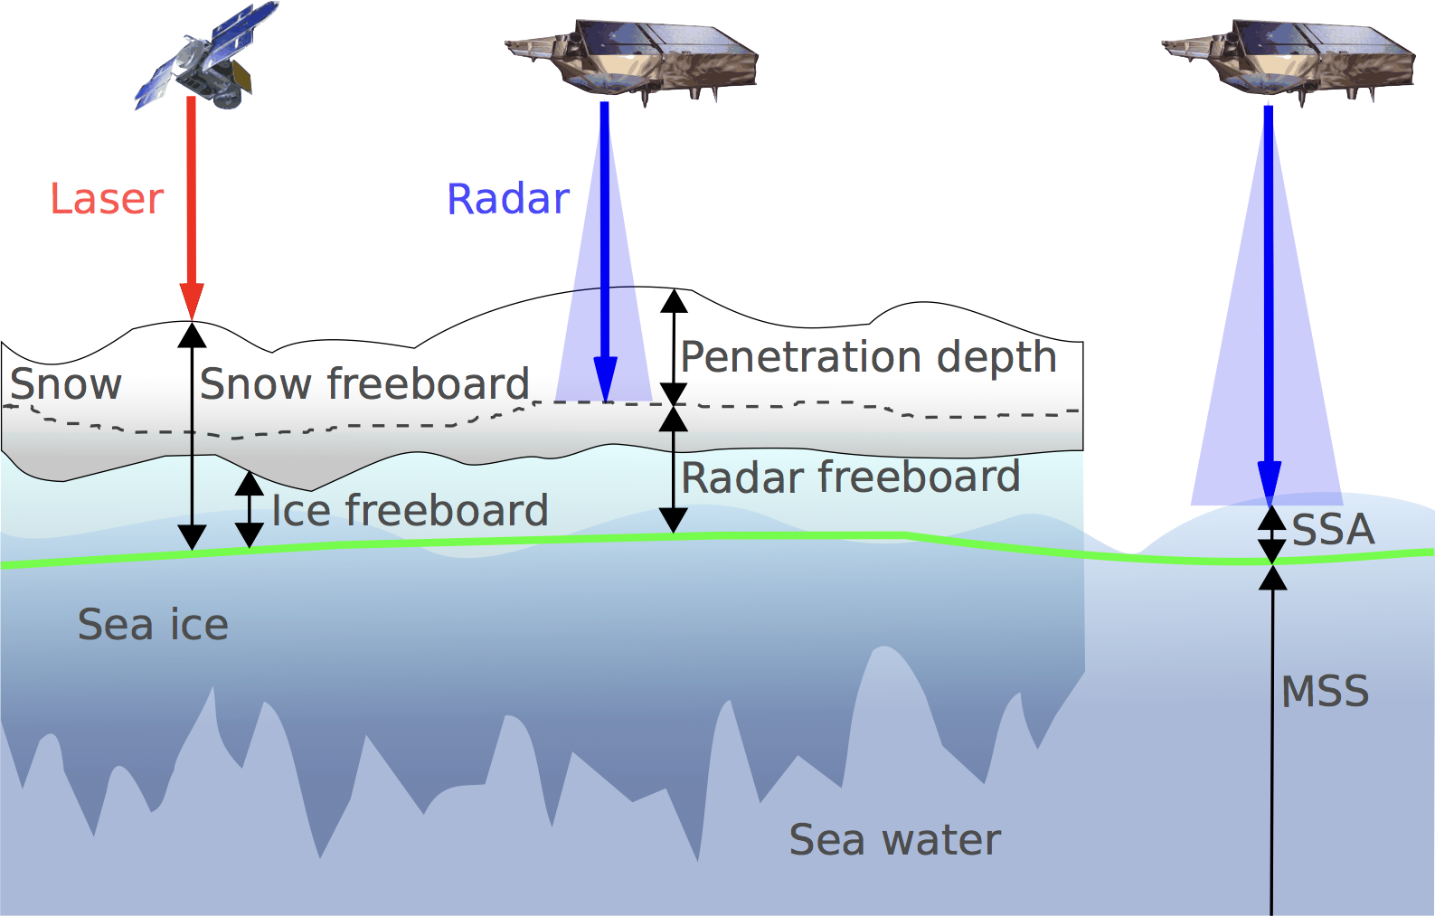
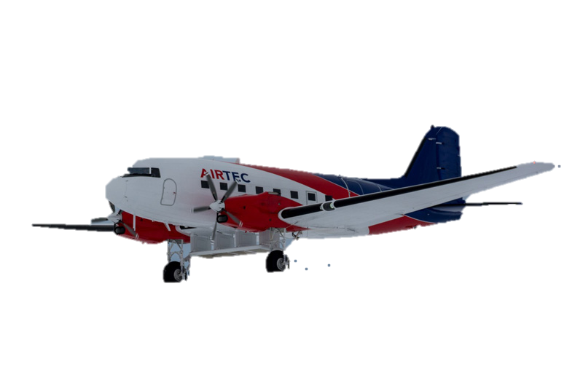
To validate of S3^{A,B} Freeboard measurements
Surface Measured
Validation Instrument/ Campaign | Radar Freeboard | Snow Freeboard | Ice Freeboard
Sentinel-3 | ✓
CryoSat-2 | ✓
ICESat-2 |  | ✓
Operation IceBridge |  | ✓ | ✓ with snow radar
CryoVex Karen 2017¹ | ✓ | ✓
¹ two under-flights of S3A over Fram Strait & Baffin Bay
Comparison between snow, ice and radar freeboard requires knowledge of snow depth, density, temperature, snow properties, and surface roughness.
Diagram adapted from Ricker, et al (AWI)

Slide 19
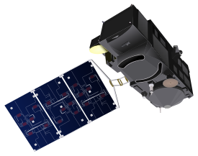
To validate of S3^{A,B} Freeboard measurements
Surface Measured
S3^{A,B}
CryoSat-2
Validation Instrument/ Campaign | Radar Freeboard | Snow Freeboard | Ice Freeboard
Sentinel-3 | ✓
CryoSat-2 | ✓
As S3^{A,B} and CryoSat-2
Similar Ku-band SAR altimeter instrument from (S3^{SRAL}, CS2^{SIRAL})
Similar doppler footprint (~300m along track, by ~1.65km across track)
we expect a close match of freeboard measurement statistics in SAR mode with identical processing and appropriate calibration.
CryoSat-2 has 10 years of sea ice validation campaigns from which S3
can benefit from.
Diagram adapted from Ricker, et al (AWI)

Slide 20
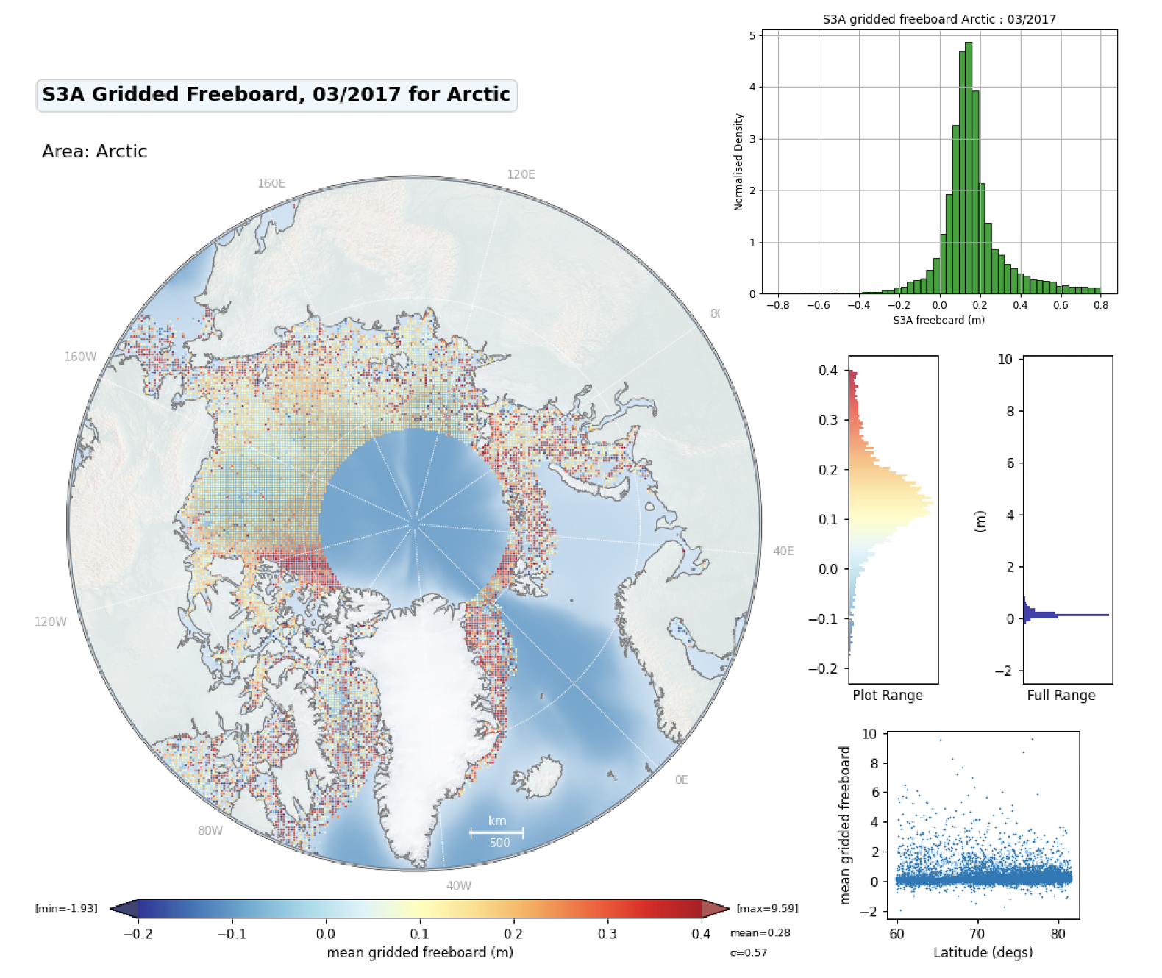
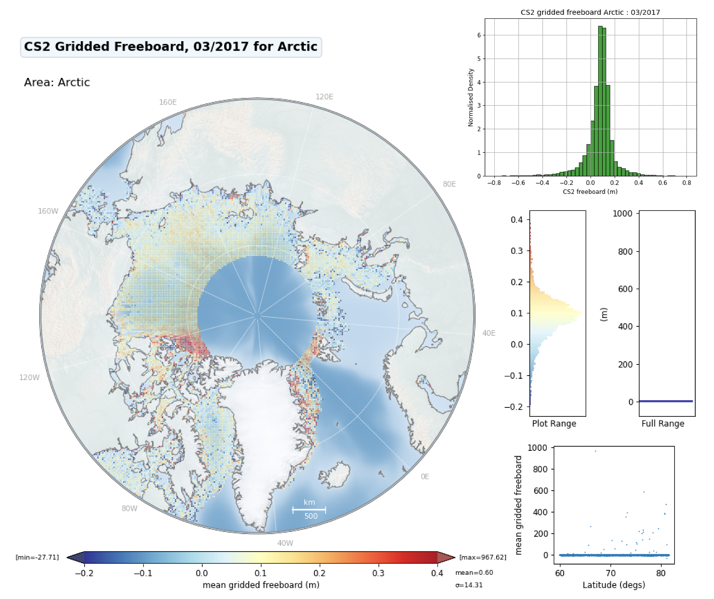
Mean 25km Gridded Freeboard for March 2017
S3A
CS2

Slide 21
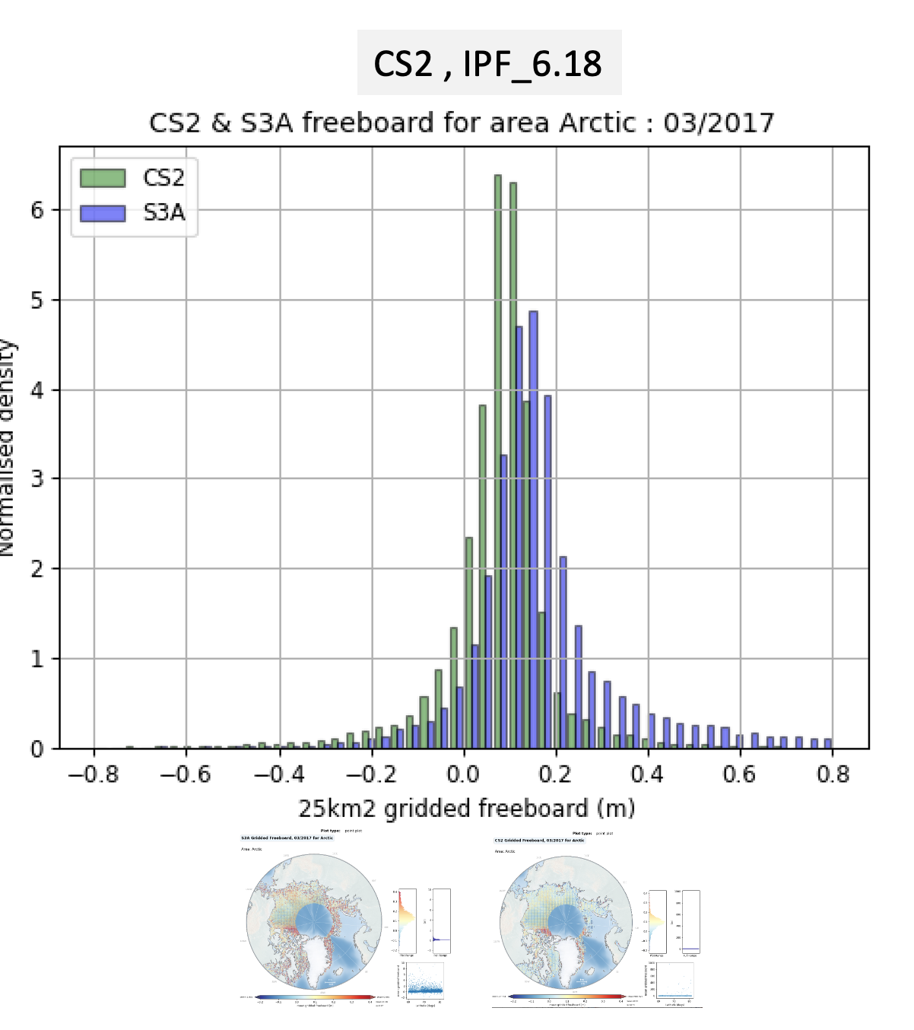
S3A (IPF 6.18) and CS2 Baseline-D Gridded Mean Freeboard

Slide 22
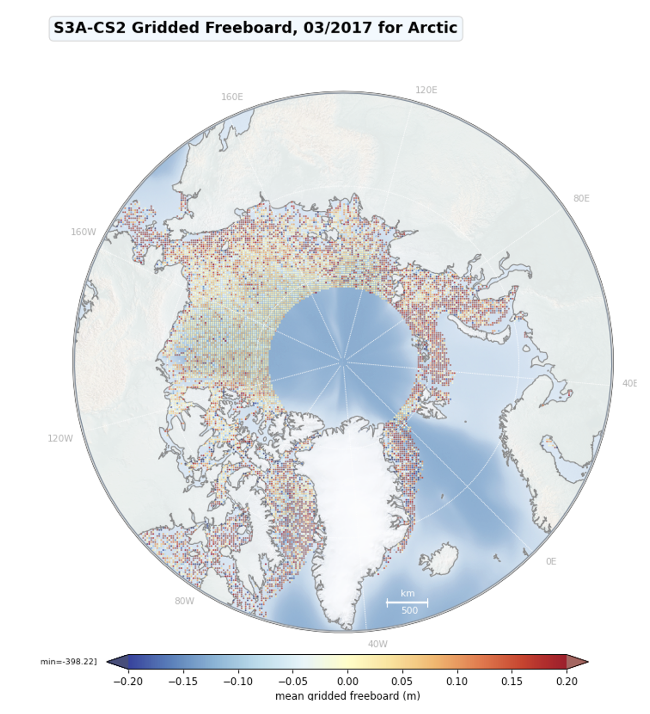
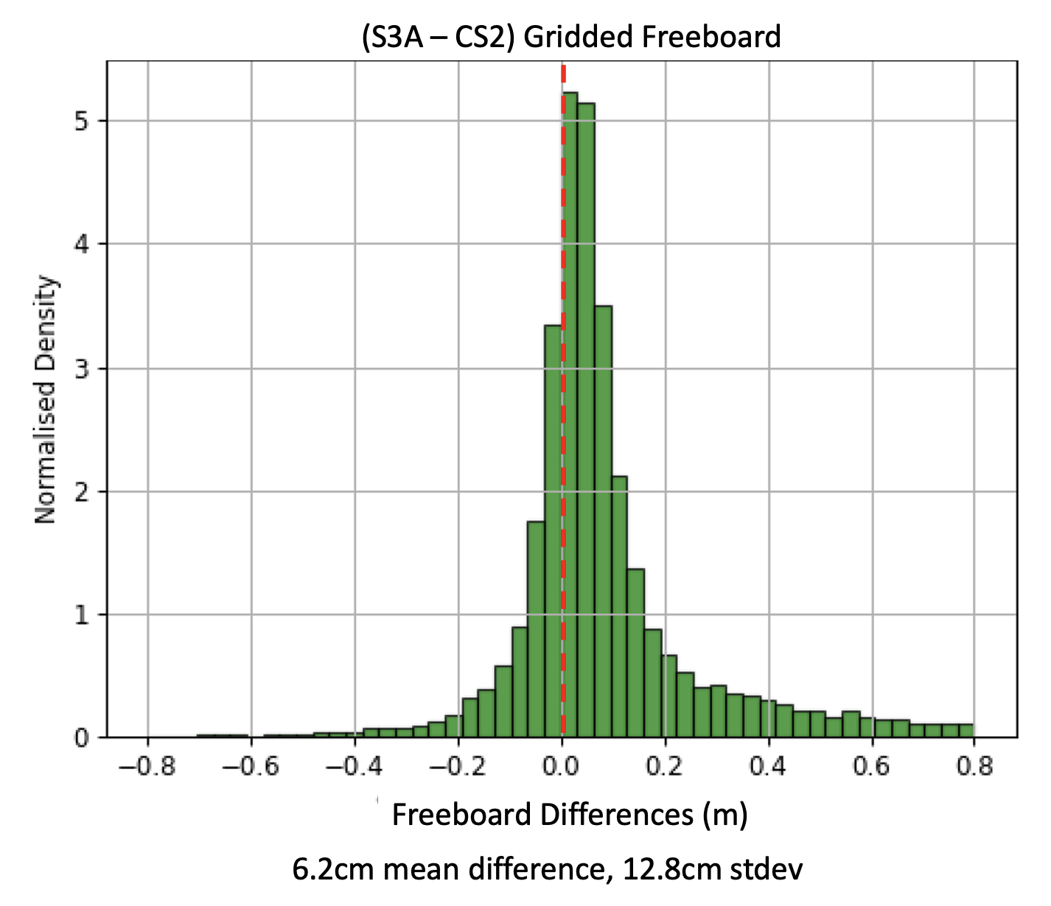

Slide 23
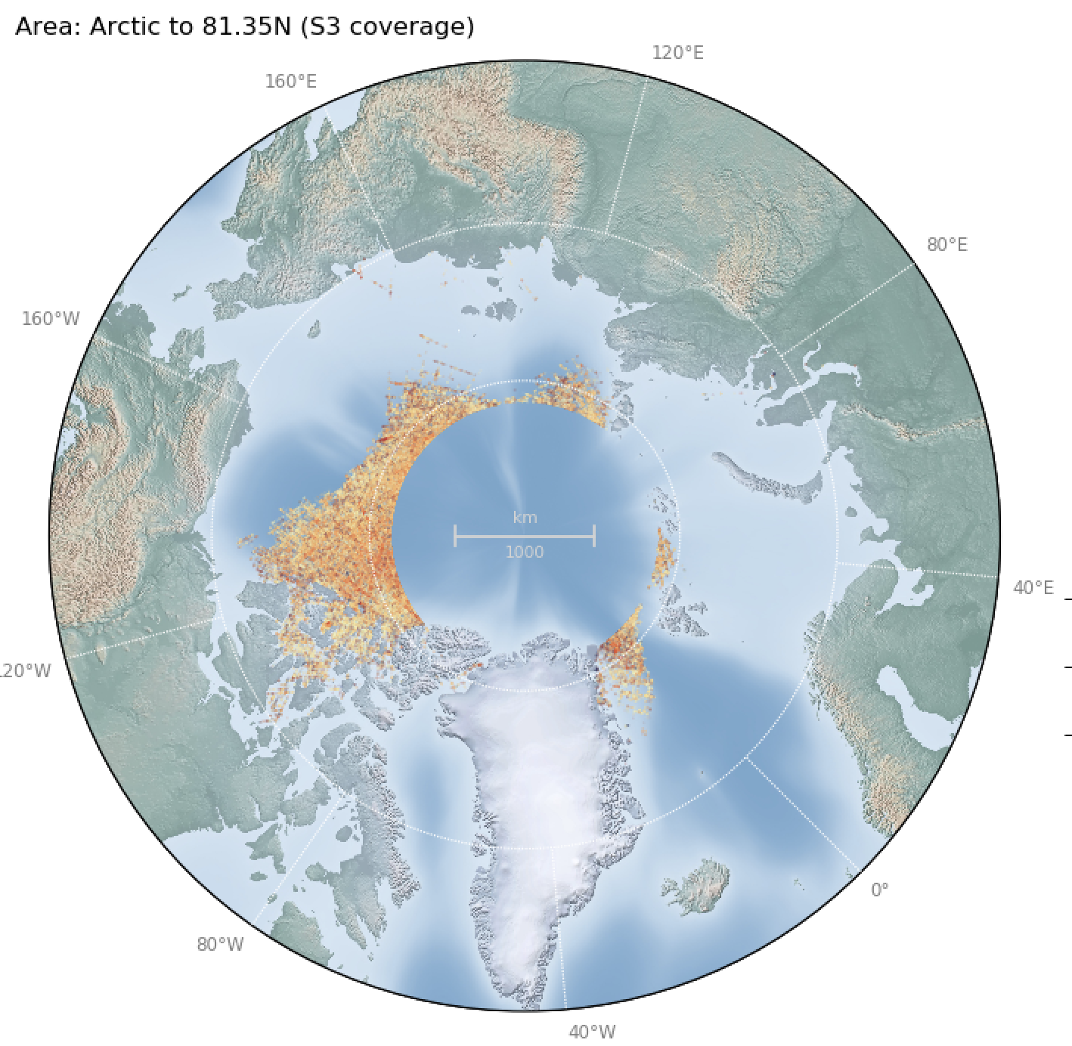
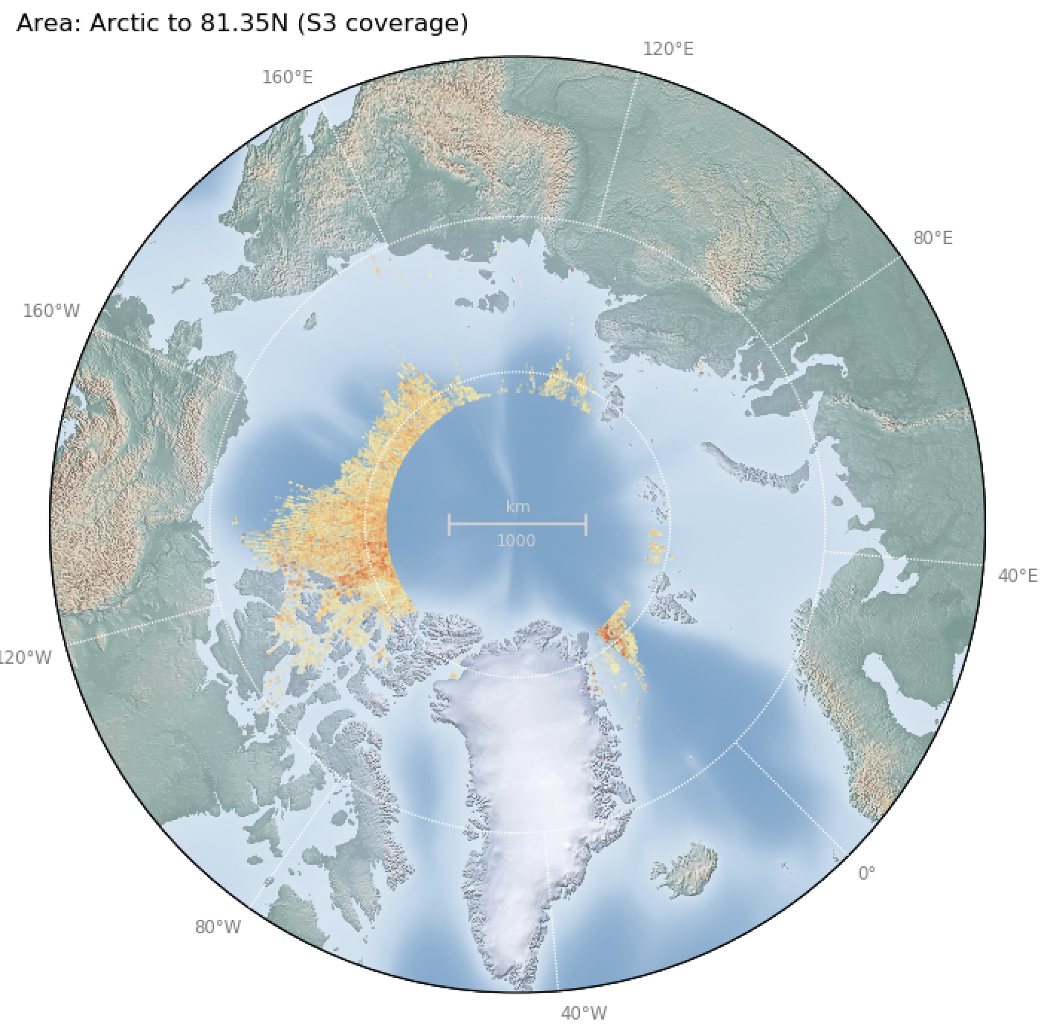
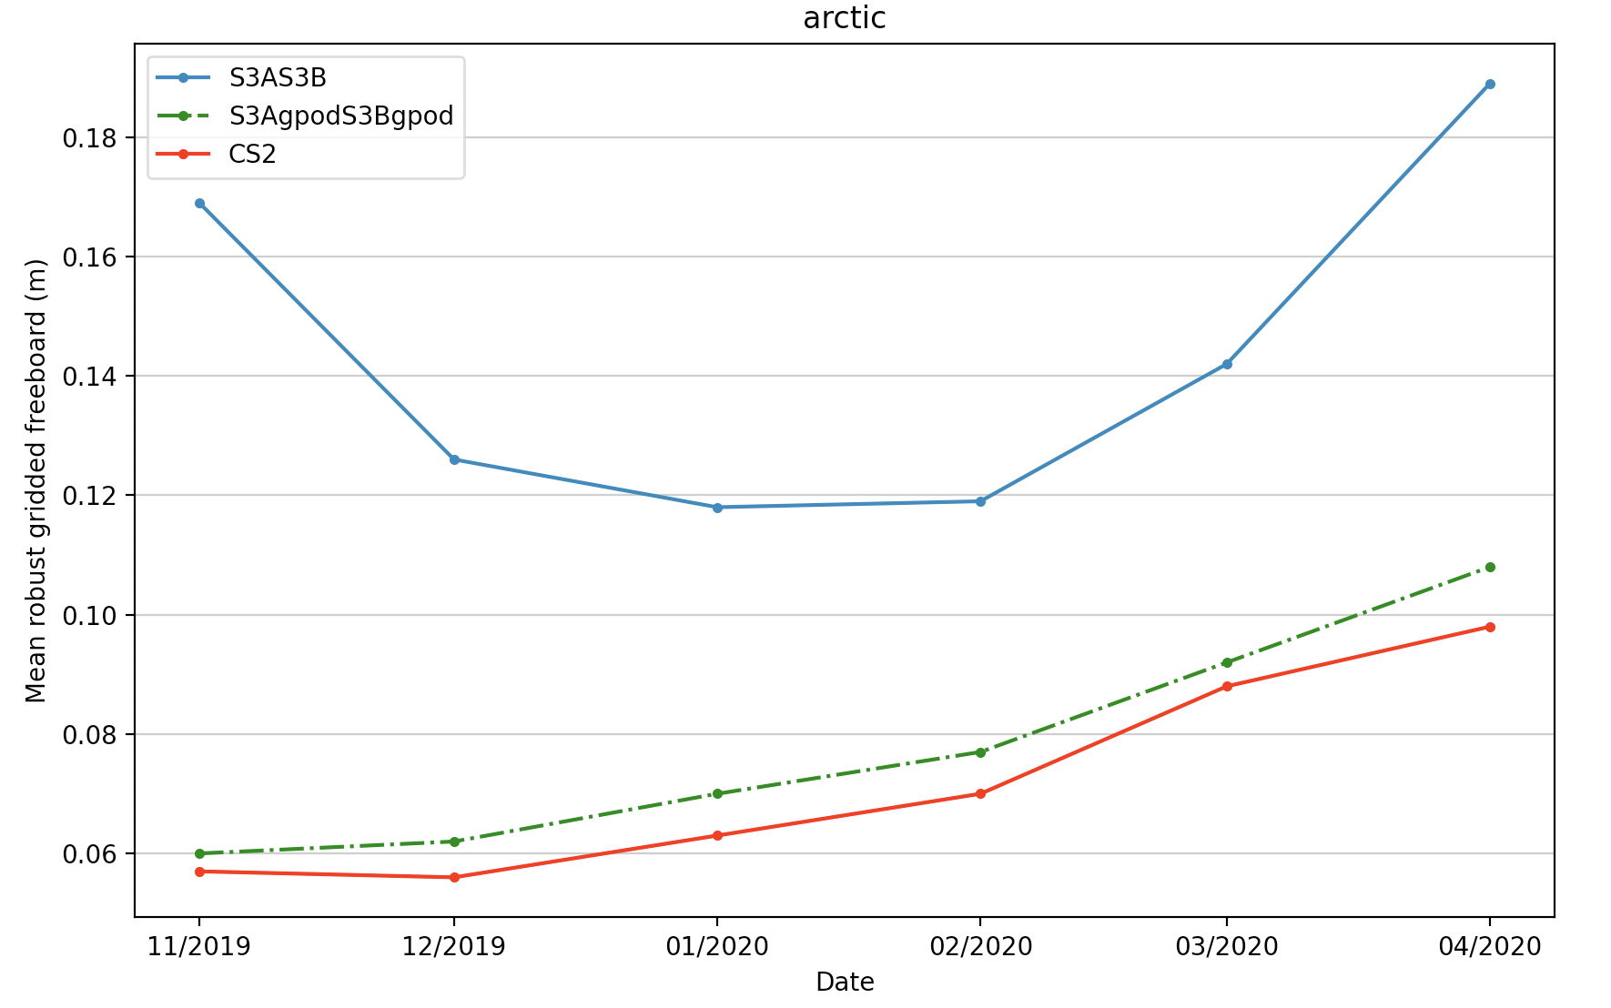
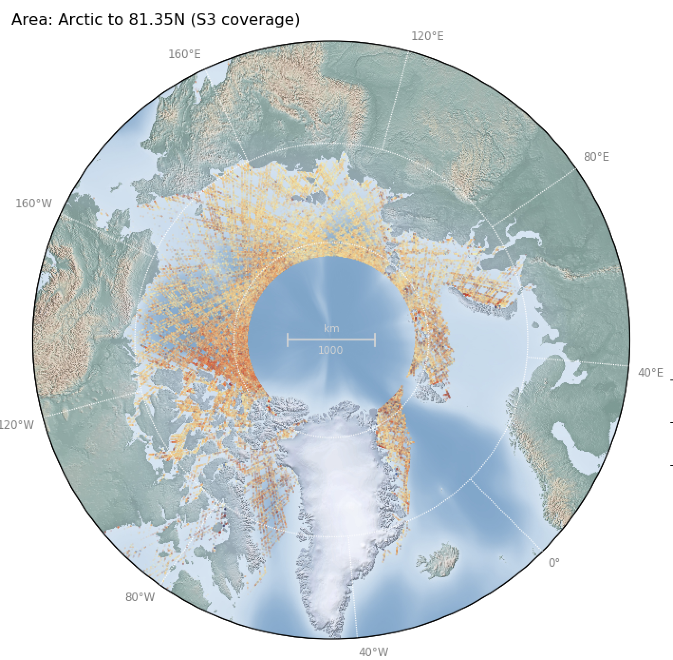
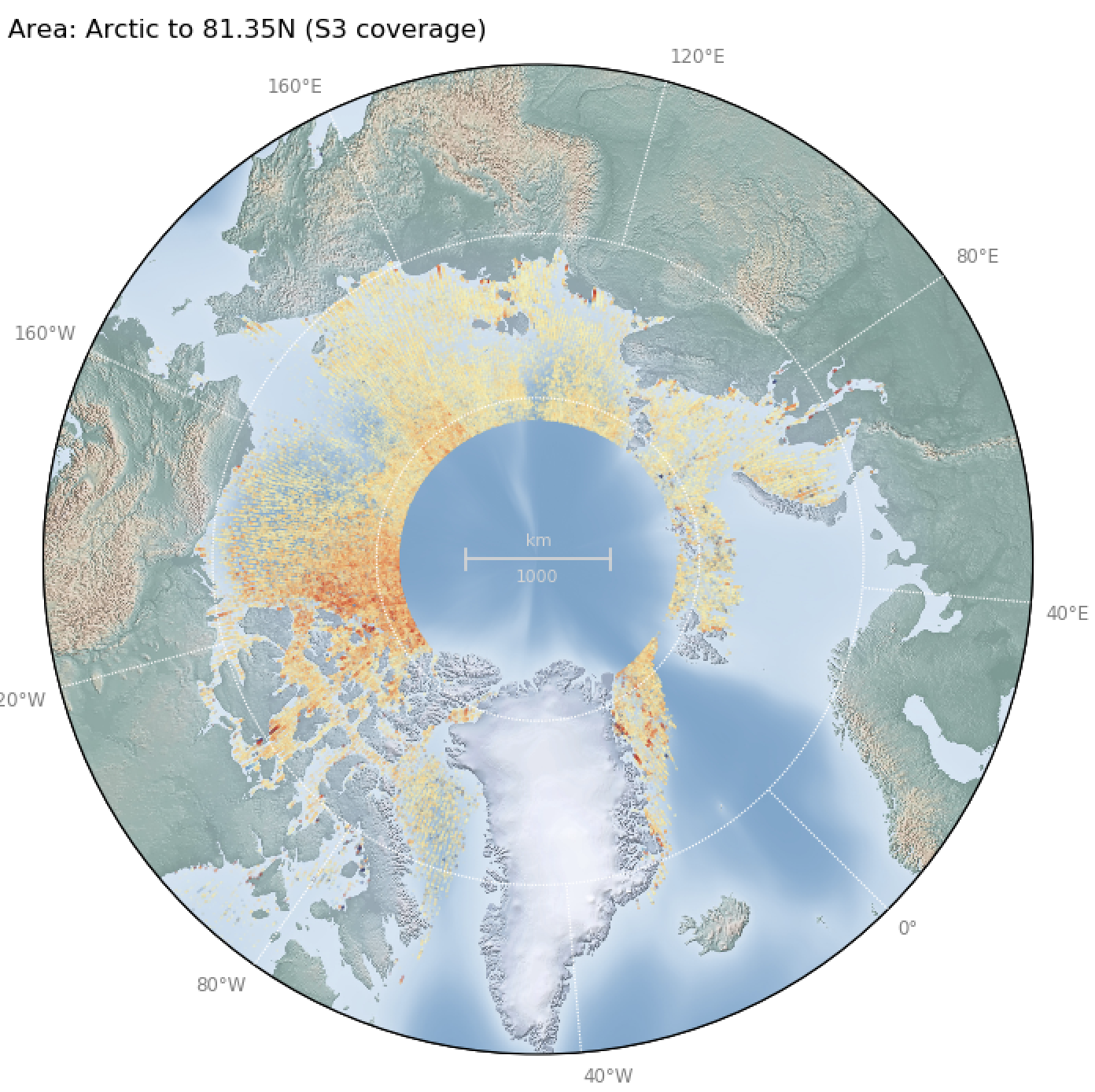
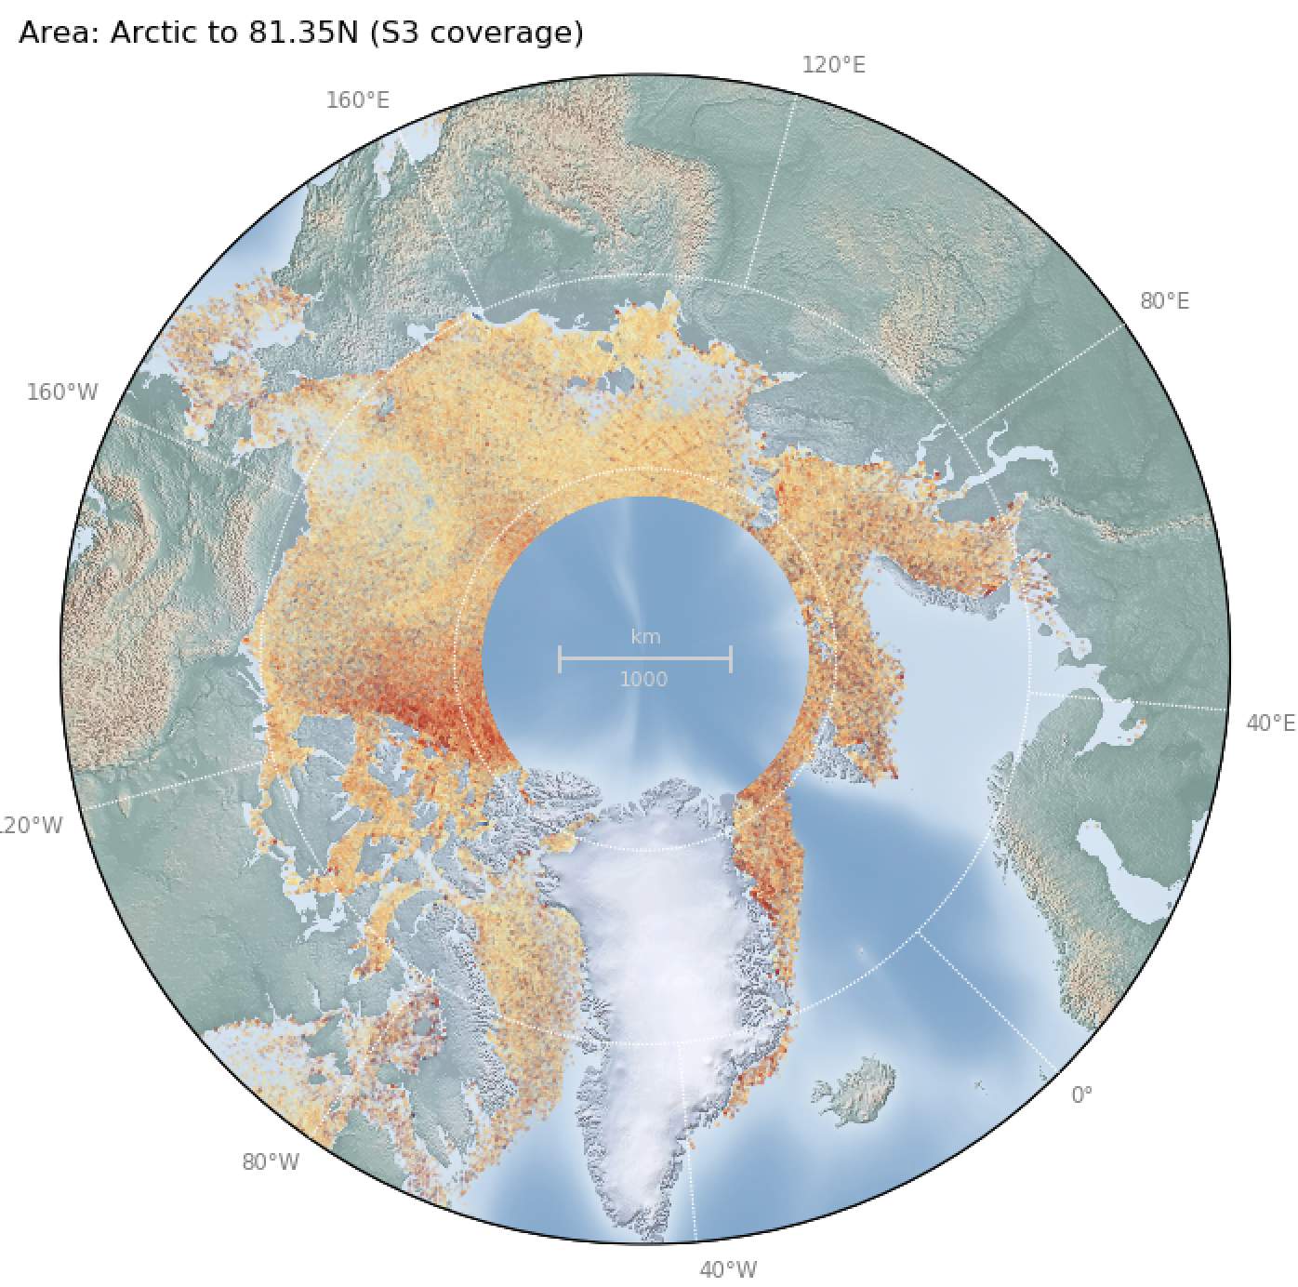
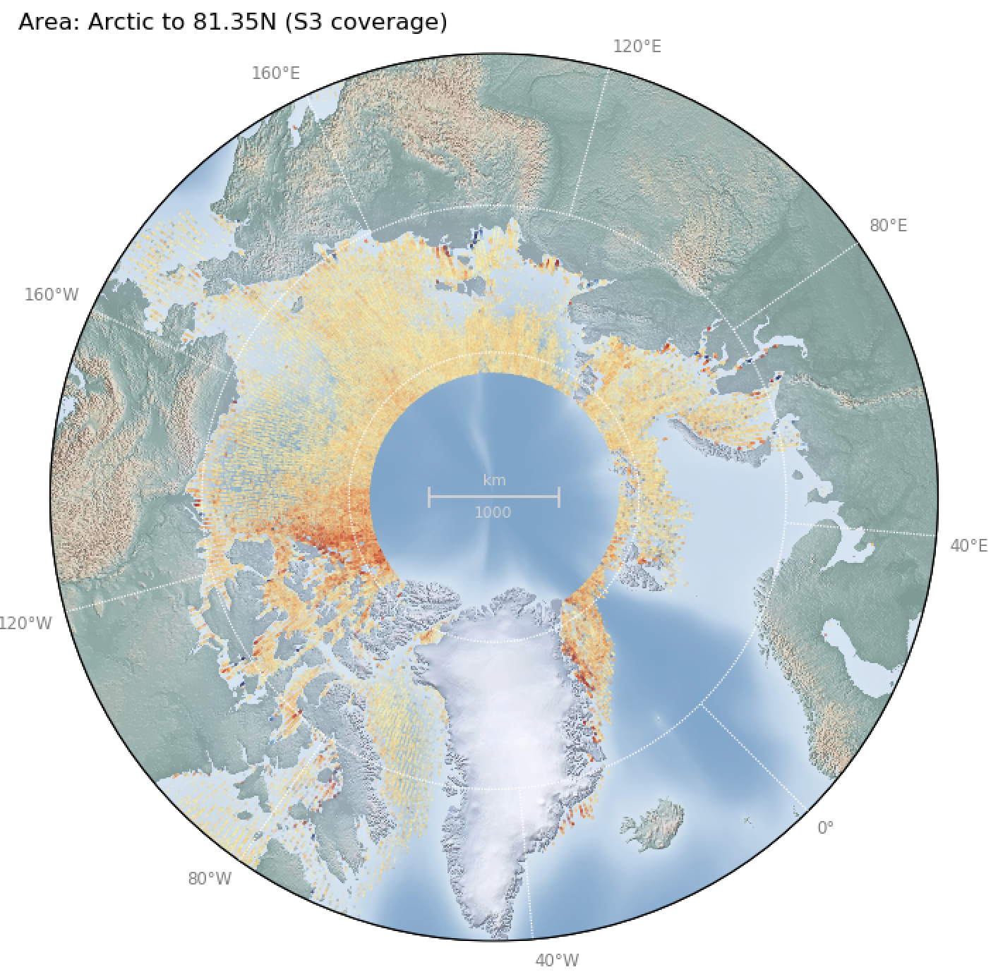
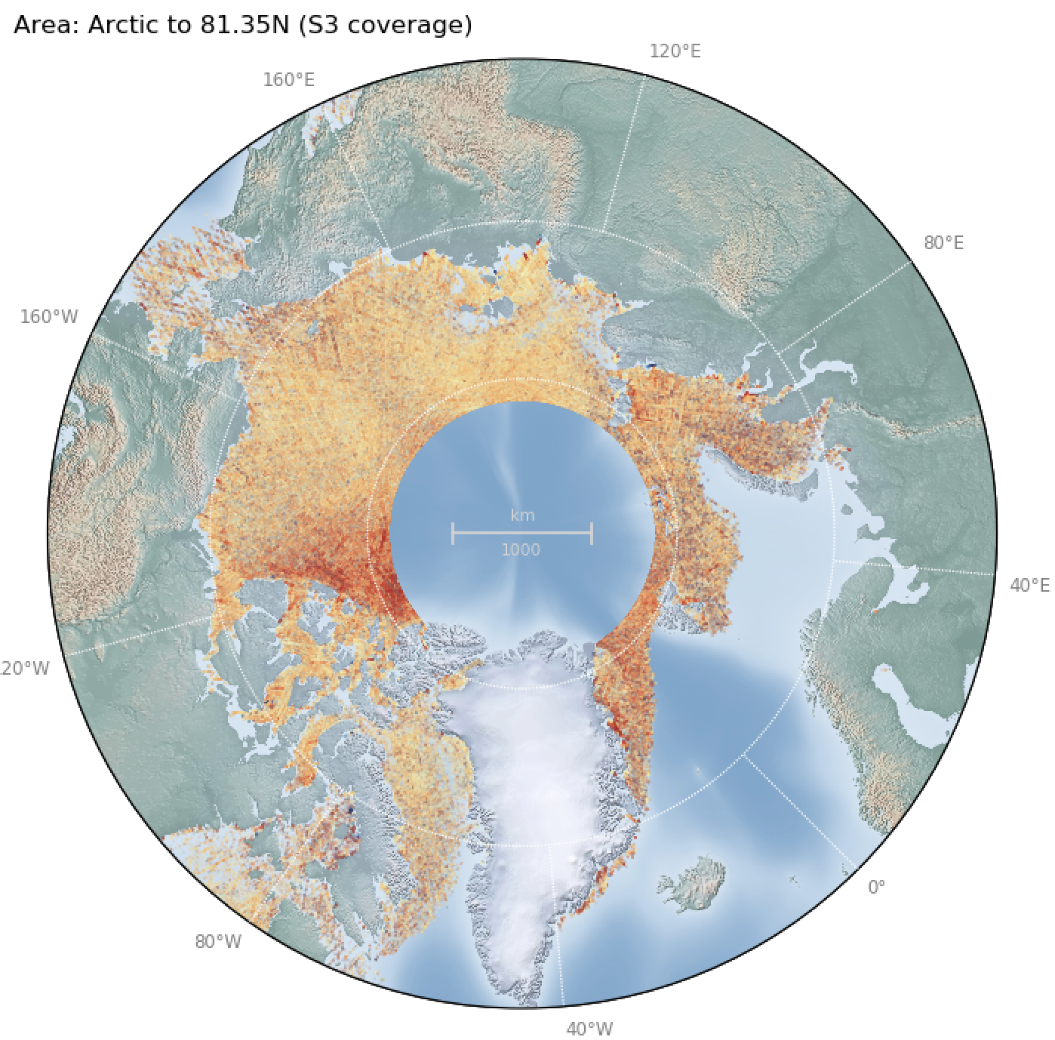
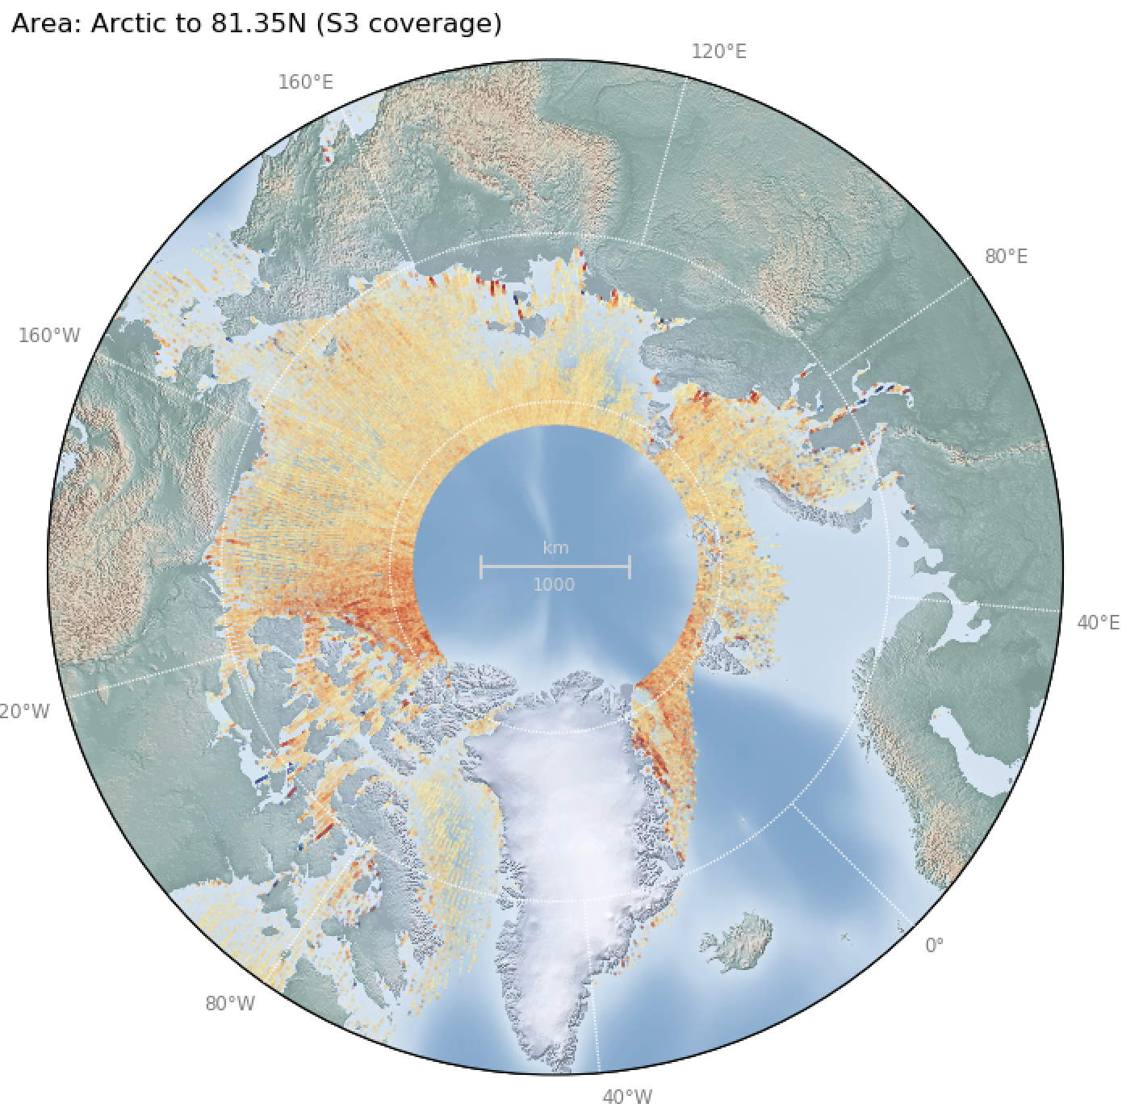
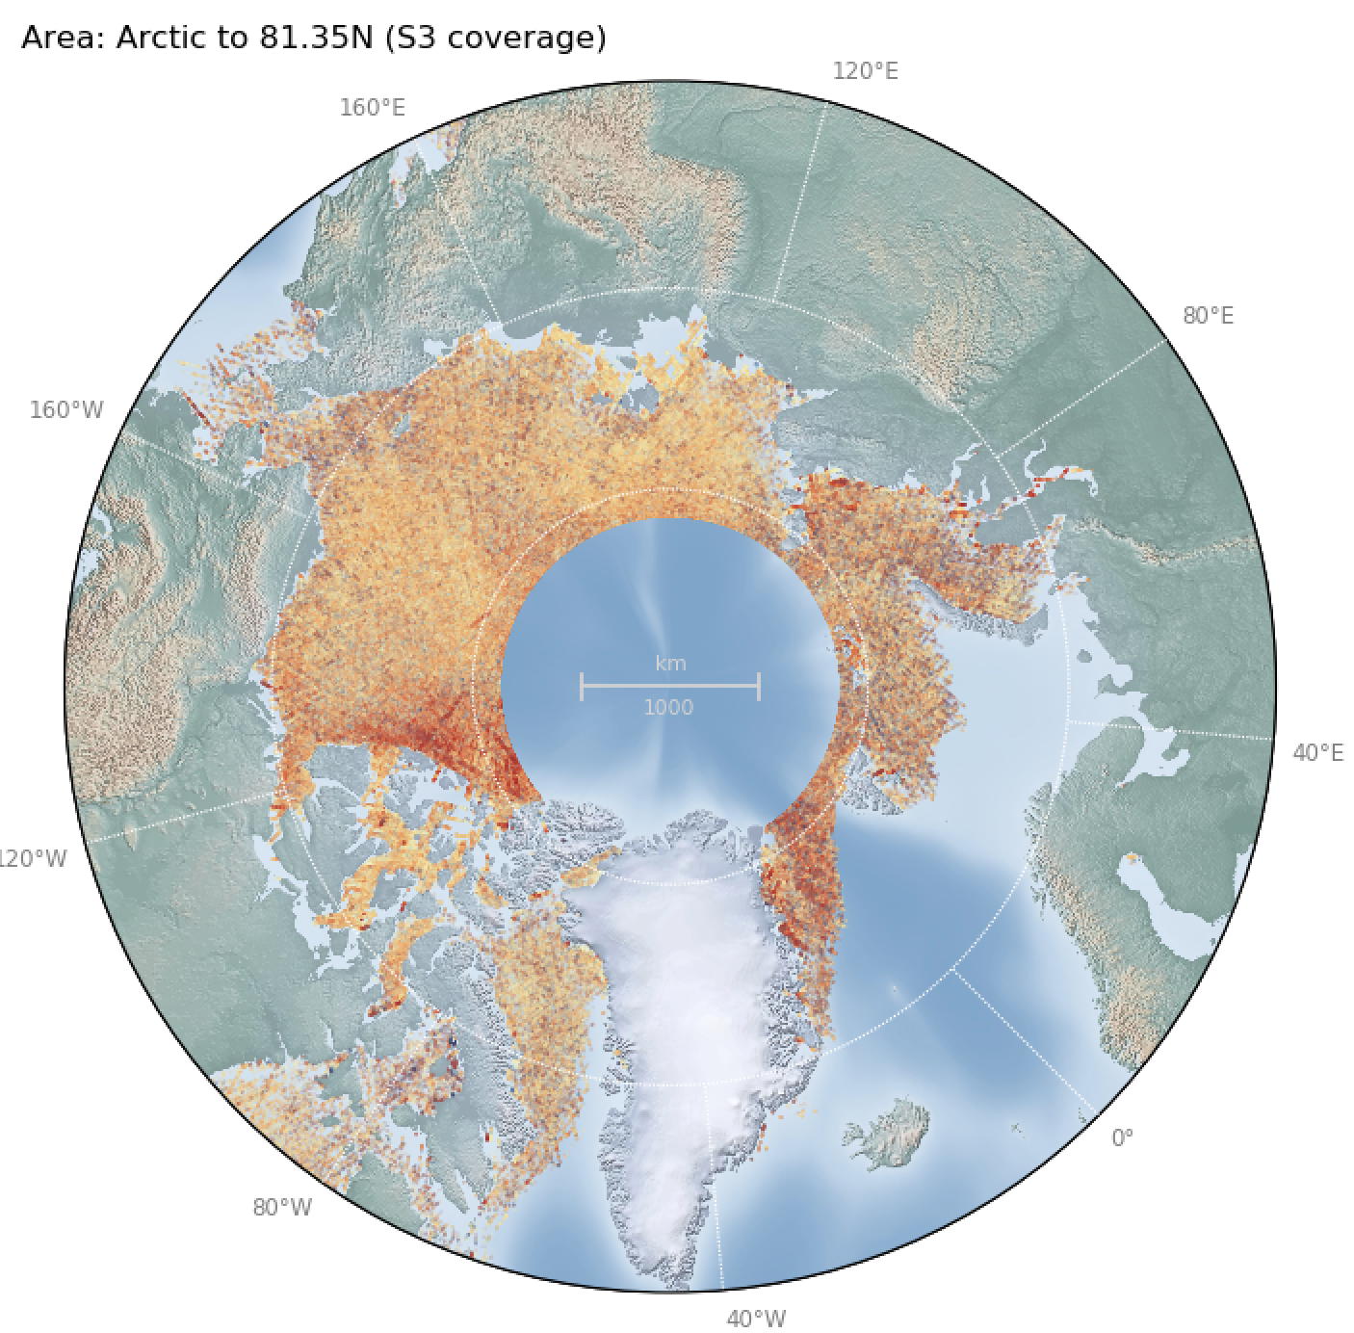
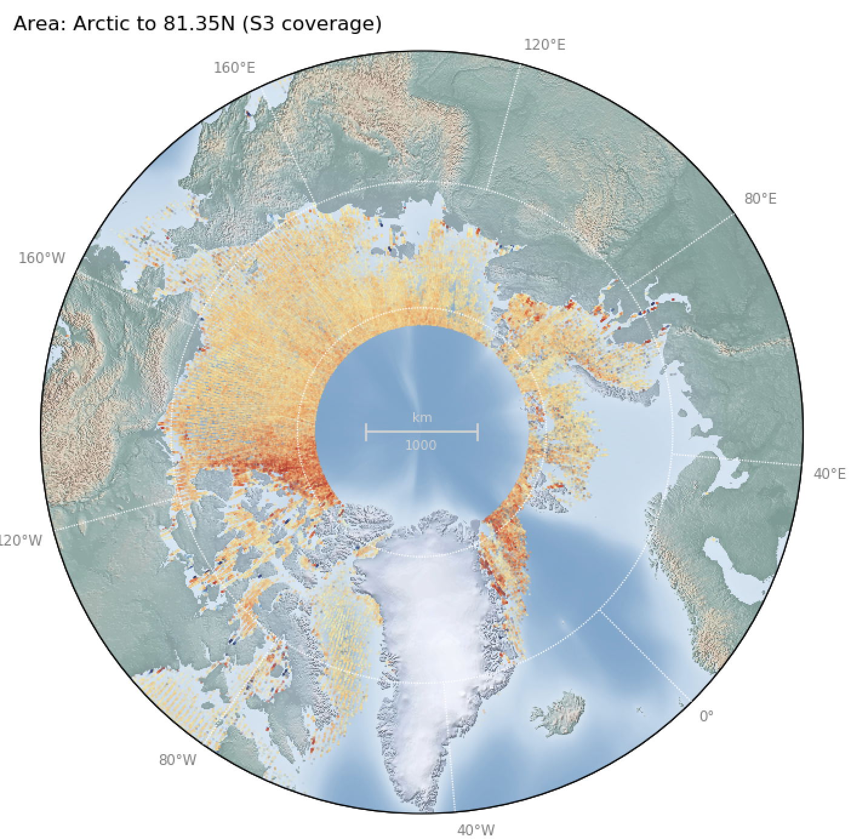
S3^{AB}
CS2
Monthly Changes in Mean Freeboard (Arctic, 2019/2020)
Mean Gridded ESA and GPOD S3^{AB} and CS2 Freeboard (m) over Arctic (Winter 2019/2020)
Oct 2019
Oct 2019
…
Dec 2019
Dec 2019
…
S3^{AB}
Mean Gridded Freeboard (m)
4.9cm
Feb 2020
Feb 2020
S3^{AB GPOD}
Mar 2020
Mar 2020
CS2
Apr 2020
Apr 2020
Notes:
plot_fb_stats.py -a arctic_to_81_35N -v robust_mean -m s3as3b -c

Slide 24
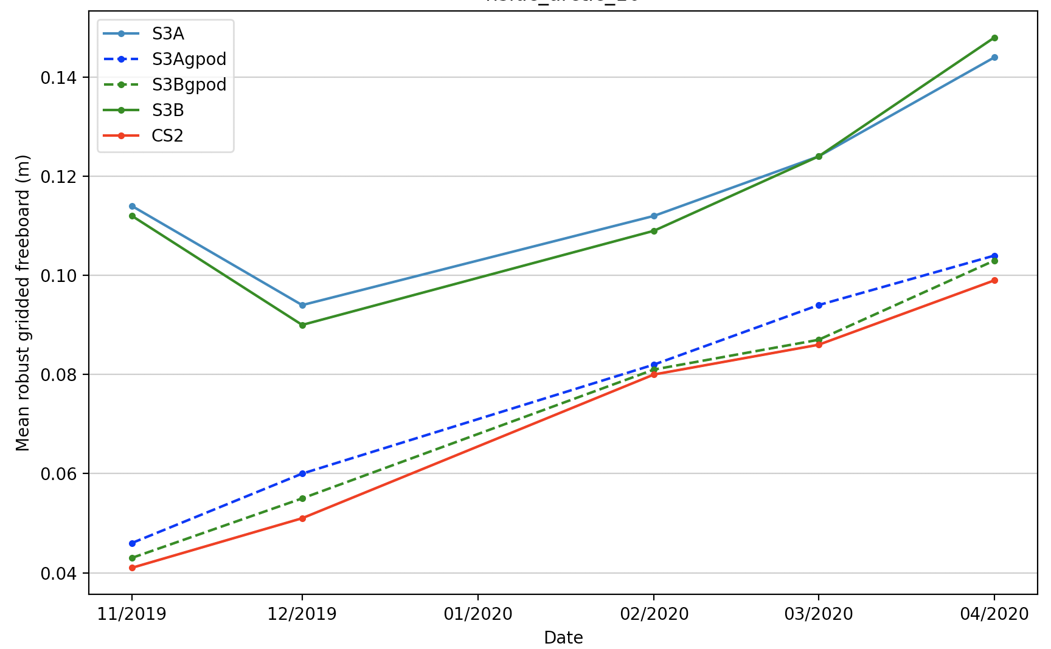
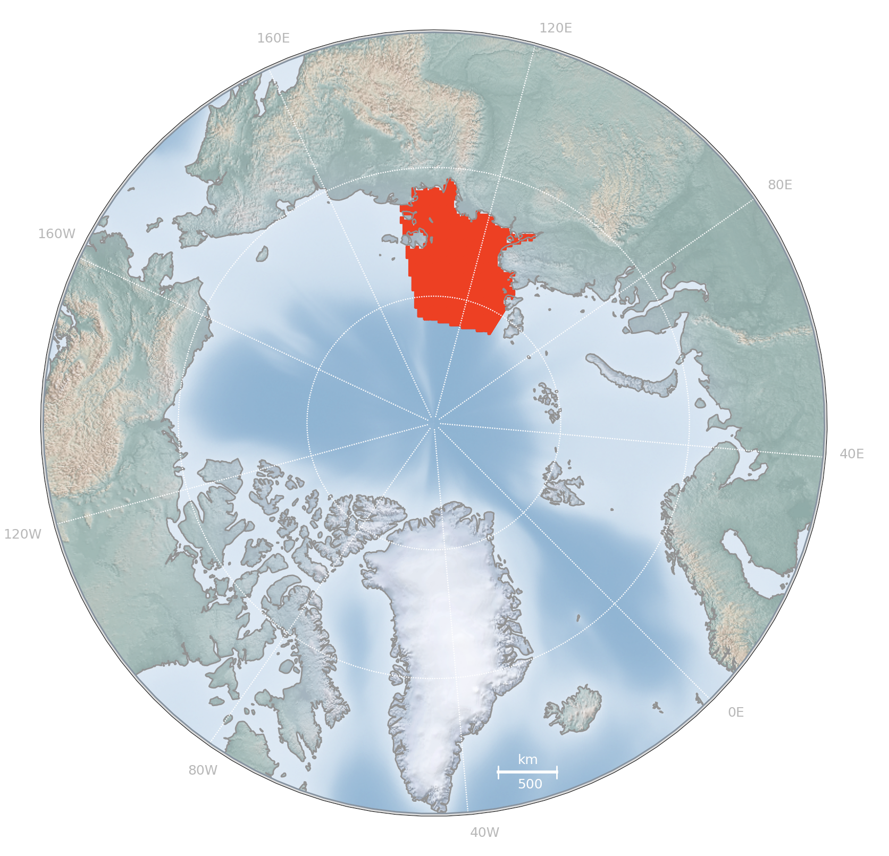
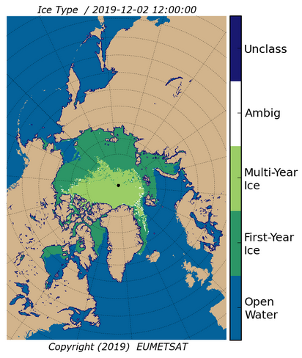
Area of First Year Ice (FYI)
Monthly Mean Freeboard : Laptev Sea
NSIDC Arctic area 10: Laptev Sea
S3B
S3A
S3B^{GPOD}
S3A^{GPOD}
CS2
Dec 2019
S3A
Dec 2019
S3B
Dec 2019
CS2
Dec 2019
S3A^{GPOD}
Notes:
./plot_all_nsidc_arctic_areas.py -b nsidc_arctic_14 -m arctic

Slide 25
Area of Multi Year Ice (MYI)
Monthly Mean Freeboard : Central Arctic
NSIDC Arctic area 10: Central Arctic
S3B
S3A
S3B^{GPOD}
S3A^{GPOD}
CS2
Dec 2019
Dec 2019
Dec 2019
Dec 2019
S3A
S3B
CS2
S3A^{GPOD}
Notes:
./plot_all_nsidc_arctic_areas.py -b nsidc_arctic_14 -m arctic

Slide 26
Jan 2020
S3A
Jan 2020
S3B
Jan 2020
CS2
< 81.35N
SARin
Mean Freeboard: Winter 2019/2020
S3B
S3A, S3B
S3A
S3A^{G-POD}
S3B^{G-POD}
CS2
CS2 SARin
NSIDC Basin 14: Canadian Islands
Notes:
plot_fb_stats.py -a arctic_basin3 -v nvals -m s3a -s3b -cs2 -g
plot_fb_stats.py -a arctic_basin3 -v nvals -m s3a -s3b -cs2

Slide 27
Gridded Freeboard Uncertainty
Using available L2 data from <= PB 2.68
25km
25km
?

Slide 28
Gridded Freeboard Uncertainty
S3A
CS2

Slide 29
Known L1b Issues (PB2.68)
# | Issue | Effect | Resolved in Thematic TDS
1 | No Hamming weighting in L1b | Hamming weighting dampens the contribution from high off-nadir beams to mitigate the effect of side-lobe ambiguities. This can result in contamination of echoes over floes with off-nadir leads. | ✓
2 | No Zero-padding in L1b | Under-sampled specular echoes over Leads : 3x loss of precision in lead SSHA, jitter | ✓ Sampling rate TBD

Slide 31
L2 Sea Ice Evolutions/Tuning
# | Evolution/Tuning | Effect | In Thematic TDS
1 | Tuning of discrimination thresholds from OLCI imagery | Improved surface type discrimination: [Leads, Sea Ice Floes, Open Ocean, Unclassified] | ✓ [Will require re-tuning]
2 | Tuning of sea ice retracker bias following MSSL study | Improves the accuracy of the bias between floe and lead retrackers | ✓ [Will require re-tuning]
3 | Using Sea ice type in discrimination filtering (from instrument sea ice type parameter or daily OSI-SAF sea ice type ADF) as Tilling et al, 2018. | Allow improved filtering of ambiguous regions between MYI and FYI, as well as ice free and unclassified regions | x

Slide 32
Lead/Floe Discrimination using S3 OLCI
S3 Discrimination Tuning Study
(Ocean and Land Colour Instrument)
Discrimination with Current Thresholds
Discrimination with Retuned Thresholds
Discrimination will require retuning for sea ice thematic products (Apr 2021)
(due to waveform shape changes)
lead peakiness: 21
floe peakiness: 11
lead SSD: n/a
floe SSD: n/a
lead peakiness: 24
floe peakiness: 16
lead SSD: 0.0027
floe SSD: 0.0033
Notes:
Advantages of OLCI:
* Co-temporal to the altimetry data
- No need for ice drift vectors
* Removes the need to search for overlapping SAR images
- Currently the key issue with creating a large validation/tuning dataset
* Comes with rich header information
- Can help discard cloud cover
Cons
* Images have cloud cover, SAR doesn't
* Lower resolution than SAR
- Will get lead detections from small leads that appear to be floes
- However, this can still happen with SAR
* Primarily useful for daytime images
- Passive instrument whereas SAR is active

Slide 33
L2 Sea Ice Evolutions/Tuning
# | Evolution/Tuning | Effect | In Thematic TDS
1 | Tuning of discrimination thresholds from OLCI imagery | Improved surface type discrimination: [Leads, Sea Ice Floes, Open Ocean, Unclassified] | ✓ [Will require re-tuning]
2 | Tuning of sea ice retracker bias following MSSL study | Improves the accuracy of the bias between floe and lead retrackers | ✓ [Will require re-tuning]
3 | Using Sea ice type in discrimination filtering (from instrument sea ice type parameter or daily OSI-SAF sea ice type ADF) as Tilling et al, 2018. | Allow improved filtering of ambiguous regions between MYI and FYI, as well as ice free and unclassified regions | x

Slide 34
Sea Ice Retracker bias tuning (with PB2.68)

Slide 35
L2 Sea Ice Evolutions/Tuning
# | Evolution/Tuning | Effect | In Thematic TDS
1 | Tuning of discrimination thresholds from OLCI imagery | Improved surface type discrimination: [Leads, Sea Ice Floes, Open Ocean, Unclassified] | ✓ [Will require re-tuning]
2 | Tuning of sea ice retracker bias following MSSL study | Improves the accuracy of the bias between floe and lead retrackers | ✓ [Will require re-tuning]
3 | Using Sea ice type in discrimination filtering (from instrument sea ice type parameter or daily OSI-SAF sea ice type ADF) as Tilling et al, 2018. | Allow improved filtering of ambiguous regions between MYI and FYI, as well as ice free and unclassified regions | x

Slide 36
OSI SAF Global Sea Ice Type
Daily product
Allows removal of ambiguous and
unclassified sea ice records.

Slide 37
L2 Sea Ice Evolutions/Tuning
# | Evolution/Tuning | Effect | In Thematic TDS
4 | Snow Density: Use a linearly increasing snow density as per Mallet et al, 2020. | Currently a fixed mean arctic snow density of 400kg/m3 is used from Warren (99). As snow density increases during each Arctic season, Mallet et al recommends a linear seasonal increase of snow density: 𝜌𝑠 = 274.51 + 6.5t, where t represents the time in fractional month since October 15 | x
5 | New snow depth correction. Derivation and application of a dynamic snow depth correction using sea ice type, as is done for CS2 Baseline-E ‘snow_depth_cor_20_ku’ | Provide a correction to the calculated freeboard to account for the reduced propagation speed of light through the snow cover on sea ice floes | x (is in CS2 Baseline-E)

Slide 38
L2 Sea Ice Evolutions/Tuning
# | Evolution/Tuning | Effect | In Thematic TDS
4 | Snow Density: Use a linearly increasing snow density as per Mallet et al, 2020. | Currently a fixed snow density of 400kg/m3 is used from Warren (99). As snow density increases during each Arctic season, Mallet et al recommends a linear seasonal increase of snow density: 𝜌𝑠 = 274.51 + 6.5t, where t represents the time in fractional month since October 15 | x
5 | New snow depth correction parameter. Derivation and application of a dynamic snow depth correction using sea ice type, as is done for CS2 Baseline-E ‘snow_depth_cor_20_ku’ | Provide a correction to the calculated freeboard to account for the reduced propagation speed of light through the snow cover on sea ice floes | x (is in CS2 Baseline-E)

Slide 39
= snow depth
= speed of light through vacuum
= speed of light through snow
Correction is added to radar freeboard

Slide 40
S3 Freeboard Performance (from PB2.68) Summary
Freeboard area extent matches monthly extent from passive microwave data in the Arctic.
Antarctica peak measurement numbers (Aug) lag behind peak extent (Sep/Oct) by ~1-2 months.
S3A and S3B coverage similar (orbits are different) and freeboard histogram shows no significant bias.
Precision of Lead SHA is ~3x worse than CryoSat (due to lack of ZP).
High freeboard variability near coastline compared to CryoSat (due to lack of ZP/Hamming).
~6cm freeboard bias as compared to CryoSat.
Much higher gridded monthly freeboard uncertainty than CryoSat.
Recommended next tuning/evolutions listed.
TN issued on Sea Ice Performance of PB2.68 (22-Oct-21)
Thematic Sea Ice TDS fixes most sea ice issues in PB2.68 (separate CM#8 presentation)

