Slide 1
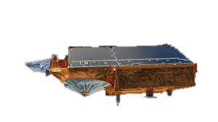
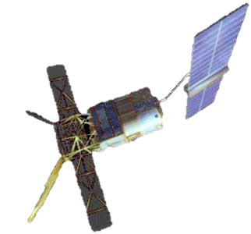
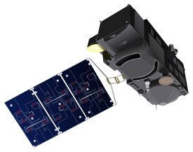
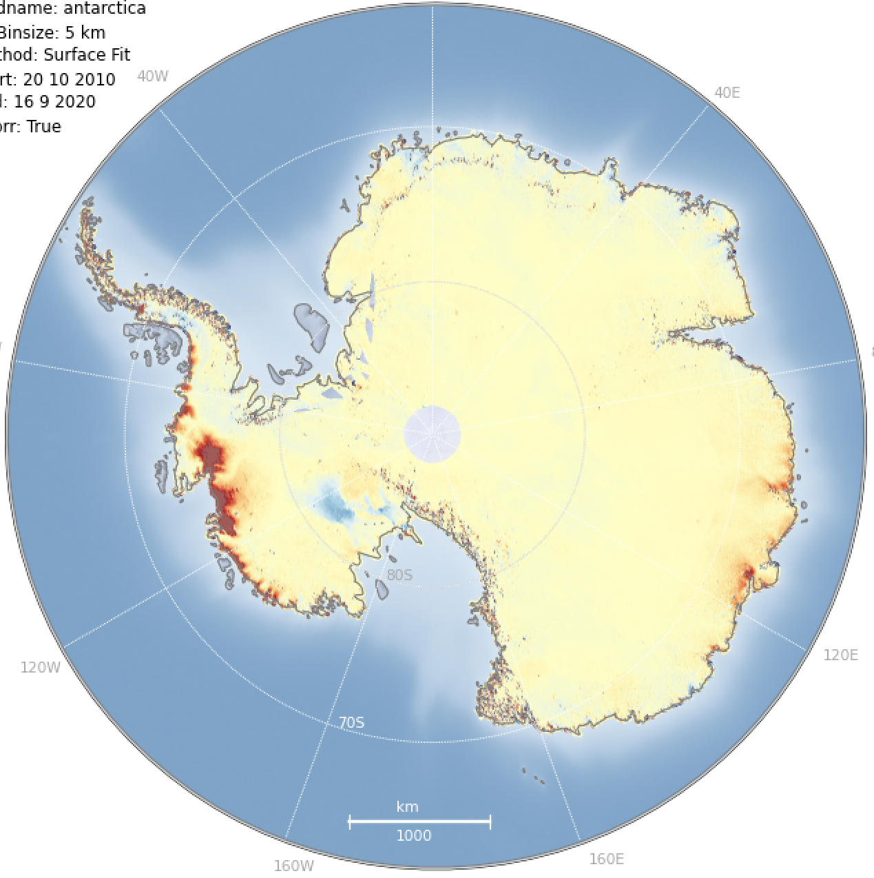


Surface Elevation Change
Phase 2
R&D Activities
PM-03
Oct 2025
Tom Slater²
Andrew Shepherd², Inès Otosaka^{2,} ,
Nitin Ravinder²,Alan Muir¹ , Ben Palmer²
1.
2.
¹

Slide 2

Surface Elevation Change
products produced from 34 years of Radar and Laser Altimetry
ERS-1
ERS-2
ENVISAT
radar altimetry
CryoSat-2
Sentinel-3A
Sentinel-3B
1991
1996
2002
2010
2016
2018
2025
laser
ICESat-2

Slide 3
Overview of the Baseline Products

Slide 4
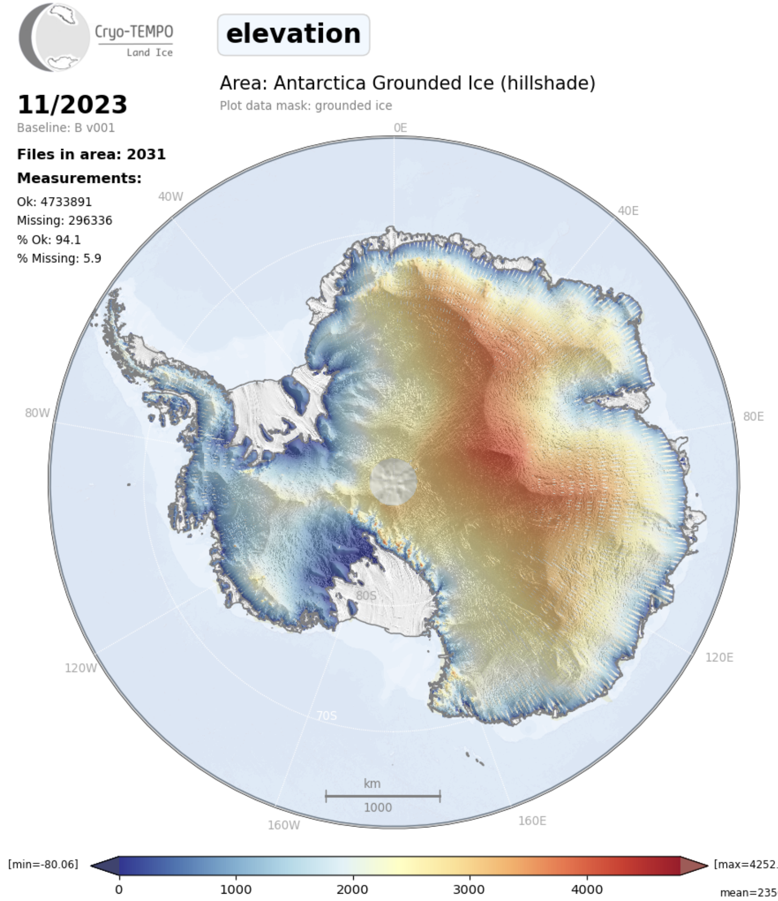
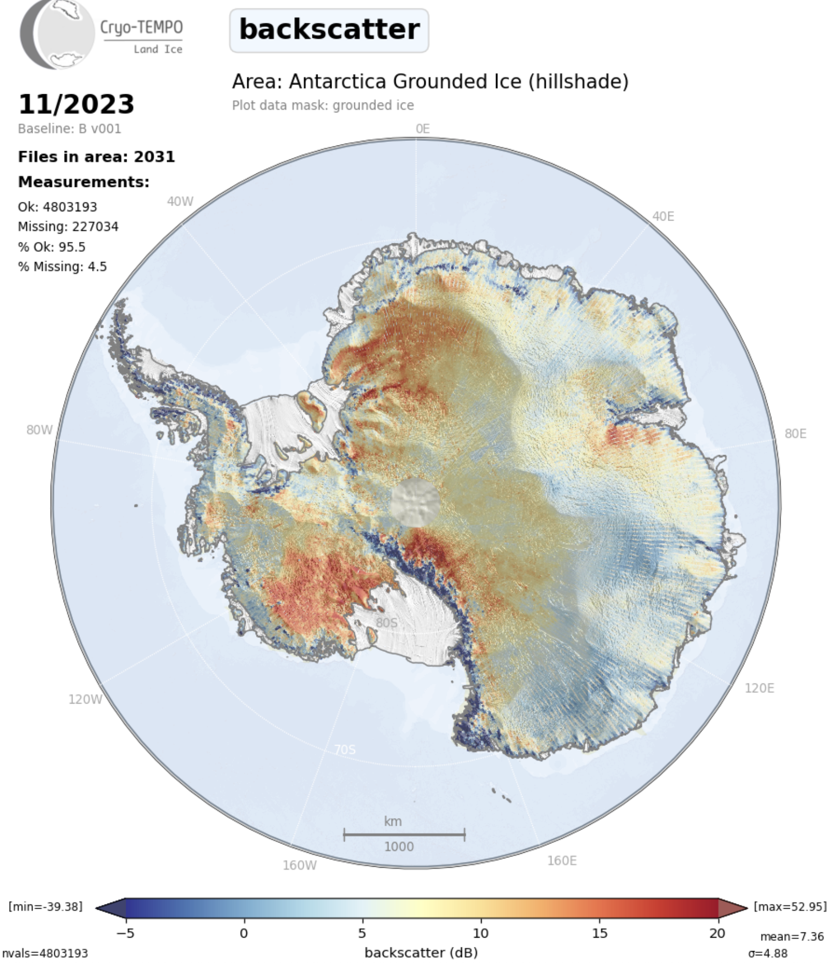
Primary RA Parameters
Single Mission L2 Elevation
Backscatter

Slide 5
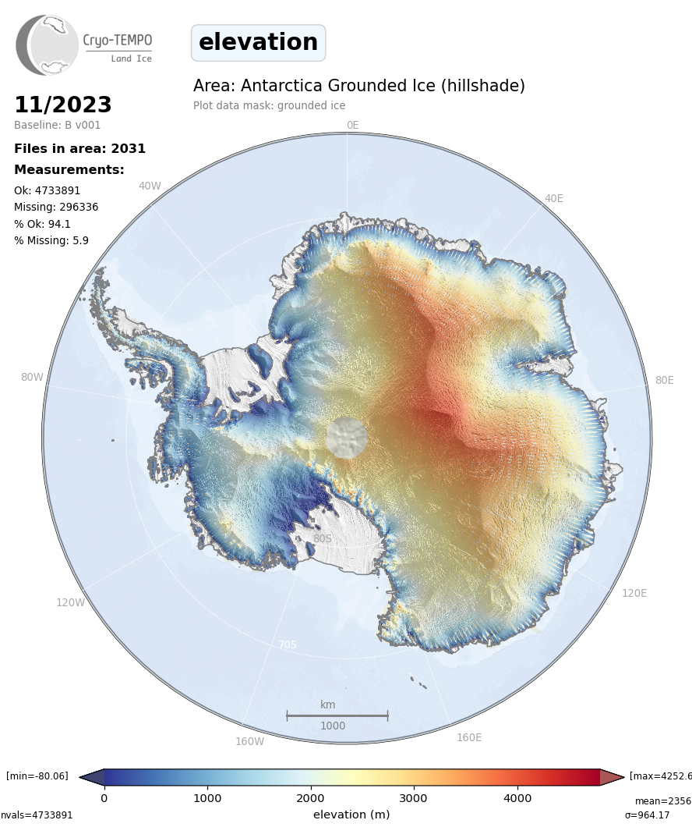
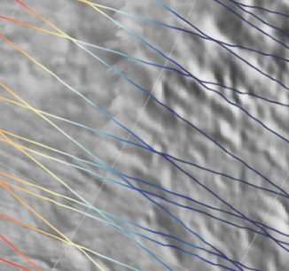
Model-fit method of SEC Determination
t0
5km
tN
Surface change is modelled
over time in each grid cell.
Local topography removed
to leave the temporal change
Corrected for backscatter
variations (correlated with elevation change)
& GIA

Slide 6
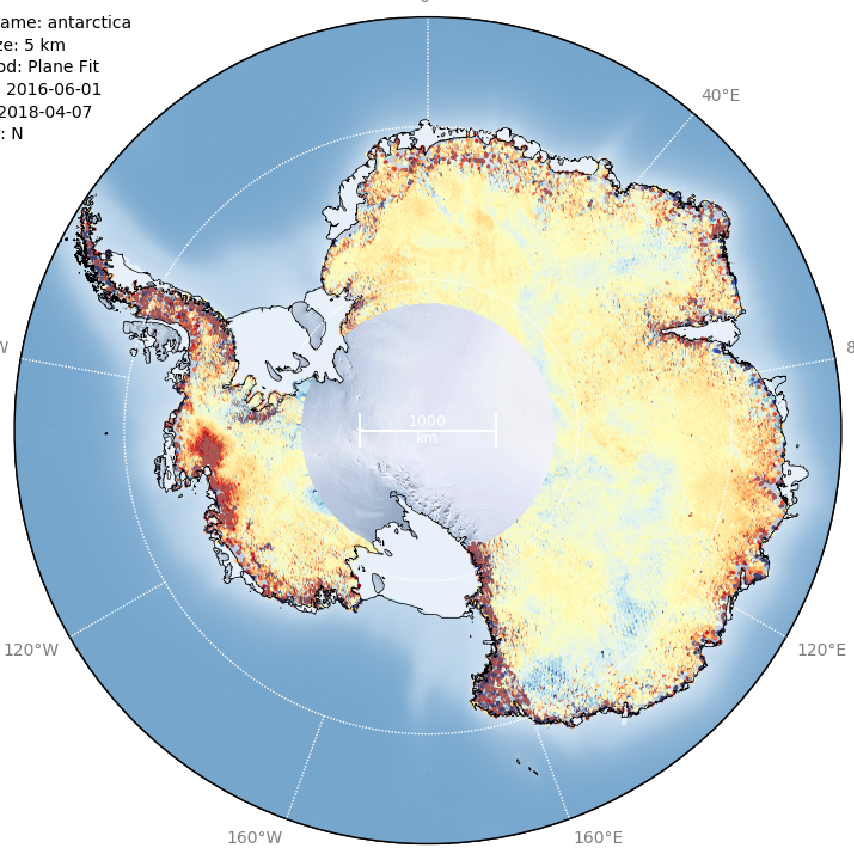
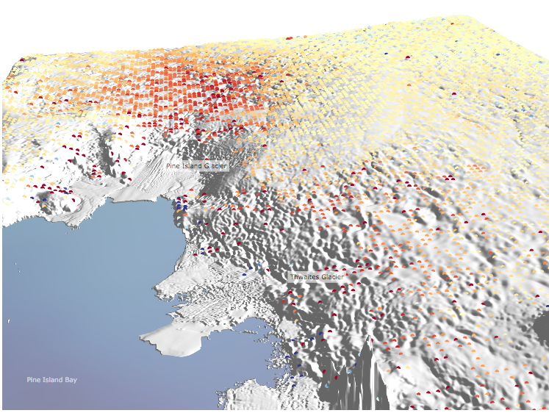
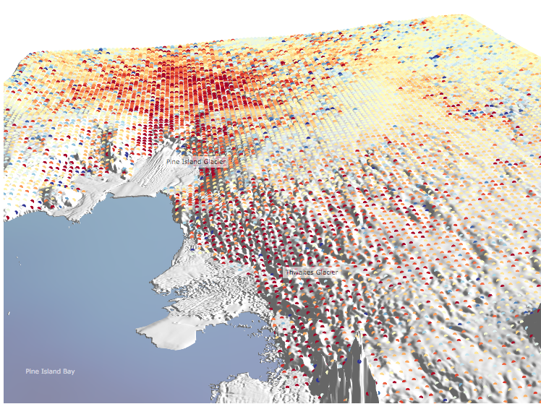
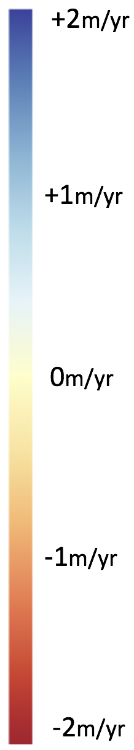
epoch average
140-days
SEC
single mission dH timeseries ->
->
dh/dt
5km Grids
S3A
CryoSat-2
Pine Island Glacier
Pine Island Glacier
Thwaites Glacier
Thwaites Glacier
Surface Elevation Change (May 2016-Apr 2018)
dh/dt
Surface Elevation Change (May 2014-Apr 2016)

Slide 7
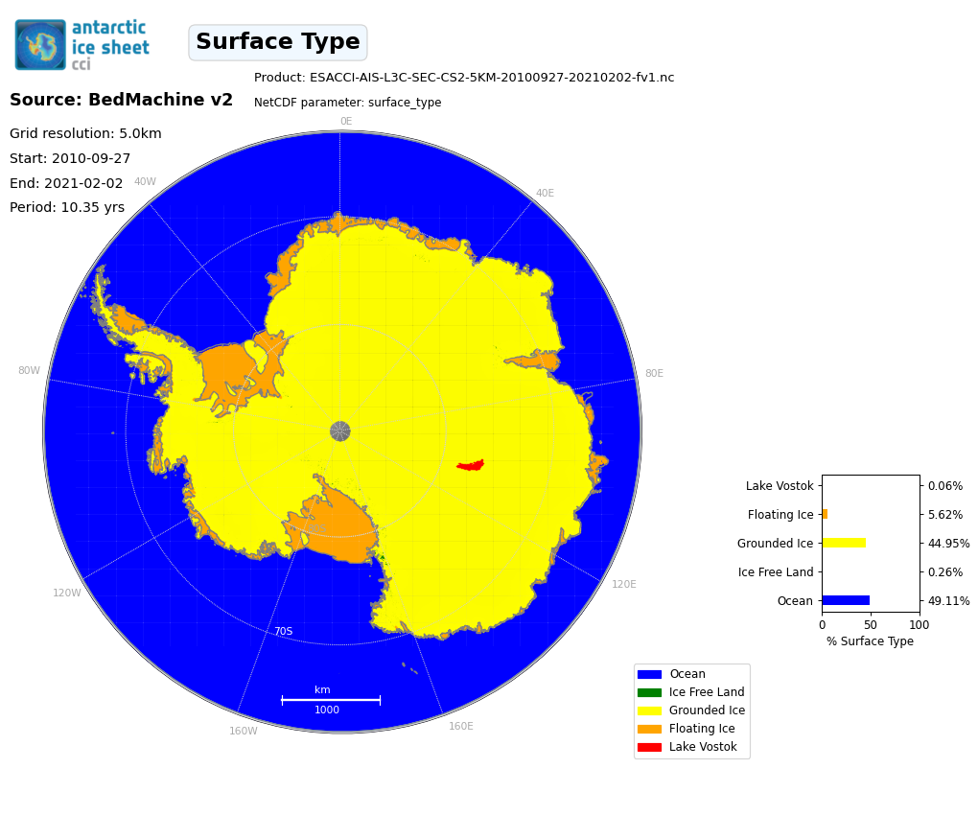
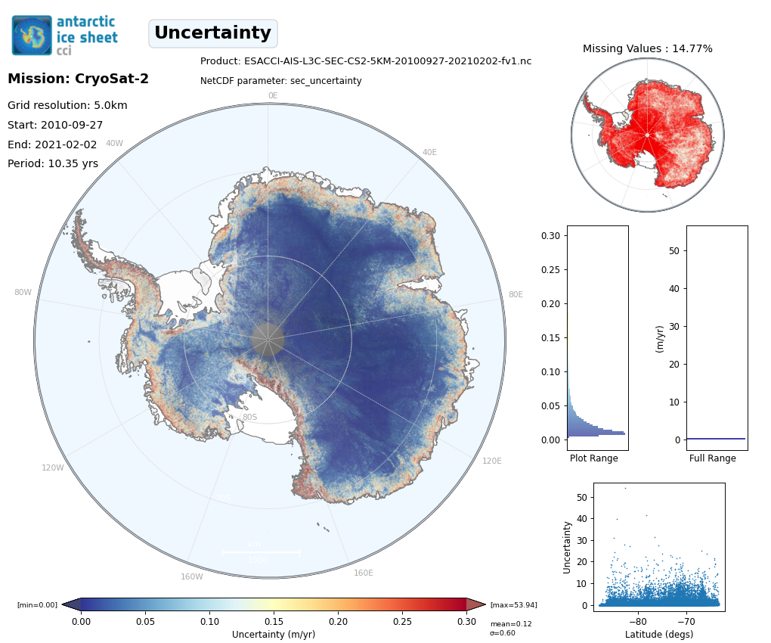
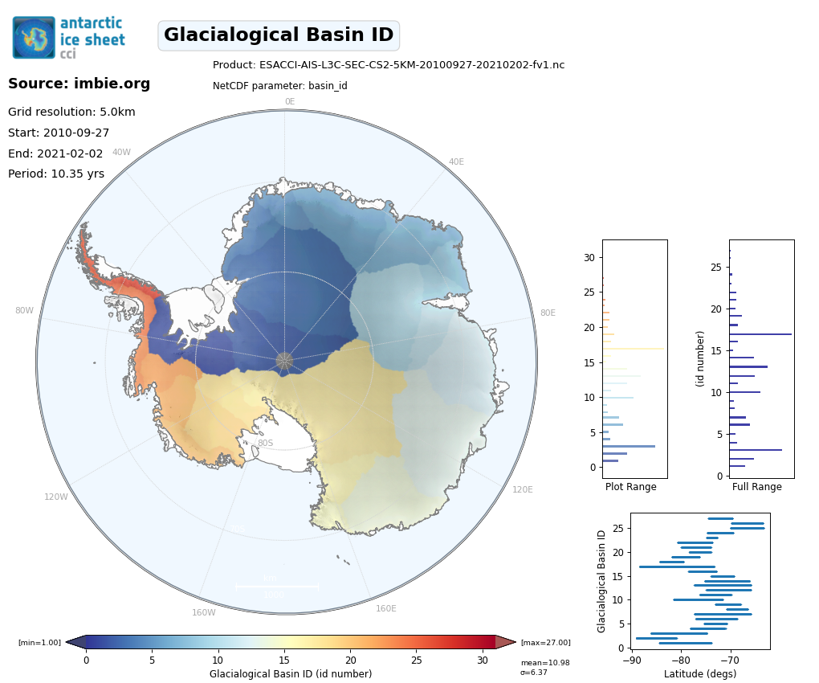
Single Mission Products : Main Parameters
Rignot(2016)

Slide 8
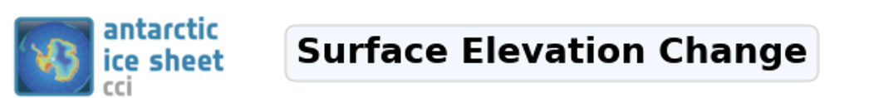
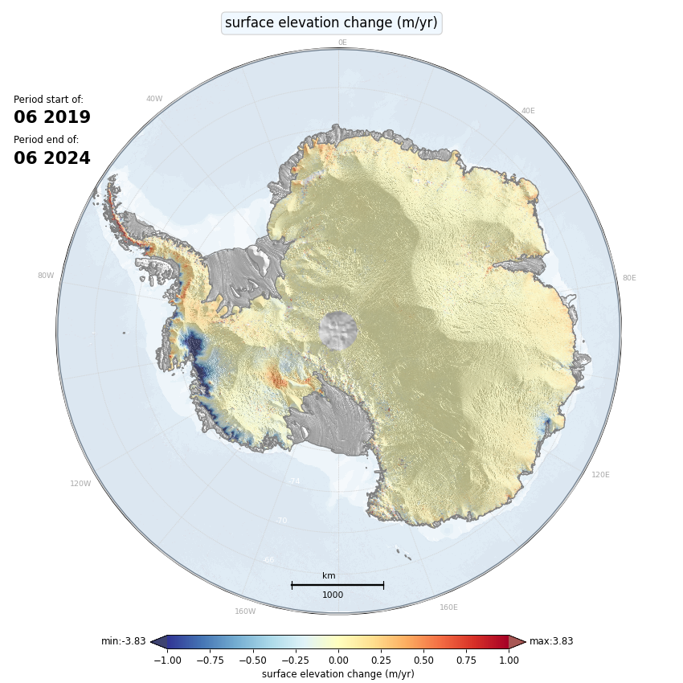
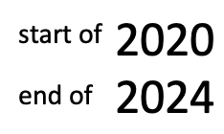
Single Mission dH timeseries ->
cross-calibration ->
Multi-mission SEC
5km Grids
Multi-mission RA
5km Grid
5-year periods
monthly updates

Slide 9
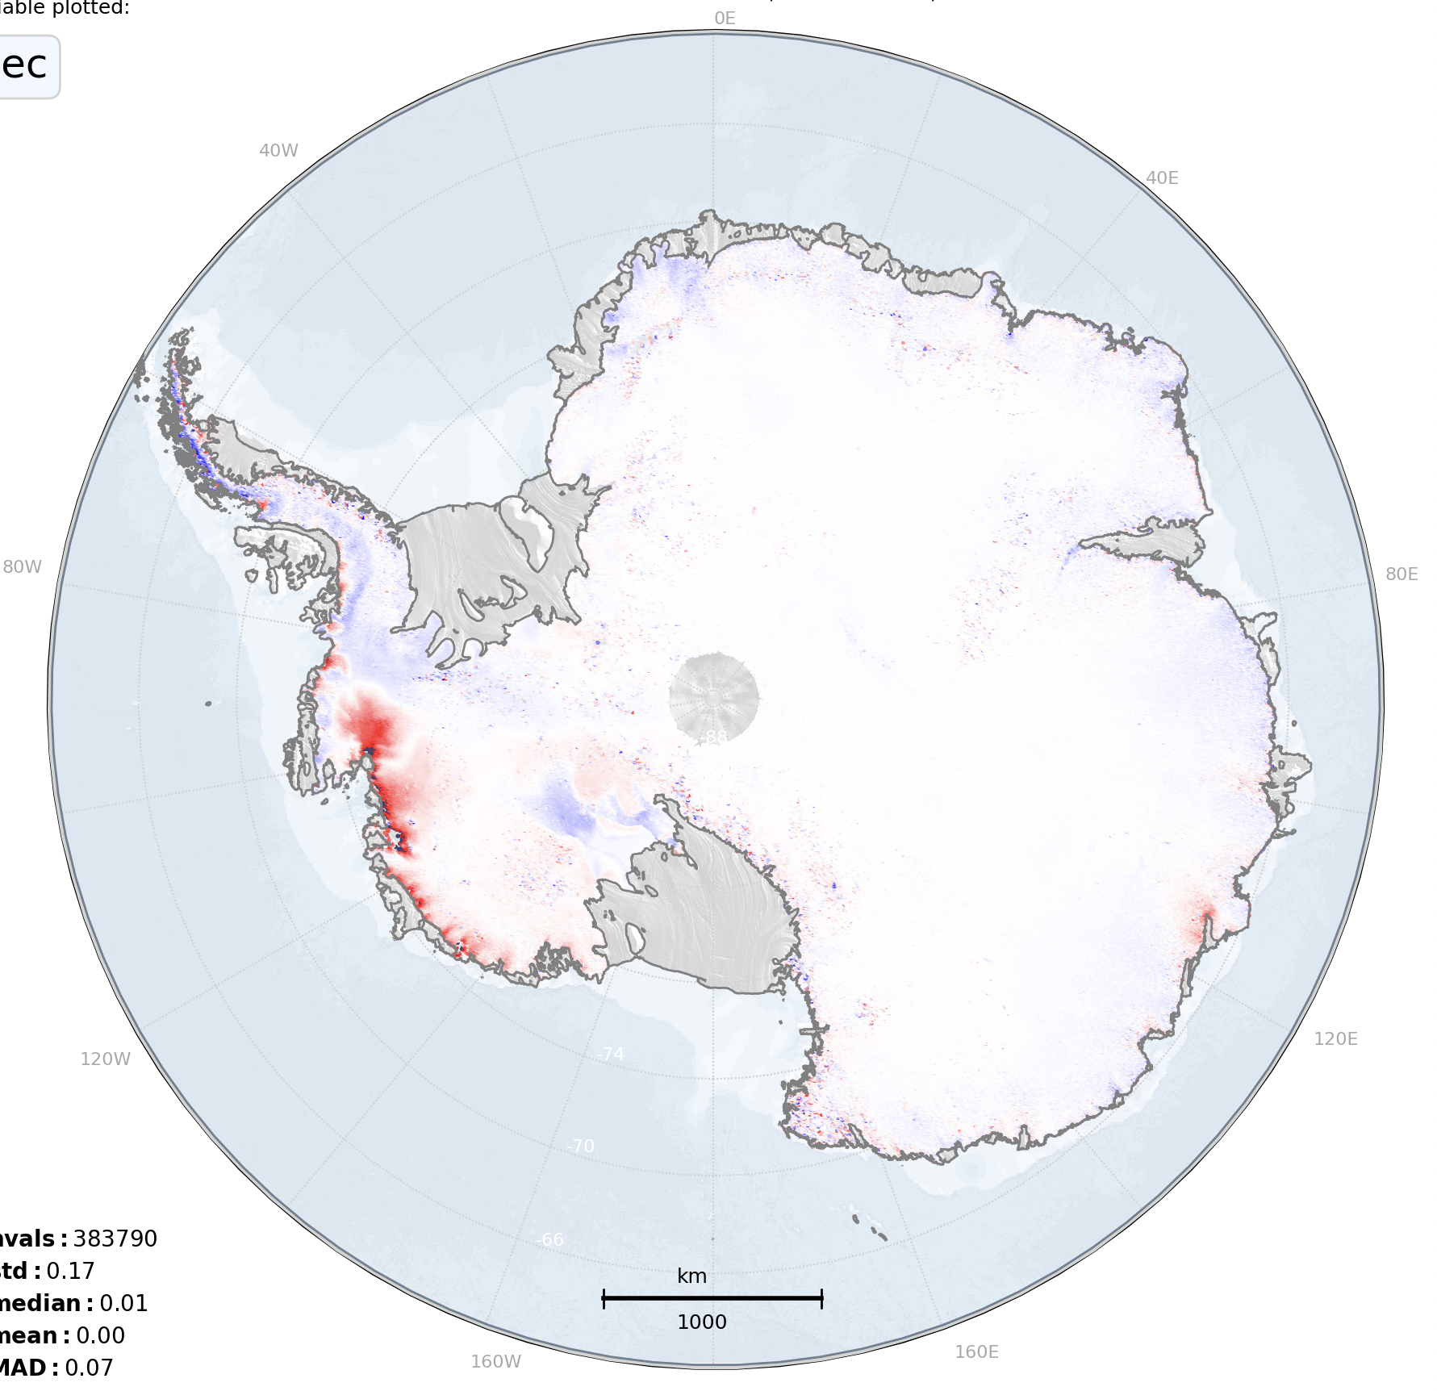
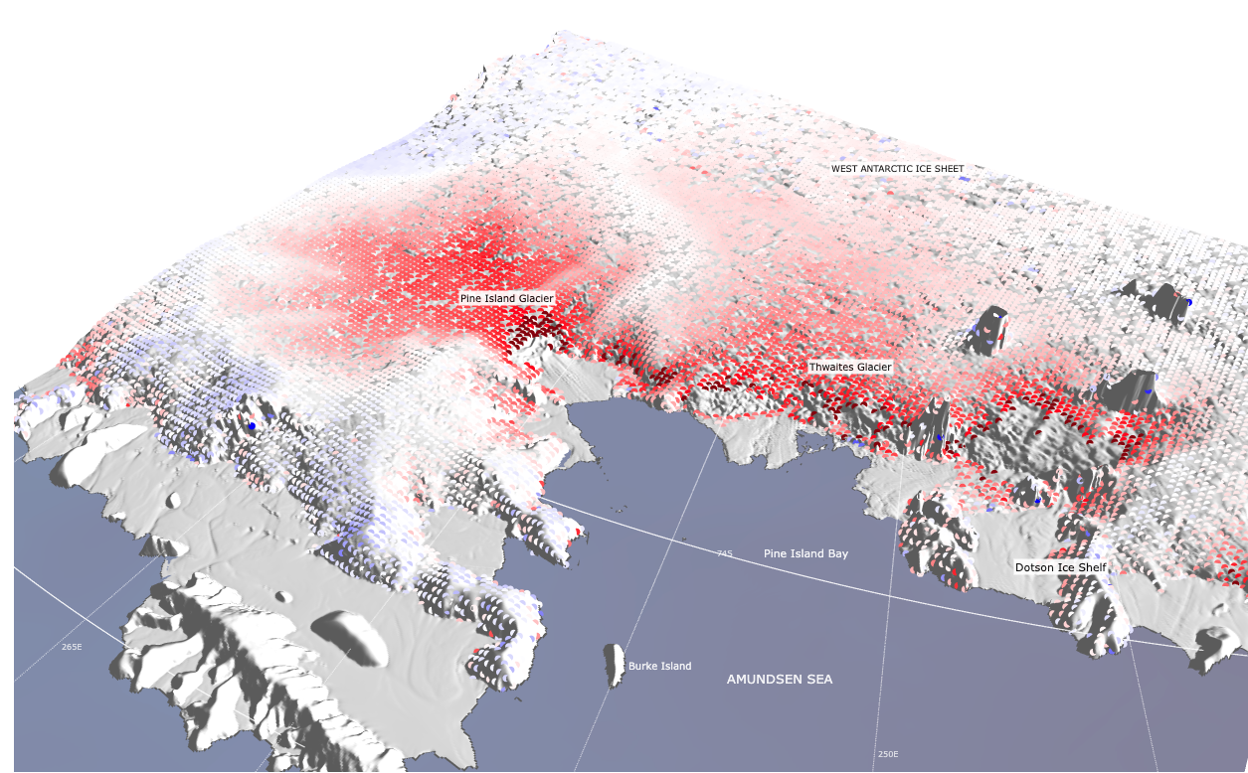

SEC
Multi- Mission dH timeseries ->
5km Grids
5-year Antarctic Ice Sheet
Surface Elevation Change
2019-2024
m/yr
2.0
multi-mission radar altimetry
1.5
1.0
0.5
0
-0.5
-1.0
-1.5
-2.0

Slide 10
AIS CCI+ SEC Baseline Product Summary
Single RA Mission SEC Products
Multi-mission SEC
Sensor Product | Grid Resolution | Temporal Coverage | Period | Main Parameters | Format
ERS-1 RA FDR4ALT v1 | 5km | 03-Aug-1991 02-Jun-1996 | 3 yrs, 10m | dh/dt, error | NetCDF + Quicklook jpg
ERS-2 RA FDR4ALT v1 | 5km | 13-May-1995 04-Jul-2003 | 8 yrs, 1m | dh/dt, error | NetCDF + Quicklook jpg
ENVISAT RA2 FDR4ALT v1 | 5km | 09-Apr-2002 18-Oct-2010 | 8 yrs, 5m | dh/dt, error | NetCDF + Quicklook jpg
CryoSat CryoTEMPO-D | 5km | 16-Jul-2010 31-Jun-2025 | 15 yrs, 0m | dh/dt, error | NetCDF + Quicklook jpg
Sentinel-3A BC04 | 5km | Dec-2016 31-Jun-2025 | 9 yrs, 7m | dh/dt, error | NetCDF + Quicklook pngs
Sentinel-3B BC04 | 5km | Nov-2018 31-Jun-2025 | 6 yrs, 8m | dh/dt, error | NetCDF + Quicklook pngs
Multi-mission
5-year means Monthly product 5km grid resolution dh/dt error new multi-mission cross-calibration algorithm developed

Slide 11
R&D Activities in Phase-2

Slide 12
R&D Activities in Phase-2
Integration and testing of new baseline products/formats for
all RA Missions
Development of new SEC products from ICESat-2
Development of new Annual dH Products

Slide 13
Integration of new Input Altimetry Products – (Phase-2)
Sensor | Products used in AIS CCI+ Phase-1 | New Product Baselines (AIS CCI phase-2, 2025)
ERS1 | REAPER v1 | FDR4ALT v1 Thematic Land Ice
ERS2 | REAPER v1 | FDR4ALT v1 Thematic Land Ice
ENVISAT | GDR v3 | FDR4ALT v1 Thematic Land Ice
CryoSat-2 | ESA L2i Baseline-D | ESA CryoTEMPO LI Baseline-D
Sentinel-3A | ESA L2 BC-04 | ESA Thematic Land Ice L2
Sentinel-3B | ESA L2 BC-04 | ESA Thematic Land Ice L2
New in phase-2:
ICESat-2 | - | ATL-06 v006, v007

Slide 14
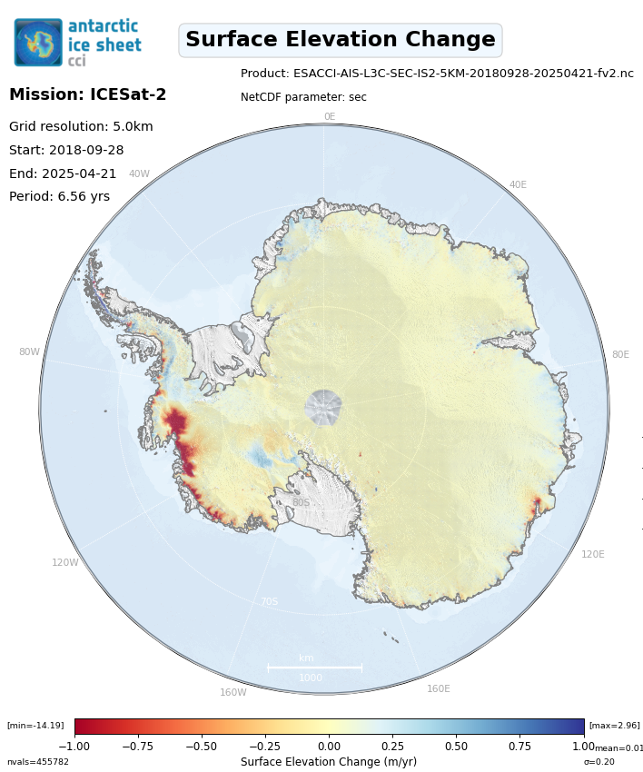
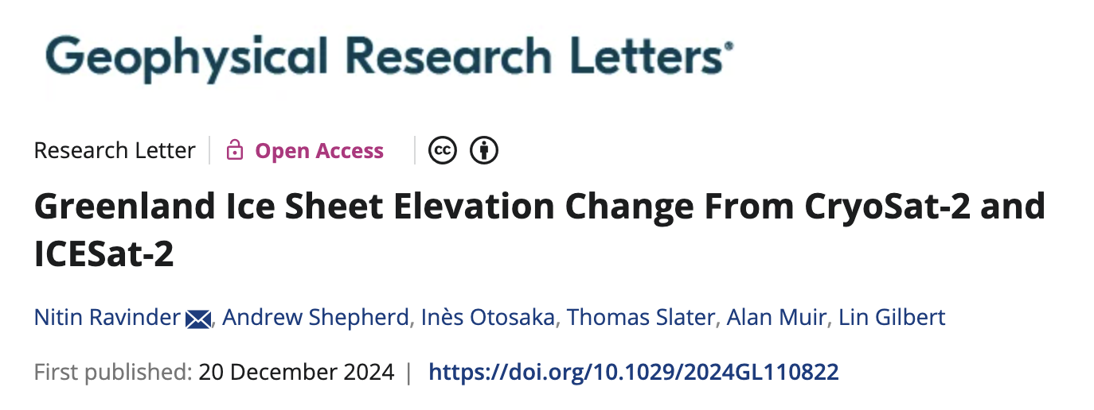
ICESat-2
2018 – 2025…
New SEC product
in CCI phase-2
Required a new segmented processing scheme (due to higher data volume than RA)
Perform weighted surface fit using the IS2 uncertainty values as weighting
Method published:

Slide 15
ICESat-2 Laser Altimeter method
ATL-06 Elevation data
Masking and Gridding
Remove points that aren't in the target area and add remaining elevation measurements to a uniform grid
Fragment gridded files
Divide gridded files into smaller fragments to reduce resource usage
Weighted Surface Fitting
Elevation change for each grid cell is modelled using a plane fit method, using an uncertainty parameter as a model weight
Epoch Averaging and Corrections
Apply glacial isostatic adjustment corrections if required, and calculate the mean elevation change within periods of a set length
Join fragments together
Rejoin fragments to recreate the whole target area
Calculate dh/dt
Calculate the elevation change rate for the desired time period

Slide 16
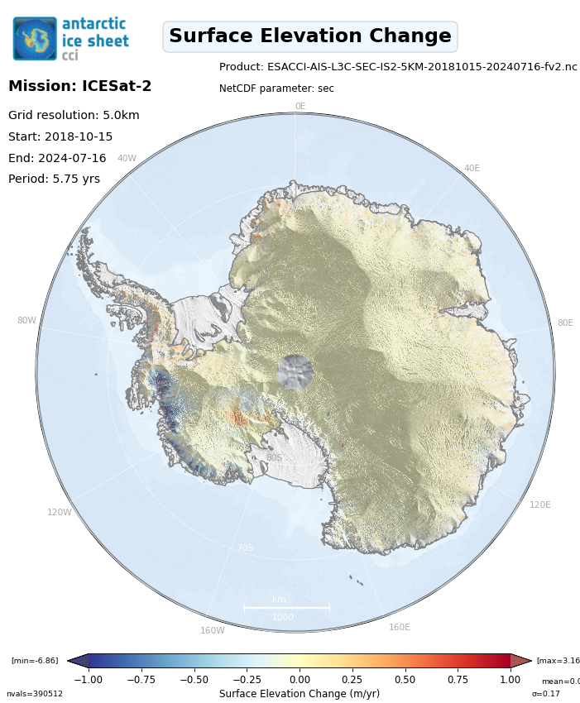
ICESat-2
2018 – 2025…
New SEC product
in CCI phase-2
Required a new segmented processing scheme (due to higher data volume than RA)
Perform weighted surface fit using the IS2 uncertainty values as weighting
Method published:
IS2 processing presentation
by Nitin at PM1 (Sep 24).

Slide 17
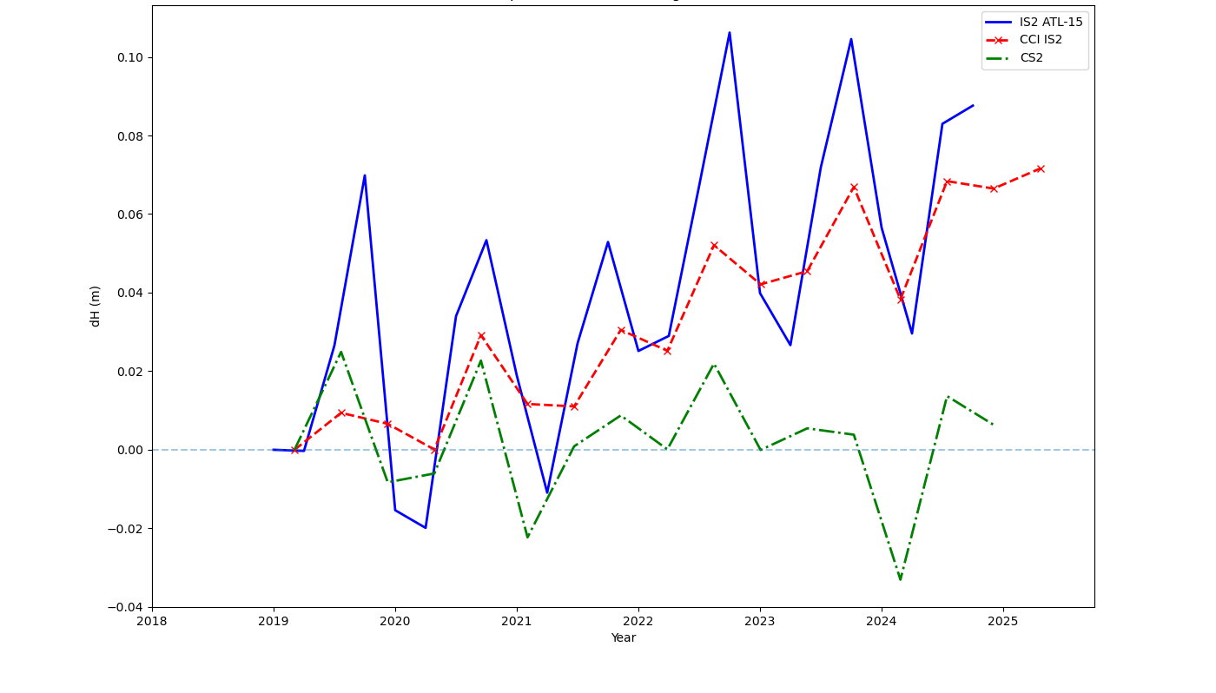
Antarctic Ice Sheet
Comparison of dH values vs ATL-15 and CS2

Slide 18
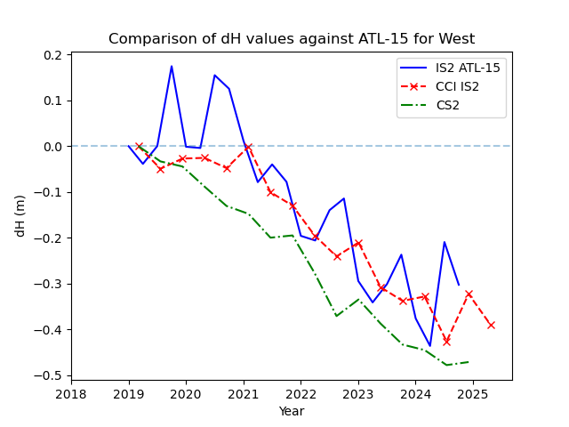
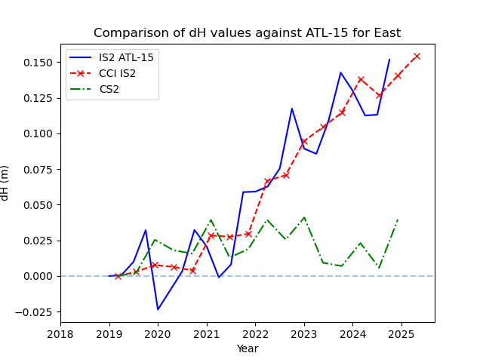
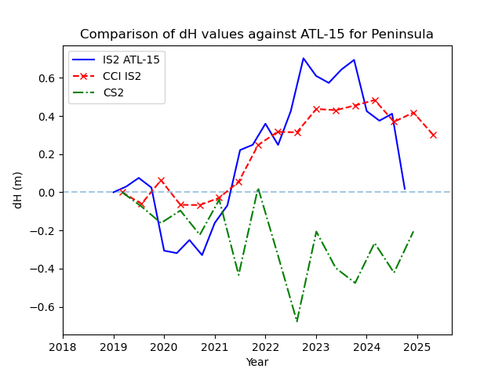
Antarctic Ice Sheet
Comparison of dH values vs ATL-15 and CS2
West
East
Peninsula

Slide 19
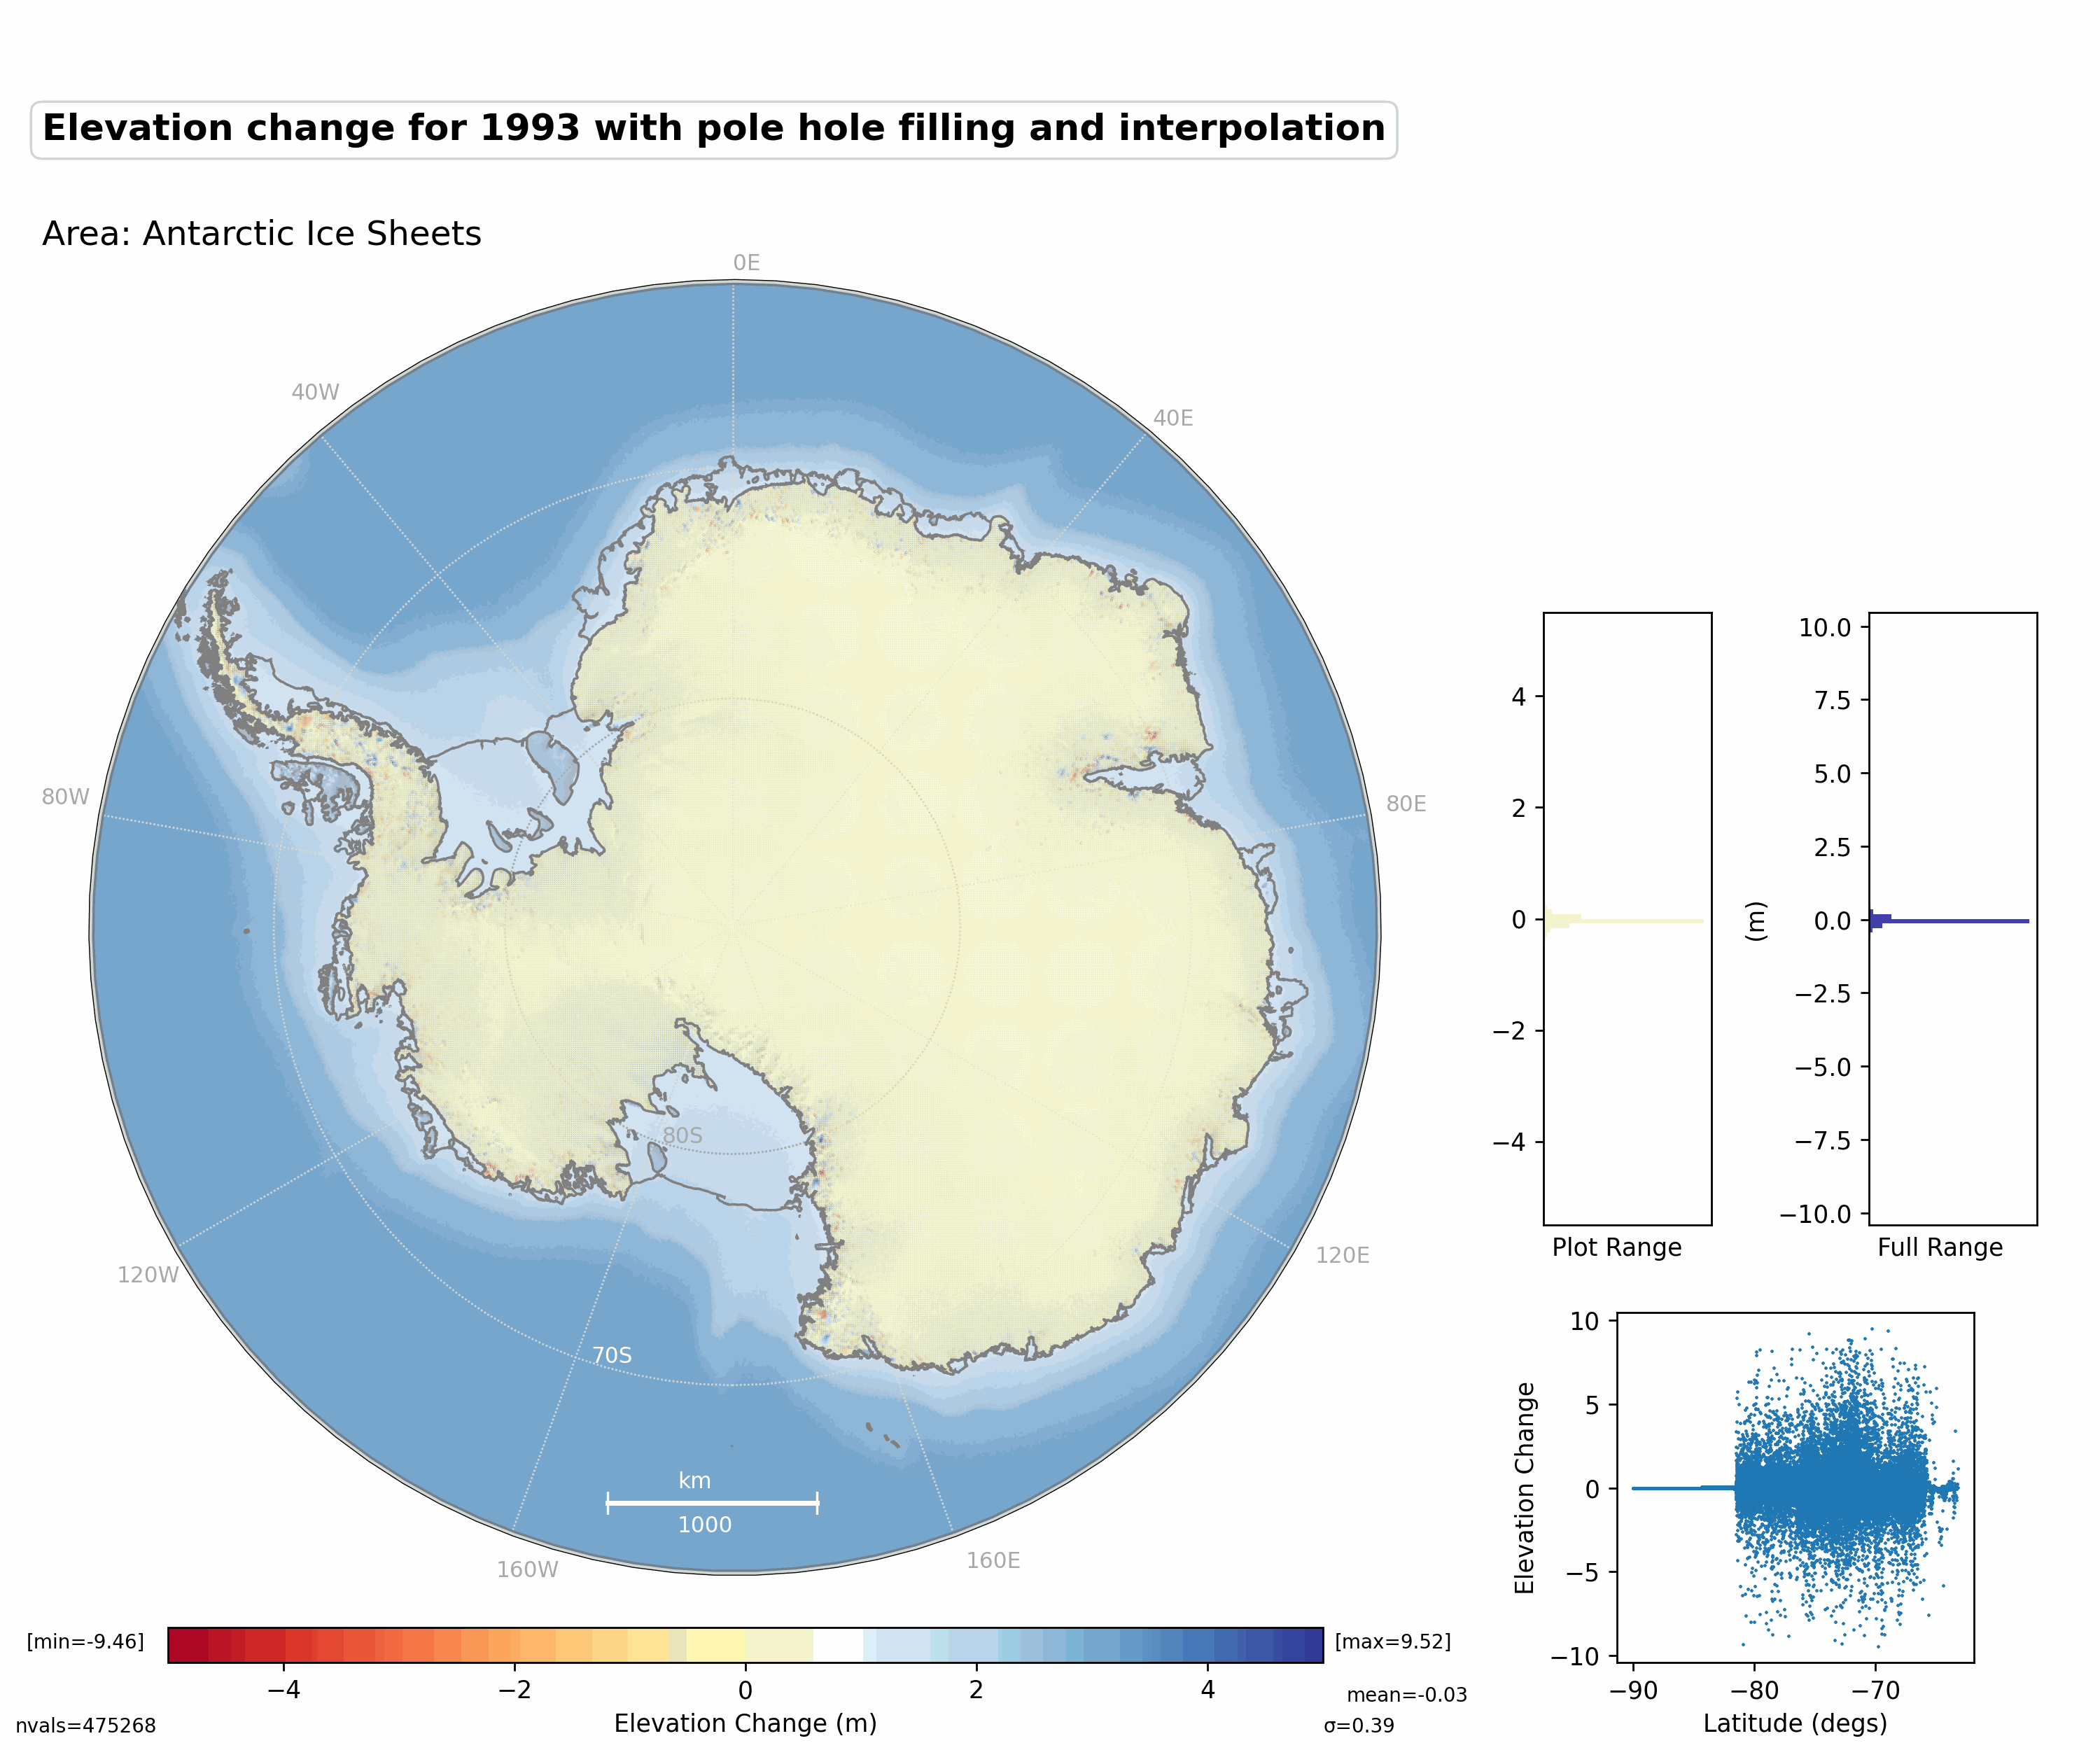
Annual Elevation Change (dH) grid product
Fill in the pole hole
Calculate multi-mission time series
Interpolate missing cells
Calculate dH per year

Slide 20
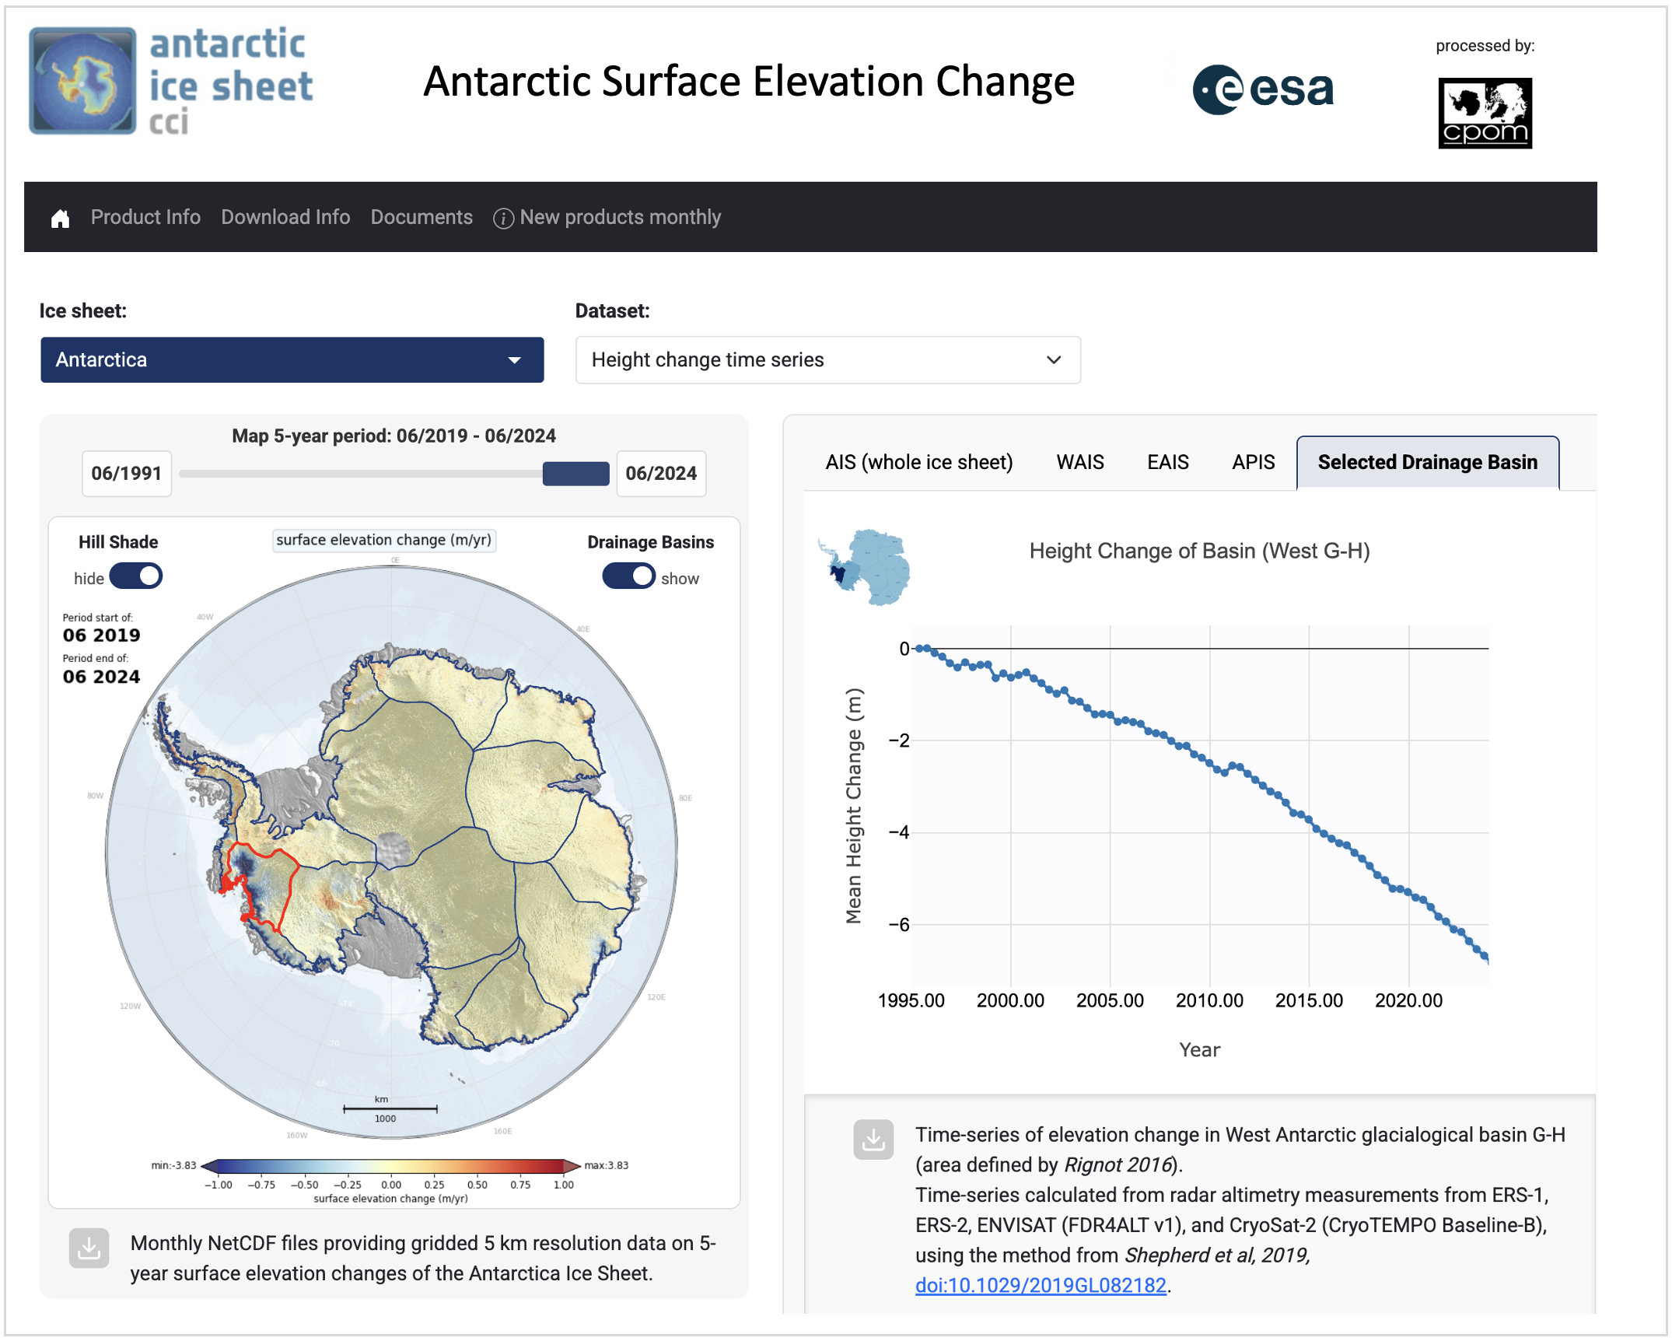
AIS CCI phase-2
products will be
available shortly
on a new portal

Slide 21
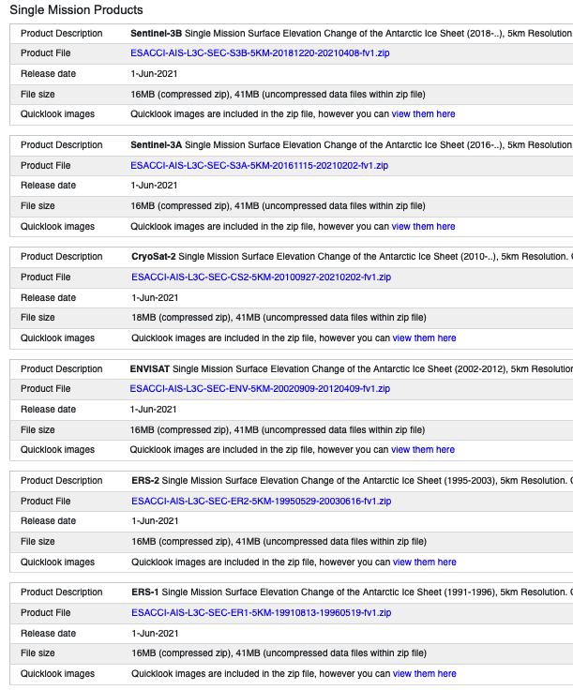
ESACCI-AIS-L3C-SEC-CS2-5KM-20100927-20210202-fv1.zip
ESACCI-AIS-L3C-SEC-CS2-5KM-20100927-20210202-fv1.nc
+
ESACCI-AIS-L3C-SEC-CS2-5KM-20100927-20210202-fv1_sec.png
ESACCI-AIS-L3C-SEC-CS2-5KM-20100927-20210202-fv1_sec_uncertainty.png
ESACCI-AIS-L3C-SEC-CS2-5KM-20100927-20210202-fv1_basin_id.png
ESACCI-AIS-L3C-SEC-CS2-5KM-20100927-20210202-fv1_surface_type.png
Products Comply with CCI Data Standards v2.2
[Climate and Forecast Metadata ]CF 1.9 compliant

Slide 22
Phase-2 SEC Summary
Integration of all new L2 product baselines
for all RA missions
  ERS-1, ERS-2,ENVISAT, CS2, S3A, S3B
Development of new products for Phase-2
  ICESat-2
    new processing chain developed at NU using method as per
    Ravinder at al, GRL, 2024
  Annual DEMs from full RA timeframe
  Final phase-2 product verification & validation in process
  New product portal will be available in Q4 2025 for product
  dissemination and basin time series visualization.

