Slide 1
S3 MPC S3 Thematic Sea Ice TDS Validation
Alan Muir^{1,2}, David Brockley¹ , Steve Baker¹
¹Mullard Space Science Laboratory (MSSL), University College London (UCL), UK. ² Centre for Polar Observation and Modeling (CPOM), UCL, UK.
S3 Mission Performance Centre, ESL for Ice Surfaces
ESL STM Council Meeting #8 – Nov 2021

Slide 2
Validation of:
Sea Ice Thematic IPF TDS (version 2)
Availability : from CLS on 7th Sep 2021
T-IPF Sea Ice TDS : cycle 15/16 : 04-Mar-2017 -> 30-Mar-2017
Also provided:
IPF 6.18 reference TDS: for same period.

Slide 3
Changes in S3__SR_2_CON_AX Thresholds used in T-IPF for Sea Ice
Sea Ice Discrimination
 | IPF | T-IPF
ALT_MAN_WAV_02: peakiness_high_ths_ice | 11 | 16
Peakiness_low_ths_lead | 21 | 24
Sea Ice Retracker Bias
 | IPF | T-IPF
ALT_RET_ICE_06: diffuse_bias_c: | 0.1623 | 0.1789
Based on tuning studies from IPF data (will need repeating with T-IPF once enough data is available)

Slide 4
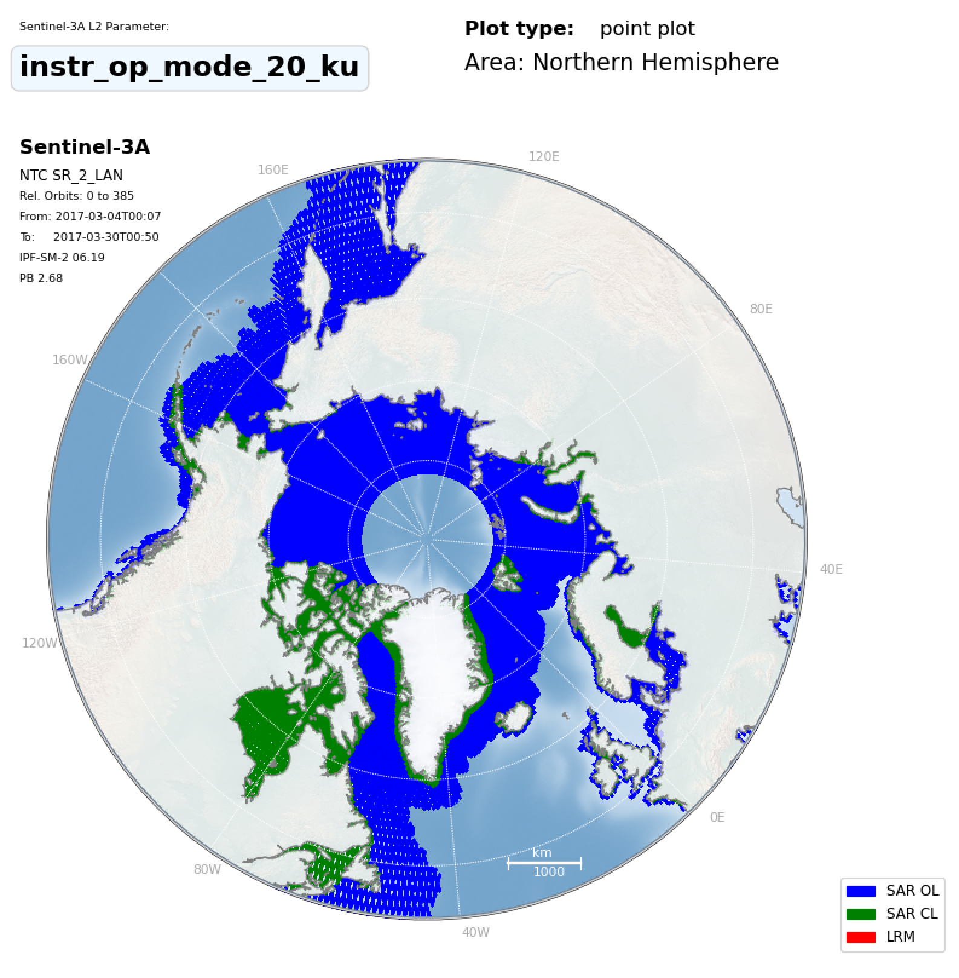
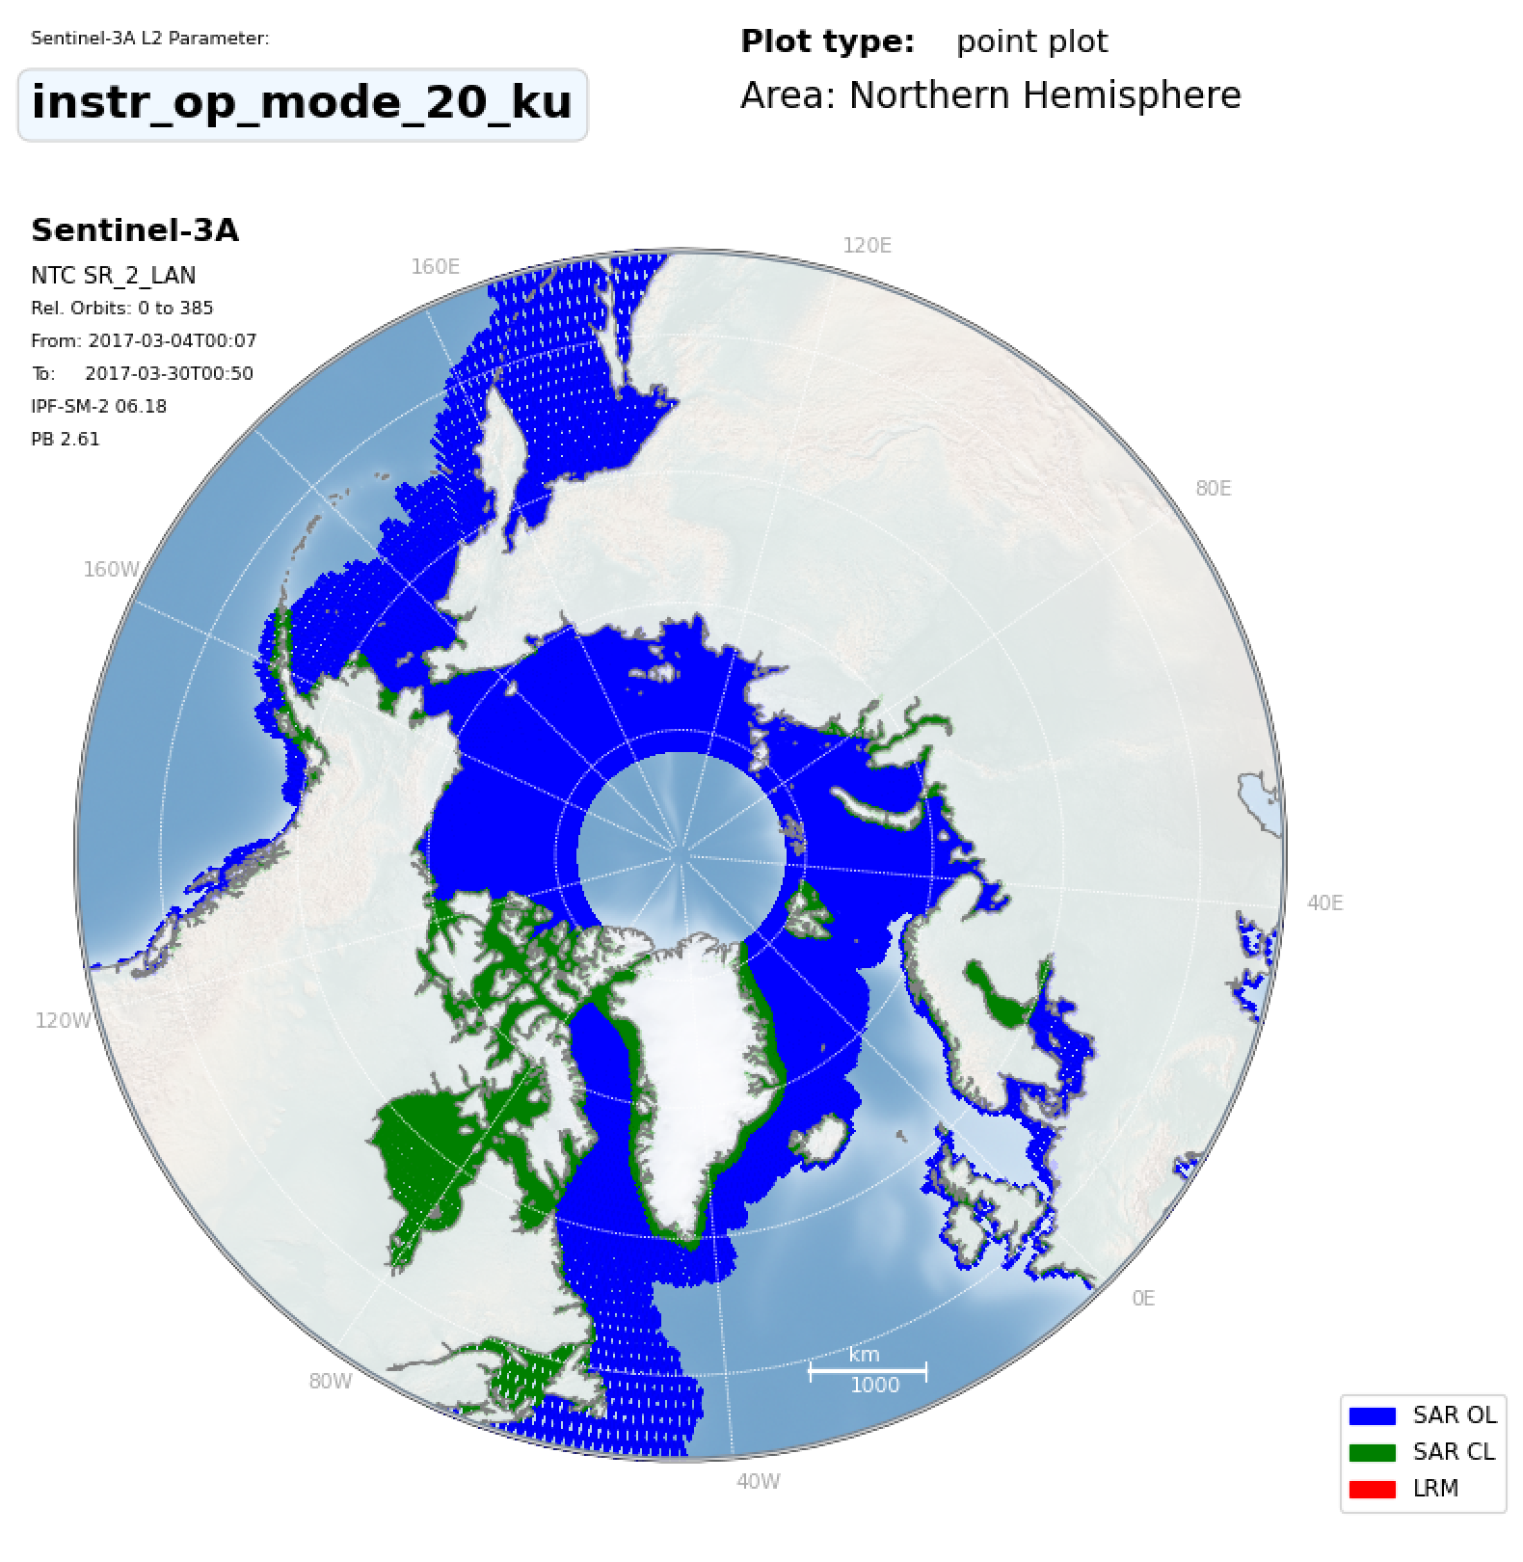
THEMATIC_SEAICE
Area Coverage/Mode
IPF_6.18

Slide 5
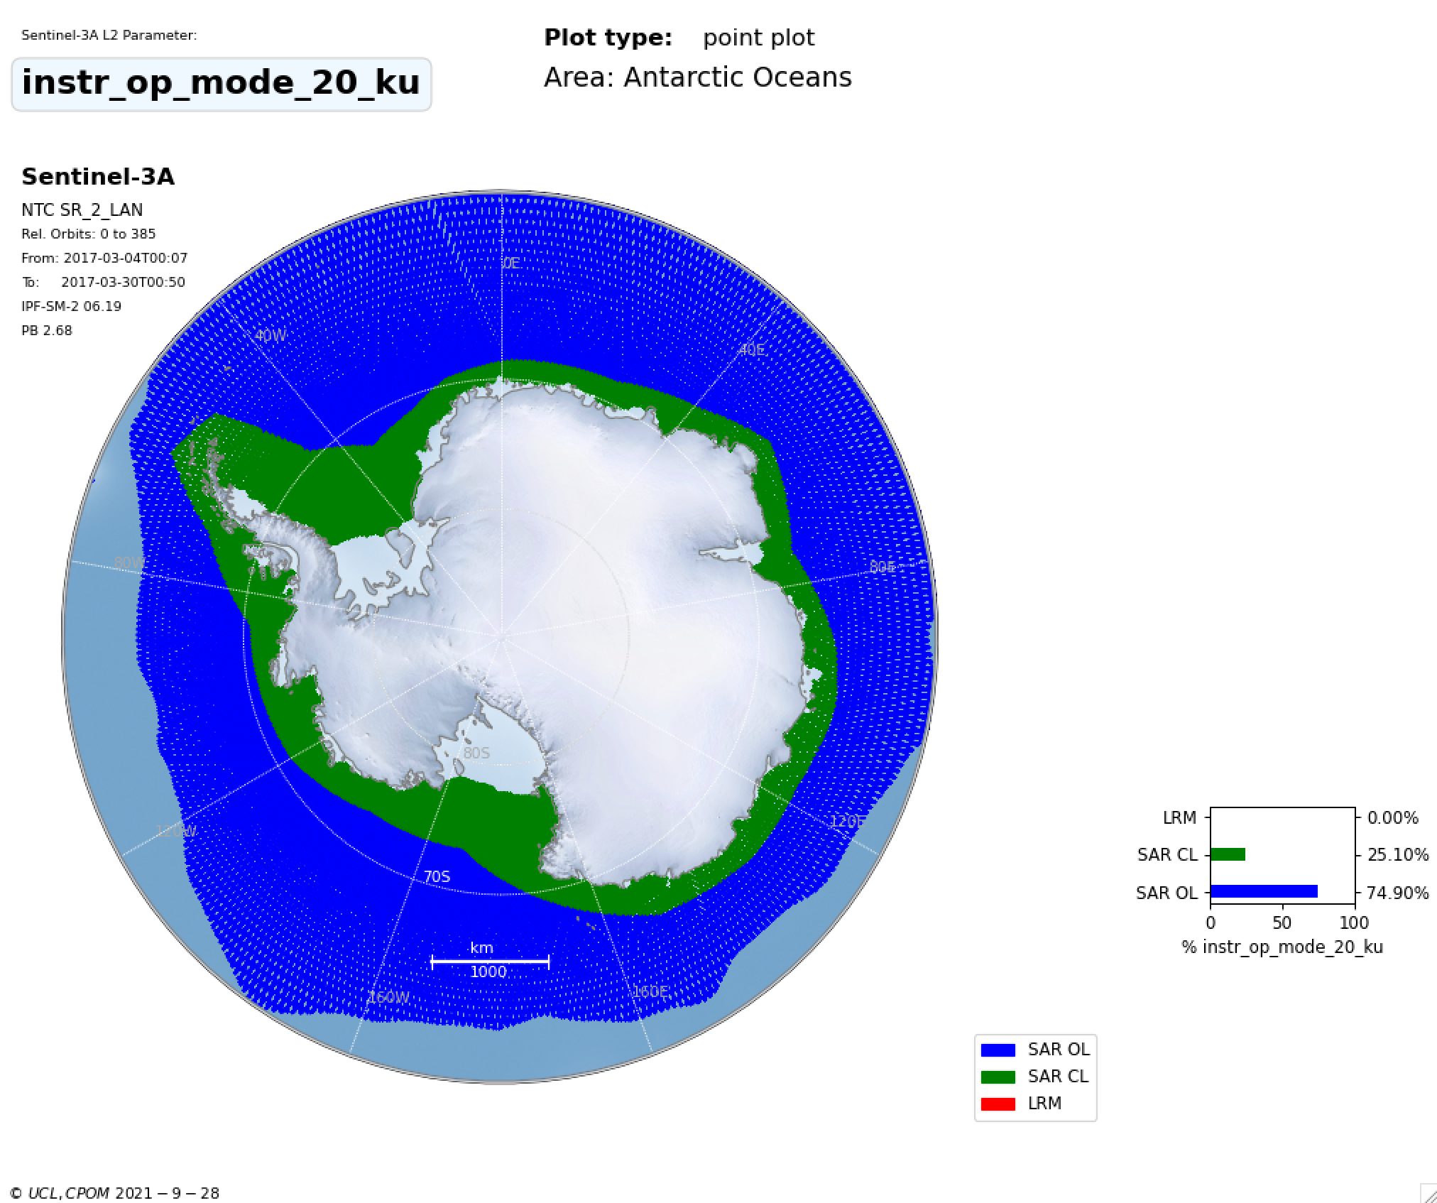
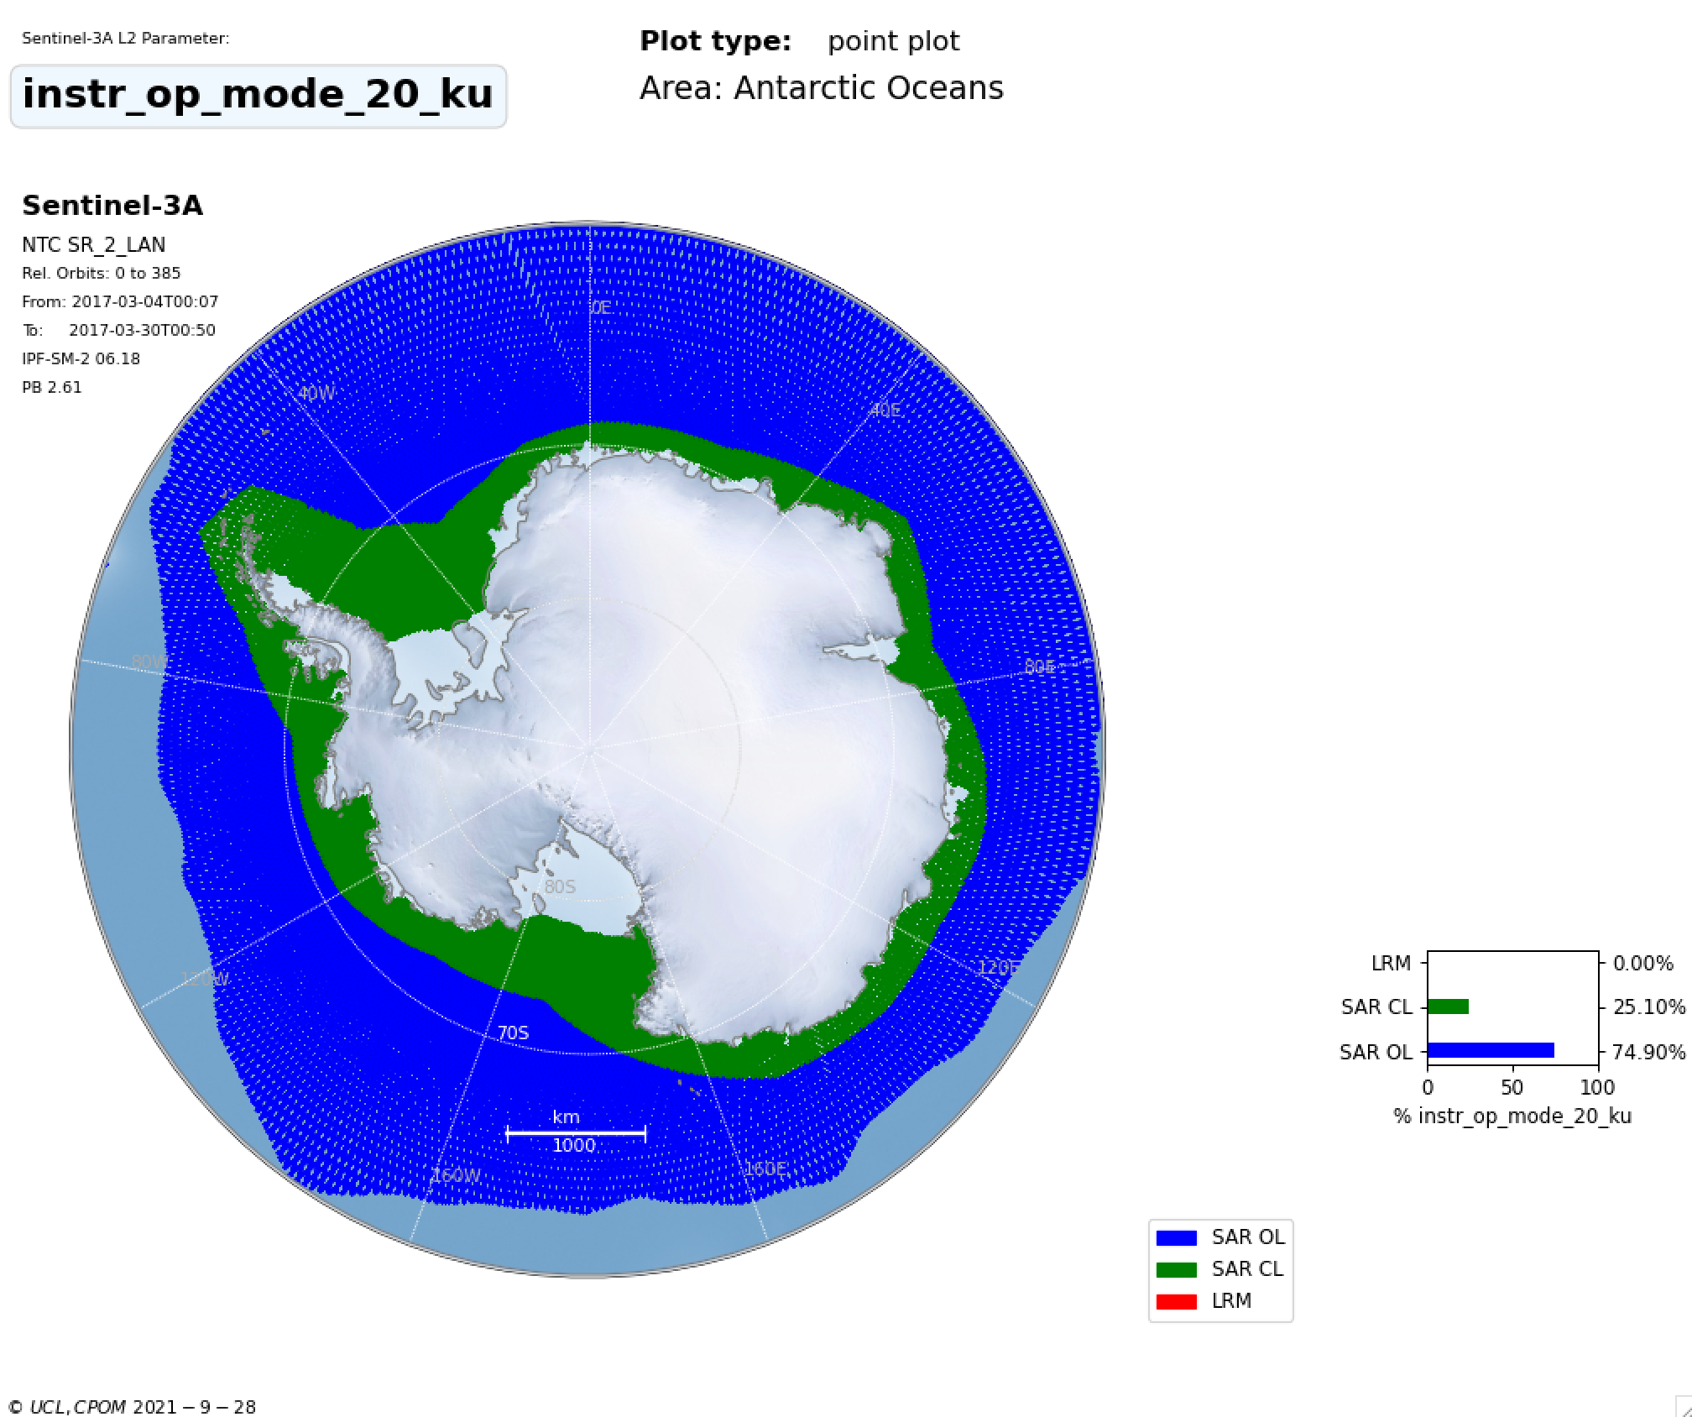
THEMATIC_SEAICE
Area Coverage/Mode
IPF_6.18

Slide 6
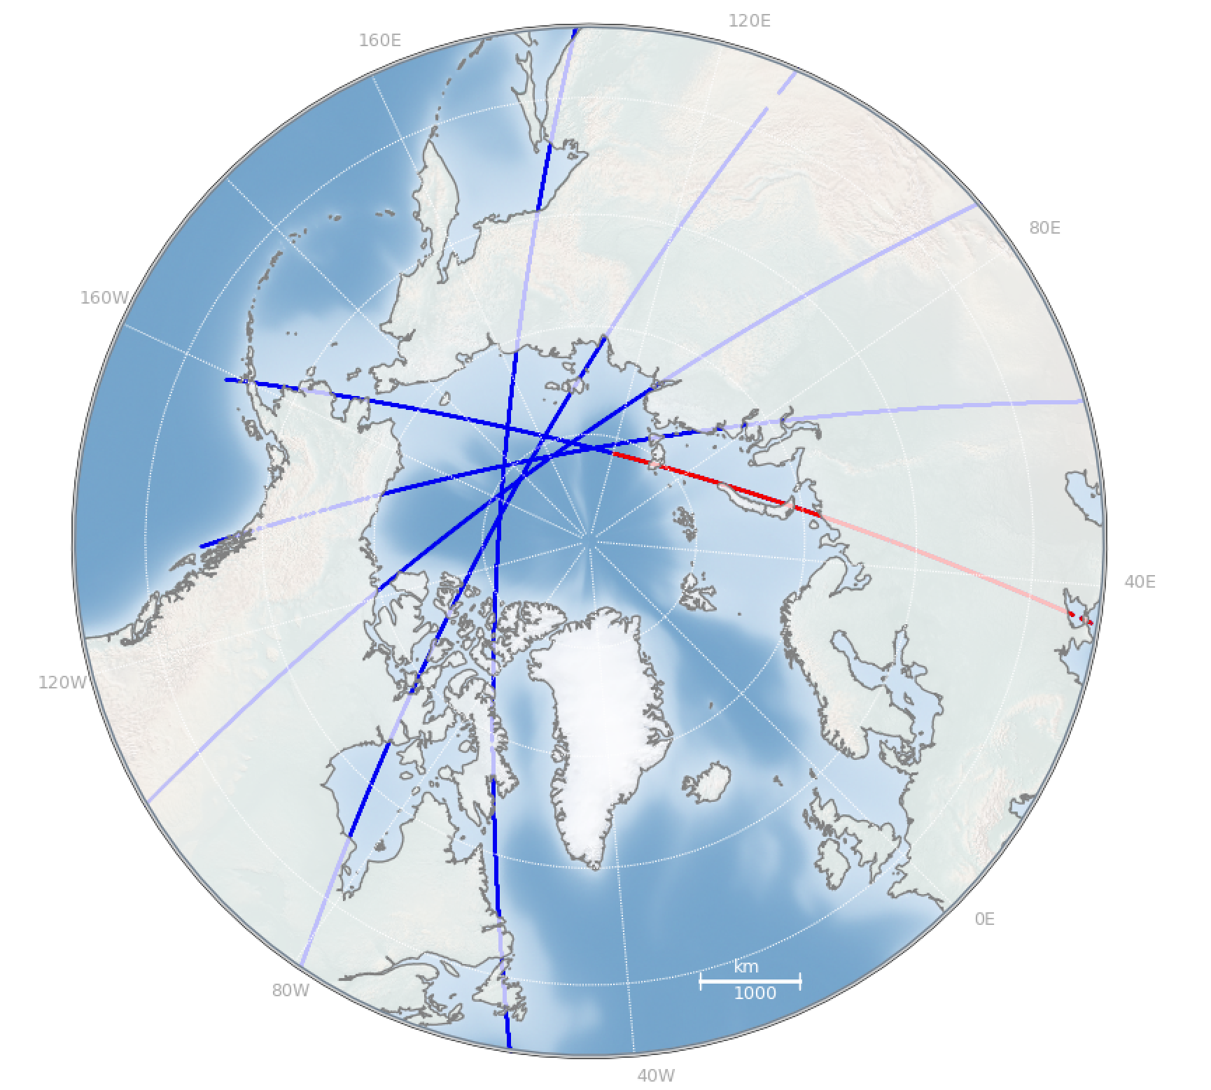
T-IPF was not processed
Equator to Equator
(as it should be)
1 L2 product

Slide 7
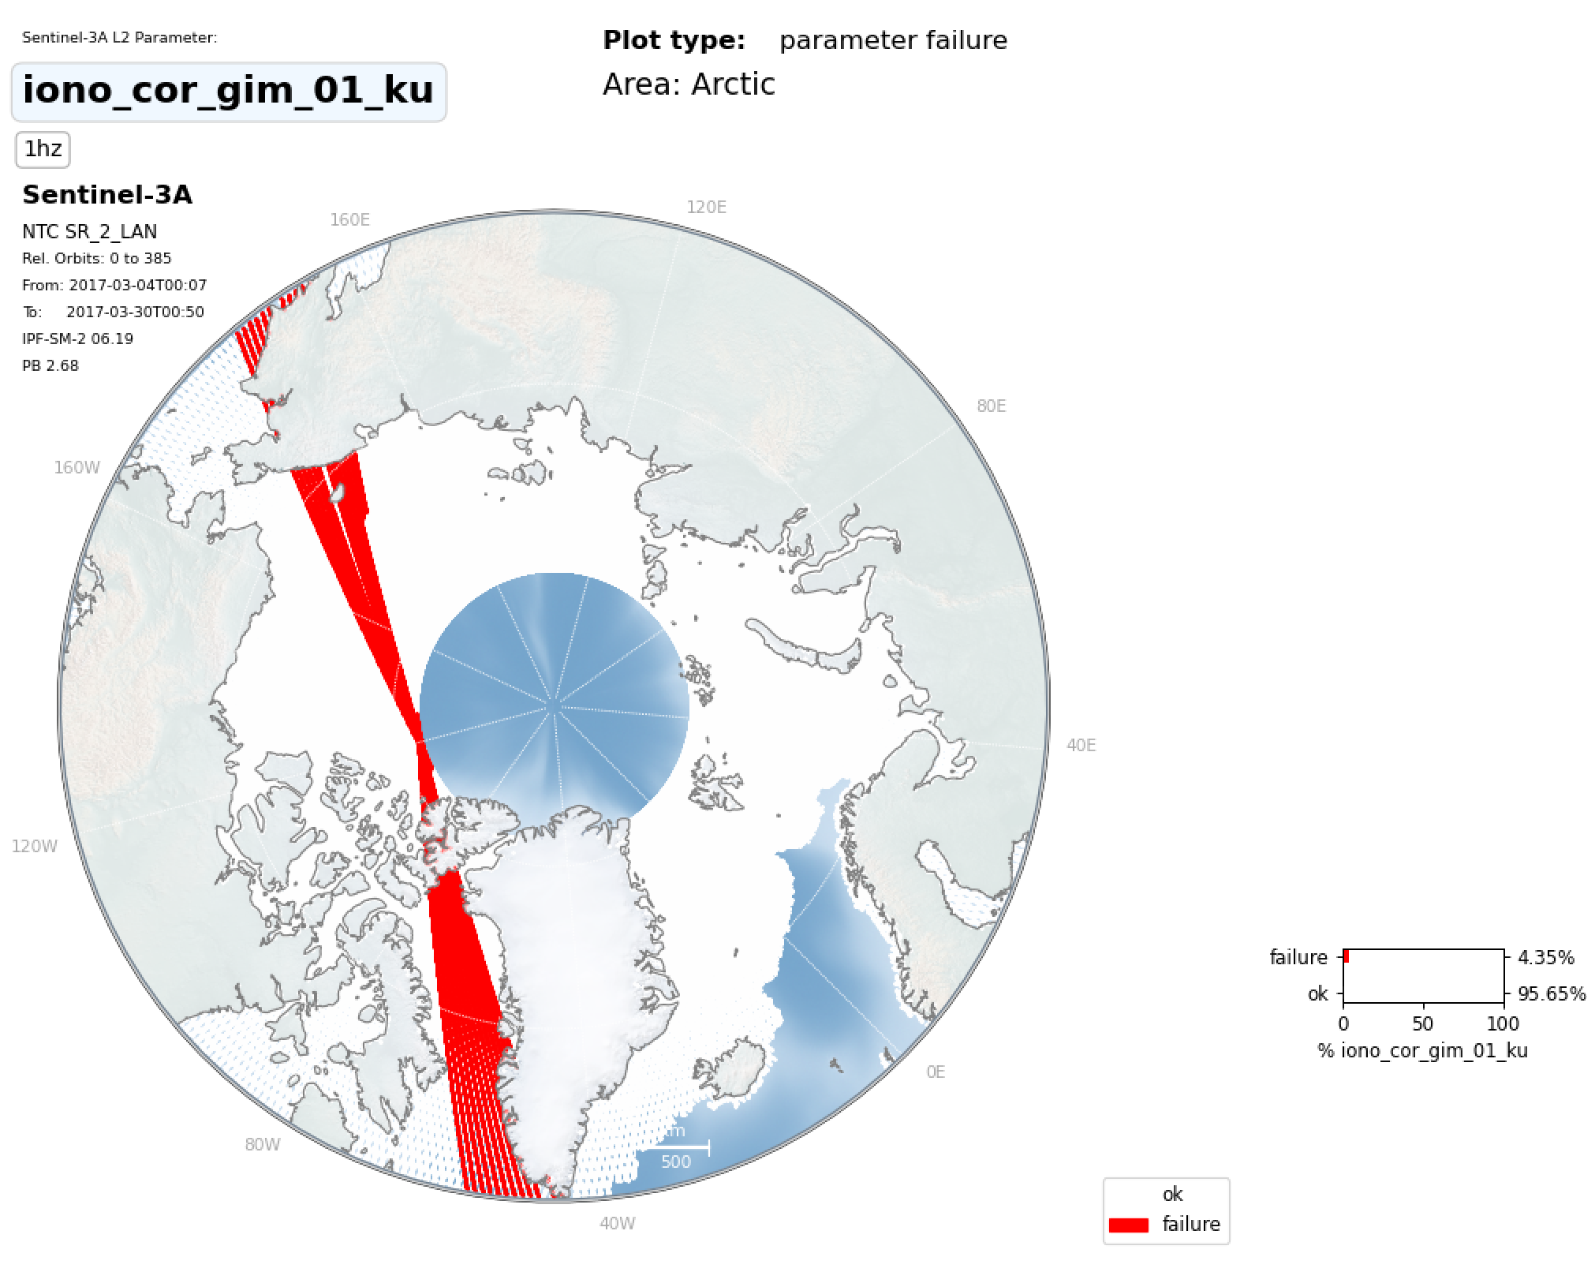
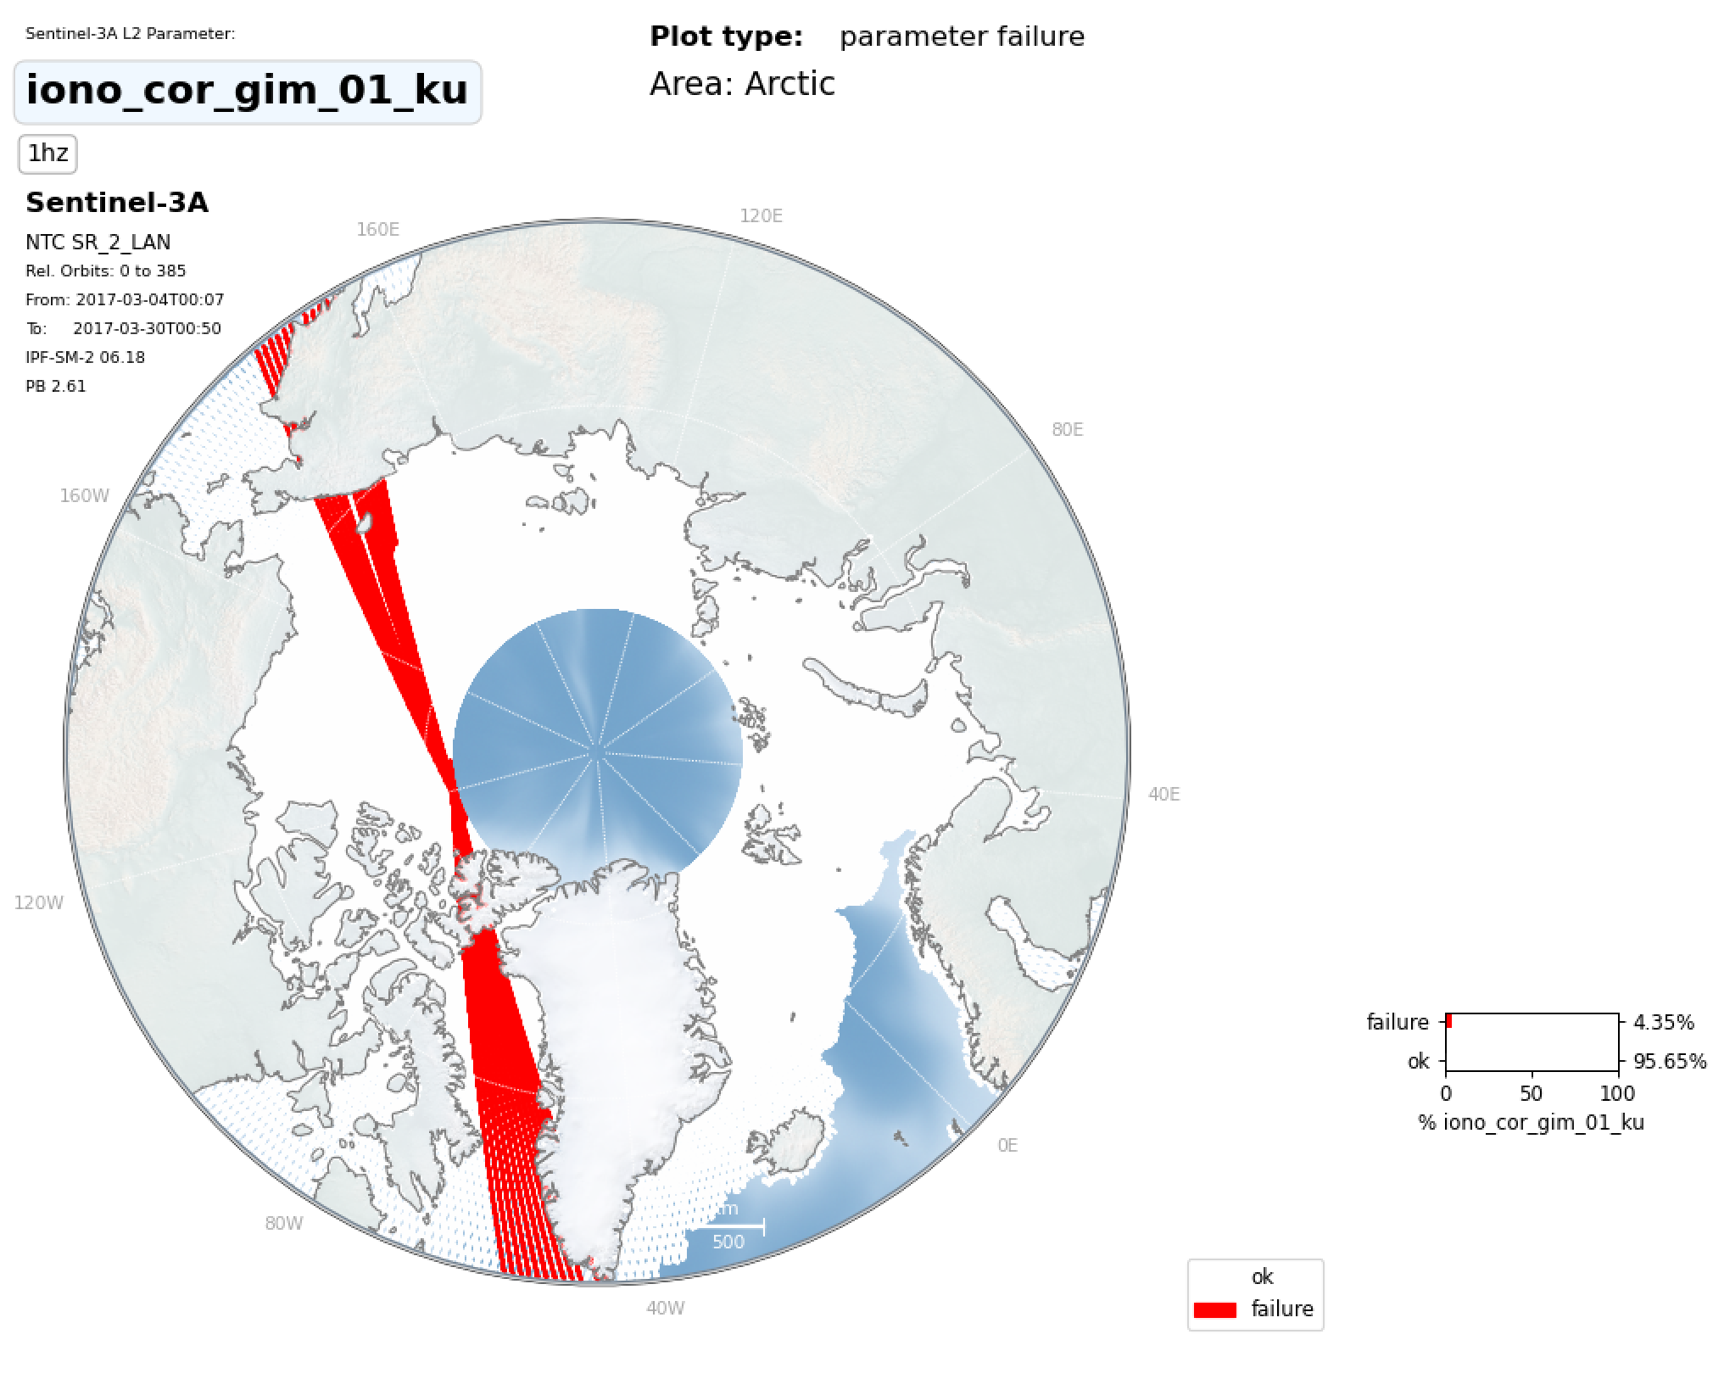
THEMATIC_SEAICE
Missing corrections in both
IPF_6.18
Correction missing
Correction missing

Slide 8
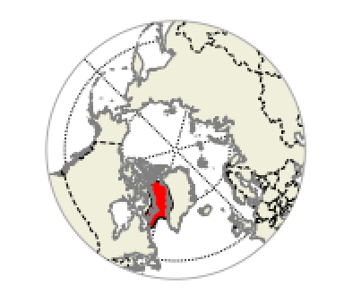
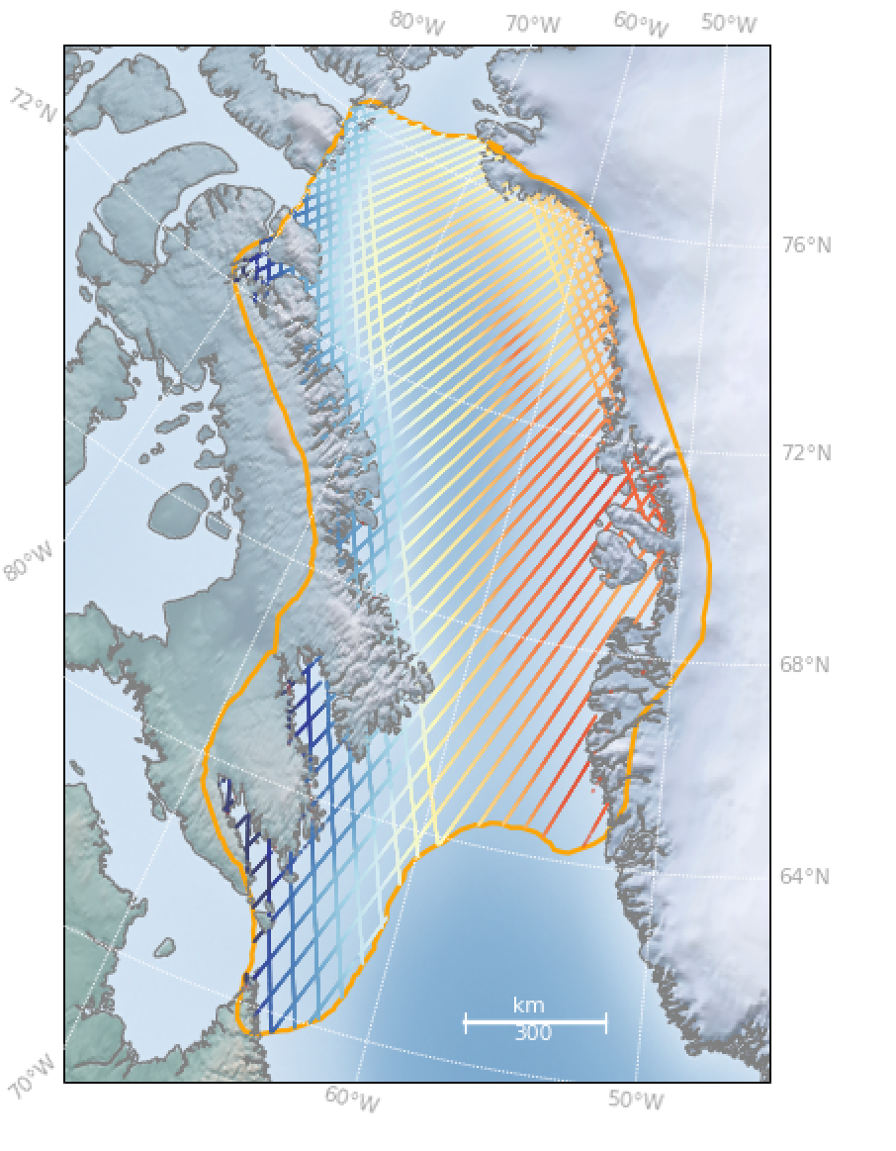
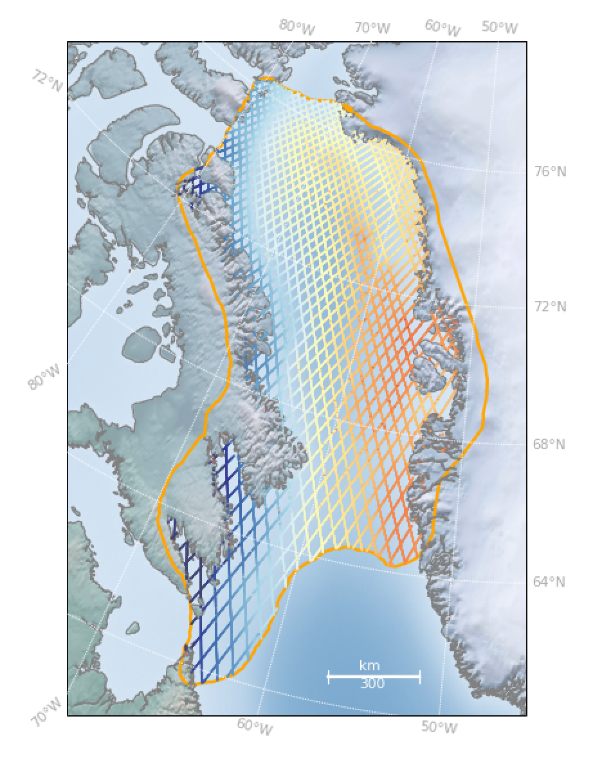
T-IPF
IPF
Missing tracks
In T-IPF due to
missing corrections
Expected behaviour in T-IPF and IPF 6.19
not good for comparison statistics between T-IPF and reference data set (6.18)

Slide 9
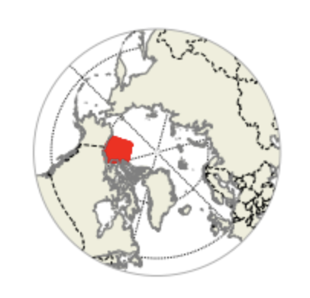
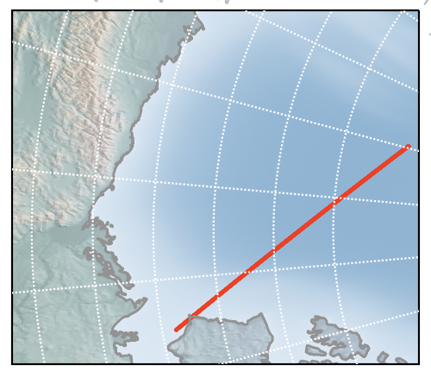
Arctic: Beaufort Sea
Zero padding: 2x sampling
THEMATIC_SEAICE
256
IPF_6.18
128

Slide 10
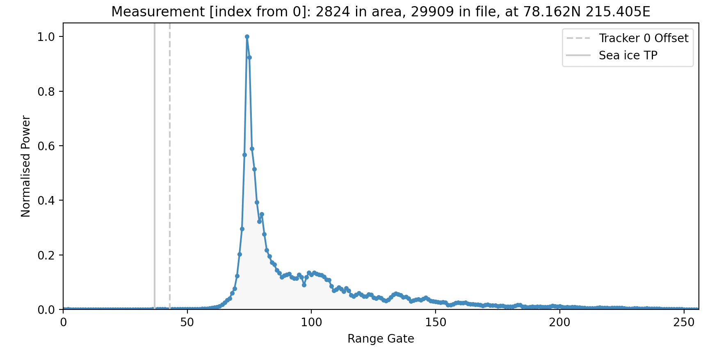
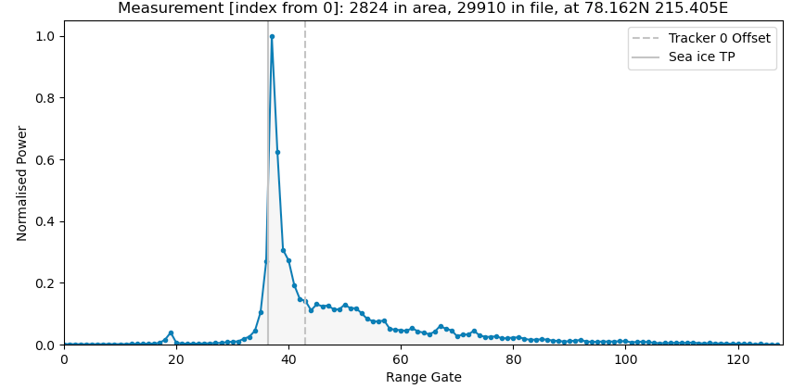
Twice sampling of the leading edge
THEMATIC_SEAICE
Arctic: Beaufort Sea
Off-nadir peaks removed
IPF_6.18

Slide 11
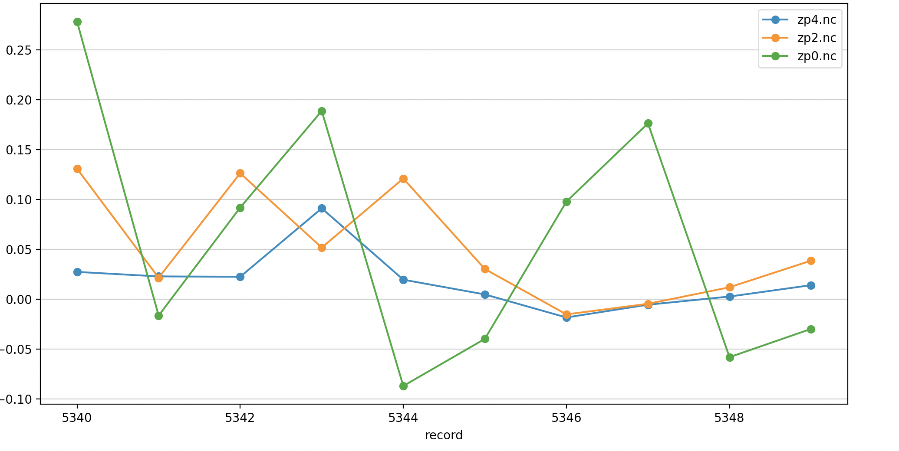
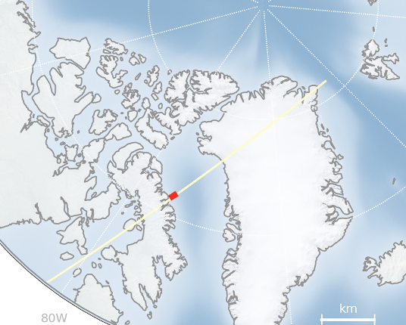
Lead SSHA Jitter and Precision improves with Zero Padding sampling rates
S3A_SR_2_LAN____20170304T162333_20170304T171402
Area of test track where we have consecutive Lead measurements
No ZP
Lead SSHA (m)
ZP=2
ZP=4
 | No ZP | ZP2 | ZP4
SD (m) | 0.12 | 0.05 | 0.03
MAD (m) | 0.09 | 0.03 | 0.01
Mean (m) | 0.06 | 0.05 | 0.02
Notes:
[macbook] cd /cpdata/SATS/RA/S3A/TDS/ZERO_PADDING_4_TDS/S3A_SR_2_LAN____20170304T162333_20170304T171402_20211026T172954_3029_015_083______LN3_O_NT_004.SEN3
/Users/alanmuir/software/cpom_software/cpom/altimetry/tools/plot_params_along_track.py -f zp4.nc -v sea_ice_ssha_20_ku_leads -m s3a -r 5340,5350 -f2 zp2.nc -f3 zp0.nc

Slide 12
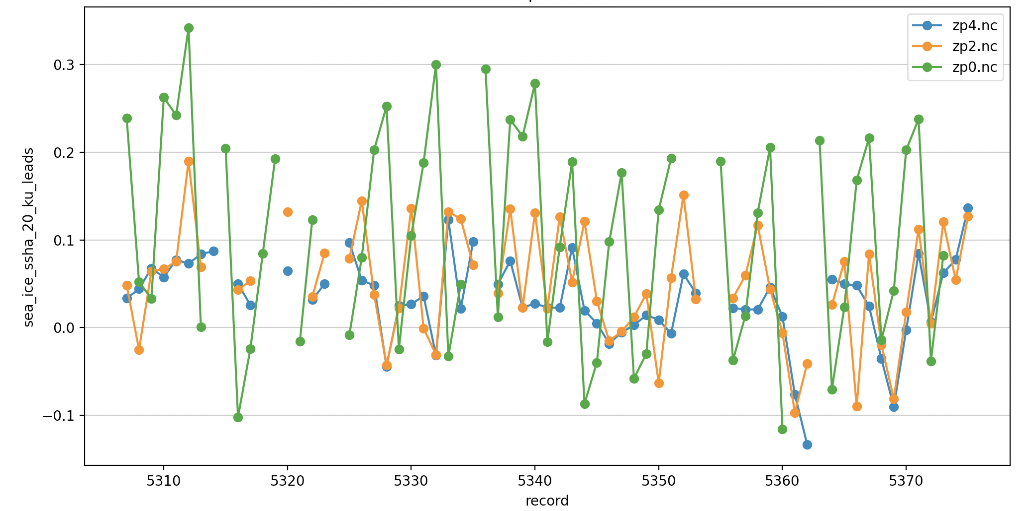
The effect of Zero-Padding (sampling rate) on Lead SSHA Jitter and Precision
S3A_SR_2_LAN____20170304T162333_20170304T171402
Area of test track where we have consecutive Lead measurements
No ZP
ZP=2
Lead SSHA (m)
ZP=4
 | No ZP | ZP2 | ZP4
SD (m) | 0.12 | 0.06 | 0.04
MAD (m) | 0.11 | 0.04 | 0.02
Mean (m) | 0.10 | 0.05 | 0.03
Notes:
[macbook] cd /cpdata/SATS/RA/S3A/TDS/ZERO_PADDING_4_TDS/S3A_SR_2_LAN____20170304T162333_20170304T171402_20211026T172954_3029_015_083______LN3_O_NT_004.SEN3
/Users/alanmuir/software/cpom_software/cpom/altimetry/tools/plot_params_along_track.py -f zp4.nc -v sea_ice_ssha_20_ku_leads -m s3a -r 5340,5350 -f2 zp2.nc -f3 zp0.nc

Slide 13
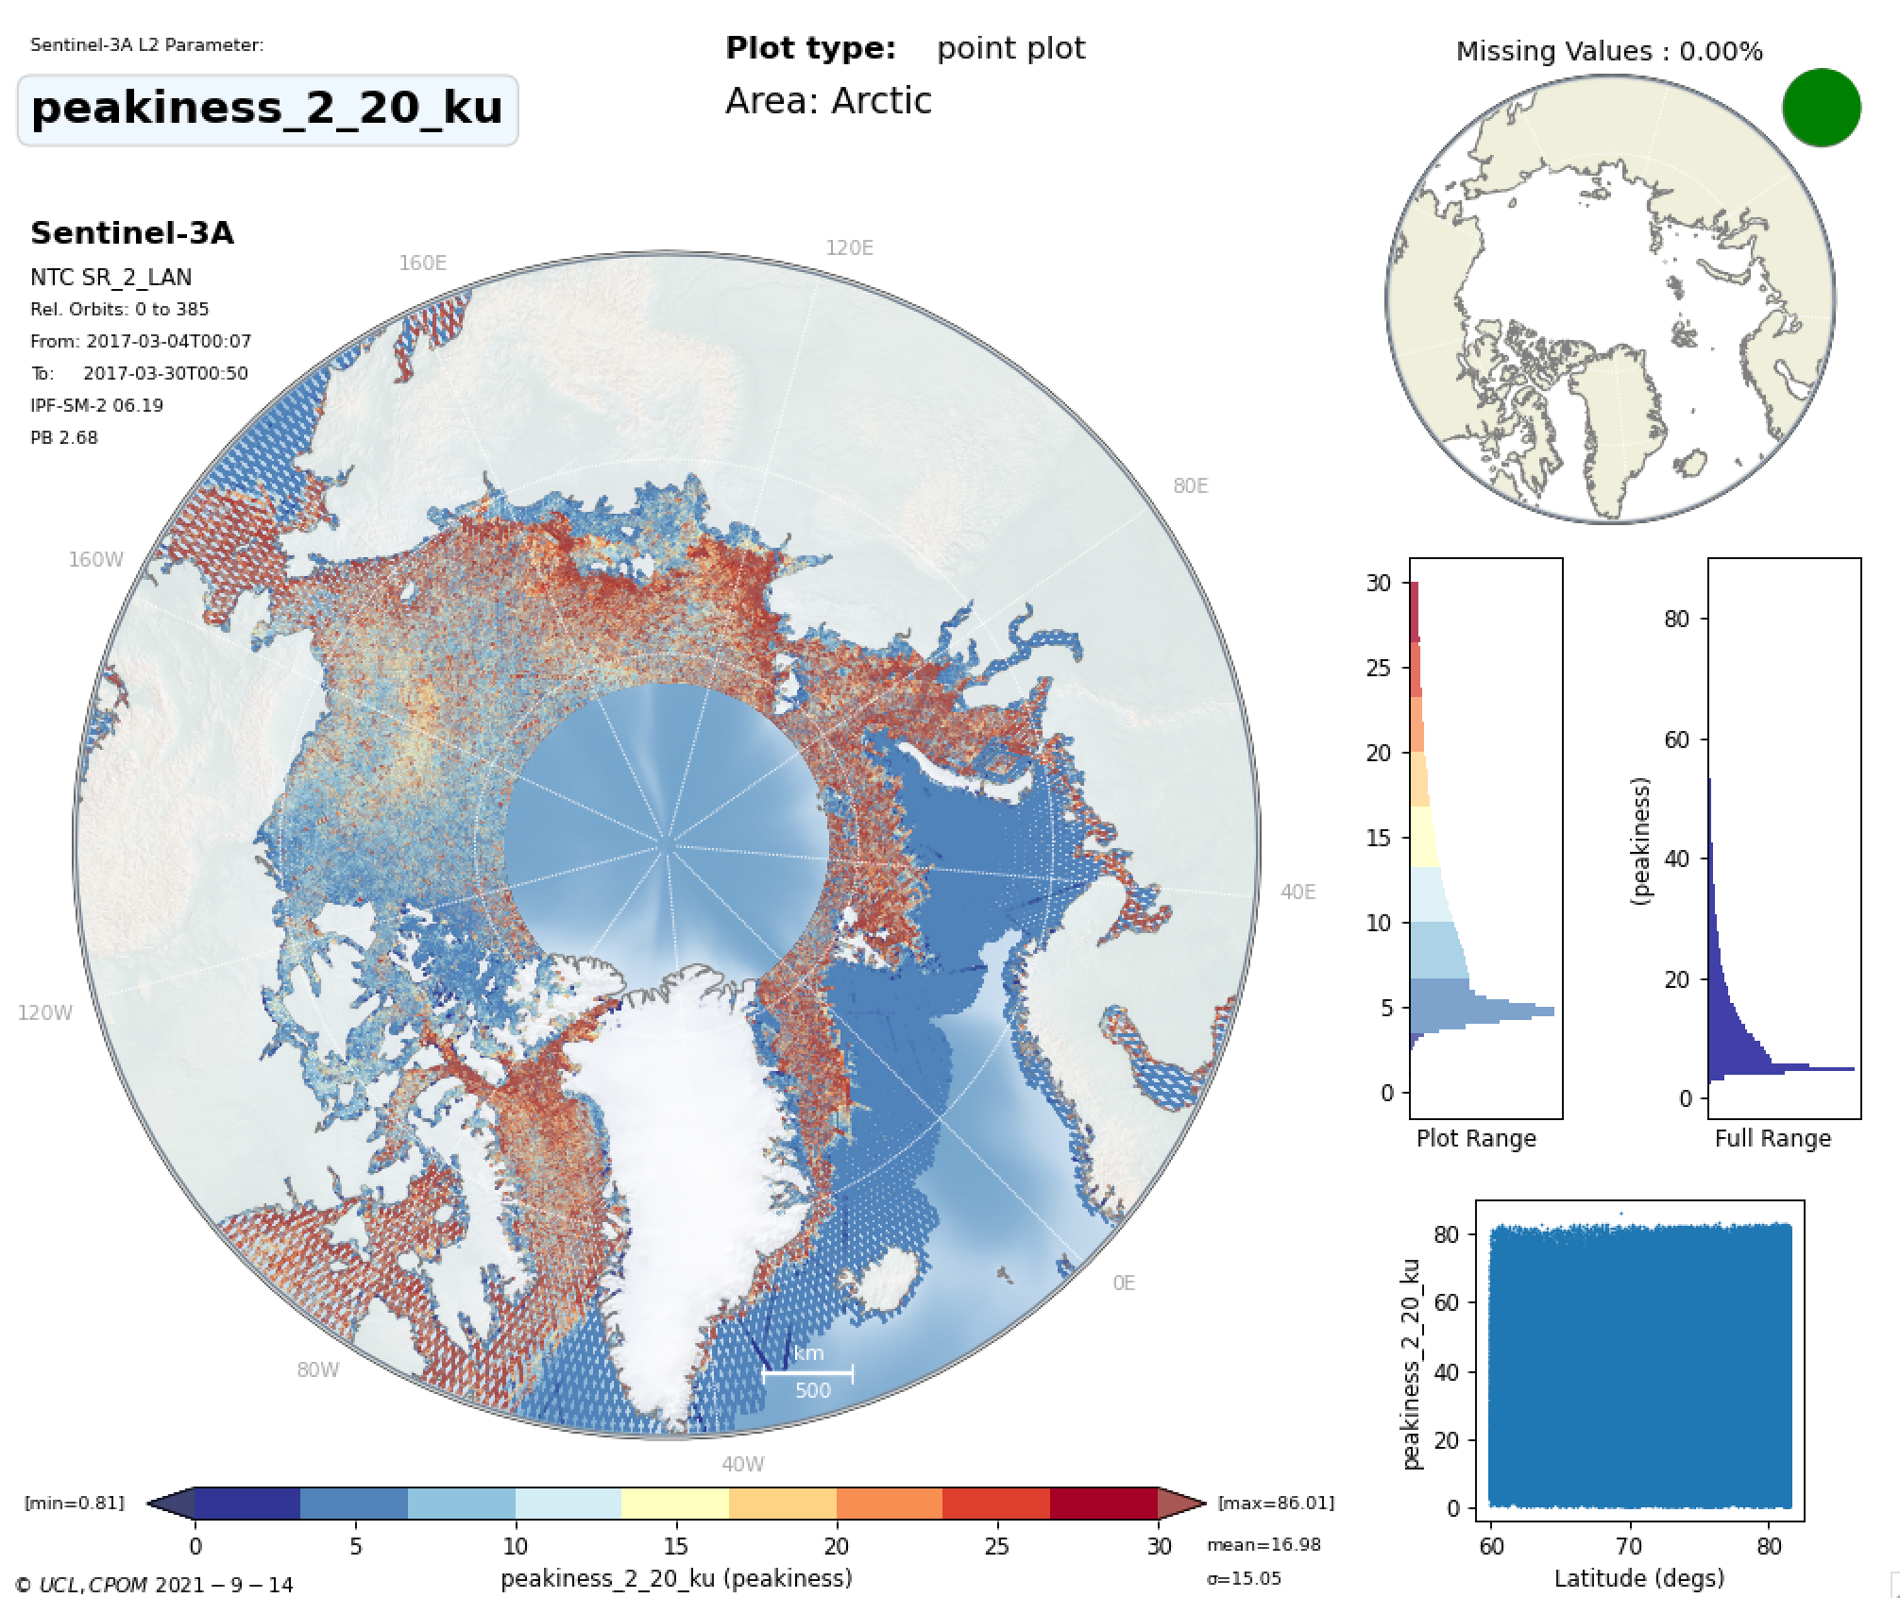
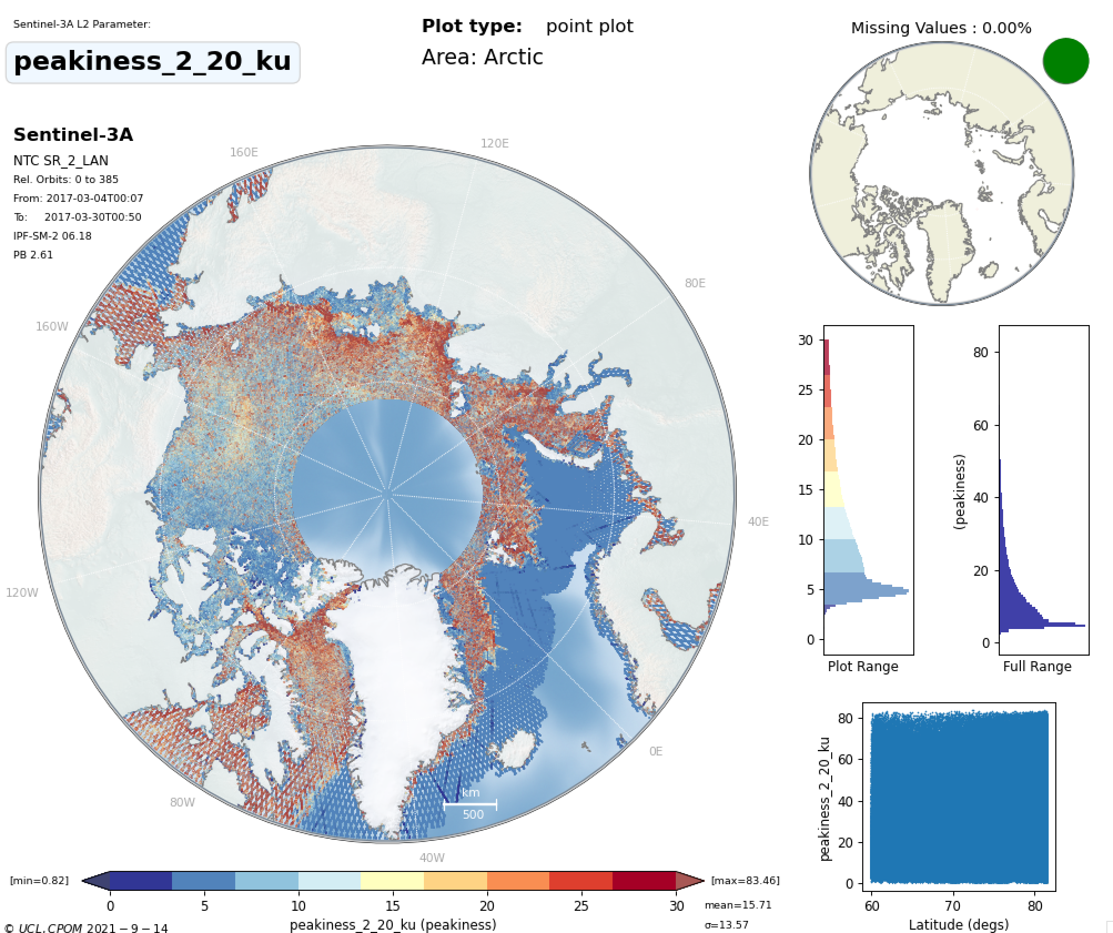
THEMATIC_SEAICE
IPF_6.18
Mean peakiness=16.98
Mean peakiness=15.71
Slightly higher peakiness expected with ZP/Hamming

Slide 14
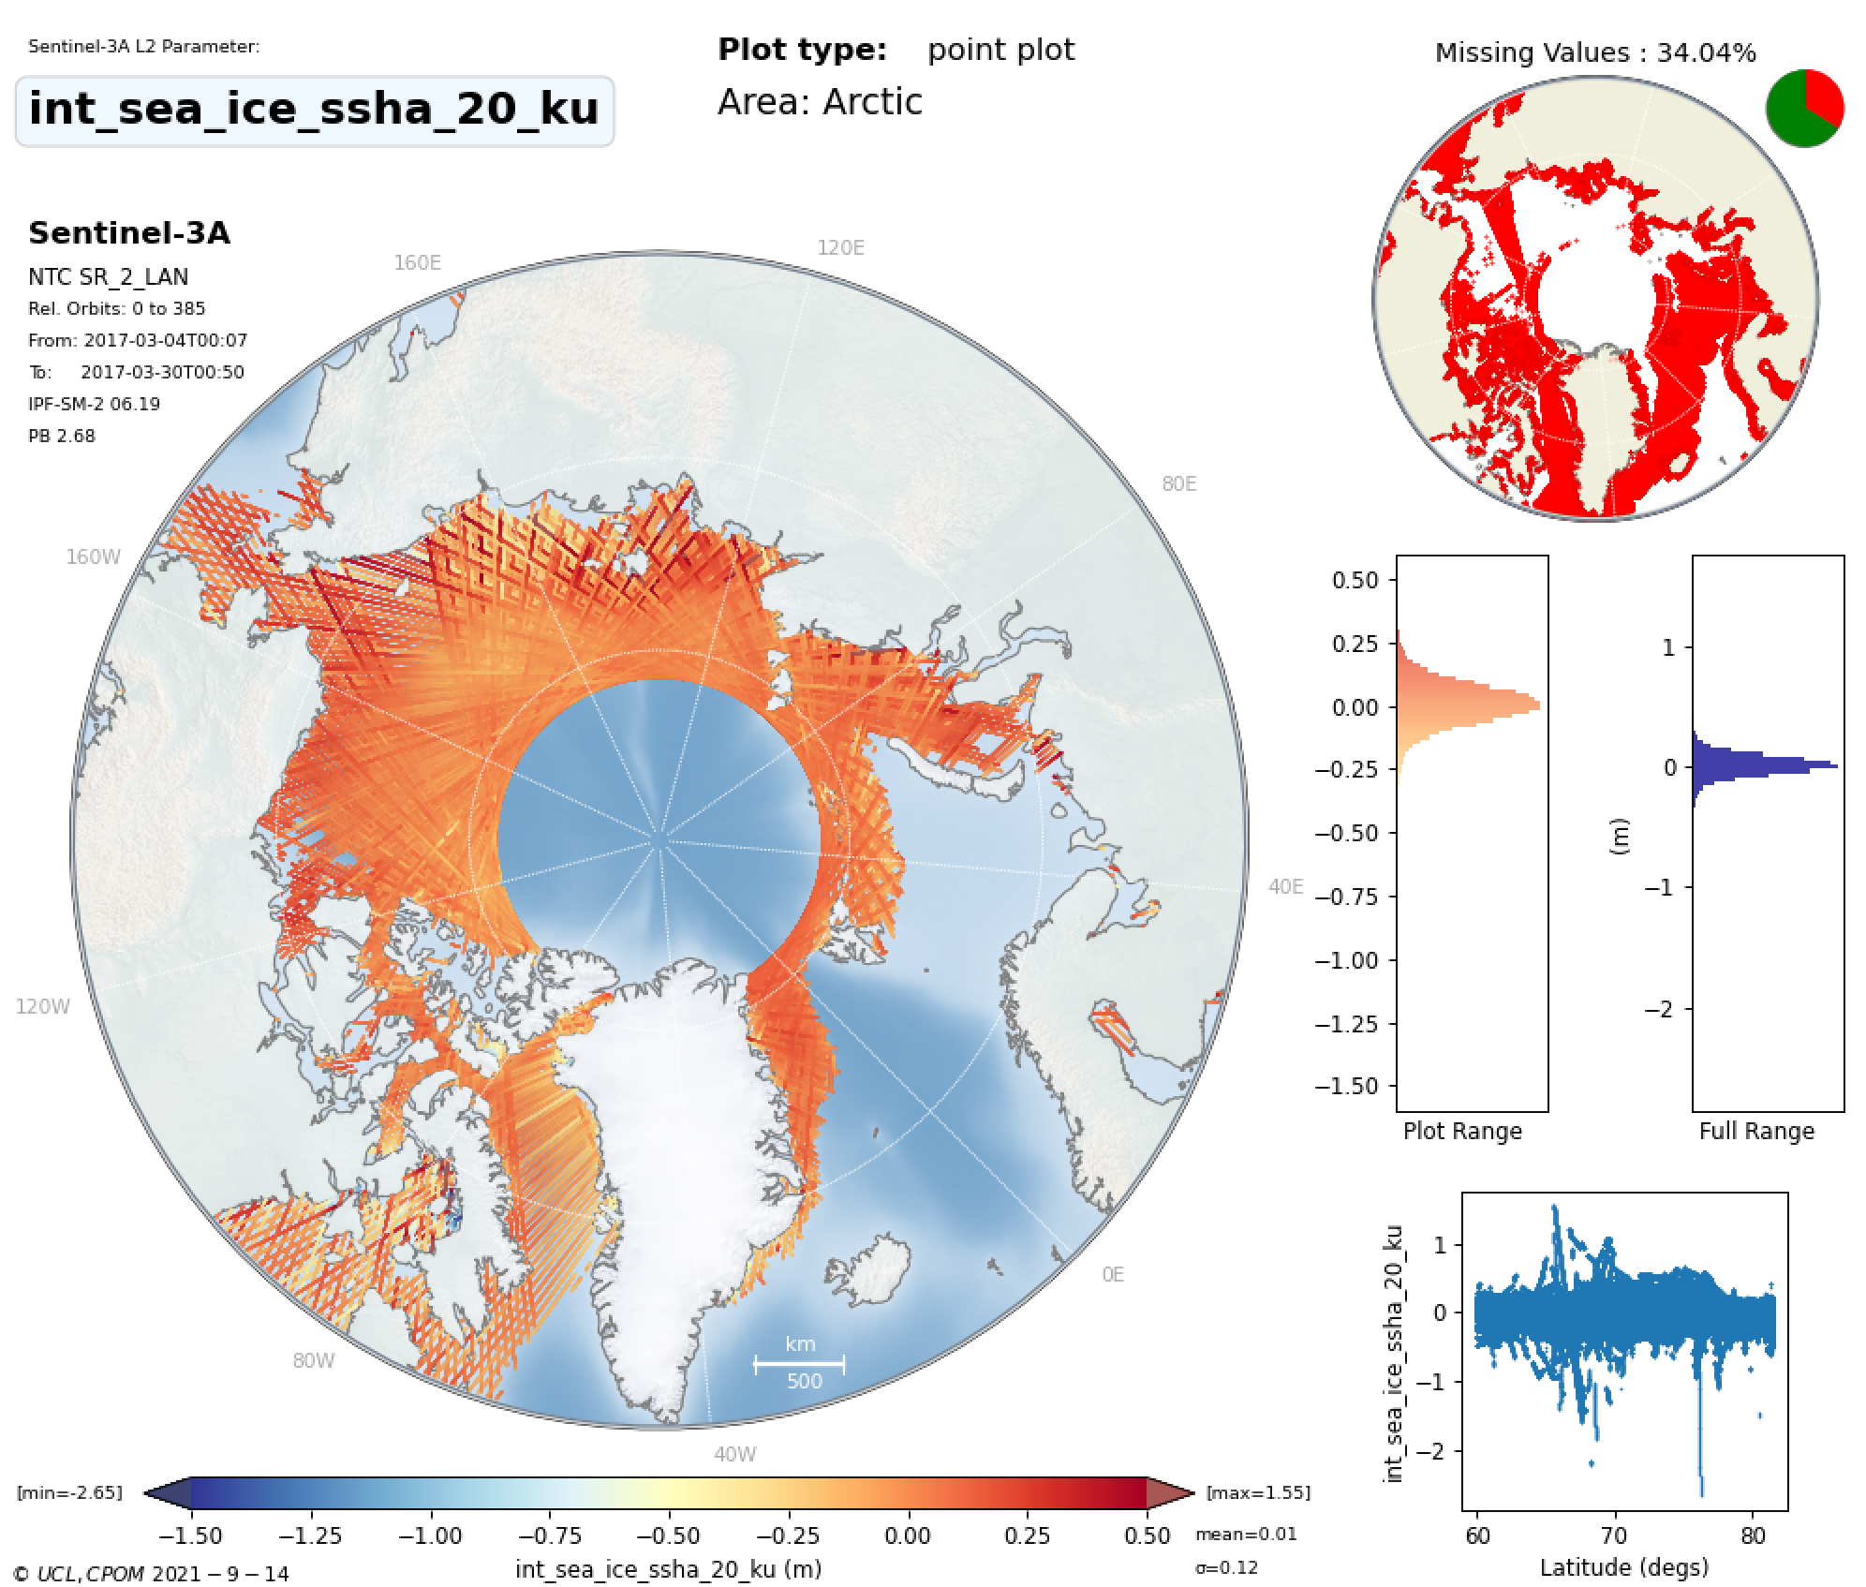
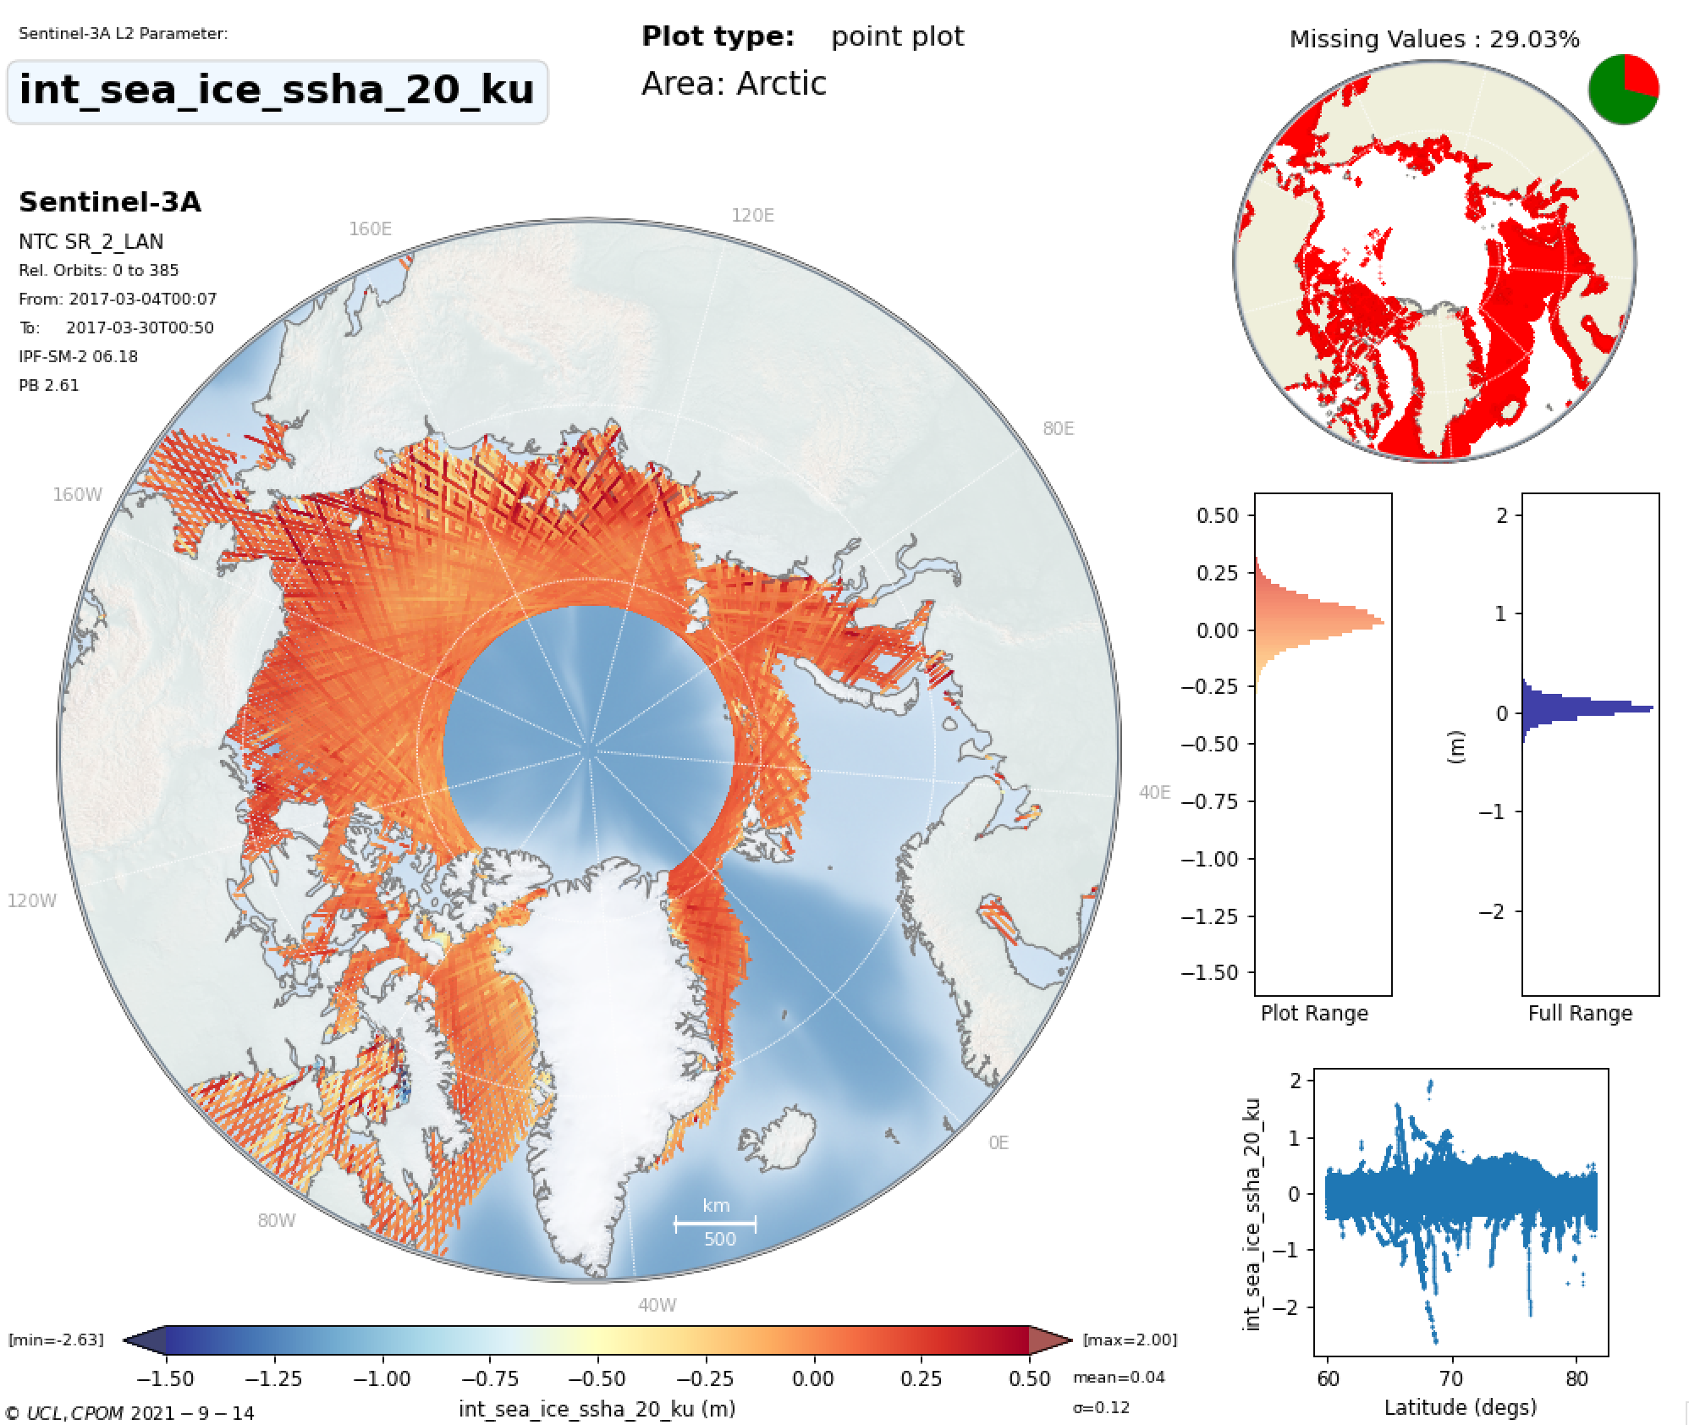
Interpolated SSHA between Leads
THEMATIC_SEAICE
IPF_6.18
MEAN =0.01m
MEAN =0.04m

Slide 15
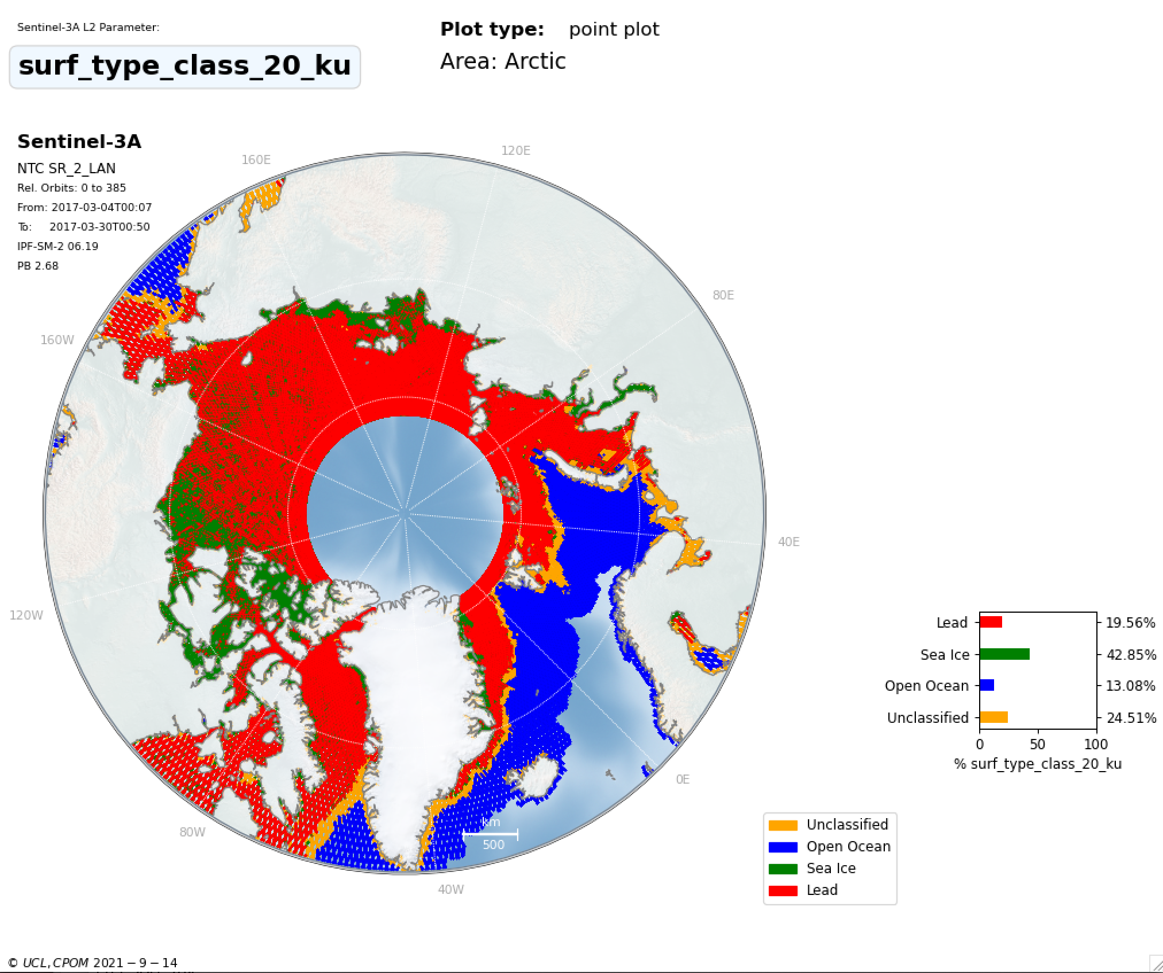
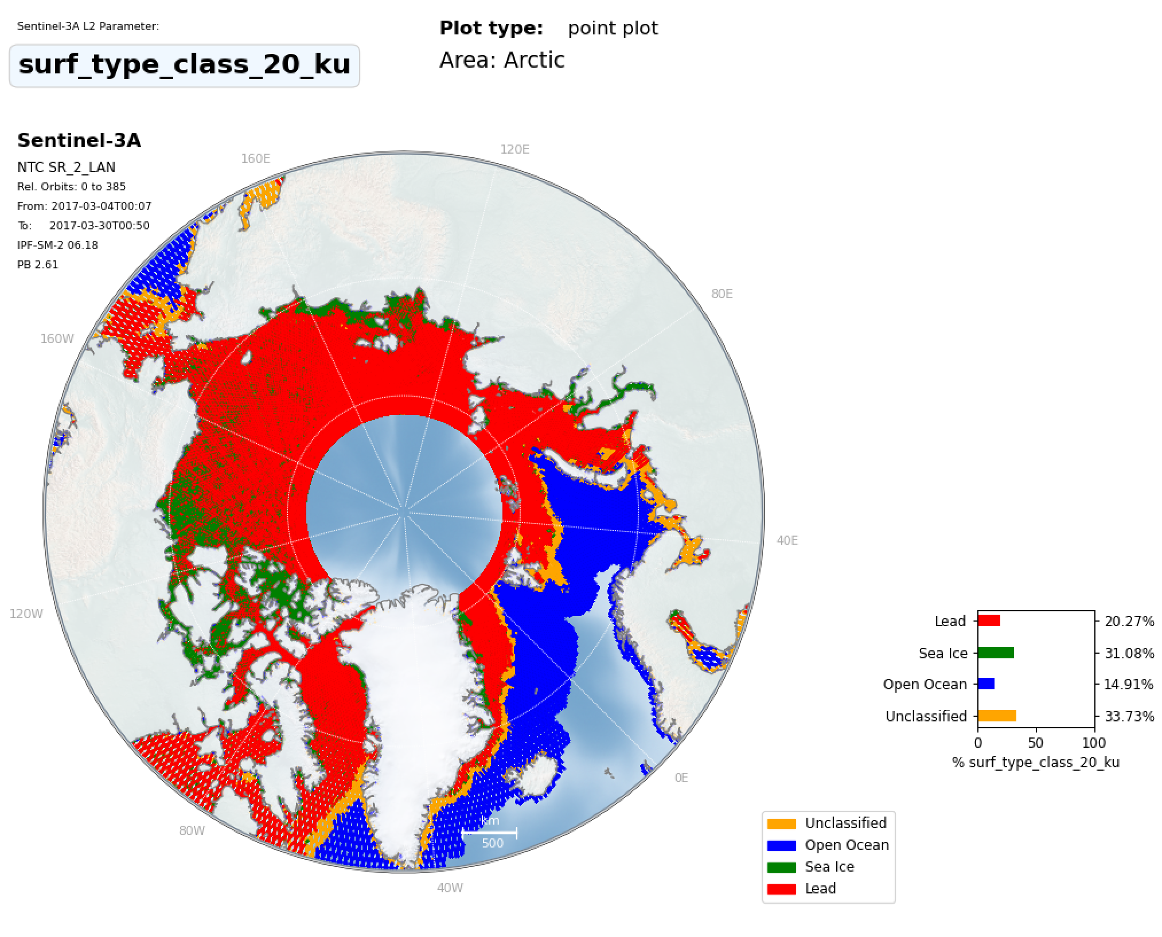
THEMATIC_SEAICE
Sea Ice Discrimination
IPF_6.18
11% more sea ice floes classified
9% less unclassified waveforms
Due to Hamming & new discrimination tuning

Slide 16
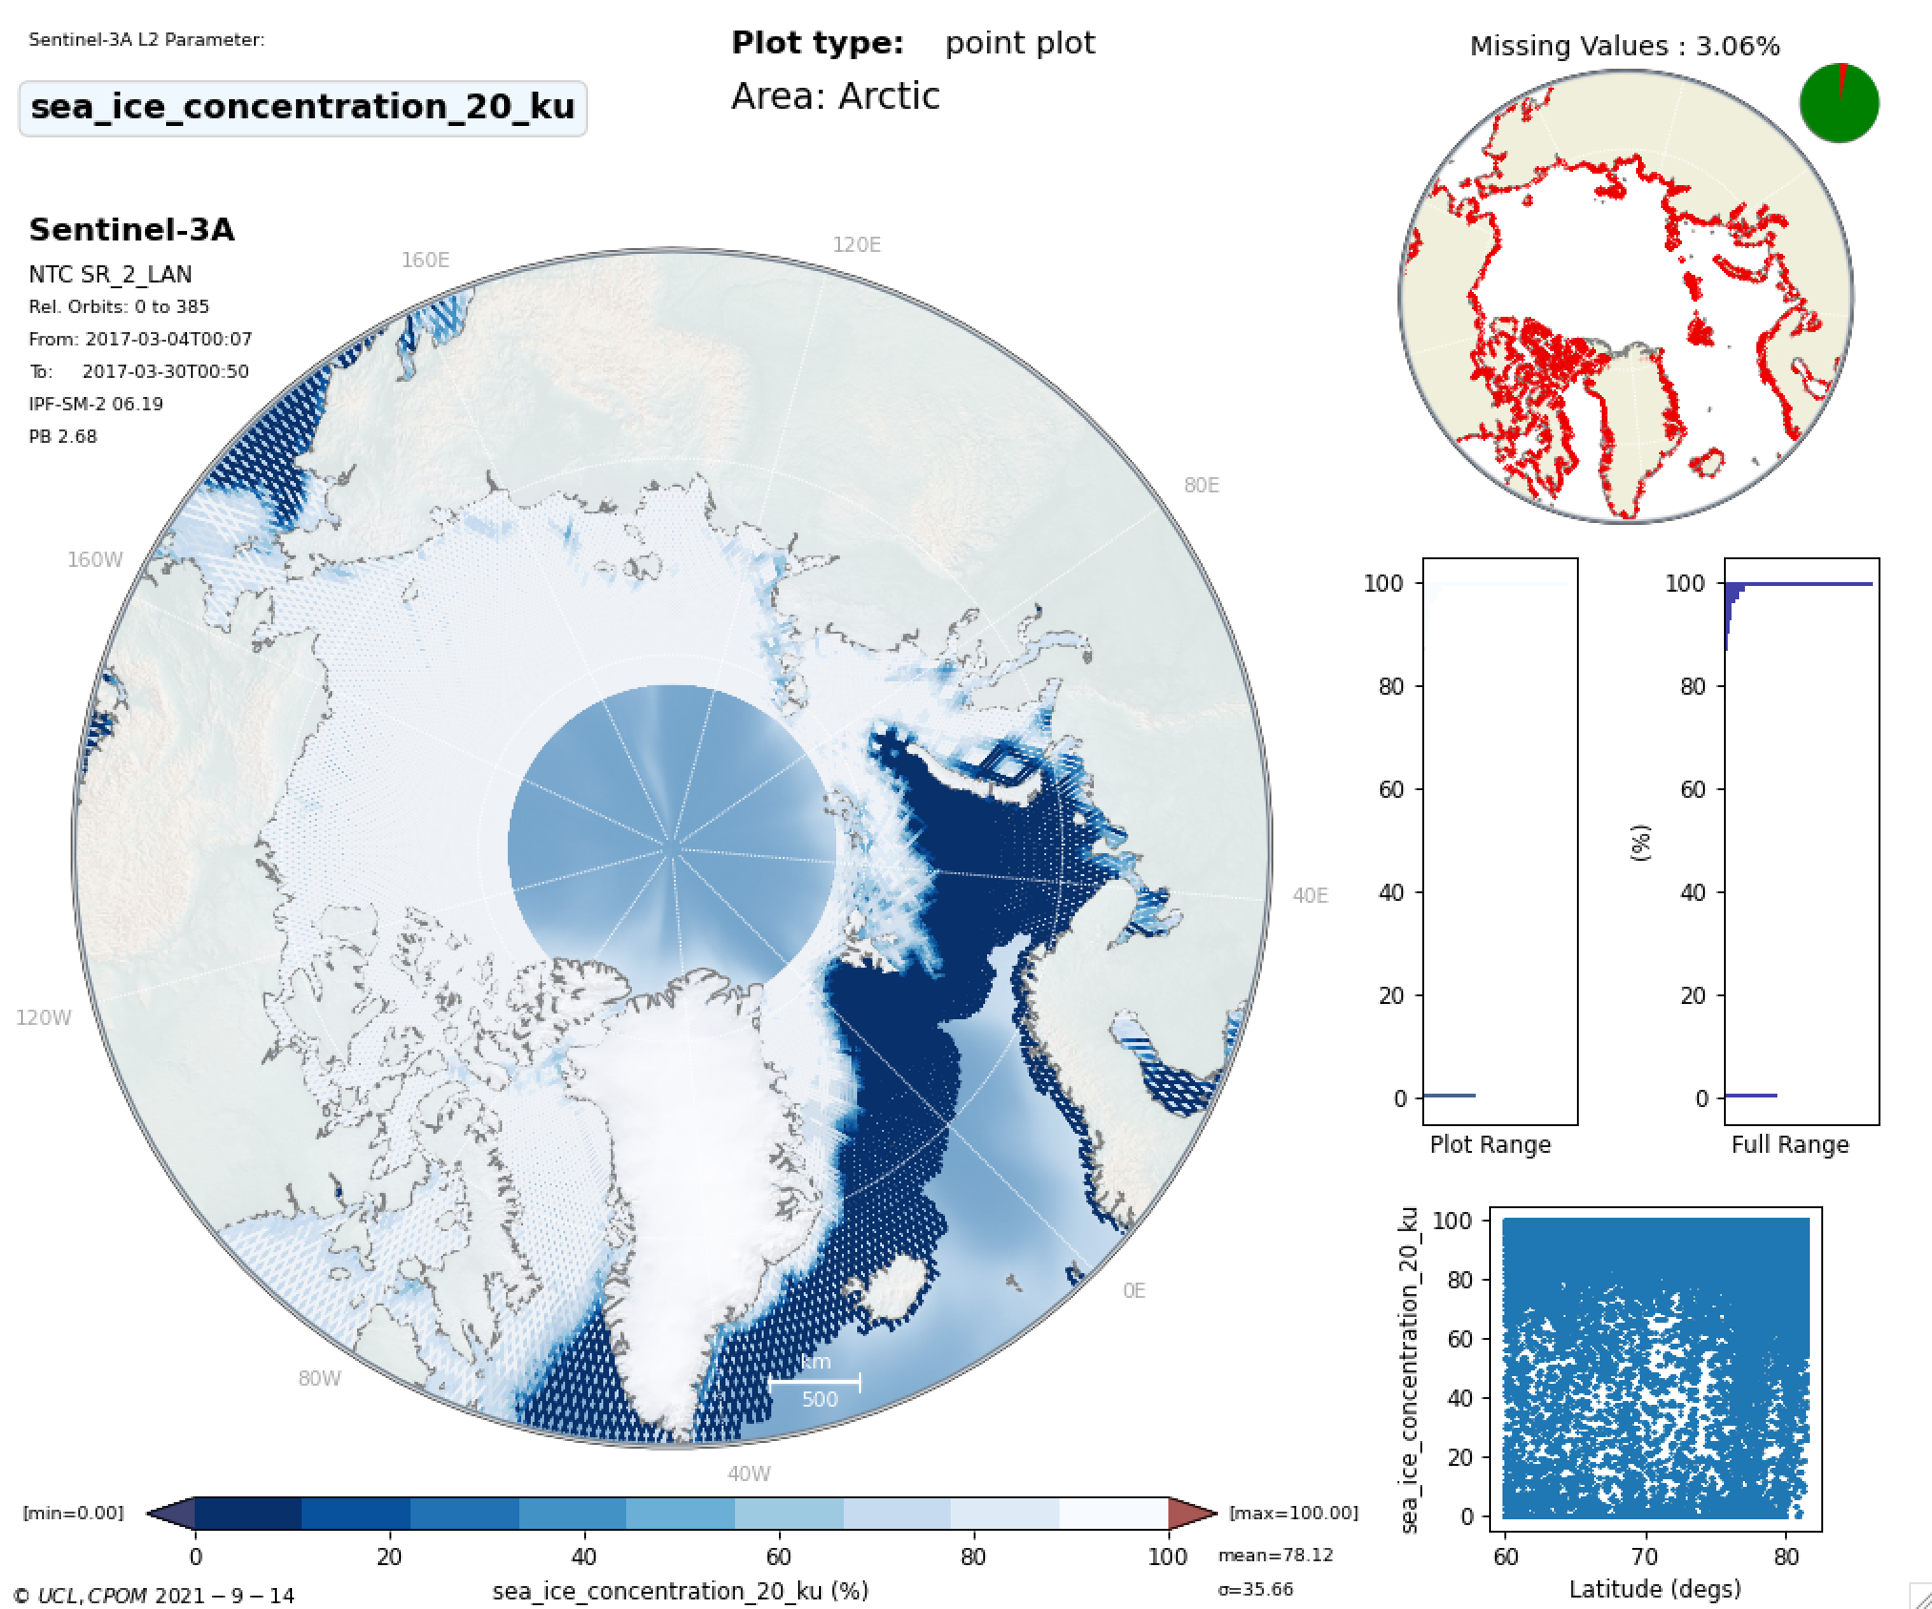
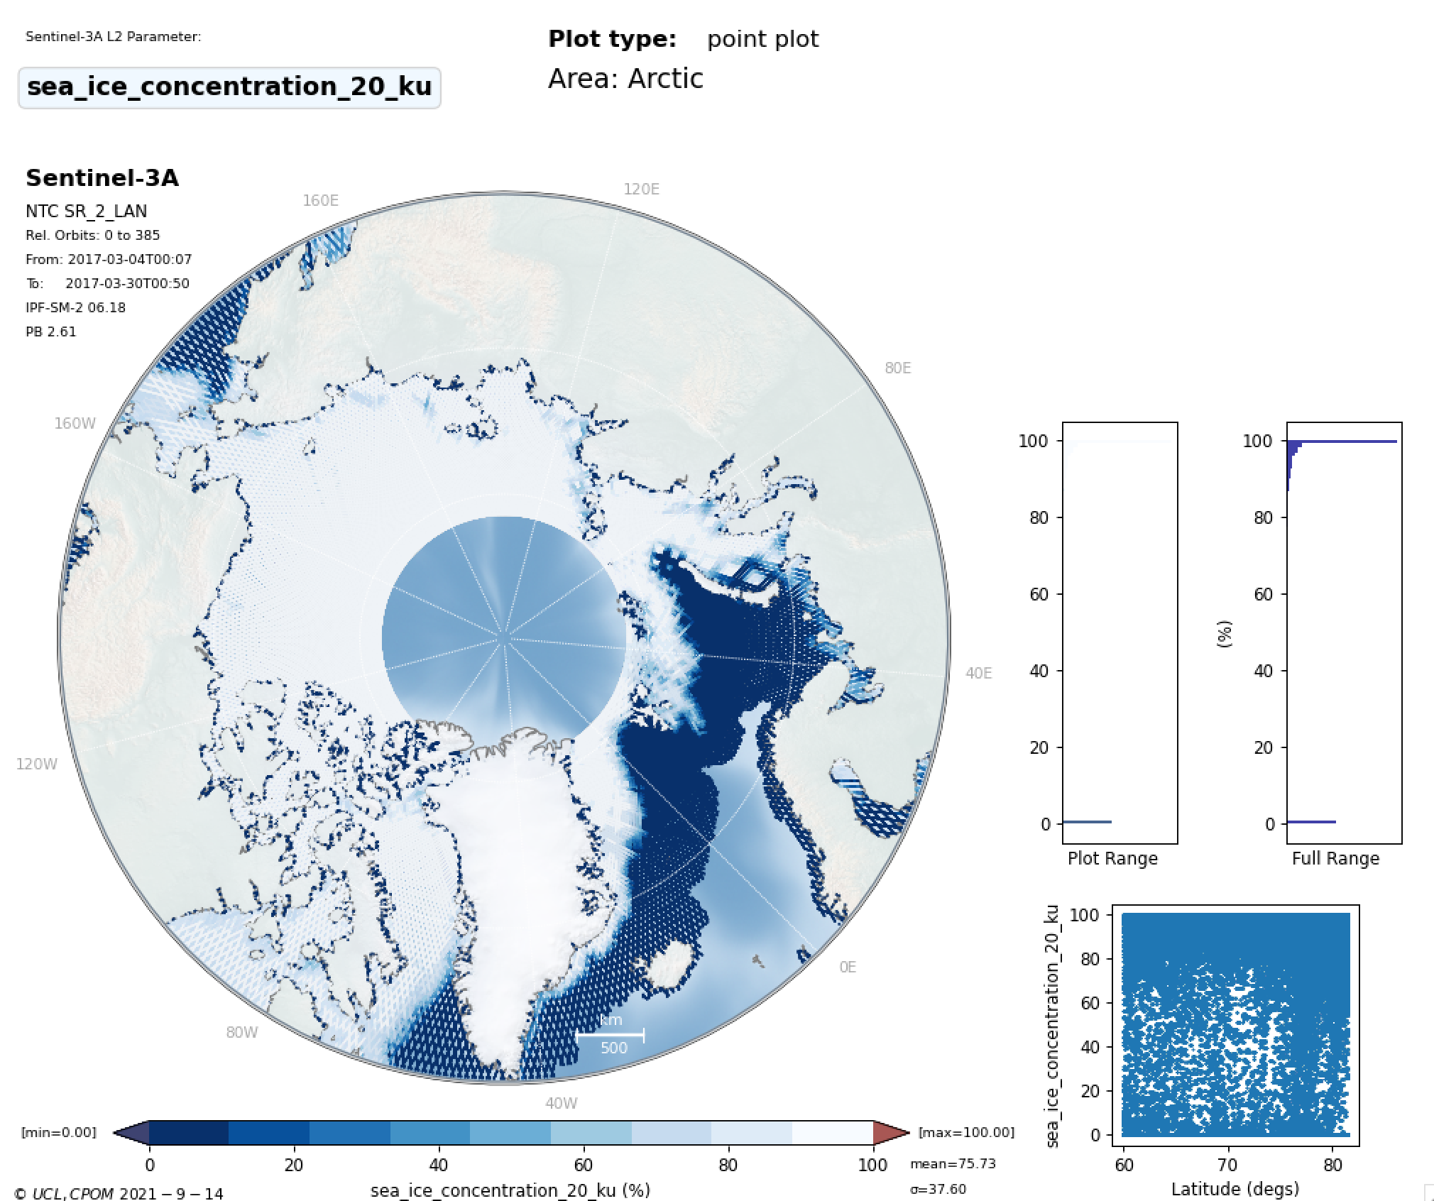
Sea Ice Concentration
THEMATIC_SEAICE
IPF_6.18

Slide 17
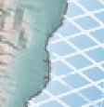
THEMATIC_SEAICE
IPF_6.18
Sea Ice
Concentration
Expected behaviour in Thematic product
Zero values around coastline
Notes:
./plot_combined_freeboard.py -f2 ~/fb2/cs2/2017/3/*.npz -f1 ~/fb2/s3a_ipf/s3a/2017/3/*.npz -o ~/fb2 –diff
./plot_combined_freeboard.py -f2 ~/fb2/cs2/2017/3/*.npz -f1 ~/fb2/s3a_thematic/s3a/2017/3/*.npz -o ~/fb2 --diff

Slide 18
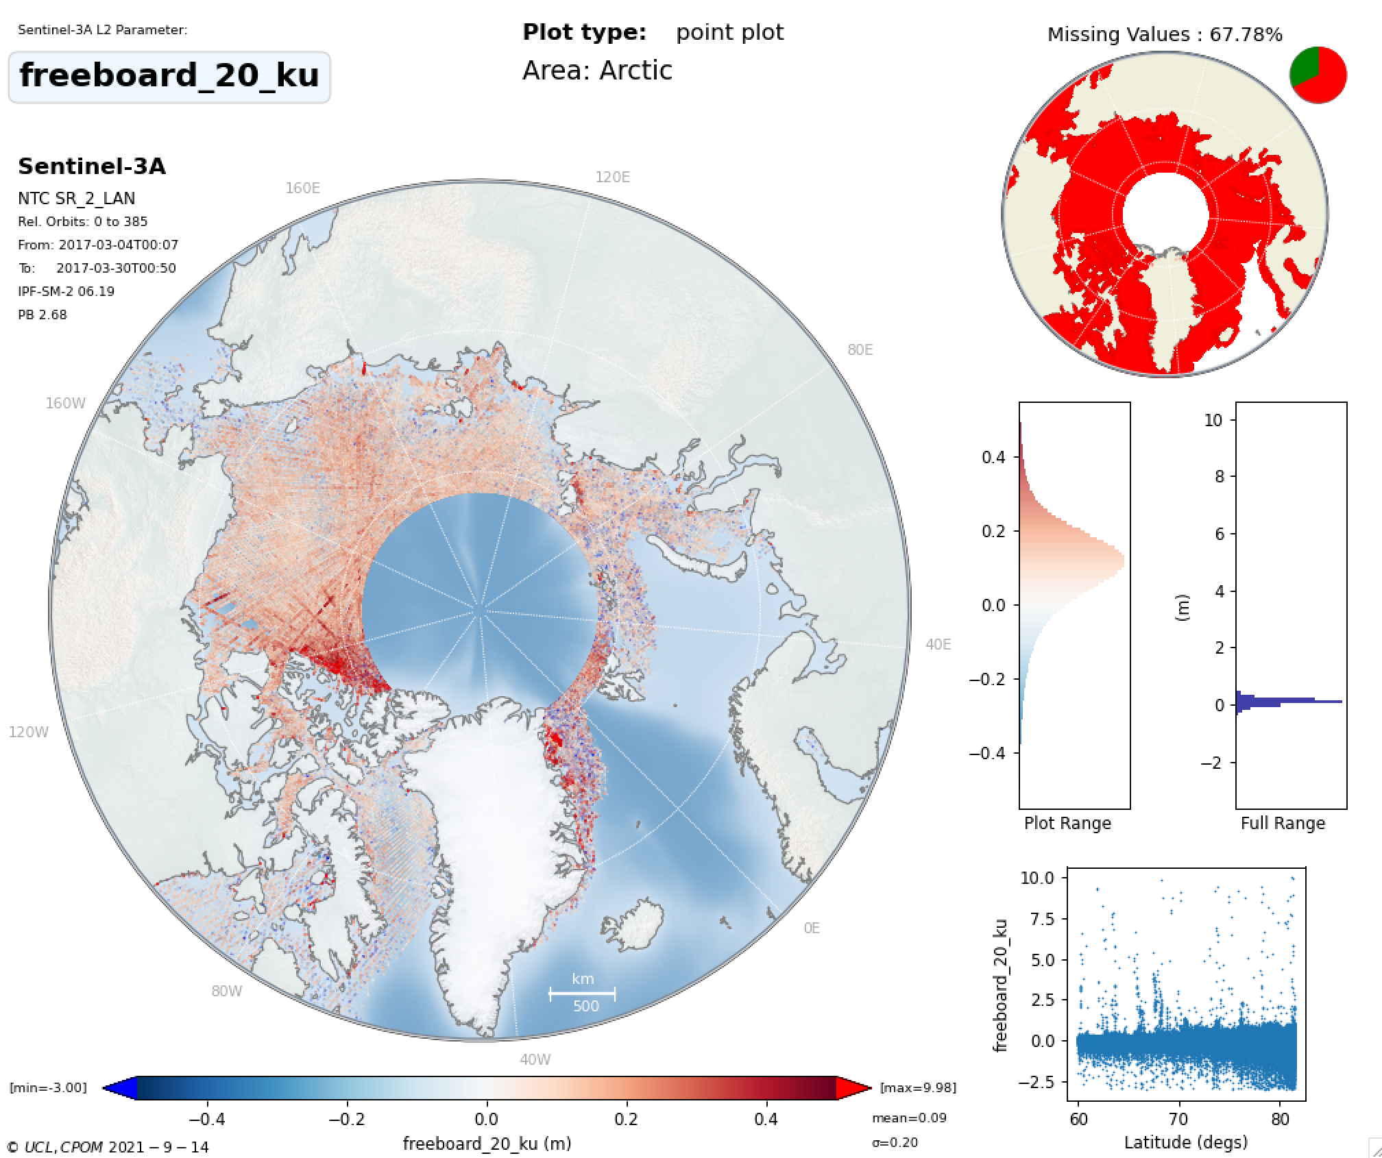
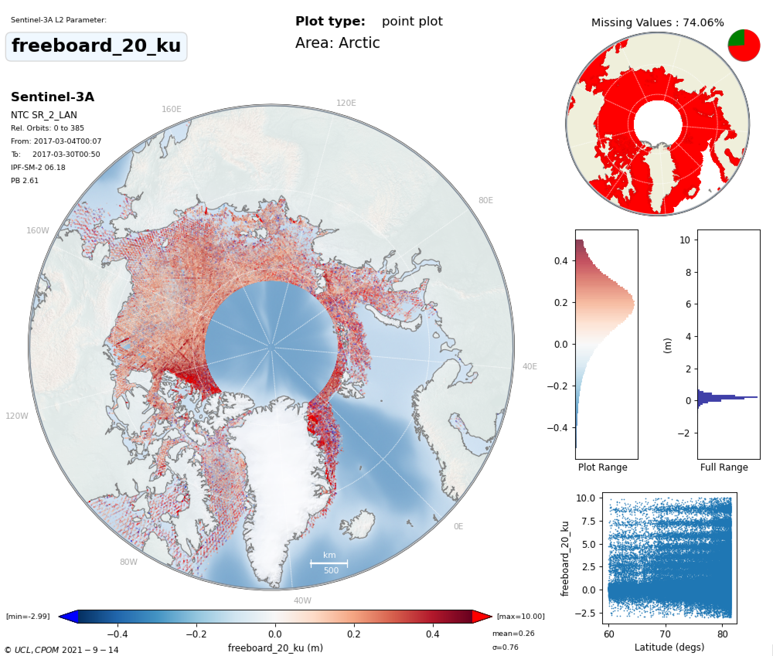
THEMATIC_SEAICE
Freeboard
IPF_6.18
Number of freeboard measurements: 1286206
250715 more measurements (24% more)
Number of freeboard measurements: 1035491

Slide 19
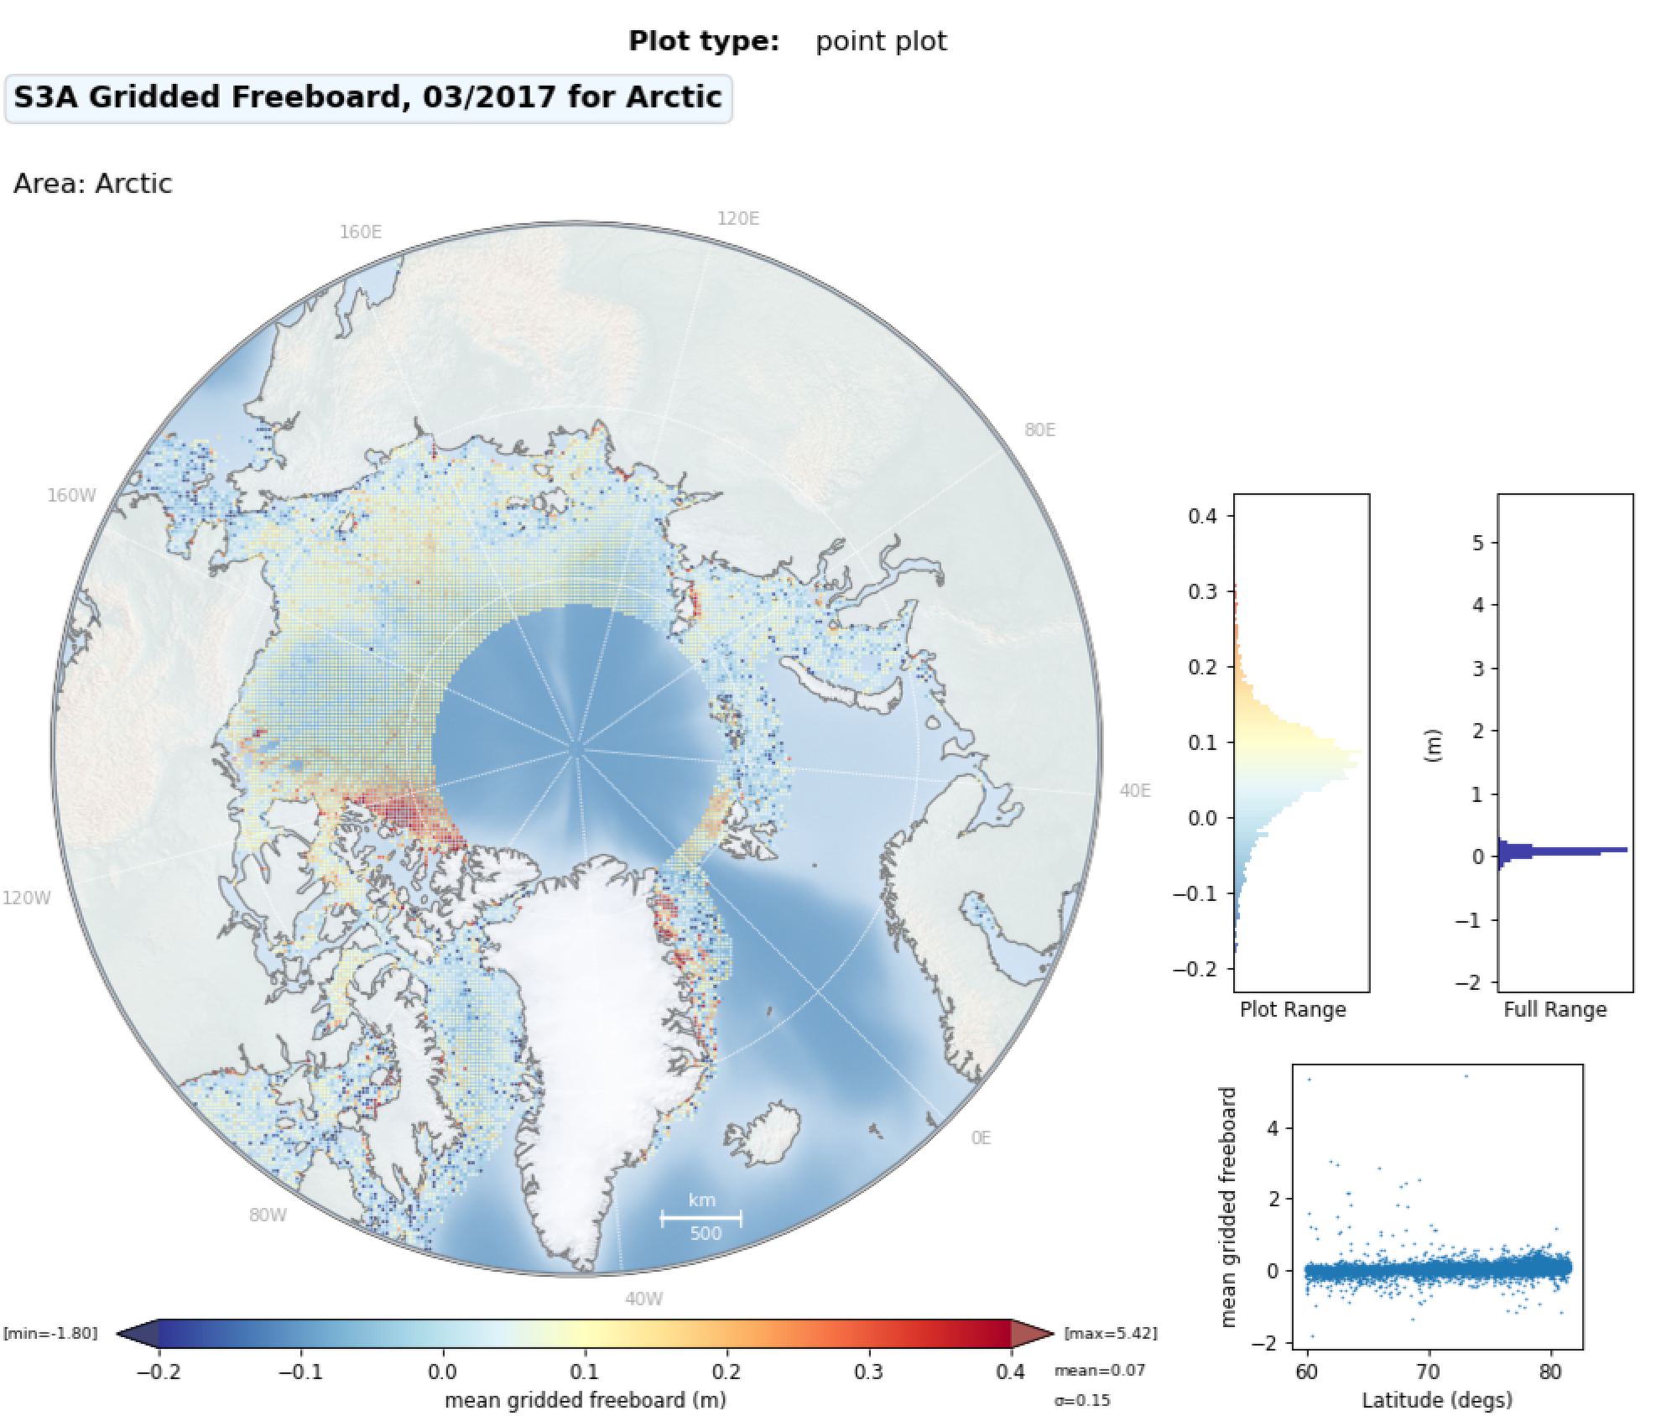
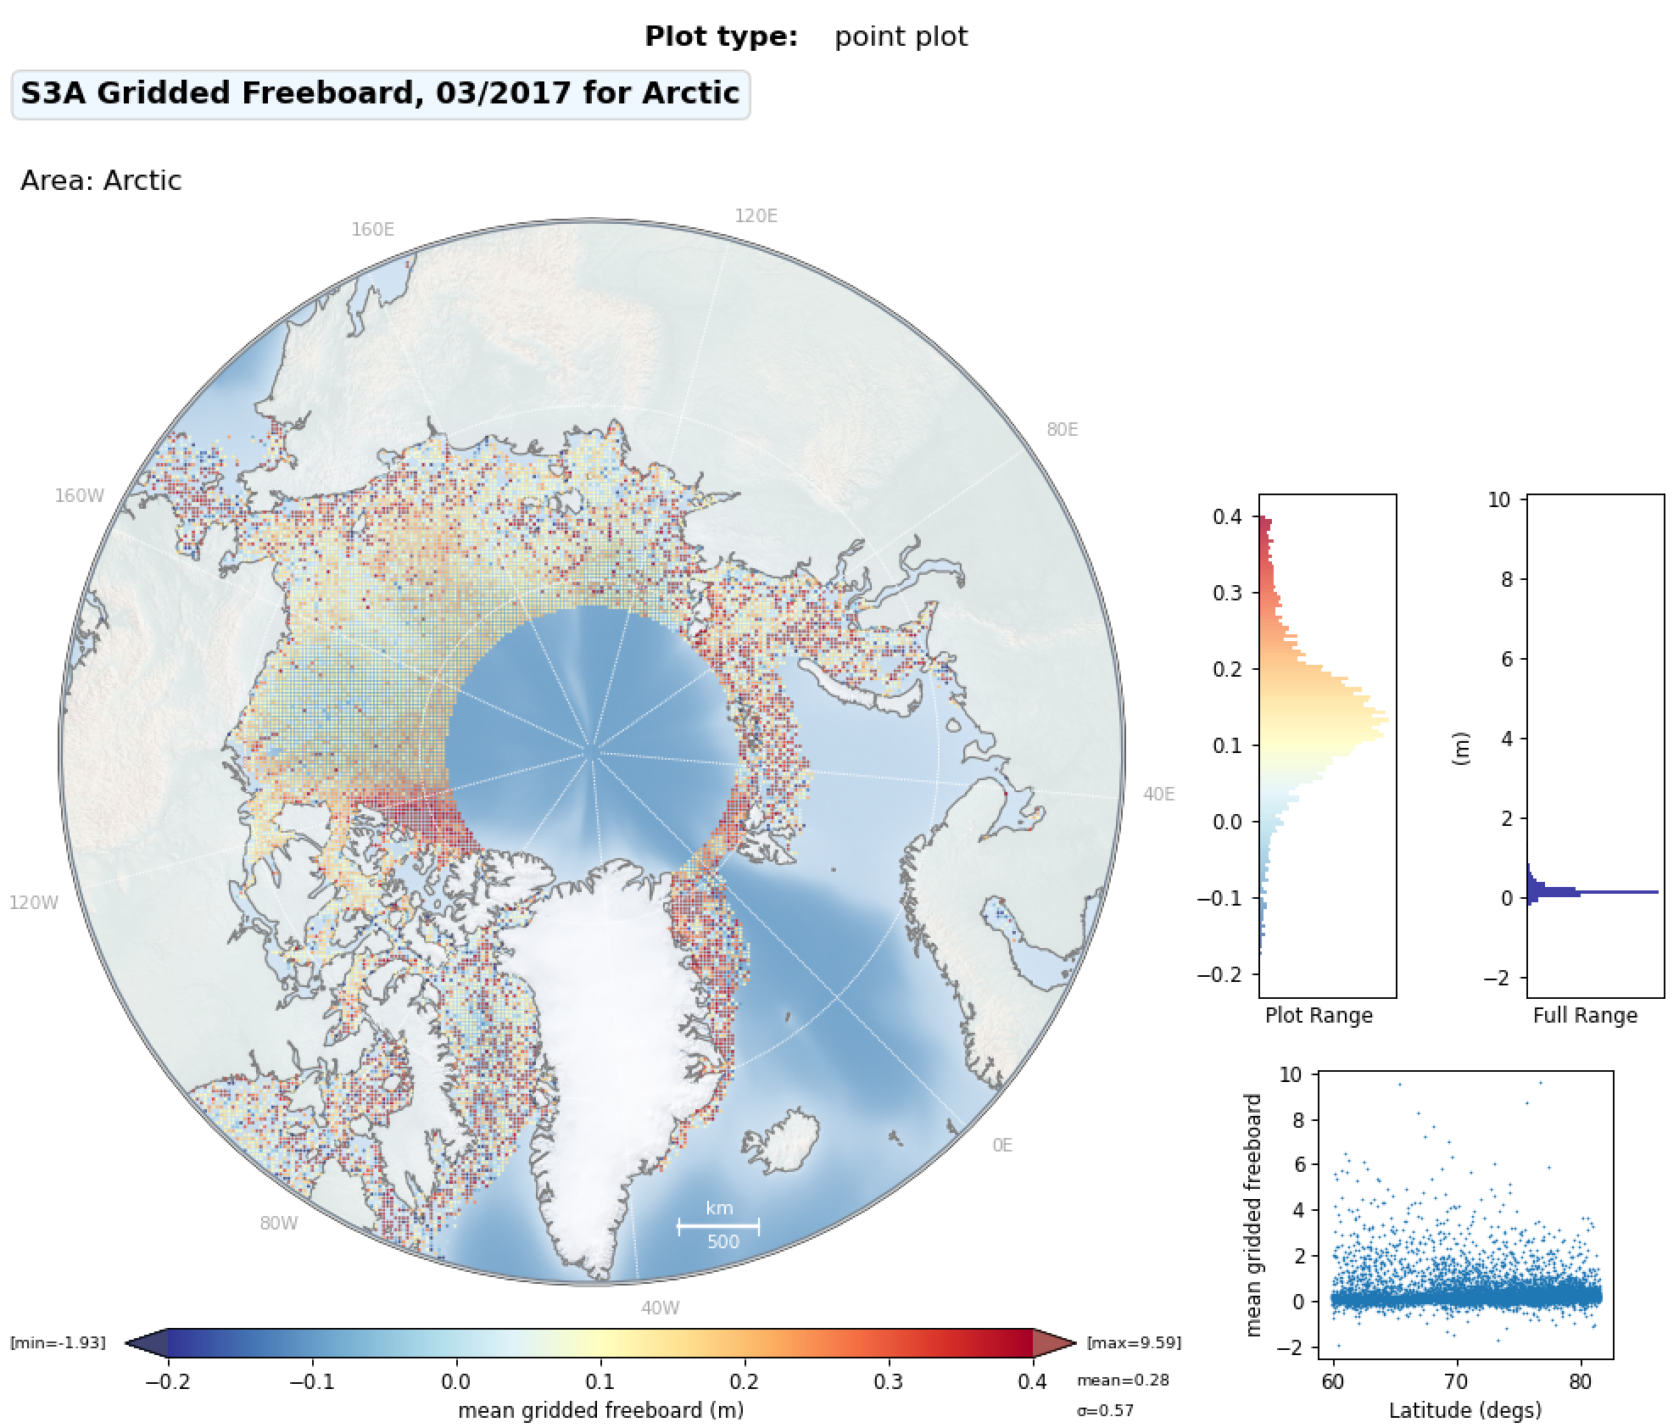
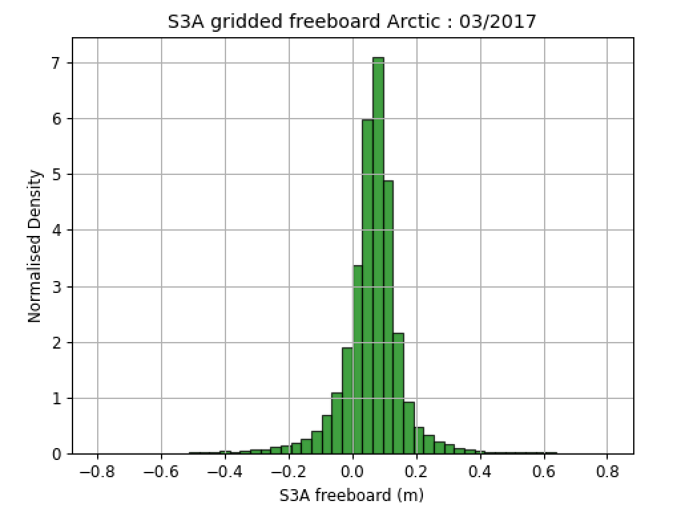
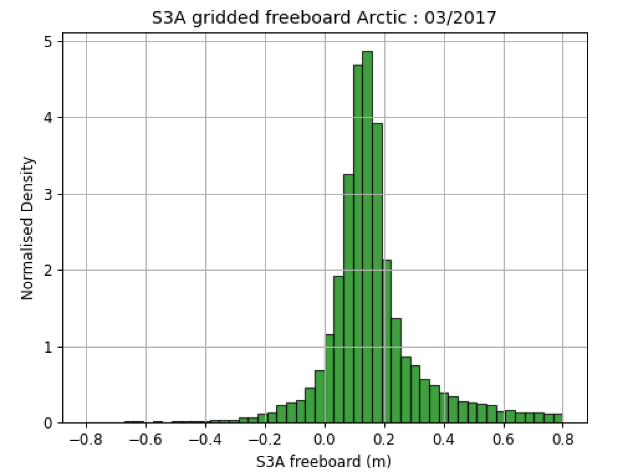
25km Gridded Arctic Freeboard (March 2017):
THEMATIC_SEAICE
CS2 Baseline-D
IPF_6.18

Slide 20
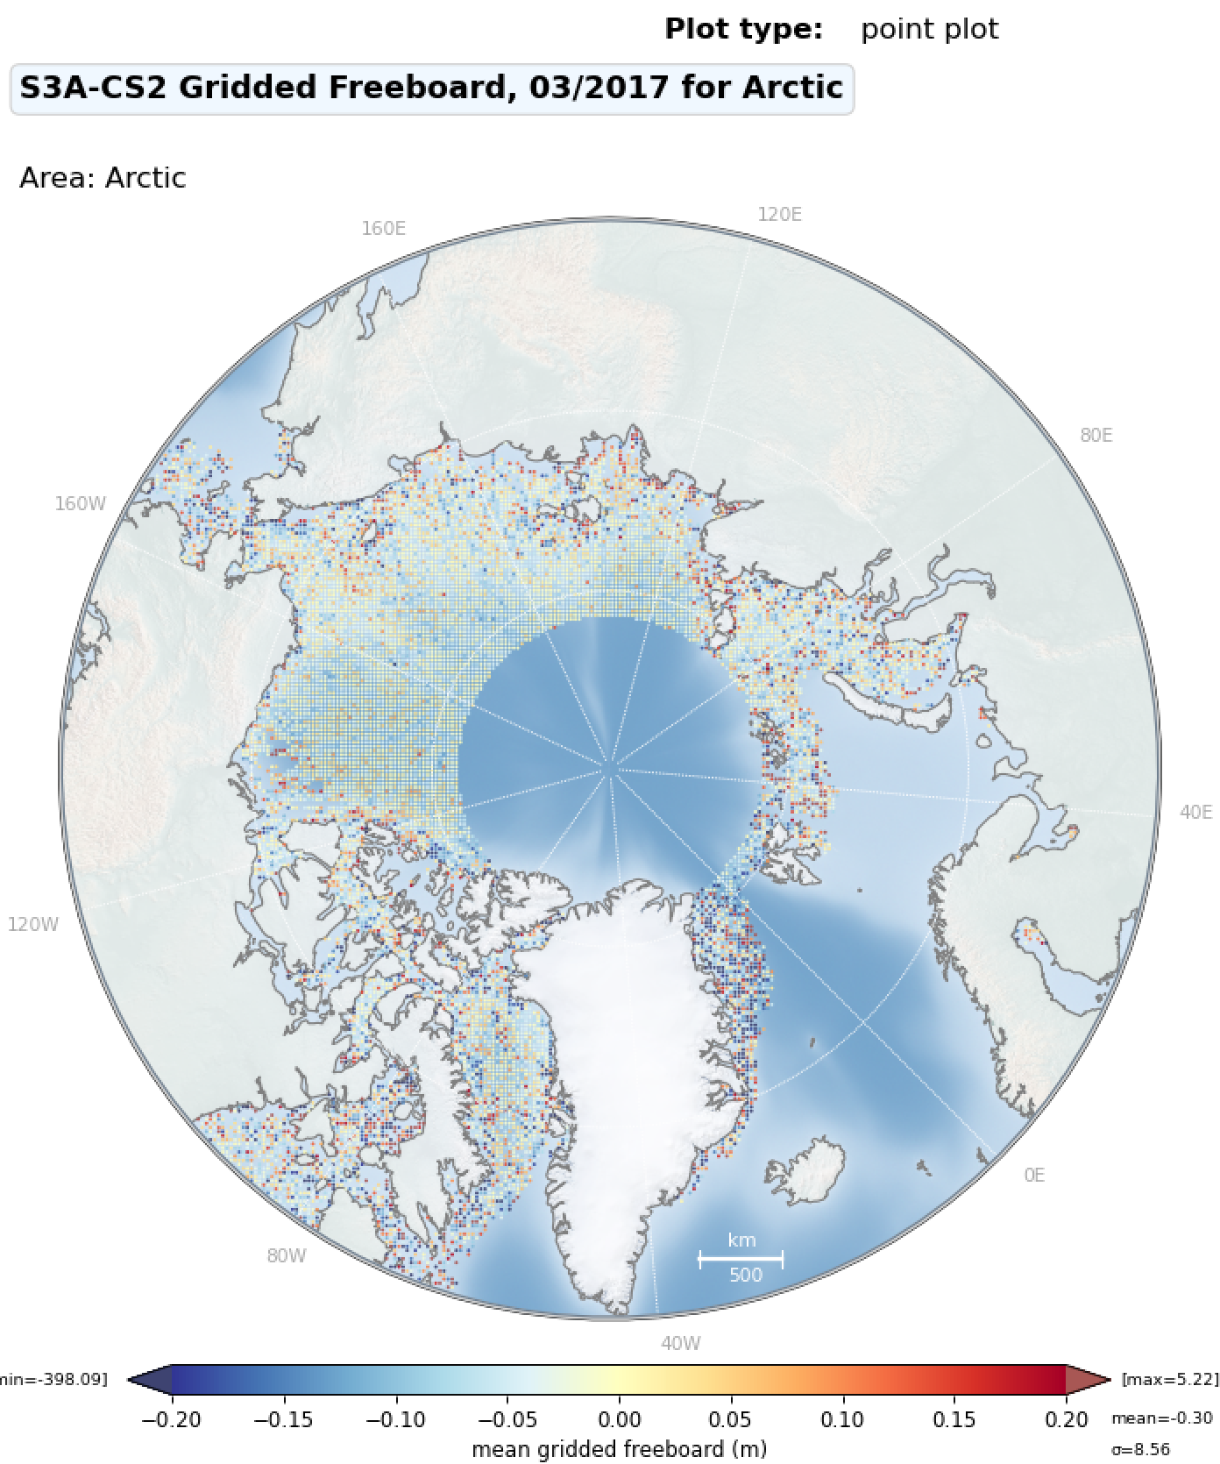
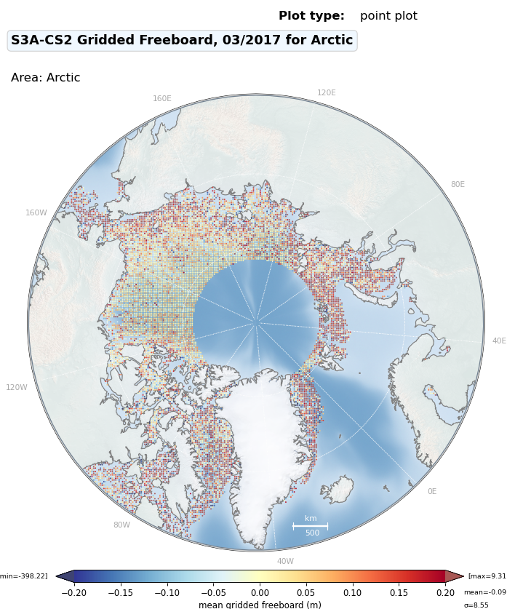
Gridded Freeboard Differences to CS2
T-IPF
IPF 6.18
S3A-CS2
S3A-CS2

Slide 21
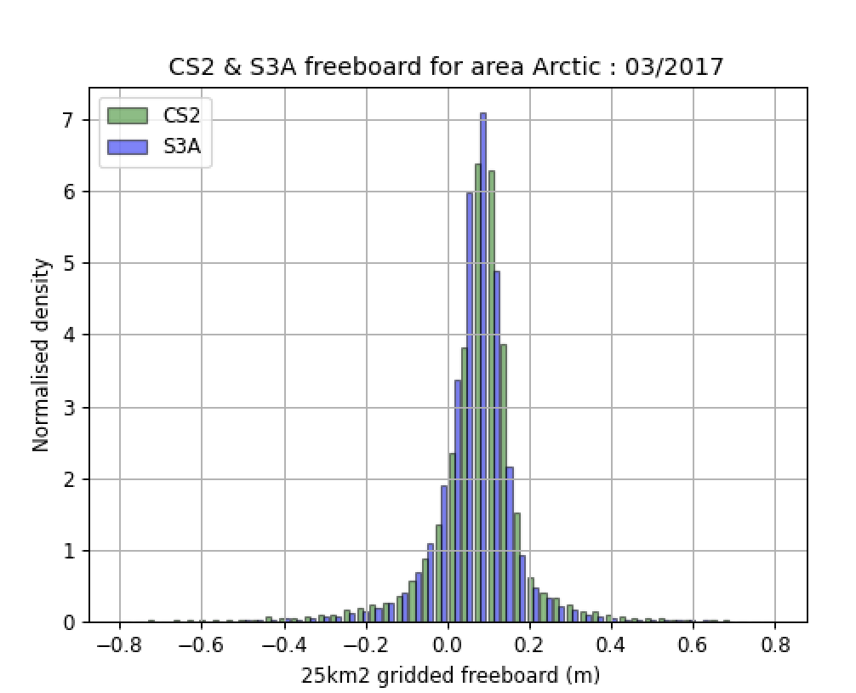
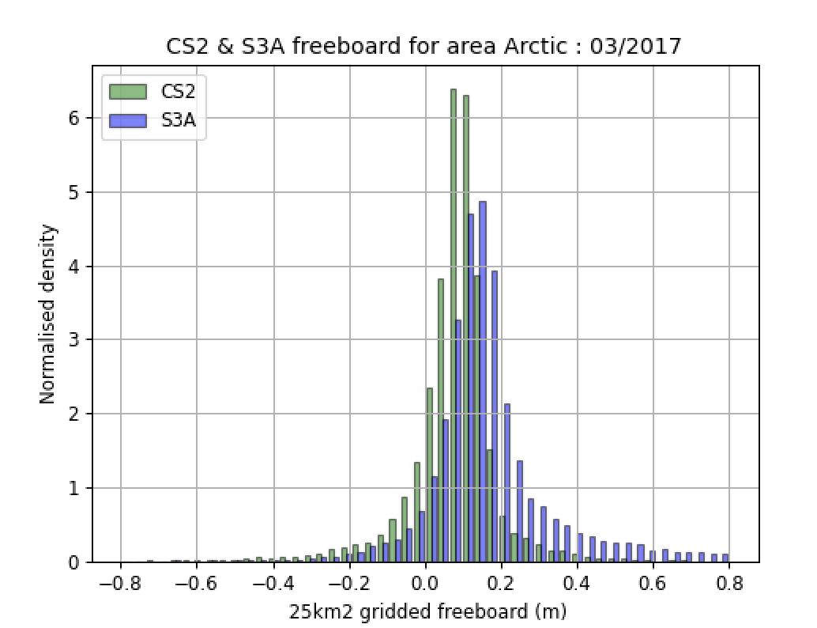
Histogram of Gridded Arctic Freeboard (March 2017):
CS2 , S3 Thematic TDS
CS2 , IPF_6.18
Notes:
./plot_combined_freeboard.py -f1 ~/fb2/cs2/2017/3/*.npz -f2 ~/fb2/s3a_ipf/s3a/2017/3/*.npz -o ~/fb2
./plot_combined_freeboard.py -f1 ~/fb2/cs2/2017/3/*.npz -f2 ~/fb2/s3a_thematic/s3a/2017/3/*.npz -o ~/fb2

Slide 22
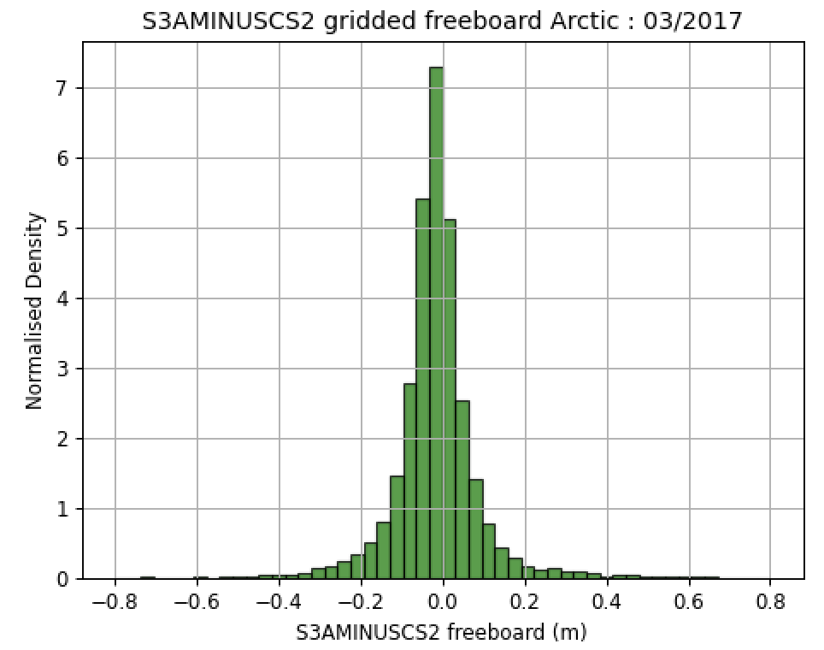
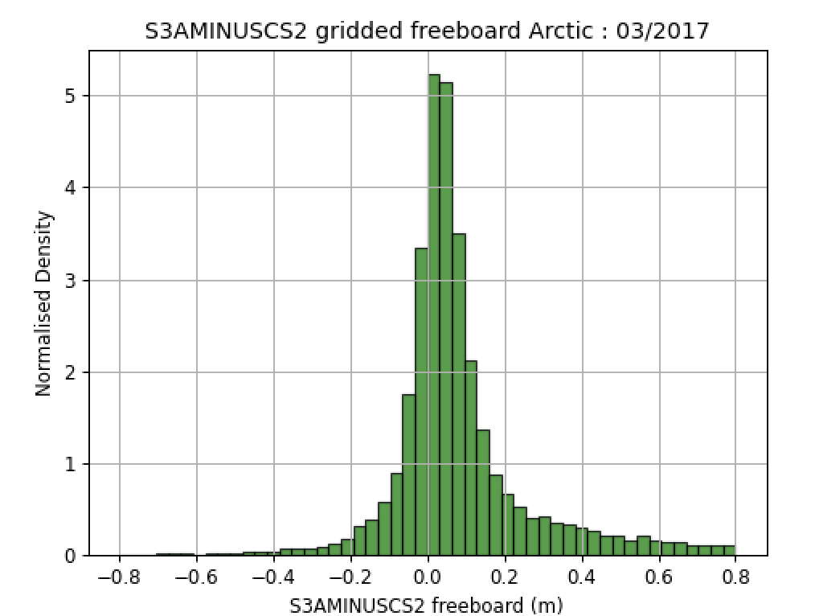
Gridded Arctic Freeboard
Differences to CryoSat-2: Mar 2017, Arctic (below 81.35N)
-1.8cm mean diff
6.9cm stdev
(S3A Thematic TDS – CS2)
-
(S3A IPF_6.18 – CS2)
+6.2cm mean diff
12.8cm stdev
-
Notes:
./plot_combined_freeboard.py -f2 ~/fb2/cs2/2017/3/*.npz -f1 ~/fb2/s3a_ipf/s3a/2017/3/*.npz -o ~/fb2 –diff
./plot_combined_freeboard.py -f2 ~/fb2/cs2/2017/3/*.npz -f1 ~/fb2/s3a_thematic/s3a/2017/3/*.npz -o ~/fb2 --diff

Slide 23
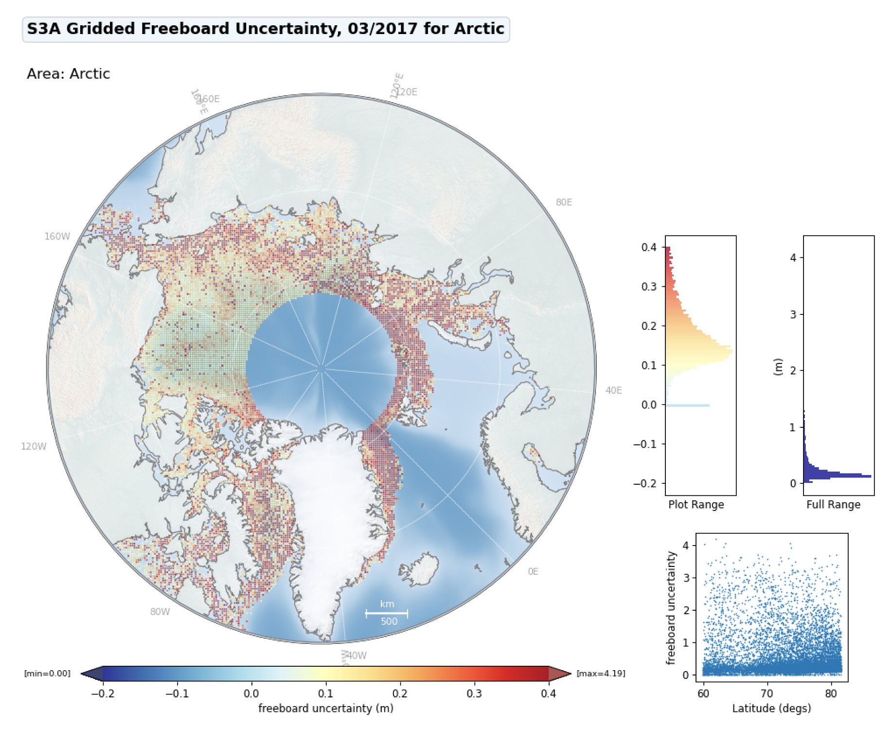
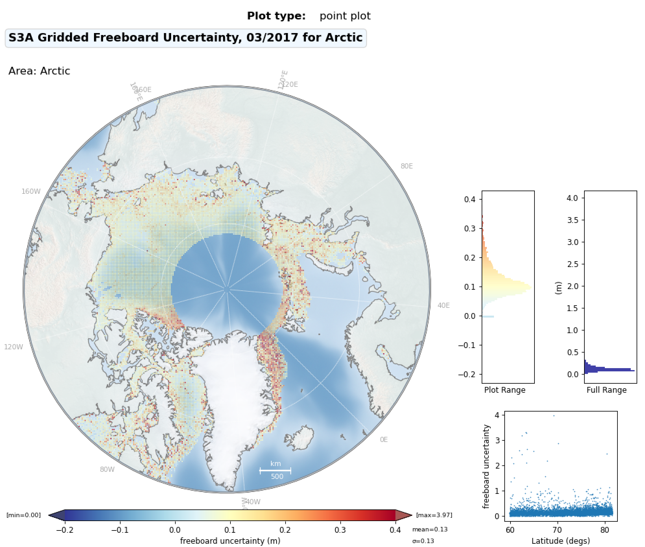
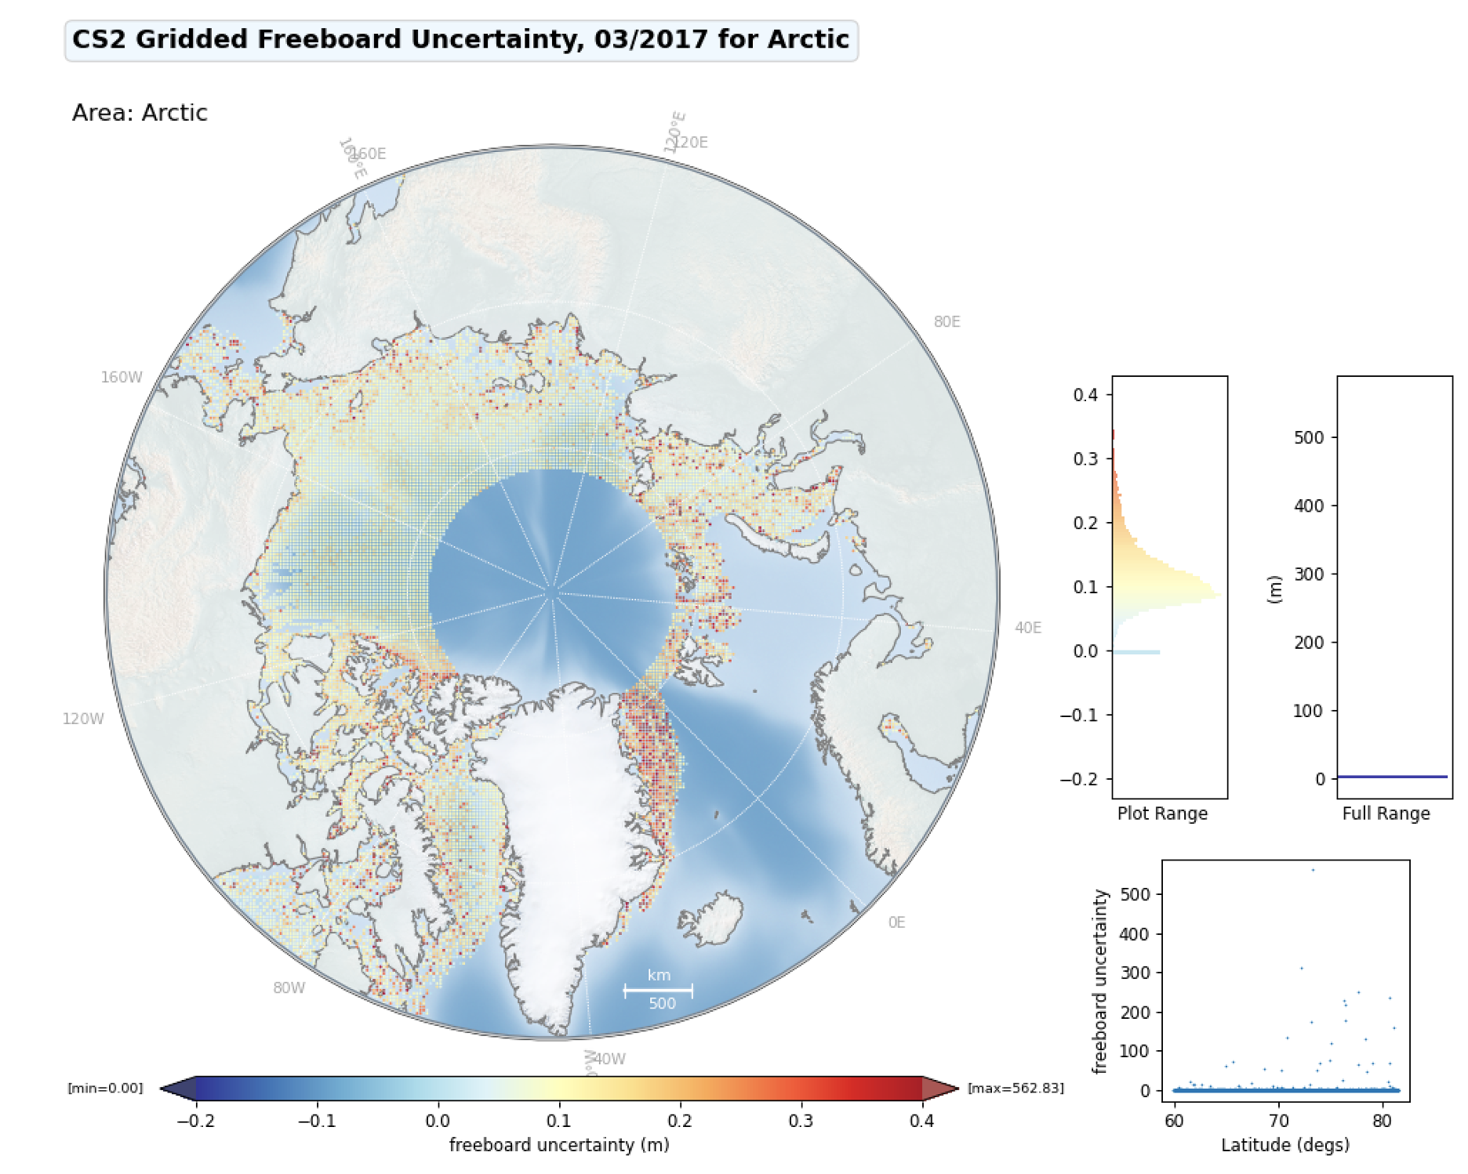
Gridded Freeboard Uncertainty
IPF
T-IPF
CS2

Slide 24
T-IPF Sea Ice Study Conclusions
Expected performance found with T-IPF 1-month TDS over sea ice
T-IPF not processed equator to equator.
Hamming/Zero Padding (ZP-2) applied.
ZP-4 (separate test track) seems to improve precision further
Comparison done against same data from IPF 6.18 : would be better to use IPF 6.19
Missing Iono corrections are handled differently in T-IPF and IPF-6.18
Improved classification of echoes (9% less unclassified)
Sea ice concentration calculated correctly around coastline
24% more freeboard measurements in T-IPF
Good correspondence with CryoSat freeboard histogram for T-IPF (<2cm bias)
T-IPF gridded freeboard uncertainty equivalent to CS2 (and big improvement on IPF).
Further tuning of retracker bias, and discrimination parameters with whole Arctic winter and summer season of T-IPF data required to reduce bias to CryoSat-2 further.

