Slide 1
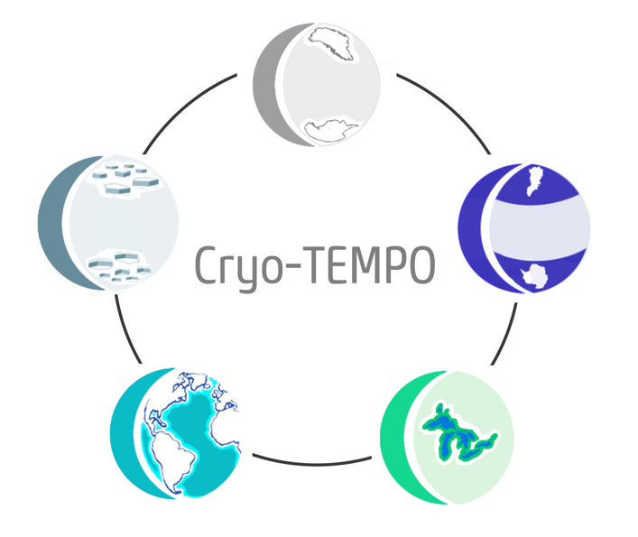
Land Ice Uncertainty Results

Slide 2
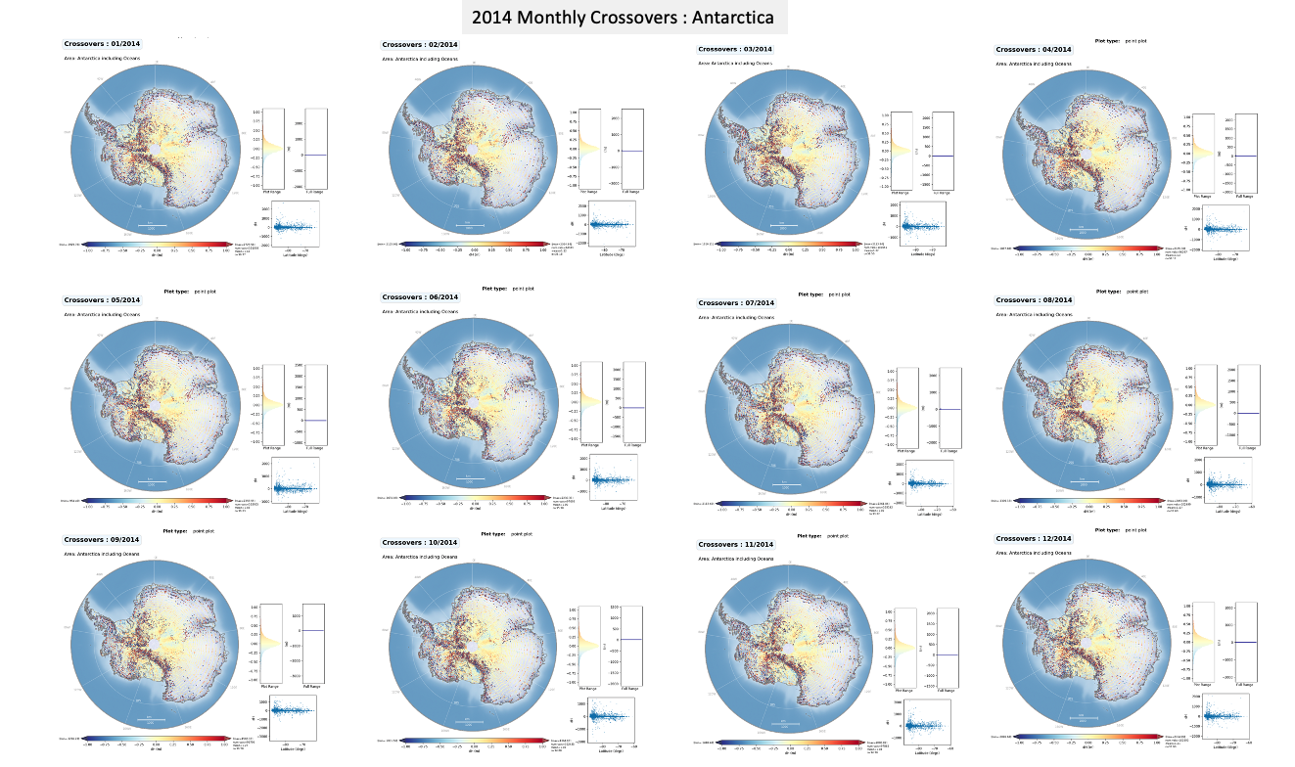

Slide 3
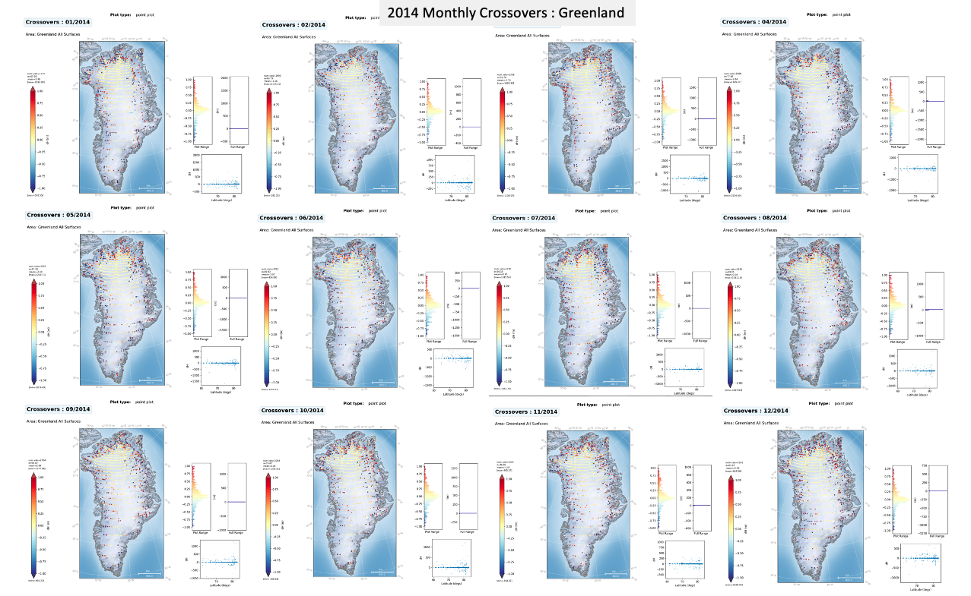

Slide 4
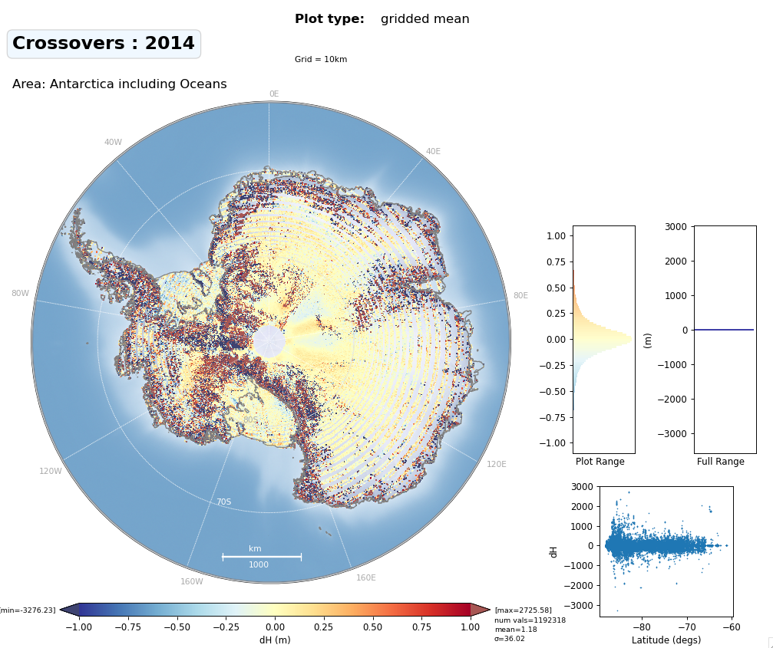
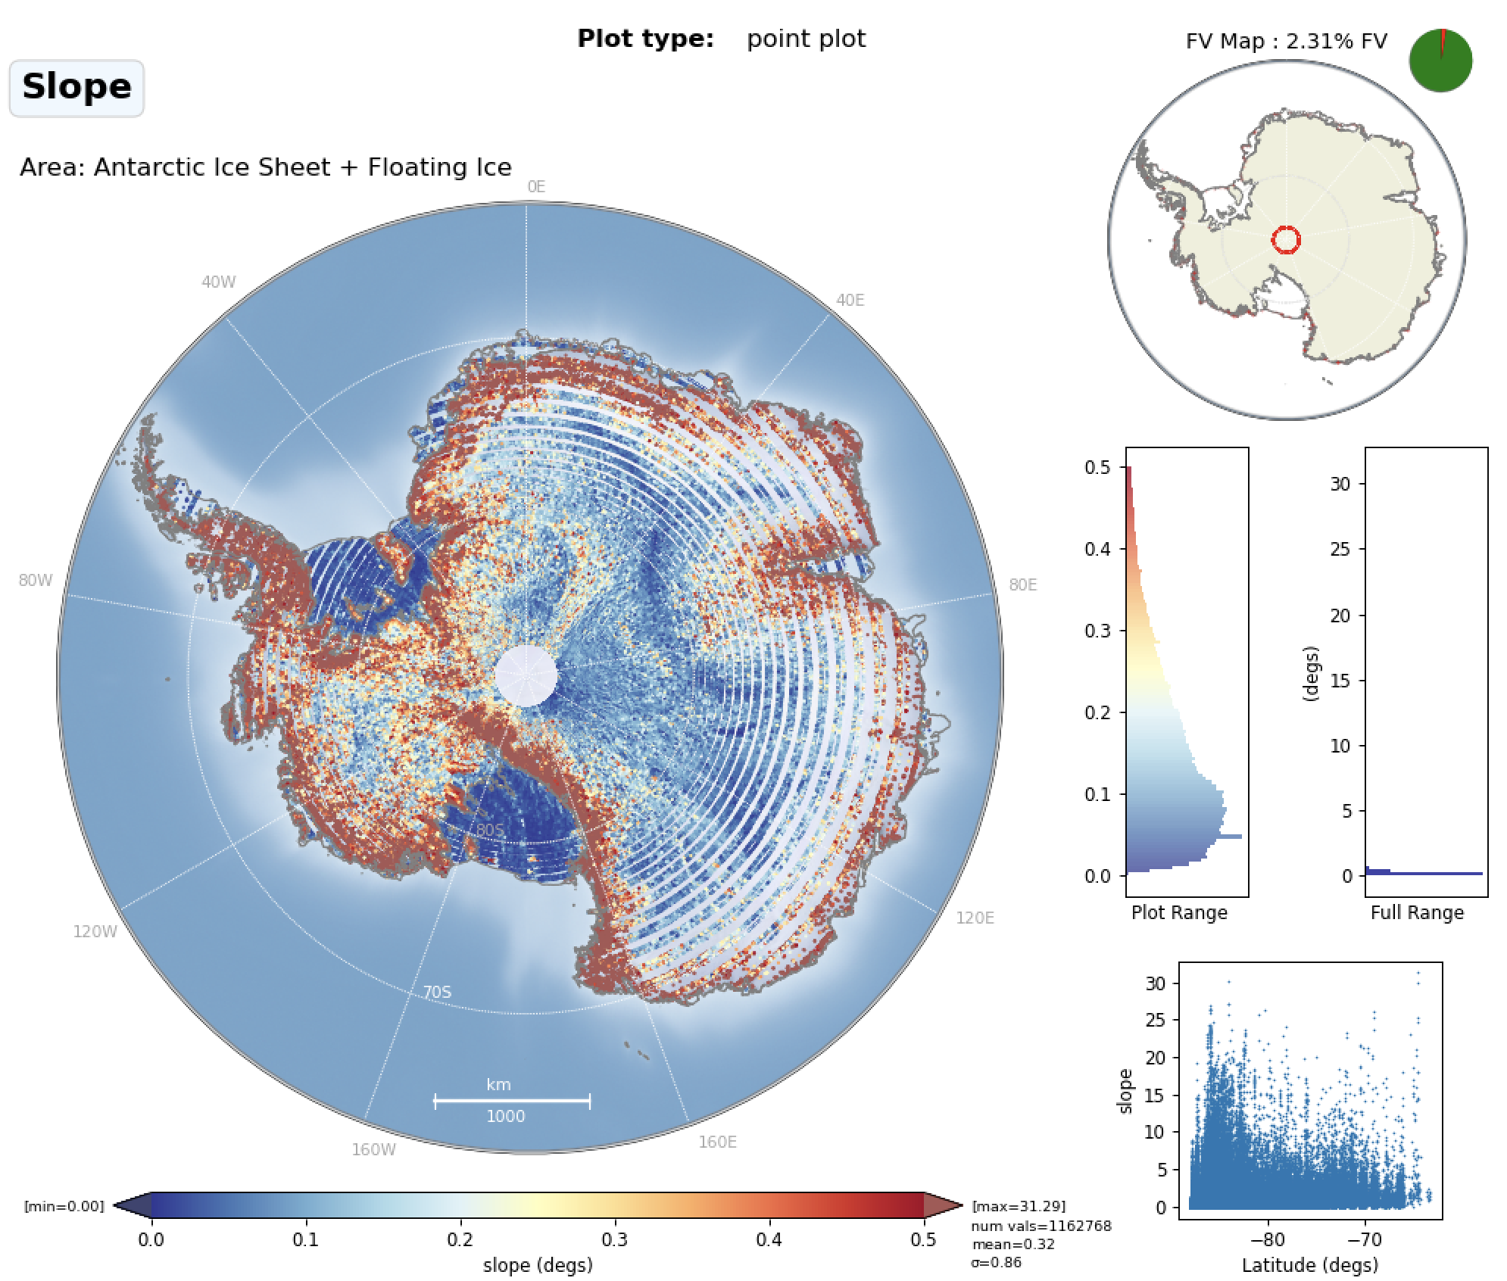
Cryo-TEMPO Uncertainty : Combined monthly crossovers for 2014

Slide 5
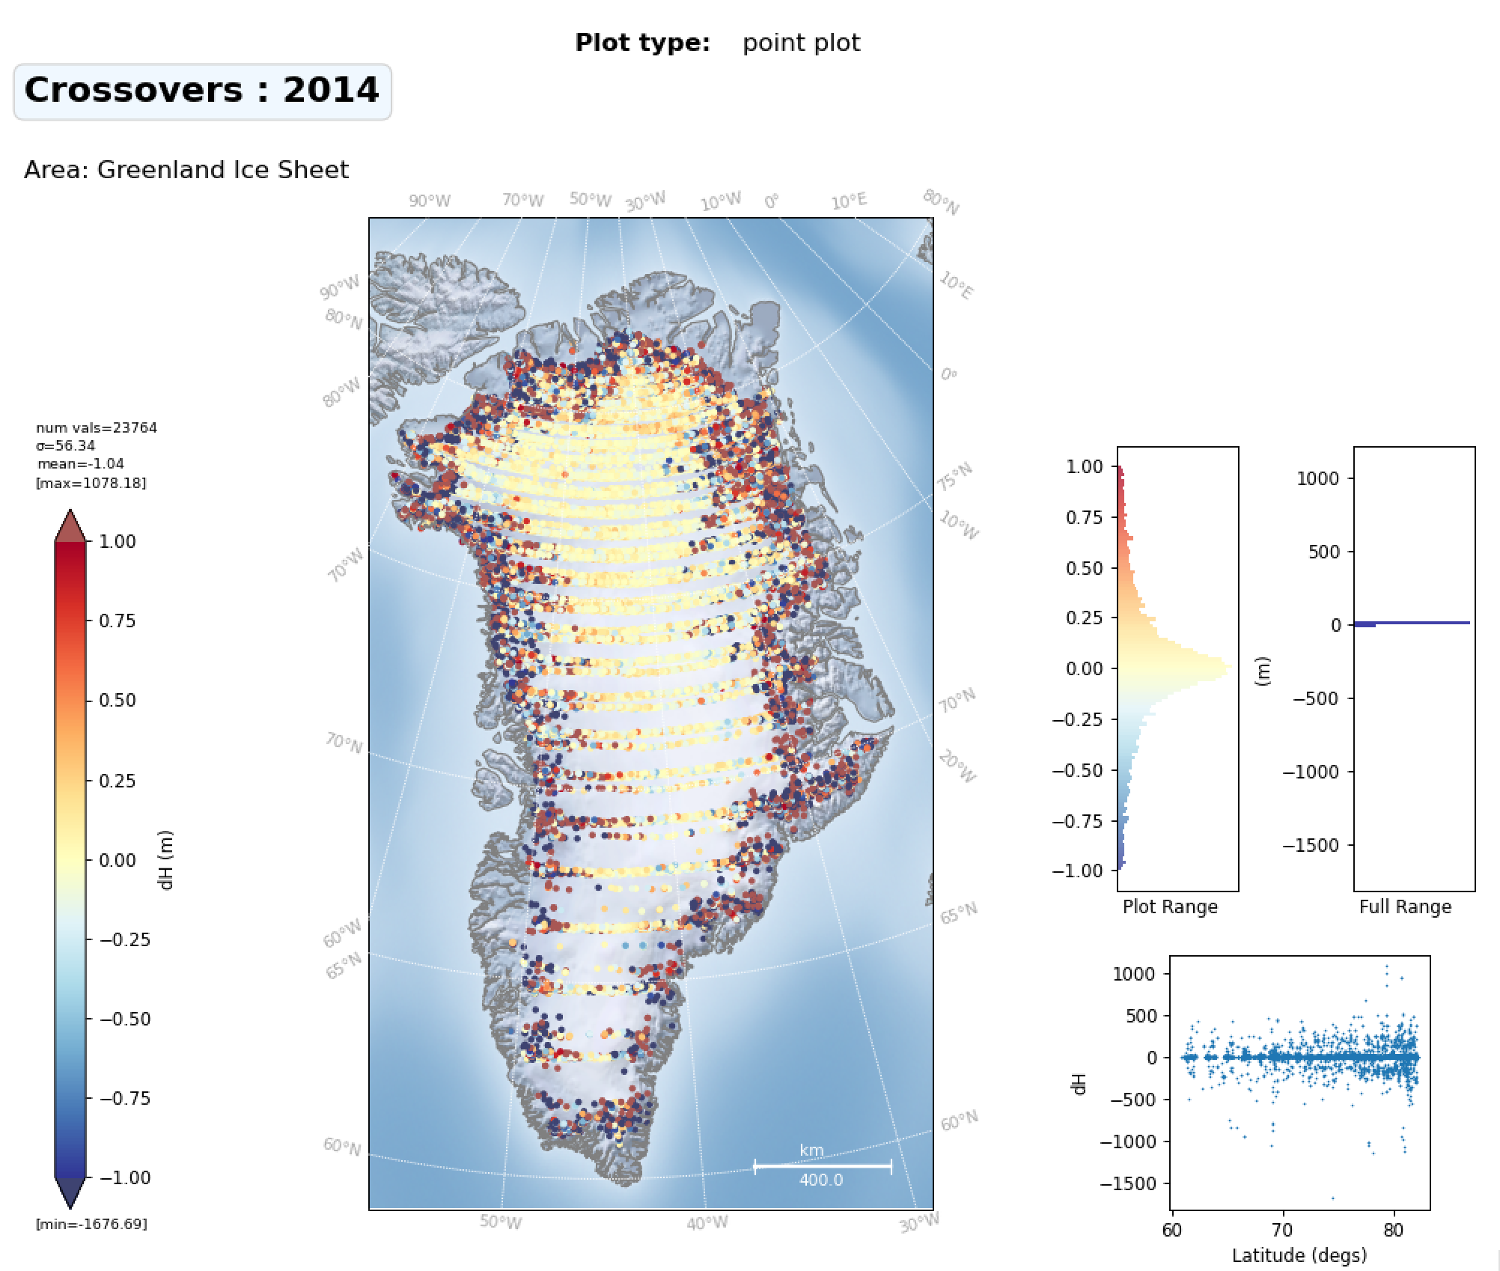
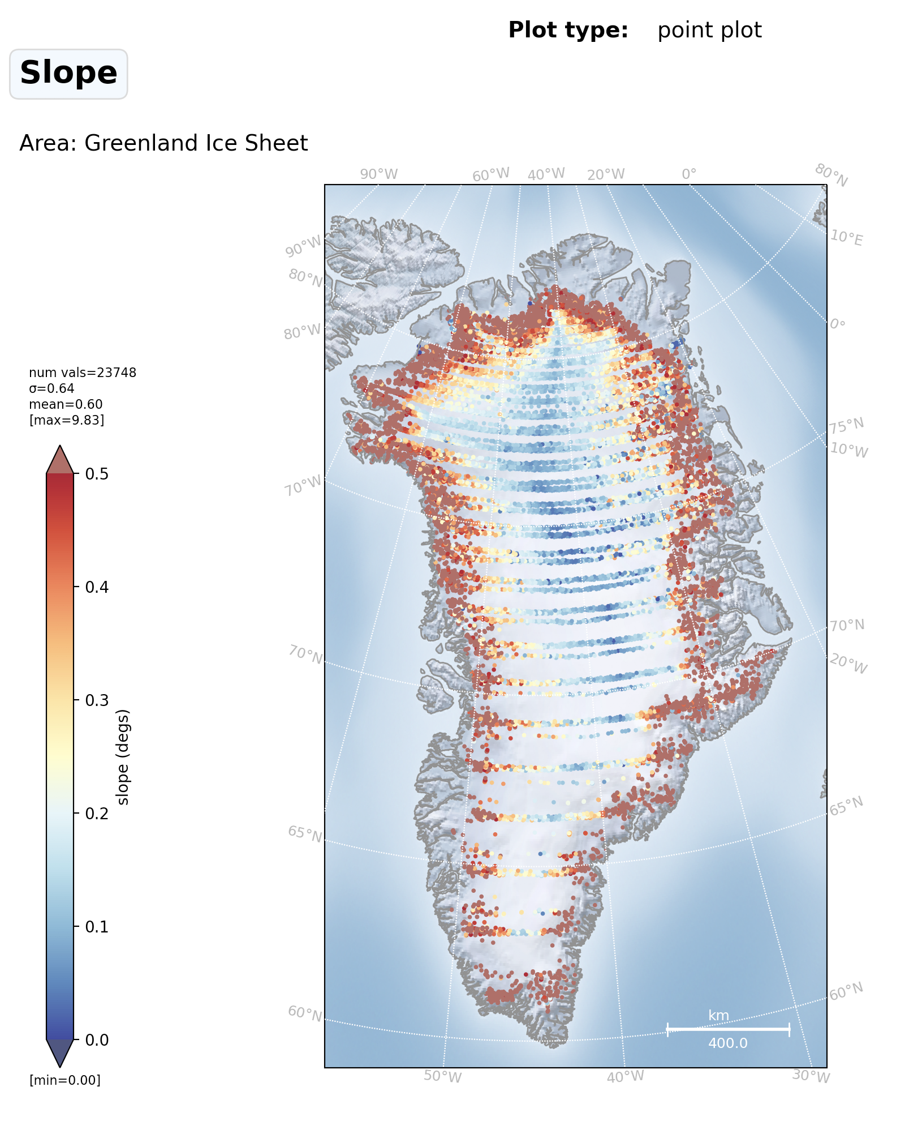
Cryo-TEMPO Uncertainty : Combined monthly crossovers for 2014

Slide 6
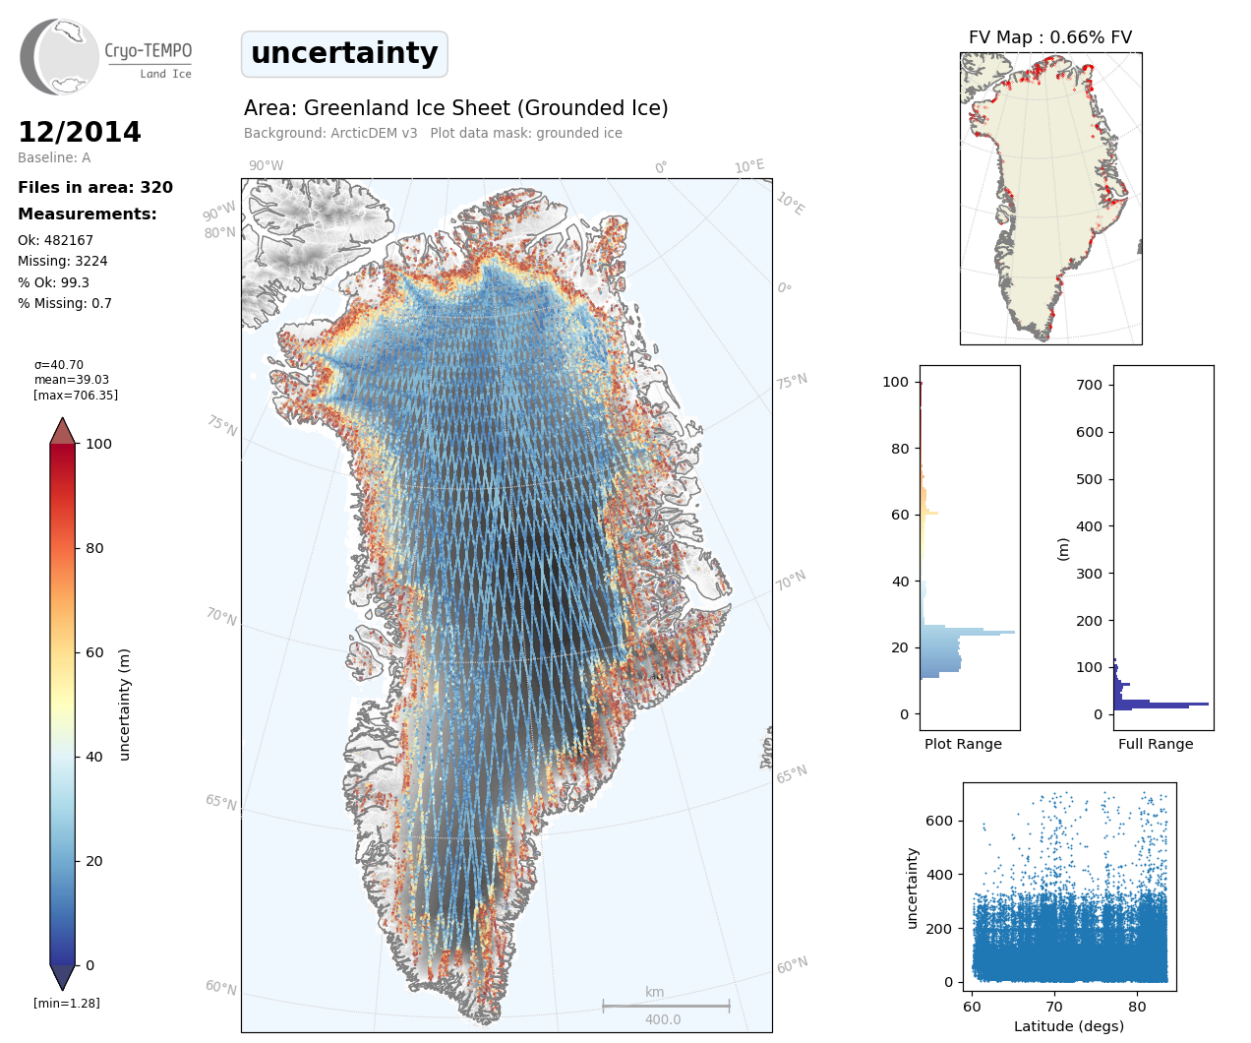
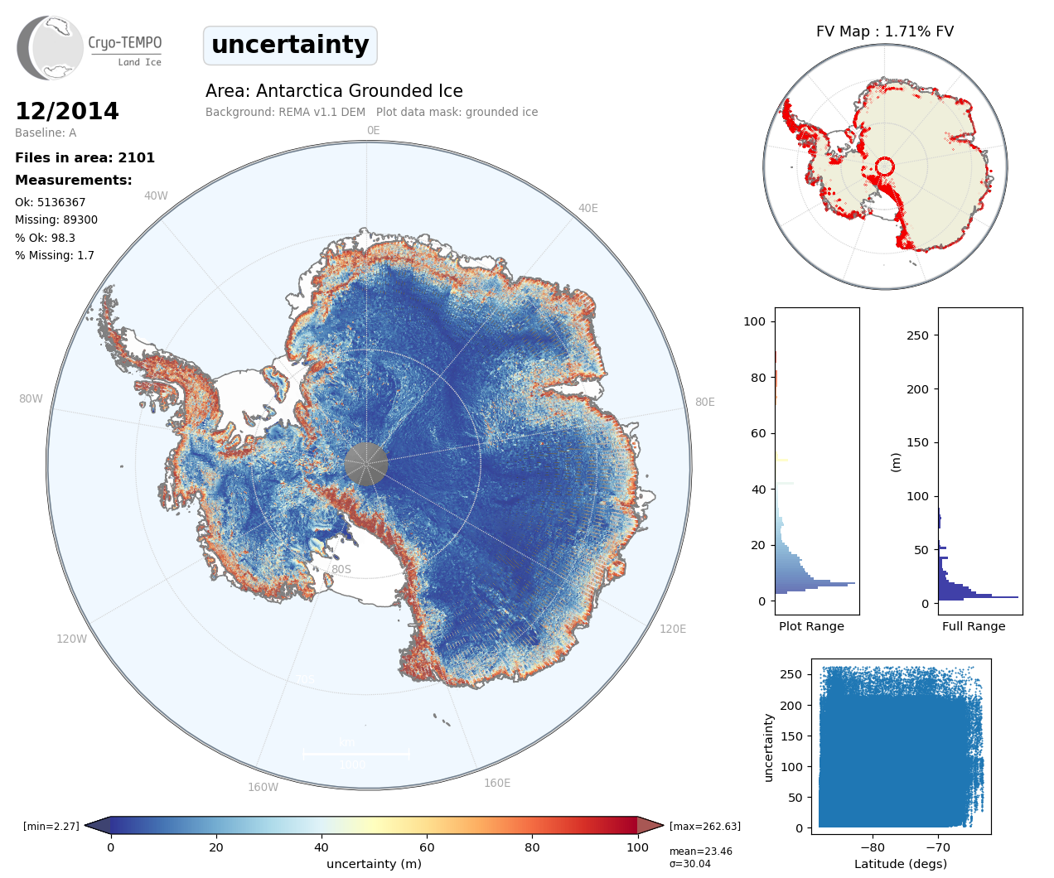
Final uncertainty maps calculated using standard deviation of crossover dh in 100 slope bands

Slide 7
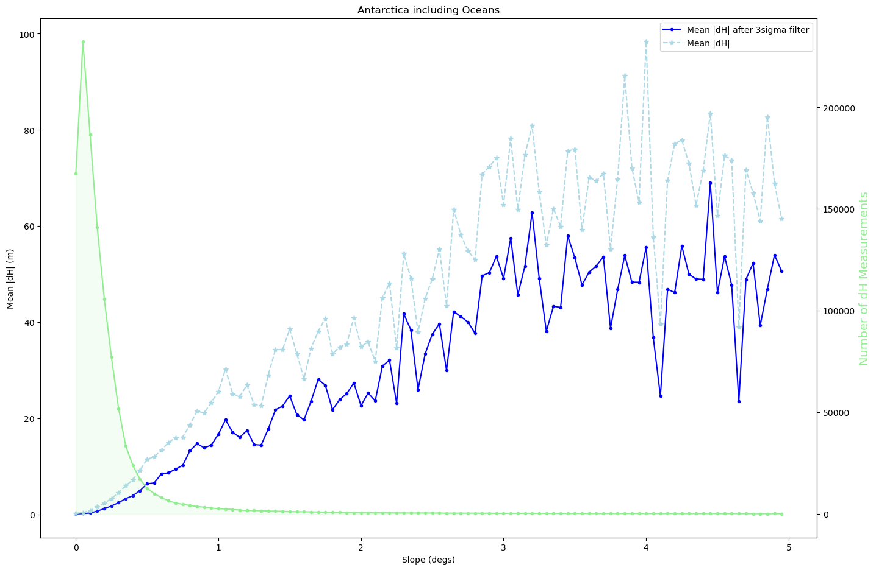
Antarctica : Mean Absolute Crossover dH from 2014

Slide 8
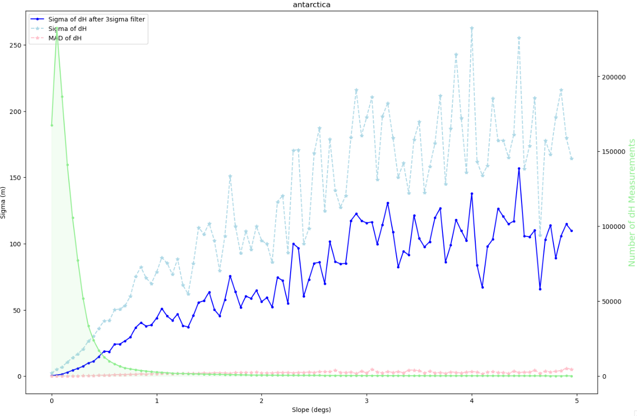
Antarctica: StDev of dH vs Slope Band (2014)

Slide 9
Antarctica: Median Absolute Deviation (MAD) of dH vs Slope Band (2014)

Slide 10
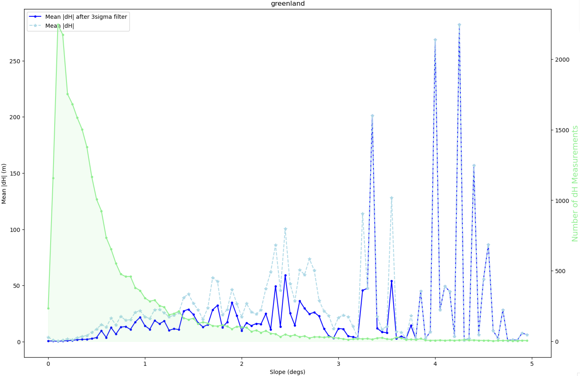
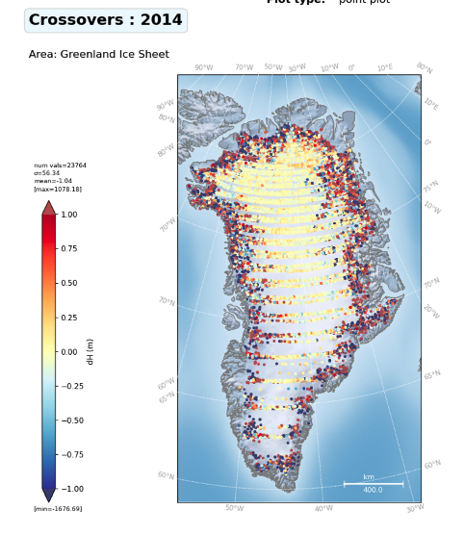
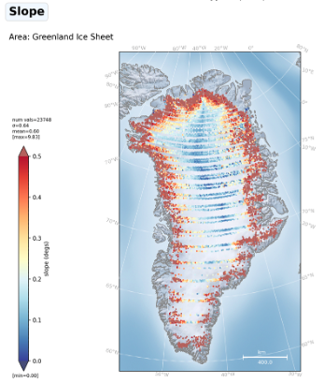
Greenland : Mean Absolute Crossover dH from 2014

Slide 11
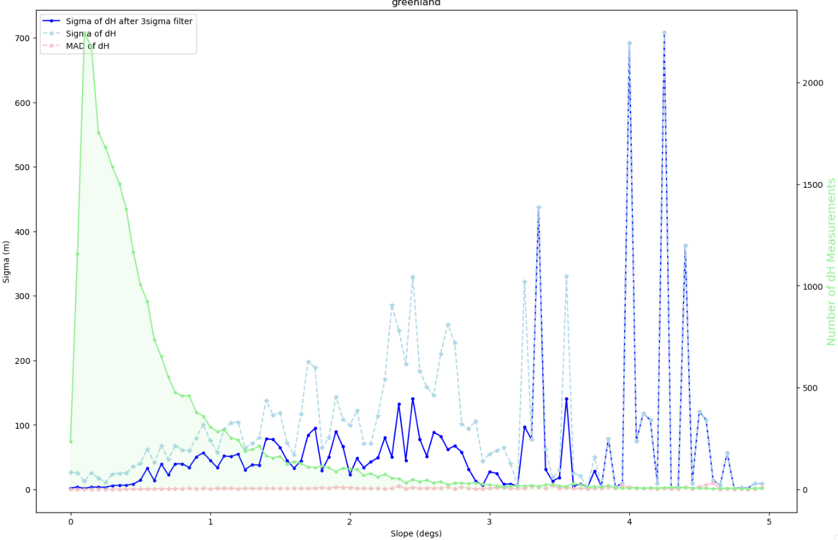
Greenland: StDev of dH vs Slope Band (2014)

Slide 12
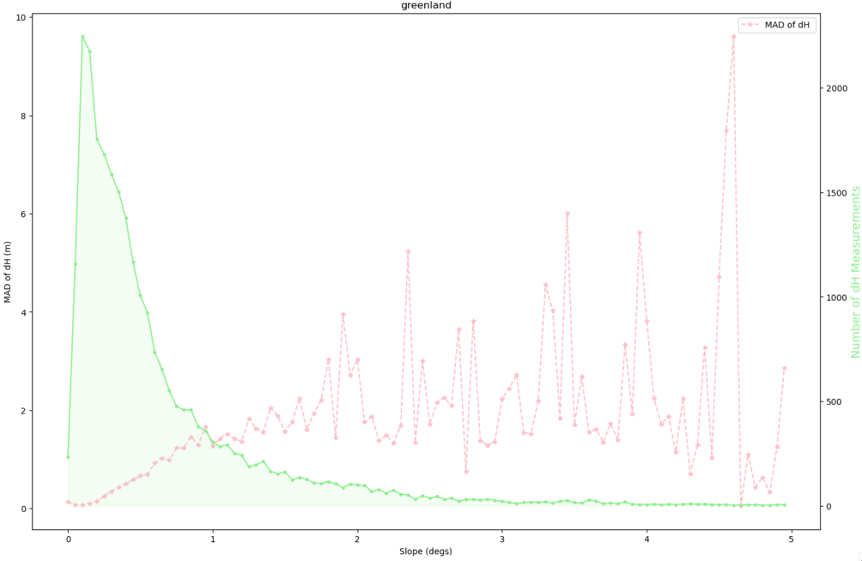
Greenland: Median Absolute Deviation (MAD) of dH vs Slope Band (2014)

Slide 13
Questions
Should we restrict the range of slope to say 5 degs or less?
For the uncertainty statistic (default is sigma), should we consider a different statistic such as the Median Absolute Deviation (MAD) to better represent the uncertainty (precision) and reduce the significance of outliers?
Should we use a linear (or other) function to model the slope vs uncertainty stat in order to smooth out the variation (particularly at higher slope (> 1 deg) there is high variation).

Slide 14
